Slide 1
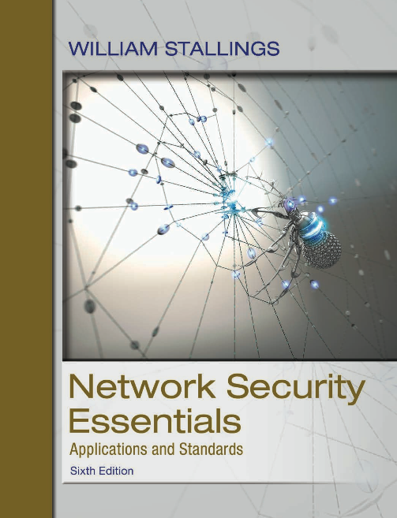
Network Security Essentials: Applications and Standards
Sixth Edition
Chapter 2
Symmetric Encryption and
Message Confidentiality
Copyright © 2017 Pearson Education, Inc. All Rights Reserved
Notes:
If this PowerPoint presentation contains mathematical equations, you may need to check that your computer has the following installed:
1) MathType Plugin
2) Math Player (free versions available)
3) NVDA Reader (free versions available)
This chapter provides a general overview of the subject matter that structures the material in the remainder of the book. We begin with a general discussion of network security services and mechanisms and of the types of attacks they are designed for. Then we develop a general overall model within which the security services and mechanisms can be viewed.

Slide 2
Symmetric encryption
Also known as conventional encryption, single-key encryption, and secret-key encryption.
Most widely used encryption scheme.

Slide 3
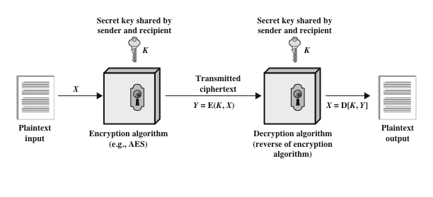
Figure 2-1: Simplified Model of Symmetric Encryption
Notes:
A symmetric encryption scheme has five ingredients (Figure 2.1):
• Plaintext: This is the original message or data that is fed into the algorithm
as input.
• Encryption algorithm: The encryption algorithm performs various substitutions
and transformations on the plaintext.
• Secret key: The secret key is also input to the algorithm. The exact substitutions
and transformations performed by the algorithm depend on the key.
• Ciphertext: This is the scrambled message produced as output. It depends on
the plaintext and the secret key. For a given message, two different keys will
produce two different ciphertexts.
• Decryption algorithm: This is essentially the encryption algorithm run in
reverse. It takes the ciphertext and the same secret key and produces the
original plaintext.

Slide 4
Requirements (1 of 2)
There are two requirements for secure use of symmetric encryption:
  A strong encryption algorithm
  Sender and receiver must have obtained copies of the secret key in a secure fashion and must keep the key secure
The security of symmetric encryption depends on the secrecy of the key, not the secrecy of the algorithm
  This makes it feasible for widespread use
Notes:
There are two requirements for secure use of symmetric encryption:
1. We need a strong encryption algorithm. At a minimum, we would like the
algorithm to be such that an opponent who knows the algorithm and has
access to one or more ciphertexts would be unable to decipher the ciphertext
or figure out the key. This requirement is usually stated in a stronger form:
The opponent should be unable to decrypt ciphertext or discover the key even
if he or she is in possession of a number of ciphertexts together with the plaintext
that produced each ciphertext.
2. Sender and receiver must have obtained copies of the secret key in a secure
fashion and must keep the key secure. If someone can discover the key and
knows the algorithm, all communication using this key is readable.
It is important to note that the security of symmetric encryption depends on
the secrecy of the key, not the secrecy of the algorithm. That is, it is assumed that
it is impractical to decrypt a message on the basis of the ciphertext plus knowledge
of the encryption/decryption algorithm. In other words, we do not need to keep the
algorithm secret; we need to keep only the key secret.
This feature of symmetric encryption is what makes it feasible for widespread
use. The fact that the algorithm need not be kept secret means that manufacturers
can and have developed low-cost chip implementations of data encryption
algorithms. These chips are widely available and incorporated into a number of
products. With the use of symmetric encryption, the principal security problem is
maintaining the secrecy of the key.

Slide 5
Requirements (2 of 2)
  Manufacturers can and have developed low-cost chip implementations of data encryption algorithms
  These chips are widely available and incorporated into a number of products
Notes:
There are two requirements for secure use of symmetric encryption:
1. We need a strong encryption algorithm. At a minimum, we would like the
algorithm to be such that an opponent who knows the algorithm and has
access to one or more ciphertexts would be unable to decipher the ciphertext
or figure out the key. This requirement is usually stated in a stronger form:
The opponent should be unable to decrypt ciphertext or discover the key even
if he or she is in possession of a number of ciphertexts together with the plaintext
that produced each ciphertext.
2. Sender and receiver must have obtained copies of the secret key in a secure
fashion and must keep the key secure. If someone can discover the key and
knows the algorithm, all communication using this key is readable.
It is important to note that the security of symmetric encryption depends on
the secrecy of the key, not the secrecy of the algorithm. That is, it is assumed that
it is impractical to decrypt a message on the basis of the ciphertext plus knowledge
of the encryption/decryption algorithm. In other words, we do not need to keep the
algorithm secret; we need to keep only the key secret.
This feature of symmetric encryption is what makes it feasible for widespread
use. The fact that the algorithm need not be kept secret means that manufacturers
can and have developed low-cost chip implementations of data encryption
algorithms. These chips are widely available and incorporated into a number of
products. With the use of symmetric encryption, the principal security problem is
maintaining the secrecy of the key.

Slide 6
Cryptography (1 of 3)
Cryptographic systems are generically classified along three independent dimensions:
The type of operations used for transforming plaintext to ciphertext
  Substitution
    Each element in the plaintext is mapped into another element
  Transposition
    Elements in the plaintext are rearranged
    Fundamental requirement is that no information be lost
Notes:
Cryptographic systems are generically classified along three independent
dimensions:
1. The type of operations used for transforming plaintext to ciphertext. All
encryption algorithms are based on two general principles: substitution, in
which each element in the plaintext (bit, letter, group of bits or letters) is
mapped into another element, and transposition, in which elements in the
plaintext are rearranged. The fundamental requirement is that no information
be lost (i.e., that all operations be reversible). Most systems, referred to as
product systems, involve multiple stages of substitutions and transpositions.
2. The number of keys used. If both sender and receiver use the same key, the
system is referred to as symmetric, single-key, secret-key, or conventional
encryption. If the sender and receiver each use a different key, the system is
referred to as asymmetric, two-key, or public-key encryption.
3. The way in which the plaintext is processed. A block cipher processes the
input one block of elements at a time, producing an output block for each
input block. A stream cipher processes the input elements continuously, producing
output one element at a time, as it goes along.

Slide 7
Cryptography (2 of 3)
  Product systems
    Involve multiple stages of substitutions and transpositions
The number of keys used
  Referred to as symmetric, single-key, secret-key, or conventional encryption if both sender and receiver use the same key
  Referred to as asymmetric, two-key, or public-key encryption if the sender and receiver each use a different key
Notes:
Cryptographic systems are generically classified along three independent
dimensions:
1. The type of operations used for transforming plaintext to ciphertext. All
encryption algorithms are based on two general principles: substitution, in
which each element in the plaintext (bit, letter, group of bits or letters) is
mapped into another element, and transposition, in which elements in the
plaintext are rearranged. The fundamental requirement is that no information
be lost (i.e., that all operations be reversible). Most systems, referred to as
product systems, involve multiple stages of substitutions and transpositions.
2. The number of keys used. If both sender and receiver use the same key, the
system is referred to as symmetric, single-key, secret-key, or conventional
encryption. If the sender and receiver each use a different key, the system is
referred to as asymmetric, two-key, or public-key encryption.
3. The way in which the plaintext is processed. A block cipher processes the
input one block of elements at a time, producing an output block for each
input block. A stream cipher processes the input elements continuously, producing
output one element at a time, as it goes along.

Slide 8
Cryptography (3 of 3)
The way in which the plaintext is processed
  Block cipher processes the input one block of elements at a time, producing an output block for each input block
  Stream cipher processes the input elements continuously, producing output one element at a time, as it goes along
Notes:
Cryptographic systems are generically classified along three independent
dimensions:
1. The type of operations used for transforming plaintext to ciphertext. All
encryption algorithms are based on two general principles: substitution, in
which each element in the plaintext (bit, letter, group of bits or letters) is
mapped into another element, and transposition, in which elements in the
plaintext are rearranged. The fundamental requirement is that no information
be lost (i.e., that all operations be reversible). Most systems, referred to as
product systems, involve multiple stages of substitutions and transpositions.
2. The number of keys used. If both sender and receiver use the same key, the
system is referred to as symmetric, single-key, secret-key, or conventional
encryption. If the sender and receiver each use a different key, the system is
referred to as asymmetric, two-key, or public-key encryption.
3. The way in which the plaintext is processed. A block cipher processes the
input one block of elements at a time, producing an output block for each
input block. A stream cipher processes the input elements continuously, producing
output one element at a time, as it goes along.

Slide 9
Table 2-1: Types of Attacks on Encrypted Messages (1 of 2)
Type of Attack | Known to Cryptanalyst
Ciphertext only | •Encryption algorithm •Ciphertext to be decoded
Known plaintext | •Encryption algorithm •Ciphertext to be decoded •One or more plaintext-ciphertext pairs formed with the secret key
Chosen plaintext | •Encryption algorithm •Ciphertext to be decoded •Plaintext message chosen by cryptanalyst. together with its corresponding ciphertext generated with the secret key
Notes:
The process of attempting to discover the plaintext or key is known as cryptanalysis .
The strategy used by the cryptanalyst depends on the nature of the encryption scheme
and the information available to the cryptanalyst.
Table 2.1 summarizes the various types of cryptanalytic attacks based on the
amount of information known to the cryptanalyst. The most difficult problem is
presented when all that is available is the ciphertext only . In some cases, not even
the encryption algorithm is known, but in general, we can assume that the opponent
does know the algorithm used for encryption. One possible attack under these circumstances
is the brute-force approach of trying all possible keys. If the key space
is very large, this becomes impractical. Thus, the opponent must rely on an analysis
of the ciphertext itself, generally applying various statistical tests to it. To use this
approach, the opponent must have some general idea of the type of plaintext that
is concealed, such as English or French text, an EXE file, a Java source listing, an
accounting file, and so on.
The ciphertext-only attack is the easiest to defend against because the
opponent has the least amount of information to work with. In many cases, however,
the analyst has more information. The analyst may be able to capture one
or more plaintext messages as well as their encryptions. Or the analyst may know
that certain plaintext patterns will appear in a message. For example, a file that is
encoded in the Postscript format always begins with the same pattern, or there may
be a standardized header or banner to an electronic funds transfer message, and so
on. All of these are examples of known plaintext . With this knowledge, the analyst
may be able to deduce the key on the basis of the way in which the known plaintext
is transformed.
Closely related to the known-plaintext attack is what might be referred to as a
probable-word attack. If the opponent is working with the encryption of some general
prose message, he or she may have little knowledge of what is in the message.
However, if the opponent is after some very specific information, then parts of the
message may be known. For example, if an entire accounting file is being transmitted,
the opponent may know the placement of certain key words in the header of
the file. As another example, the source code for a program developed by a corporation
might include a copyright statement in some standardized position.
If the analyst is able somehow to get the source system to insert into the system
a message chosen by the analyst, then a chosen-plaintext attack is possible. In
general, if the analyst is able to choose the messages to encrypt, the analyst may
deliberately pick patterns that can be expected to reveal the structure of the key.
Table 2.1 lists two other types of attack: chosen ciphertext and chosen text.
These are less commonly employed as cryptanalytic techniques but are nevertheless
possible avenues of attack.

Slide 10
Table 2-1: Types of Attacks on Encrypted Messages (2 of 2)
Chosen ciphertext | •Encryption algorithm •Ciphertext to be decoded •Purported ciphertext chosen by cryptanalyst. together with its corresponding decrypted plaintext generated with the secret key
Chosen text | •Encryption algorithm •Ciphertext to be decoded •Plaintext message chosen by cryptanalyst. together with its corresponding ciphertext generated with the secret key •Purported ciphertext chosen by cryptanalyst. together with its corresponding decrypted plaintext generated with the secret key
Notes:
The process of attempting to discover the plaintext or key is known as cryptanalysis .
The strategy used by the cryptanalyst depends on the nature of the encryption scheme
and the information available to the cryptanalyst.
Table 2.1 summarizes the various types of cryptanalytic attacks based on the
amount of information known to the cryptanalyst. The most difficult problem is
presented when all that is available is the ciphertext only . In some cases, not even
the encryption algorithm is known, but in general, we can assume that the opponent
does know the algorithm used for encryption. One possible attack under these circumstances
is the brute-force approach of trying all possible keys. If the key space
is very large, this becomes impractical. Thus, the opponent must rely on an analysis
of the ciphertext itself, generally applying various statistical tests to it. To use this
approach, the opponent must have some general idea of the type of plaintext that
is concealed, such as English or French text, an EXE file, a Java source listing, an
accounting file, and so on.
The ciphertext-only attack is the easiest to defend against because the
opponent has the least amount of information to work with. In many cases, however,
the analyst has more information. The analyst may be able to capture one
or more plaintext messages as well as their encryptions. Or the analyst may know
that certain plaintext patterns will appear in a message. For example, a file that is
encoded in the Postscript format always begins with the same pattern, or there may
be a standardized header or banner to an electronic funds transfer message, and so
on. All of these are examples of known plaintext . With this knowledge, the analyst
may be able to deduce the key on the basis of the way in which the known plaintext
is transformed.
Closely related to the known-plaintext attack is what might be referred to as a
probable-word attack. If the opponent is working with the encryption of some general
prose message, he or she may have little knowledge of what is in the message.
However, if the opponent is after some very specific information, then parts of the
message may be known. For example, if an entire accounting file is being transmitted,
the opponent may know the placement of certain key words in the header of
the file. As another example, the source code for a program developed by a corporation
might include a copyright statement in some standardized position.
If the analyst is able somehow to get the source system to insert into the system
a message chosen by the analyst, then a chosen-plaintext attack is possible. In
general, if the analyst is able to choose the messages to encrypt, the analyst may
deliberately pick patterns that can be expected to reveal the structure of the key.
Table 2.1 lists two other types of attack: chosen ciphertext and chosen text.
These are less commonly employed as cryptanalytic techniques but are nevertheless
possible avenues of attack.

Slide 11
Cryptanalysis
An encryption scheme is computationally secure if the ciphertext generated by the scheme meets one or both of the following criteria:
  The cost of breaking the cipher exceeds the value of the encrypted information
  The time required to break the cipher exceeds the useful lifetime of the information
Notes:
Only relatively weak algorithms fail to withstand a ciphertext-only attack.
Generally, an encryption algorithm is designed to withstand a known-plaintext
attack.
An encryption scheme is computationally secure if the ciphertext generated
by the scheme meets one or both of the following criteria:
• The cost of breaking the cipher exceeds the value of the encrypted information.
• The time required to break the cipher exceeds the useful lifetime of the
information.

Slide 12
Brute Force Attack
Involves trying every possible key until an intelligible translation of the cipher text into plaintext is obtained
On average, half of all possible keys must be tried to achieve success
Unless known plaintext is provided, the analyst must be able to recognize plaintext as plaintext
To supplement the brute-force approach
  Some degree of knowledge about the expected plaintext is needed
  Some means of automatically distinguishing plaintext from garble is also needed
Notes:
Unfortunately, it is very difficult to estimate the amount of effort required
to cryptanalyze ciphertext successfully. However, assuming there are no inherent
mathematical weaknesses in the algorithm, then a brute-force approach is indicated.
A brute-force attack involves trying every possible key until an intelligible
translation of the ciphertext into plaintext is obtained. On average, half of all possible
keys must be tried to achieve success. That is, if there are x different keys, on
average an attacker would discover the actual key after x /2 tries. It is important
to note that there is more to a brute-force attack than simply running through all
possible keys. Unless known plaintext is provided, the analyst must be able to recognize
plaintext as plaintext. If the message is just plaintext in English, then the
result pops out easily, although the task of recognizing English would have to be
automated. If the text message has been compressed before encryption, then recognition
is more difficult. And if the message is some more general type of data,
such as a numerical file, and this has been compressed, the problem becomes even
more difficult to automate. Thus, to supplement the brute-force approach, some
degree of knowledge about the expected plaintext is needed, and some means of
automatically distinguishing plaintext from garble is also needed.

Slide 13
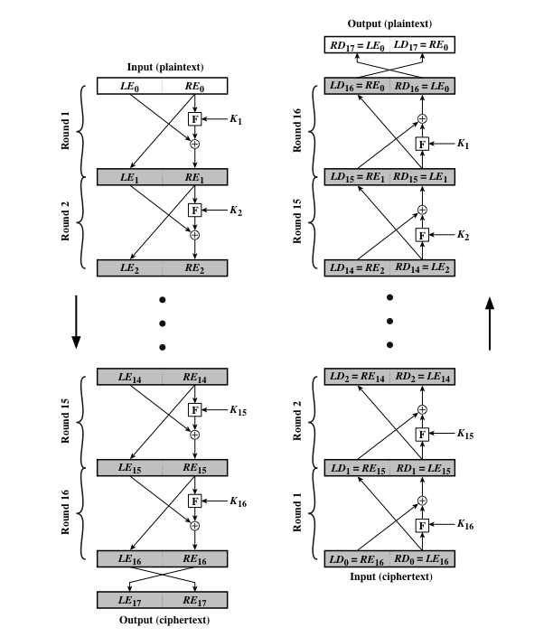
Figure 2-2: Feistel Encryption and Decryption (16 Rounds)
Notes:
Many symmetric block encryption algorithms, including DES, have a structure first
described by Horst Feistel of IBM in 1973 [FEIS73] and shown in Figure 2.2. The
inputs to the encryption algorithm are a plaintext block of length 2w bits and a key
K . The plaintext block is divided into two halves, LE₀ and RE₀ . The two halves
of the data pass through n rounds of processing and then combine to produce the
ciphertext block. Each round i has as inputs LE_{i-1} and RE_{i-1} derived from the previous
round, as well as a subkey K_{i} derived from the overall K . In general, the subkeys
K_{i} are different from K and from each other and are generated from the key
by a subkey generation algorithm. In Figure 2.2, 16 rounds are used, although any
number of rounds could be implemented. The right-hand side of Figure 2.2 shows
the decryption process.
All rounds have the same structure. A substitution is performed on the left half
of the data. This is done by applying a round function F to the right half of the data
and then taking the exclusive-OR (XOR) of the output of that function and the left
half of the data. The round function has the same general structure for each round
but is parameterized by the round subkey K_{i}. Following this substitution, a permutation
is performed that consists of the interchange of the two halves of the data.

Slide 14
Feistel Cipher Design Elements (1 of 3)
Block size
Larger block sizes mean greater security but reduced encryption/decryption speed
Key size
Larger key size means greater security but may decrease encryption/decryption speed
Number of rounds
The essence of a symmetric block cipher is that a single round offers inadequate security but that multiple rounds offer increasing security
Notes:
The Feistel structure is a particular example of the more general structure
used by all symmetric block ciphers. In general, a symmetric block cipher consists of
a sequence of rounds, with each round performing substitutions and permutations
conditioned by a secret key value. The exact realization of a symmetric block cipher
depends on the choice of the following parameters and design features.
• Block size: Larger block sizes mean greater security (all other things being
equal) but reduced encryption/decryption speed. A block size of 128 bits is a
reasonable trade-off and is nearly universal among recent block cipher designs.
• Key size: Larger key size means greater security but may decrease encryption/
decryption speed. The most common key length in modern algorithms is 128 bits.
• Number of rounds: The essence of a symmetric block cipher is that a single
round offers inadequate security but that multiple rounds offer increasing
security. A typical size is from 10 to 16 rounds.
• Subkey generation algorithm: Greater complexity in this algorithm should
lead to greater difficulty of cryptanalysis.
• Round function: Again, greater complexity generally means greater resistance
to cryptanalysis.
There are two other considerations in the design of a symmetric block cipher:
• Fast software encryption/decryption: In many cases, encryption is embedded
in applications or utility functions in such a way as to preclude a hardware
implementation. Accordingly, the speed of execution of the algorithm
becomes a concern.
• Ease of analysis: Although we would like to make our algorithm as difficult as
possible to cryptanalyze, there is great benefit in making the algorithm easy to
analyze. That is, if the algorithm can be concisely and clearly explained, it is
easier to analyze that algorithm for cryptanalytic vulnerabilities and therefore
develop a higher level of assurance as to its strength. DES, for example, does
not have an easily analyzed functionality.

Slide 15
Feistel Cipher Design Elements (2 of 3)
Sub key generation algorithm
Greater complexity in this algorithm should lead to greater difficulty of cryptanalysis
Round function
Greater complexity generally means greater resistance to cryptanalysis
Notes:
The Feistel structure is a particular example of the more general structure
used by all symmetric block ciphers. In general, a symmetric block cipher consists of
a sequence of rounds, with each round performing substitutions and permutations
conditioned by a secret key value. The exact realization of a symmetric block cipher
depends on the choice of the following parameters and design features.
• Block size: Larger block sizes mean greater security (all other things being
equal) but reduced encryption/decryption speed. A block size of 128 bits is a
reasonable trade-off and is nearly universal among recent block cipher designs.
• Key size: Larger key size means greater security but may decrease encryption/
decryption speed. The most common key length in modern algorithms is 128 bits.
• Number of rounds: The essence of a symmetric block cipher is that a single
round offers inadequate security but that multiple rounds offer increasing
security. A typical size is from 10 to 16 rounds.
• Subkey generation algorithm: Greater complexity in this algorithm should
lead to greater difficulty of cryptanalysis.
• Round function: Again, greater complexity generally means greater resistance
to cryptanalysis.
There are two other considerations in the design of a symmetric block cipher:
• Fast software encryption/decryption: In many cases, encryption is embedded
in applications or utility functions in such a way as to preclude a hardware
implementation. Accordingly, the speed of execution of the algorithm
becomes a concern.
• Ease of analysis: Although we would like to make our algorithm as difficult as
possible to cryptanalyze, there is great benefit in making the algorithm easy to
analyze. That is, if the algorithm can be concisely and clearly explained, it is
easier to analyze that algorithm for cryptanalytic vulnerabilities and therefore
develop a higher level of assurance as to its strength. DES, for example, does
not have an easily analyzed functionality.

Slide 16
Feistel Cipher Design Elements (3 of 3)
Fast software encryption/decryption
In many cases, encryption is embedded in applications or utility functions in such a way as to preclude a hardware implementation; accordingly, the seed of execution of the algorithm becomes a concern
Ease of analysis
If the algorithm can be concisely and clearly explained, it is easier to analyze that algorithm for cryptanalytic vulnerabilities and therefore develop a higher level of assurance as to its strength
Notes:
The Feistel structure is a particular example of the more general structure
used by all symmetric block ciphers. In general, a symmetric block cipher consists of
a sequence of rounds, with each round performing substitutions and permutations
conditioned by a secret key value. The exact realization of a symmetric block cipher
depends on the choice of the following parameters and design features.
• Block size: Larger block sizes mean greater security (all other things being
equal) but reduced encryption/decryption speed. A block size of 128 bits is a
reasonable trade-off and is nearly universal among recent block cipher designs.
• Key size: Larger key size means greater security but may decrease encryption/
decryption speed. The most common key length in modern algorithms is 128 bits.
• Number of rounds: The essence of a symmetric block cipher is that a single
round offers inadequate security but that multiple rounds offer increasing
security. A typical size is from 10 to 16 rounds.
• Subkey generation algorithm: Greater complexity in this algorithm should
lead to greater difficulty of cryptanalysis.
• Round function: Again, greater complexity generally means greater resistance
to cryptanalysis.
There are two other considerations in the design of a symmetric block cipher:
• Fast software encryption/decryption: In many cases, encryption is embedded
in applications or utility functions in such a way as to preclude a hardware
implementation. Accordingly, the speed of execution of the algorithm
becomes a concern.
• Ease of analysis: Although we would like to make our algorithm as difficult as
possible to cryptanalyze, there is great benefit in making the algorithm easy to
analyze. That is, if the algorithm can be concisely and clearly explained, it is
easier to analyze that algorithm for cryptanalytic vulnerabilities and therefore
develop a higher level of assurance as to its strength. DES, for example, does
not have an easily analyzed functionality.

Slide 17
Symmetric Block Encryption Algorithms
Block cipher
  The most commonly used symmetric encryption algorithms
  Processes the plaintext input in fixed-sized blocks and produces a block of ciphertext of equal size for each plaintext block
  The three most important symmetric block ciphers
Data Encryption Standard (D E S)
Triple DES (3 D E S)
Advanced Encryption Standard (A E S)
Notes:
The most commonly used symmetric encryption algorithms are block ciphers.
A block cipher processes the plaintext input in fixed-sized blocks and produces a
block of ciphertext of equal size for each plaintext block. This section focuses on
the three most important symmetric block ciphers: the Data Encryption Standard
(DES), triple DES (3DES), and the Advanced Encryption Standard (AES).

Slide 18

Data Encryption Standard (D E S)
Most widely used encryption scheme
Issued in 1977 as Federal Information Processing Standard 46 (F I P S 46) by the National Institute of Standards and Technology (N I S T)
The algorithm itself is referred to as the Data Encryption Algorithm (D E A)
Notes:
Until the introduction of the Advanced Encryption Standard in 2001, the most
widely used encryption scheme was based on the Data Encryption Standard (DES)
issued in 1977 as Federal Information Processing Standard 46 (FIPS 46) by the
National Bureau of Standards, now known as the National Institute of Standards
and Technology (NIST). The algorithm itself is referred to as the Data Encryption
Algorithm (DEA).

Slide 19
D E S Algorithm (1 of 2)
Description of the algorithm:
  Plaintext is 64 bits in length
  Key is 56 bits in length
  Structure is a minor variation of the Feistel network
  There are 16 rounds of processing
  Process of decryption is essentially the same as the encryption process
Notes:
The plaintext is 64 bits in length and the key is
56 bits in length; longer plaintext amounts are processed in 64-bit blocks. The DES
structure is a minor variation of the Feistel network shown in Figure 2.2. There are
16 rounds of processing. From the original 56-bit key, 16 subkeys are generated, one
of which is used for each round.
The process of decryption with DES is essentially the same as the encryption
process. The rule is as follows: Use the ciphertext as input to the DES algorithm, but
use the subkeys K_{i} in reverse order. That is, use K₁₆ on the first iteration, K₁₅ on the
second iteration, and so on until K₁ is used on the 16th and last iteration.
Concerns about the strength of DES fall into two categories:
concerns about the algorithm itself and concerns about the use of a 56-bit key.
The first concern refers to the possibility that cryptanalysis is possible by exploiting
the characteristics of the DES algorithm. Over the years, there have been numerous
attempts to find and exploit weaknesses in the algorithm, making DES the most studied
encryption algorithm in existence. Despite numerous approaches, no one
has so far succeeded in discovering a fatal weakness in DES.
A more serious concern is key length. With a key length of 56 bits, there are
2⁵⁶ possible keys, which is approximately 7.2 * 10¹⁶ keys. Thus, on the face of it,
a brute-force attack appears impractical. Assuming that on average half the key
space has to be searched, a single machine performing one DES encryption per
microsecond would take more than a thousand years to break the cipher.
However, the assumption of one encryption per microsecond is overly
conservative. DES finally and definitively proved insecure in July 1998, when the
Electronic Frontier Foundation (EFF) announced that it had broken a DES encryption
using a special-purpose “DES cracker” machine that was built for less than
$250,000. The attack took less than three days. The EFF has published a detailed
description of the machine, enabling others to build their own cracker [EFF98].
And, of course, hardware prices will continue to drop as speeds increase, making
DES virtually worthless.
With current technology, it is not even necessary to use special, purpose-built
hardware. Rather, the speed of commercial, off-the-shelf processors threaten the
security of DES. A paper from Seagate Technology [SEAG08] suggests that a rate
of one billion (10⁹ ) key combinations per second is reasonable for today’s multicore
computers. Recent offerings confirm this. Both Intel and AMD now offer hardware based
instructions to accelerate the use of AES. Tests run on a contemporary multicore
Intel machine resulted in an encryption rate of about half a billion [BASU12].
Another recent analysis suggests that with contemporary supercomputer technology,
a rate of 10¹³ encryptions/s is reasonable [AROR12].

Slide 20
D E S Algorithm (2 of 2)
The strength of D E S:
  Concerns fall into two categories
    The algorithm itself
      Refers to the possibility that cryptanalysis is possible by exploiting the characteristics of the algorithm
    The use of a 56-bit key
      Speed of commercial, off-the-shelf processors threatens the security
Notes:
The plaintext is 64 bits in length and the key is
56 bits in length1; longer plaintext amounts are processed in 64-bit blocks. The DES
structure is a minor variation of the Feistel network shown in Figure 2.2. There are
16 rounds of processing. From the original 56-bit key, 6 subkeys are generated, one
of which is used for each round.
The process of decryption with DES is essentially the same as the encryption
process. The rule is as follows: Use the ciphertext as input to the DES algorithm, but
use the subkeys K_{i} in reverse order. That is, use K₁₆ on the first iteration, K₁₅ on the
second iteration, and so on until K₁ is used on the 16th and last iteration.
Concerns about the strength of DES fall into two categories:
concerns about the algorithm itself and concerns about the use of a 56-bit key.
The first concern refers to the possibility that cryptanalysis is possible by exploiting
the characteristics of the DES algorithm. Over the years, there have been numerous
attempts to find and exploit weaknesses in the algorithm, making DES the most studied
encryption algorithm in existence. Despite numerous approaches, no one
has so far succeeded in discovering a fatal weakness in DES.
A more serious concern is key length. With a key length of 56 bits, there are
2⁵⁶ possible keys, which is approximately 7.2 * 10¹⁶ keys. Thus, on the face of it,
a brute-force attack appears impractical. Assuming that on average half the key
space has to be searched, a single machine performing one DES encryption per
microsecond would take more than a thousand years to break the cipher.
However, the assumption of one encryption per microsecond is overly
conservative. DES finally and definitively proved insecure in July 1998, when the
Electronic Frontier Foundation (EFF) announced that it had broken a DES encryption
using a special-purpose “DES cracker” machine that was built for less than
$250,000. The attack took less than three days. The EFF has published a detailed
description of the machine, enabling others to build their own cracker [EFF98].
And, of course, hardware prices will continue to drop as speeds increase, making
DES virtually worthless.
With current technology, it is not even necessary to use special, purpose-built
hardware. Rather, the speed of commercial, off-the-shelf processors threaten the
security of DES. A paper from Seagate Technology [SEAG08] suggests that a rate
of one billion (10⁹ ) key combinations per second is reasonable for today’s multicore
computers. Recent offerings confirm this. Both Intel and AMD now offer hardware based
instructions to accelerate the use of AES. Tests run on a contemporary multicore
Intel machine resulted in an encryption rate of about half a billion [BASU12].
Another recent analysis suggests that with contemporary supercomputer technology,
a rate of 10¹³ encryptions/s is reasonable [AROR12].

Slide 21
Table 2-2: Average Time Required for Exhaustive Key Search
Key size (bits) | Cipher | Number of Alternative Keys | Time Required at 10 to the ninth power decryptions/s | Time Required at 10 to the thirteenth power decryptions/s
56 | D E S | 2 to the fifty sixth power approximately equals 7.2 times 10 to the sixteenth power | 2 to the fifty fifth power nanoseconds = 1.125 years. | 1 hour
128 | A E S | 2 to the 120 eighth power approximately equals 3.4 times 10 to the thirty eighth power | 2 to the 120 seventh power nanoseconds = 5.3 times 10 to the twenty first power years. | 5.3 times 10 to the seventeenth power years
168 | Triple D E S | 2 to the 160 eighth power approximately equals 3.7 times 10 to the fiftieth power | 2 to the 160 seventh power nanoseconds = 5.8 times 10 to the thirty third power years | 5.8 times 10 to the twenty ninth power years
192 | A E S | 2 to the 190 second power approximately equals 6.3 times 10 to the fifty seventh power | 2 to the 190 first power nanoseconds = 9.8 times 10 to the fortieth power years. | 9.8 times 10 to the thirty sixth power years
256 | A E S | 2 to the 250 sixth power approximately equals 1.2 times 10 to the seventy seventh power. | 2 to the 250 fifth power nanoseconds = 1.8 times 10 to the sixtieth power years. | 1.8 times 10 to the fifty sixth power years.
Notes:
Considering these results, Table 2.2 shows how much time is required for a
brute-force attack for various key sizes. As can be seen, a single PC can break DES
in about a year; if multiple PCs work in parallel, the time is drastically shortened.
And today’s supercomputers should be able to find a key in about an hour. Key
sizes of 128 bits or greater are effectively unbreakable using simply a brute-force
approach. Even if we managed to speed up the attacking system by a factor of 1 trillion
(10¹² ), it would still take over 100,000 years to break a code using a 128-bit key.

Slide 22
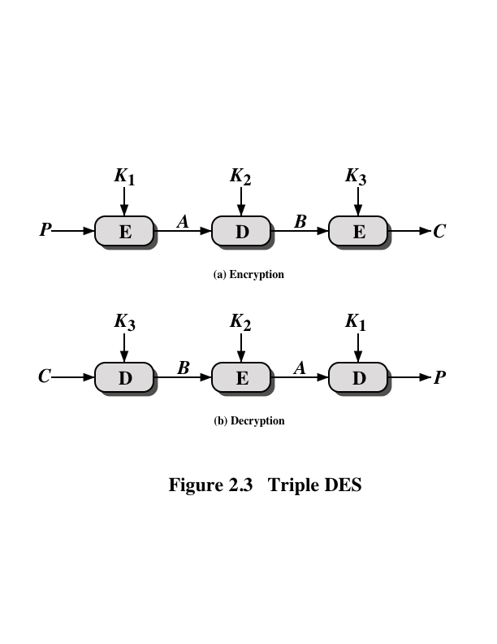
Figure 2-3: Triple D E S
Notes:
Triple DES (3DES) was first standardized for use in financial applications in ANSI
standard X9.17 in 1985. 3DES was incorporated as part of the Data Encryption
Standard in 1999 with the publication of FIPS 46-3.
3DES uses three keys and three executions of the DES algorithm. The function
follows an encrypt-decrypt-encrypt (EDE) sequence (Figure 2.3a).
There is no cryptographic significance to the use of decryption for the second
stage of 3DES encryption. Its only advantage is that it allows users of 3DES to
decrypt data encrypted by users of the older single DES.
With three distinct keys, 3DES has an effective key length of 168 bits.

Slide 23
3 D E S Guidelines
F I P S 46-3 includes the following guidelines for 3 D E S:
  3 D E S is the F I P S-approved symmetric encryption algorithm of choice
  The original D E S, which uses a single 56-bit key, is permitted under the standard for legacy systems only; new procurements should support 3 D E S
  Government organizations with legacy D E S systems are encouraged to transition to 3 D E S
  It is anticipated that 3 D E S and the Advanced Encryption Standard (A E S) will coexist as F I P S-approved algorithms, allowing for a gradual transition to A E S
Notes:
FIPS 46-3 includes the following guidelines for 3DES.
• 3DES is the FIPS-approved symmetric encryption algorithm of choice.
• The original DES, which uses a single 56-bit key, is permitted under the standard
for legacy systems only. New procurements should support 3DES.
• Government organizations with legacy DES systems are encouraged to transition
to 3DES.
• It is anticipated that 3DES and the Advanced Encryption Standard (AES) will
coexist as FIPS-approved algorithms, allowing for a gradual transition to AES.
It is easy to see that 3DES is a formidable algorithm. Because the underlying
cryptographic algorithm is DEA, 3DES can claim the same resistance to cryptanalysis
based on the algorithm as is claimed for DEA. Furthermore, with a 168-bit key
length, brute-force attacks are effectively impossible.
Ultimately, AES is intended to replace 3DES, but this process will take a
number of years. NIST anticipates that 3DES will remain an approved algorithm
(for U.S. government use) for the foreseeable future.

Slide 24
Advanced Encryption Standard (A E S) (1 of 2)
In 1997 N I S T issued a call for proposals for a new A E S:
  Should have a security strength equal to or better than 3 D E S and significantly improved efficiency
  Must be a symmetric block cipher with a block length of 128 bits and support for key lengths of 128, 192, and 256 bits
  Evaluation criteria included security, computational efficiency, memory requirements, hardware and software suitability, and flexibility
Notes:
The principal drawback of 3DES is that the algorithm is relatively sluggish
in software. The original DEA was designed for mid-1970s hardware implementation
and does not produce efficient software code. 3DES, which has three times
as many rounds as DEA, is correspondingly slower. A secondary drawback is that
both DEA and 3DES use a 64-bit block size. For reasons of both efficiency and
security, a larger block size is desirable.
Because of these drawbacks, 3DES is not a reasonable candidate for long term
use. As a replacement, NIST in 1997 issued a call for proposals for a new
Advanced Encryption Standard (AES) , which should have a security strength equal
to or better than 3DES and significantly improved efficiency. In addition to these
general requirements, NIST specified that AES must be a symmetric block cipher
with a block length of 128 bits and support for key lengths of 128, 192, and 256 bits.
Evaluation criteria included security, computational efficiency, memory requirements,
hardware and software suitability, and flexibility.
In a first round of evaluation, 15 proposed algorithms were accepted. A second
round narrowed the field to five algorithms. NIST completed its evaluation process
and published a final standard (FIPS PUB 197) in November of 2001. NIST selected
Rijndael as the proposed AES algorithm. The two researchers who developed and
submitted Rijndael for the AES are both cryptographers from Belgium: Dr. Joan
Daemen and Dr. Vincent Rijmen.
AES uses a block length of 128 bits and a key length
that can be 128, 192, or 256 bits. In the description of this section, we assume a key
length of 128 bits, which is likely to be the one most commonly implemented.
The input to the encryption and decryption algorithms is a single 128-bit
block. In FIPS PUB 197, this block is depicted as a square matrix of bytes. This
block is copied into the State array, which is modified at each stage of encryption or
decryption. After the final stage, State is copied to an output matrix. Similarly, the
128-bit key is depicted as a square matrix of bytes. This key is then expanded into an
array of key schedule words: Each word is four bytes and the total key schedule is
44 words for the 128-bit key. The ordering of bytes within a matrix is by column. So,
for example, the first four bytes of a 128-bit plaintext input to the encryption cipher
occupy the first column of the in matrix, the second four bytes occupy the second
column, and so on. Similarly, the first four bytes of the expanded key, which form a
word, occupy the first column of the w matrix.

Slide 25
Advanced Encryption Standard (A E S) (2 of 2)
N I S T selected Rijndael as the proposed A E S algorithm
  F I P S P U B 197
  Developers were two cryptographers from Belgium: Dr. Joan Daemen and Dr. Vincent Rijmen
Notes:
The principal drawback of 3DES is that the algorithm is relatively sluggish
in software. The original DEA was designed for mid-1970s hardware implementation
and does not produce efficient software code. 3DES, which has three times
as many rounds as DEA, is correspondingly slower. A secondary drawback is that
both DEA and 3DES use a 64-bit block size. For reasons of both efficiency and
security, a larger block size is desirable.
Because of these drawbacks, 3DES is not a reasonable candidate for long term
use. As a replacement, NIST in 1997 issued a call for proposals for a new
Advanced Encryption Standard (AES) , which should have a security strength equal
to or better than 3DES and significantly improved efficiency. In addition to these
general requirements, NIST specified that AES must be a symmetric block cipher
with a block length of 128 bits and support for key lengths of 128, 192, and 256 bits.
Evaluation criteria included security, computational efficiency, memory requirements,
hardware and software suitability, and flexibility.
In a first round of evaluation, 15 proposed algorithms were accepted. A second
round narrowed the field to five algorithms. NIST completed its evaluation process
and published a final standard (FIPS PUB 197) in November of 2001. NIST selected
Rijndael as the proposed AES algorithm. The two researchers who developed and
submitted Rijndael for the AES are both cryptographers from Belgium: Dr. Joan
Daemen and Dr. Vincent Rijmen.
AES uses a block length of 128 bits and a key length
that can be 128, 192, or 256 bits. In the description of this section, we assume a key
length of 128 bits, which is likely to be the one most commonly implemented.
The input to the encryption and decryption algorithms is a single 128-bit
block. In FIPS PUB 197, this block is depicted as a square matrix of bytes. This
block is copied into the State array, which is modified at each stage of encryption or
decryption. After the final stage, State is copied to an output matrix. Similarly, the
128-bit key is depicted as a square matrix of bytes. This key is then expanded into an
array of key schedule words: Each word is four bytes and the total key schedule is
44 words for the 128-bit key. The ordering of bytes within a matrix is by column. So,
for example, the first four bytes of a 128-bit plaintext input to the encryption cipher
occupy the first column of the in matrix, the second four bytes occupy the second
column, and so on. Similarly, the first four bytes of the expanded key, which form a
word, occupy the first column of the w matrix.

Slide 26
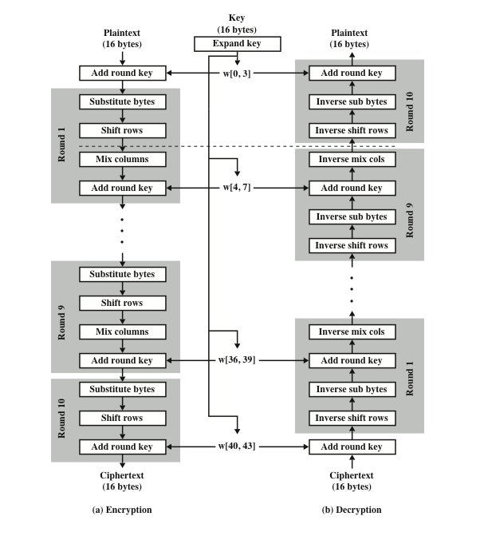
Figure 2-4: A E S Encryption and Decryption
Notes:
Four different stages are used, one of permutation and three of substitution
(Figure 2.4):
• Substitute bytes: Uses a table, referred to as an S-box, to perform a byte-by-
byte substitution of the block.
• Shift rows: A simple permutation that is performed row by row.
• Mix columns: A substitution that alters each byte in a column as a function
of all of the bytes in the column.
• Add round key: A simple bitwise XOR of the current block with a portion
of the expanded key.

Slide 27
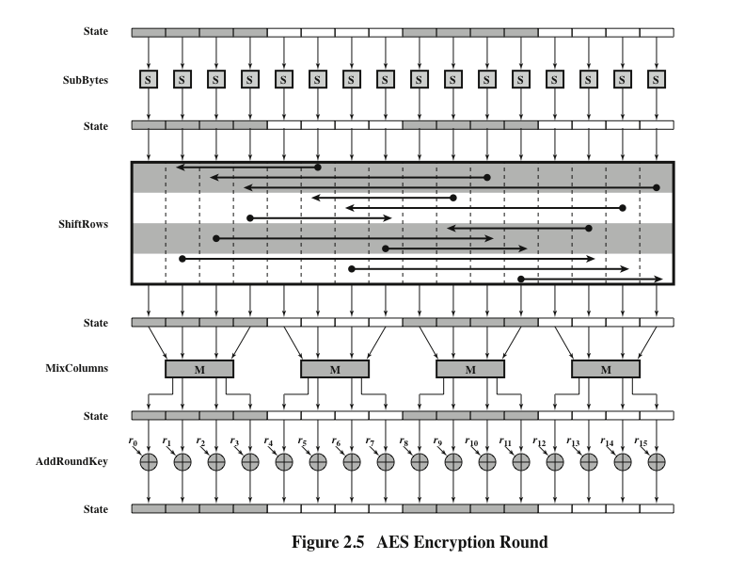
Figure 2-5: A E S Encryption Round
Notes:
Figure 2.5
depicts the structure of a full encryption round.

Slide 28
AES modes of operations
AES has several modes of operations
  ECB (Electronic Codebook): Encrypts each block of plaintext separately
  CBC (Cipher Block Chaining): XORs each plaintext block with the previous ciphertext block
  CFB (Cipher feedback): Encrypts the initialization vector (IV) and XOR the resulting output with the plaintext.
  …….

Slide 29
Initialization Vector (IV) in AES
IV is required for some modes in AES such as the CFB mode.
  CFB (Cipher feedback): Encrypts the initialization vector (IV) and XOR the resulting output with the plaintext.
Purpose: to enhance security, different encryption should use unique IV (but not secret IV).
  Consider encrypting a pdf file, which has the same header field.
  Without using IV, all encrypted pdf file will have the same first few blocks – some information is leaked.
  Using IV solves this problem

Slide 30
Symmetric Encryption in Python
There are several cryptography libraries in Python
On linprog, pycryptodomex has been installed.
See lect15/encryption.py for an example AES encryption/decryption class.

Slide 31

Copyright

