Slide 1
Software Defined Networking (SDN)
  A brief introduction
  SDN promises and challenges

Slide 2
What is “software defined?”
“Software defined” becomes a very popular word lately
  Software defined networking, software defined storage, software defined radio, etc.
What is it?
  The control of the underlying system is exposed to the upper layer developer through an API.
  System functionality is implemented over the API as an app (software).
  This allows for customization for what users want.
Another word for “Software defined” is “Programmable”

Slide 3
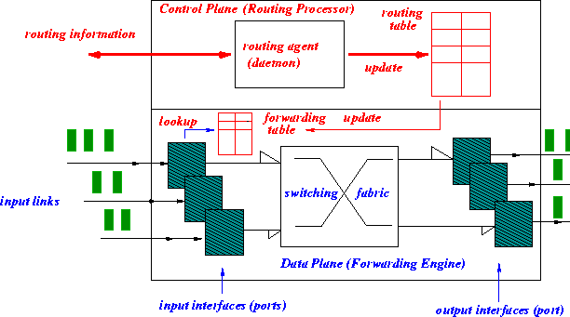
Today’s router: control plane and data plane

Slide 4
Today’s router
Tightly coupled data and control plane
Hardware vendors also provide proprietary control software
monolithic router contains switching hardware, runs proprietary implementation of Internet standard protocols (IP, RIP, IS-IS, OSPF, BGP) in proprietary router OS (e.g., Cisco IOS)

Slide 5

Today’s network
Individual routing algorithm components in each and every router interact with each other in control plane to compute forwarding tables
Routing
Algorithm
control
plane
data
plane

Slide 6
Today’s network
Equipment vendors provide a set of routing (network control) choices: OSPF, RIP, ISIS, BGP, etc.
Network control using a distributed, per router approach.
Network administrator can change network parameters to achieve certain objectives: e.g. changing routes
  Limited programmability
  If one wants a new control mechanism (e.g. new routing services for data centers), (s)he is out of luck.
  This is what SDN tries to overcome: making the network control like an APP that user can develop by themselves.
  SDN is to make network control more programmable, easier to deploy new services.

Slide 7
Today’s network
New types of applications continue to be added using ad hoc approaches
  Core networking schemes remain unchanged.
  A lot of different “middleboxes”, each speaks its own language, and interferences with one another
    NAT, firewall, IDS, WAN optimizer, load balancer, traffic shapers, transparent web proxy, application accelerators, etc.
    Data plane elements are now interacting with many different types of control elements.
  How to make all these work (well) poses significant challenges.

Slide 8
SDN motivation
Why do we want to make network control more programmable?
  Short term:
    Existing network control is no longer sufficient in several important areas, need innovation here!
      Data centers, Wireless, network security
    Existing network control is getting too complicated.
      Too many middleboxes with their own control
      Would be nice to provide a unified mechanism to deploy and manage these middleboxes
  Long term: programmability promotes innovation; and innovation is good for the networking industry.

Slide 9
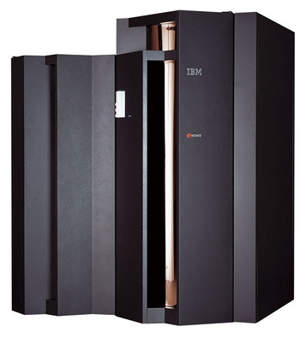
Computing systems once upon a time
Vertically integrated systems
  Proprietary hardware
  Proprietary OS
  Proprietary applications
  Highly reliable
  Dominated by a small number of large companies (IBM, HP, etc)
    Slow software innovation
      Proprietary development
    Small industry

Slide 10
Computing systems today
Open interfaces
Fast innovation
  Everyone can
  participate
Hugh industry
  Software is now part of everything.
To promote innovation, we must make network systems like this!
App
App
App
App
App
App
App
App
App
App
App
Open Interface
Windows
(OS)
Linux
Mac
OS
or
or
Open Interface
Microprocessor
Microprocessor

Slide 11
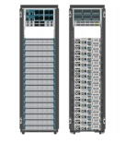
Conventional networking system today
Mainframe mindset: software for the control plane cannot be separated from the forwarding hardware in the data plane.
  Vertically integrated, complex, closed, proprietary
  Innovation is only possible if one has access to the router box.
    No significant innovation in the past 40 years.
Custom hardware
OS
Bundled applications

Slide 12
Ideal networking system for innovation
App
App
App
App
App
App
App
App
App
App
App
Network apps
Open Interface
API of Net OS
Net Windows
Net Linux
Net Mac
OS
or
or
Network Operating Systems
Open Interface
API for controlling
Network hardware
Network hardware
(data plane only)

Slide 13
Ideal networking system for innovation
App
App
App
App
App
App
App
App
App
App
App
Separate hardware from software (data plane from control plane)
Standardize the interface
  Each layer provides an abstraction
Innovation is possible for anyone just like software development for a computing system.
This is the vision of SDN/OpenFlow.
Open Interface
Net Windows
Net Linux
Net Mac
OS
or
or
Open Interface

Slide 14
SDN: separate forwarding hardware from controlling software
App
App
App
App
App
App
App
App
App
App
App
4. Firewall, virtual network, TE, IDS, etc
Open Interface
Northbound API, not standardized yet
Net Windows
Net Linux
Net Mac
OS
or
or
3. SDN controllers (floodlight, nox, etc)
Open Interface
OpenFlow: standardized for
Ethernet/IP/TCP
2. OpenFlow enabled switches/routers
simple hardware doing forwarding only
forwarding table can be set by other
entity through OpenFlow

Slide 15
SDN: Logically centralized control plane
A distinct (typically remote) controller interacts with local control agents (CAs) in routers to compute forwarding tables
Remote Controller
control
plane
data
plane
CA
CA
CA
CA
CA

Slide 16
Why a logical centralized control plane?
easier network management: avoid router misconfigurations, greater flexibility of traffic flows
table-based forwarding (recall OpenFlow API) allows “programming” routers
  centralized “programming” easier: compute tables centrally and distribute
  distributed “programming: more difficult: compute tables as result of distributed algorithm (protocol) implemented in each and every router
open (non-proprietary) implementation of control plane

Slide 17
Software defined networking (SDN)
4. programmable control applications
…
3. control plane functions external to data-plane switches
routing
access control
load
balance
Remote Controller
control
plane
data
plane
CA
2. control, data plane separation
CA
CA
CA
CA
1: generalized“ flow-based” forwarding (e.g., OpenFlow)

Slide 18
SDN perspective: data plane switches
Data plane switches
fast, simple, commodity switches implementing generalized data-plane forwarding in hardware
switch flow table computed, installed by controller
API for table-based switch control (e.g., OpenFlow)
  defines what is controllable and what is not
protocol for communicating with controller (e.g., OpenFlow)
network-control applications
…
routing
access
control
load
balance
control
plane
northbound API
SDN Controller
(network operating system)
southbound API
data
plane
SDN-controlled switches

Slide 19
SDN perspective: SDN controller
SDN controller (network OS):
maintain network state information
interacts with network control applications “above” via northbound API
interacts with network switches “below” via southbound API
implemented as distributed system for performance, scalability, fault-tolerance, robustness
network-control applications
…
routing
access
control
load
balance
control
plane
northbound API
SDN Controller
(network operating system)
southbound API
data
plane
SDN-controlled switches

Slide 20
SDN perspective: control applications
network-control apps:
“brains” of control: implement control functions using lower-level services, API provided by SND controller
unbundled: can be provided by 3rd party: distinct from routing vendor, or SDN controller
network-control applications
…
routing
access
control
load
balance
control
plane
northbound API
SDN Controller
(network operating system)
southbound API
data
plane
SDN-controlled switches

Slide 21
    How an SDN operates
Network applications specify the network functions (not the detailed implementation on the physical devices):
  Access control: who can talk to who
  Isolation: who can hear my broadcasts
  Routing: only specify routing to the degree you care
    Some flows over satellite, others over landline
  TE: specify in terms of quality of service, not routes
Network OS (or something like a compiler) compiles the network application and computes the configurations on physical devices based on the global view
Network OS distributes the configuration to physical devices through the southbound interface (OpenFlow).

Slide 22
Contrast between SDN and conventional network
SDN | Conventional
Controller may not be in the same box as the forwarding hardware | Forwarding hardware and its control are in the same box
Centralized routing algorithm with logically global view | Distributed routing algorithm
Network functions are realized with a global view | Network functions must be realized in a distributed manner, error-prone
New abstraction must be developed for the centralized view | Network abstraction is embedded in the distributed algorithms

Slide 23
    Major paradigm shift with SDN
No longer use distributed control protocols
  Design one distributed system (NOS) with the global view of the network
  Use for all control functions
Now just defining a centralized control function
  Configuration = Function(global view)
This may look easy. But this is not how it is done before, everything is new – innovation at all levels for this to happen.

Slide 24
    Major paradigm shift with SDN
This may look easy. But this is not how it is done before, everything is new – innovation at all levels for this to happen.
  High level programming languages to describe network application.
  Runtime system to realize the program efficiently, correctly, and safely.
  Abstraction design
  Debugging infrastructure
  network OS design
  Scalability issues

Slide 25
    SDN promises
A lower-entry point for innovation in the network control.
Solve the issues in the current network configuration challenges.
  Data plane interacts with many control entities
  Configure locally to achieve a global network function.

Slide 26
    Some SDN issues that are currently under extensive research
Abstraction
  A new programming system to specify network functions (programming SDN)
  An API that provides network abstraction to network application (SDN controller design)
Performance (scalability)
  Controller
  Communication between controller and devices
  Forwarding
Correctness and debugging – A SDN program has a higher bar than a typical program, multiple levels
Security

