Slide 1
Transport layer API: Socket Programming
Network Application Programming Interface
Readings
Sections 6.1.3 and 6.1.4
A classical reference book is “Unix network programming” by Richard Stevens

Slide 2
Networking with TCP/IP
Layered architecture
Application
Transport(TCP/UDP)
Network(IP)
Link (e.g. Ethernet)
Programs that you and I write
TCP/UDP API (TCP_send/recv,etc)
OS software realizing TCP/UDP
functionality
IP API (IP_send/recv,etc)
OS software realizing IP functionality
Link API (Ethernet_send/recv,etc)
OS software, NIC firmware,
NIC hardware realizing the link function

Slide 3
Networking with TCP/IP
Programs that you and I can write
TCP/UDP API (TCP_send/recv,etc)
OS software realizing TCP/UDP
functionality
Socket API
IP API (IP_send/recv,etc)
OS software realizing IP functionality
Link API (Ethernet_send/recv,etc)
OS software, NIC firmware,
NIC hardware realizing the link function

Slide 4
BSD Socket API
Introduced in 1981 BSD 4.1 UNIX
Function call interface to network services
system and library calls
Through the API, one can setup TCP connection, send and receive TCP/UDP, IP, and Ethernet packets. Sending IP and Ethernet packets require root privilege.
Network application programming primitives
Reference
Unix Network Programming by Richard Stevens
Connects two sockets on separate hosts
Sockets are owned by processes
Processes communicate through sockets

Slide 5
BSD Sockets and Internet Protocols
API: BSD Sockets
Socket: source/destination IP addresses + port numbers + protocol
Transport: TCP/UDP
TCP: in-order, reliable, byte-stream data transfer
Connection-oriented
UDP: unreliable data transfer
No connection set-up
Network: IP
Connectionless, no guarantees

Slide 6
Basic TCP API
socket
bind
listen
connect
accept
read
write
close

Slide 7
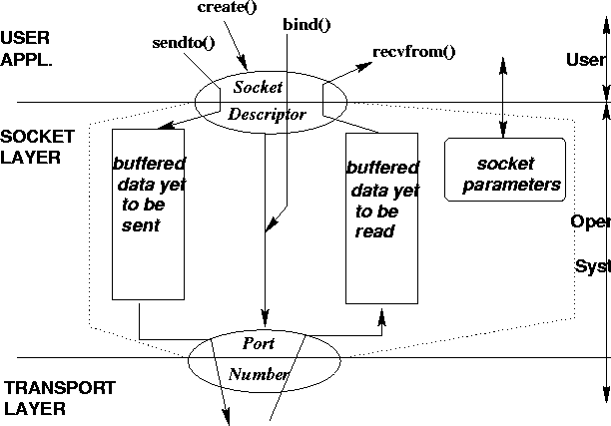
Sockets, the network end-point Conceptual View

Slide 8
Connection-Oriented Application (TCP application)
Server gets ready to service clients
Creates a socket
Binds a local address to the socket
Server’s address should be made known to clients
Listen (make the socket passive)
Client contacts the server
Creates a socket
Connects to the server
Client has to supply the address of the server
Server accepts connection requests from clients
Further communication is specific to application

Slide 9
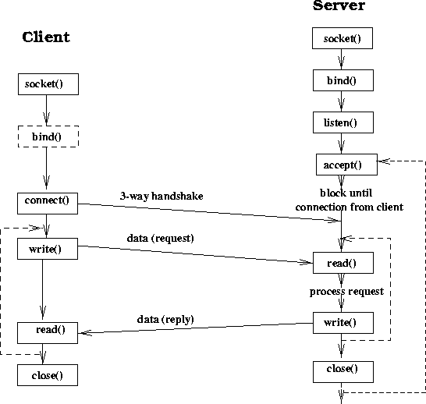

Slide 10
Creating a socket
int socket(int family, int type, int protocol)
family: symbolic name for protocol family
AF_INET, AF_UNIX
type: symbolic name for type of service
SOCK_STREAM, SOCK_DGRAM, SOCK_RAW
protocol: further info in case of raw sockets
typically set to 0
Returns socket descriptor

Slide 11
Binding Socket with an Address
int bind(int sd, struct sockaddr *addr, socklen_t len)
sd: socket descriptor returned by socket()
addr: pointer to sockaddr structure containing local address to be bound to socket
len: length of address structure
Returns 0 if success, -1 otherwise

Slide 12
Specifying Socket Address
struct sockaddr_in {
short sin_family; /* set to AF_INET */
u_short sin_port; /* 16 bit port number */
struct in_addr sin_addr; /* 32 bit host address */
char sin_zero[8]; /* not used */
};
struct in_addr {
u_long s_addr; /* 32 bit host address */
};

Slide 13
Bind Example
#include <sys/types.h>
#include <sys/socket.h>
int sd; struct sockaddr_in ma;
sd = socket(AF_INET, SOCK_STREAM, 0);
ma.sin_family = AF_INET; ma.sin_port = htons(5100); ma.sin_addr.s_addr = htonl(INADDR_ANY); if (bind(sd, (struct sockaddr *) &ma, sizeof(ma)) != -1) …
Notice that htons and htonl function? Why – integer numbers
may be represented differently in different machines? How can
the sender and the receiver agree on a format? Define a common
network format!

Slide 14
Listen
Convert a socket into a passive socket
#include <sys/socket.h>
int listen(int sockfd, int backlog)
Backlog: number of pending connections that the kernel should queue for the socket.
The socket will refuse connections if the queue is full.
Not well defined.
E.g: backlog= 5: AIX 4.2(8), Linux2.0.27(5), SunOS4.1.4(8), Solaris2.5.1(6).

Slide 15
Client: Connecting to Server
int connect(int sd,struct sockaddr *addr,socklen_t len)
sd: socket descriptor returned by socket()
addr: pointer to sockaddr structure containing server’s address (IP address and port)
len: length of address structure
Returns 0 if success, -1 otherwise

Slide 16
Client: Connect Example
int sd; struct sockaddr_in sa;
sd = socket(AF_INET, SOCK_STREAM, 0);
sa.sin_family = AF_INET; sa.sin_port = htons(5100); inet_aton(“128.186.120.34”, (struct in_addr *) &sa.sin_addr.s_addr); if (connect(sd, (struct sockaddr *) &sa, sizeof(sa)) != -1) …

Slide 17
Server: Connection Acceptance by Server
int accept(int sd, struct sockaddr *from, socklen_t *len)
sd: socket descriptor returned by socket()
from: pointer to sockaddr structure which gets filled with client’s address
len: length of address structure
Blocks until connection requested or error
returns a new socket descriptor on success

Slide 18
Connection-oriented Server
int sd, cd; struct sockaddr_in ma, ca; socklen_t calen;
sd = socket(AF_INET, SOCK_STREAM, 0); ma.sin_family = AF_INET; ma.sin_port = htons(5100); ma.sin_addr.s_addr = htonl(INADDR_ANY); bind(sd, (struct sockaddr *) &ma, sizeof(ma));
listen(sd, 5);
calen = sizeof(ca);
cd = accept(sd, (struct sockaddr *) &ca, &calen);
…read and write to client treating cd as file descriptor…

Slide 19
Examples
See example1.c and example2.c for a TCP echo server and client.

Slide 20
More on Socket Descriptor
A 5-tuple associated with a socket
{protocol, local IP address, local port, remote IP address, remote port}
socket() fills the protocol component
local IP address/port filled by bind()
remote IP address/port by accept() in case of server
in case of client both local and remote by connect()
Complete socket is like a file descriptor
Both send() and recv() through same socket
write – send, read – recv, like writing and reading a file.
accept() returns a new complete socket
Original one can be used to accept more connections

Slide 21
Streams and Datagrams
Connection-oriented reliable byte stream
SOCK_STREAM based on TCP
No message boundaries
Multiple write() may be consumed by one read()
Connectionless unreliable datagram
SOCK_DGRAM based on UDP
Message boundaries are preserved
Each sendto() corresponds to one recvfrom()

Slide 22
Basic UDP service interface:
Socket, bind, sendto, recvfrom, close
See example3.c/example4.c for a UDP echo client and server
UDP server UDP client
socket socket
bind
sendto
recvfrom recvfrom
sendto
close
TCP server TCP client
socket socket
Bind connect
Listen
Accept read/write
close
Read/write
close

Slide 23
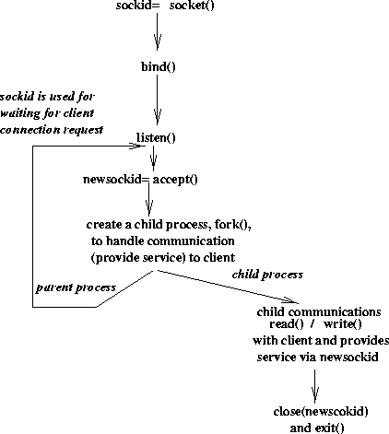
Typical Server Structure

