Slide 1
Chapter 6: Transport Layer (Part II)
Transmission Control Protocol (TCP)
Connection Management
Error/Flow/Congestion Control
User Datagram Protocol (UDP)
Readings
Sections 6.4, 6.5, 5.3.1, 5.3.2, 5.3.4

Slide 2
TCP: Overview
point-to-point:
one sender, one receiver
reliable, in-order byte steam:
no “message boundaries”
pipelined:
TCP congestion and flow control set window size
send & receive buffers
full duplex data:
bi-directional data flow in same connection
MSS: maximum segment size
connection-oriented:
handshaking (exchange of control msgs) init’s sender, receiver state before data exchange
flow controlled:
sender will not overwhelm receiver

Slide 3
TCP Segment Structure
32 bits
URG: urgent data
(generally not used)
counting
by bytes
of data
(not segments!)
source port #
dest port #
sequence number
ACK: ACK #
valid
acknowledgement number
head
len
not
used
U
rcvr window size
A
P
R
S
PSH: push data now
(generally not used)
F
# bytes
rcvr willing
to accept
checksum
ptr urgent data
RST, SYN, FIN:
connection estab
(setup, teardown
commands)
Options (variable length)
application
data
(variable length)
Internet
checksum
(as in UDP)

Slide 4
TCP Connection Management: establish a connection
TCP sender, receiver establish “connection” before exchanging data segments
initialize TCP variables:
seq. #s
buffers, flow control info
client: connection initiator
server: contacted by client
Three-way handshake:
Step 1: client end system sends TCP SYN control segment to server
specifies initial seq #
Step 2: server end system receives SYN, replies with SYNACK control segment
ACKs received SYN
allocates buffers
specifies server → receiver initial seq. #
Step 3: client replies with an ACK segment

Slide 5
TCP Connection Management: close a connection
Modified three-way handshake:
client closes socket:
Step 1: client end system sends TCP FIN control segment to server
Step 2: server receives FIN, replies with ACK. Closes connection, sends FIN.
client
server
close
FIN
ACK
close
FIN
ACK
timed wait
Step 3: client receives FIN, replies with ACK.
Enters “timed wait” - will respond with ACK to received FINs
Step 4: server, receives ACK. Connection closed.
closed
Socket programming interface
close() vs shutdown()

Slide 6
Initial state
TCP connection
Management
Finite state machine
CLOSED
Application.: passive Öpening
Send: ---
Send timeout: RST
Application.: active opening send: SYN
Receive: SYN;
send: SYN, ACK
LISTEN
Application.: send data Send: SYN
Receive: RST
Passive opening
SYN_RECV
Receive: SYN send: SYN, ACK
Simultanous opening
SYN_SENT
Application: close or timeout
Receive: ACK Send: ---
Receive: SYN, ACK Send: ACK
Application: close
Send: FIN
Passive close
ESTABLISHED
Receive: FIN Send: ACK
Application: close
Send: FIN
Data transmission
CLOSE_WAIT
Receive: FIN Send: ACK
Simultanous close
Application: close Send: FIN
FIN_WAIT_1
CLOSING
Receive: ACK Send: ---
Receive: ACK Send: ---
Receive: ACK Send: ---
Receive: FIN, ACK Send: ACK
LAST_ACK
FIN_WAIT_2
Receive: FIN Send: ACK
TIME_WAIT
2 MSL timeout
Active close
MSL: max. segment life

Slide 7
TCP Seq. #’s and ACKs
Seq. #’s:
byte stream “number”of first byte in segment’s data
ACKs:
seq # of next byte expected from other side
cumulative ACK
Host A
Host B
User
types
‘C’
Seq=42, ACK=79, data = ‘C’
host ACKs
receipt of
‘C’, echoes
back ‘C’
Seq=79, ACK=43, data = ‘C’
host ACKs
receipt
of echoed
‘C’
Seq=43, ACK=80
time
simple telnet scenario

Slide 8
TCP SYN/FIN Sequence #
TCP SYN/FIN packets consume one sequence number
For simplification, seq # counts pkts numbers in the example
In reality, it is byte counts
client
server
SYN(J)
SYN/ACK(K,J+1)
ACK(K+1)
DATA(J+1)
ACK(J+2)
FIN(M)
ACK(M+1)
FIN(N)
ACK(N+1)

Slide 9
TCP data reliable transmission
Theoretically, for every packet sent for which the sender expects an ACK,
A timer is started
What is the timeout duration?
When timer expires, this packet retransmitted
This applies to both data packets and control packets SYN and FIN
Note that ACK is cumulative
Receiver
Accept out-of-order packets
Respond by acking last pkt received in order
So, is TCP using Go-Back-N or Selective Repeat?
Hybrid, more like GBN

Slide 10
TCP: Timeout and retransmission scenarios
Host A
Host B
Host A
Host B
Seq=92, 8 bytes data
Seq=92, 8 bytes data
Seq=100, 20 bytes data
timeout
ACK=100
Seq=92 timeout
X
ACK=100
Seq=100 timeout
ACK=120
loss
Seq=92, 8 bytes data
Seq=92, 8 bytes data
ACK=120
ACK=100
time
time
lost ACK scenario
premature timeout,
cumulative ACKs

Slide 11
TCP Round Trip Time and Timeout
Q: how to set TCP timeout value?
longer than RTT
note: RTT will vary
too short: premature timeout
unnecessary retransmissions
too long: slow reaction to segment loss
Q: how to estimate RTT?
SampleRTT: measured time from segment transmission until ACK receipt
ignore retransmissions, cumulatively ACKed segments
SampleRTT will vary, want estimated RTT “smoother”
use several recent measurements, not just current SampleRTT

Slide 12
TCP Round Trip Time and Timeout
EstimatedRTT = (1-x)*EstimatedRTT + x*SampleRTT
Exponential weighted moving average (EWMA)
influence of given sample decreases exponentially fast
typical value of x: 0.1
Setting the timeout
EstimtedRTT plus “safety margin”
large variation in EstimatedRTT → larger safety margin
Timeout = EstimatedRTT + 4*Deviation
Deviation = (1-x)*Deviation +
x*|SampleRTT-EstimatedRTT|

Slide 13
TCP RTT and Timeout (Cont’d)
What happens when a timer expires?
Exponential backoff: double the Timeout value
An upper limit is also suggested (60 seconds)
How about the timeout value for the first packet?
It should be sufficient large
3 seconds recommended in RFC1122
That is, when a timer expires, we do not use the
above formulas to compute the timeout value for TCP

Slide 14
Flow/Congestion Control
Sometimes sender shouldn’t send a pkt whenever its ready
Receiver not ready (e.g., buffers full)
Avoid congestion
Sender transmits smoothly to avoid temporary network overloads
React to congestion
Many unACK’ed pkts, may mean long end-end delays, congested networks
Network itself may provide sender with congestion indication

Slide 15
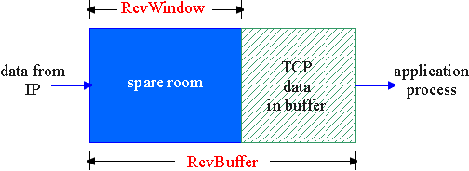
TCP Flow Control
flow control
receiver: explicitly informs sender of (dynamically changing) amount of free buffer space
RcvWindow field in TCP segment
sender: keeps the amount of transmitted, unACKed data less than most recently received RcvWindow
sender won’t overrun
receiver’s buffers by
transmitting too much,
too fast
RcvBuffer = size of TCP Receive Buffer
RcvWindow = amount of spare room in Buffer
receiver buffering

Slide 16
What is Congestion?
Informally: “too many sources sending too much data too fast for network to handle”
Different from flow control!
Manifestations at the end points:
First symptom: long delays (long queuing delay in router buffers)
Final symptom: Lost packets (buffer overflow at routers, packets dropped)

Slide 17
Effects of Retransmission on Congestion
Ideal case
Every packet delivered successfully until capacity
Beyond capacity: deliver packets at capacity rate
Reality
As offered load increases, more packets lost
More retransmissions → more traffic → more losses …
In face of loss, or long end-end delay
Retransmissions can make things worse
Decreasing rate of transmission
Increases overall throughput

Slide 18
Congestion: Moral of the Story
When losses occur
Back off, don’t aggressively retransmit
Issue of fairness
Social versus individual good
What about greedy senders who don’t back off?

Slide 19
Taxonomy of Congestion Control
Open-Loop (avoidance)
Make sure congestion doesn’t occur
Design and provision the network to avoid congestion
Closed-Loop (reactive)
Monitor, detect and react to congestion
Based on the concept of feedback loop
Hybrid
Avoidance at a slower time scale
Reaction at a faster time scale

Slide 20
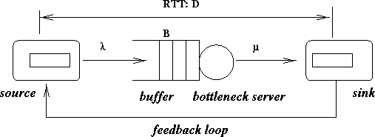
Closed-Loop Congestion Control

Slide 21
Closed-Loop Congestion Control
Explicit
network tells source its current rate
Better control but more overhead
Implicit
End point figures out rate by observing network
Less overhead but limited control
Ideally
overhead of implicit with effectiveness of explicit

Slide 22
Closed-Loop Congestion Control
Window-based vs Rate-based
Window-based: No. of pkts sent limited by a window
Rate-based: Packets to be sent controlled by a rate
Fine-grained timer needed
No coupling of flow and error control
Hop-by-Hop vs End-to-End
Hop-by-Hop: done at every link
Simple, better control but more overhead
End-to-End: sender matches all the servers on its path

Slide 23
Approaches towards Congestion Control
Two broad approaches towards congestion control:
End-end congestion control:
no explicit feedback from network
congestion inferred from end-system observed loss, delay
approach taken by TCP
Network-assisted congestion control:
routers provide feedback to end systems
single bit indicating congestion (TCP/IP ECN, SNA DECbit, ATM)
explicit rate sender should send at

Slide 24
TCP Congestion Control
Idea
Each source determines network capacity for itself
Uses implicit feedback, adaptive congestion window
ACKs pace transmission (self-clocking)
Challenge
Determining the available capacity in the first place
Adjusting to changes in the available capacity

Slide 25
Additive Increase/Multiplicative Decrease
Objective: Adjust to changes in available capacity
A state variable per connection: CongWin
Limit how much data source has is in transit
MaxWin = MIN(RcvWindow, CongWin)
Algorithm
Increase CongWin when congestion goes down (no losses)
Increment CongWin by 1 pkt per RTT (linear increase)
Decrease CongWin when congestion goes up (timeout)
Divide CongWin by 2 (multiplicative decrease)

Slide 26
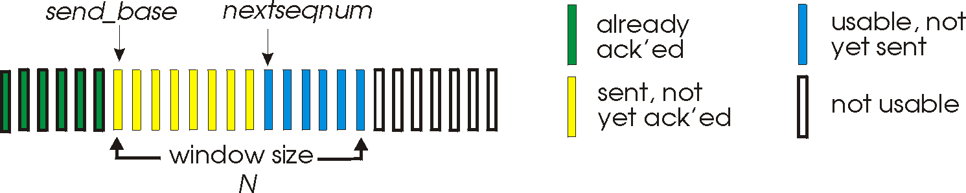
TCP Congestion Control
Window-based, implicit, end-end control
Transmission rate limited by congestion window size, Congwin, over segments:
Congwin
w segments, each with MSS bytes sent in one RTT:
w * MSS
throughput =
Bytes/sec
RTT

Slide 27
TCP Congestion Control
“probing” for usable bandwidth:
ideally: transmit as fast as possible (Congwin as large as possible) without loss
increase Congwin until loss (congestion)
loss: decrease Congwin, then begin probing (increasing) again
two “phases”
slow start
congestion avoidance
important variables:
Congwin
threshold: defines threshold between slow start phase and congestion avoidance phase

Slide 28
Why Slow Start?
Objective
Determine the available capacity in the first place
Idea
Begin with congestion window = 1 pkt
Double congestion window each RTT
Increment by 1 packet for each ack
Exponential growth but slower than one blast
Used when
First starting connection
Connection goes dead waiting for a timeout

Slide 29
TCP Slowstart
Host A
Host B
Slowstart algorithm
one segment
initialize: Congwin = 1
for (each segment ACKed)
Congwin++
until (loss event OR
CongWin > threshold)
RTT
two segments
four segments
exponential increase (per RTT) in window size (not so slow!)
loss event: timeout (Tahoe TCP) and/or or three duplicate ACKs (Reno TCP)
time

Slide 30
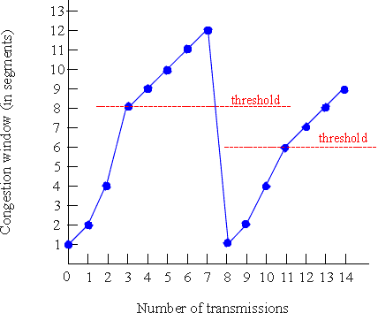
TCP Congestion Avoidance
Congestion avoidance
/* slowstart is over */
/* Congwin > threshold */
Until (loss event) {
every w segments ACKed:
Congwin++
}
threshold = Congwin/2
Congwin = 1
perform slowstart

Slide 31
Fast Retransmit/Fast Recovery
Coarse-grain TCP timeouts lead to idle periods
Fast Retransmit
Use duplicate acks to trigger retransmission
Retransmit after three duplicate acks instead of waiting for timer to expire
Fast Recovery
Remove the slow start phase
Go directly to half the last successful CongWin

Slide 32
TCP Fairness
Fairness goal: if N TCP sessions share same bottleneck link, each should get 1/N of link capacity
TCP connection 1
bottleneck
router
capacity R
TCP
connection 2
AIMD makes TCP flows roughly fair (bias towards flows with short RTT).

Slide 33
Dealing with Greedy Senders
Scheduling and dropping policies at routers
First-in-first-out (FIFO) with tail drop
Greedy sender can capture large share of capacity
Solutions?
Fair Queuing
Separate queue for each flow
Schedule them in a round-robin fashion
When a flow’s queue fills up, only its packets are dropped
Insulates well-behaved from ill-behaved flows
Random early detection (RED)

Slide 34
More on TCP
Deferred acknowledgements
Piggybacking for a free ride
Deferred transmissions
Nagle’s algorithm
TCP over wireless

Slide 35
Connectionless Service and UDP
User datagram protocol
Unreliable, connectionless
No connection management
Does little besides
Encapsulating application data with UDP header
Multiplexing application processes
Desirable for:
Short transactions, avoiding overhead of establishing/tearing down a connection
DNS, time, etc
Applications withstanding packet losses but normally not delay
Real-time audio/video

Slide 36
UDP packet format
0
15
16
31
Source port
Destination port
UDP length
UDP checksum
Payload (if any)
UDP packet format

Slide 37
UDP packet header
Source port number
Destination port number
UDP length
Including both header and payload of UDP
Checksum
Covering both header and payload

