Slide 1
Chapter 6: Transport Layer (Part I)
Transport Layer Services
Transport layer challenges
Connection Set-up and Tear-down
Readings
Sections 6.1-6.2

Slide 2
Transport Layer
Provides transport services to applications
End-host to end-host delivery of data
Aspects of transport services
Error detection and recovery
Errors (lost or corrupted data) detected at receiver?
Detected error corrected?
Framing
Data unit boundaries (e.g., message) preserved?
Timing
Timing between data preserved when delivered at receiver?

Slide 3
Common Transport Service Models
Connectionless datagram
No promises, no timing
Error detection optional, no error recovery
Connection-oriented reliable
Error recovery, no timing
Circuit-like
Timing preserved
No error recovery, optional error detection

Slide 4
Connection Paradigms
Connection-oriented
Explicitly setup/tear down connections
Setup connection context (“connection state”)
Initial sequence number, flow control window size
Exchange data within context of connection
Connectionless service
Pure datagram
One-time unreliable send
Transaction oriented
Single request from sender, single reply from receiver

Slide 5
Transportation Layer .vs. data link layer
Very similar
two hosts connected by a link or two hosts connected by a network
Build reliable services over underlying unreliable communication
differences:
When two hosts are connected by a link, packets will not reorder or duplicate (if the sender sends only once). In addition, packets will either get to the receiver or get lost.
When two hosts are connected by a network, packets can be duplicated, delayed, lost, reordered.
Implication: The problems to be addressed in the transport layer are very similar to those in the data link layer. However, the solutions may be more complex.

Slide 6
Problems
The problem is that network can delay, reorder, lose packets
Time-out/retransmission introduces duplicates of data, acknowledgement, connect, close packets
Worst case scenario: consider this bank transaction example
(a) setup connection
(b) transfer $100
(c) close connection
all messages are delayed and replayed.

Slide 7
Other challenges
Transport layer protocol: varying data rate and varying packet delay
Need to adapt to the data rate and delay rate
Sliding window alone would not be sufficient
Network congestion control issue
Flow control: fast sender and slow receiver
Congestion control: global network problem, each flow may be ok, but the sum of all flows is too much for the network to handle.
Congestion control is harder than flow control
Because of these, transport layer protocols are more difficult to design than data link layer protocols.

Slide 8
End-to-End Issues (for connection-oriented)
How to build a reliable, in-order delivery?
On top of an unreliable network layer service
Potentially connects different hosts
Need explicit connection establishment and termination
Potentially different RTT (round-trip time)
Need adaptive timeout mechanisms
Potentially long delay in network
Need to be prepared for arrival of very old packets
Connection management

Slide 9
End to End Issues for connection-oriented
Potentially unreliable network service
Need to be prepared for
corrupted/lost and out-of-order packets
Error control
Potentially different capacity at destination
Need to avoid overrunning receivers
flow control
Potentially different network capacity
Need to be prepared for network congestion
Congestion control

Slide 10
Connection Management Issues
How to identify a connection between end hosts?
Source/destination IP addresses + port numbers
Is it sufficient?
What about different incarnations?
Potential problems
Network can delay, reorder, lose packets
Time-out/retransmission introduces duplicates of
Data, acknowledgement, connect, close packets

Slide 11
Connection Management Issues
On packet arrival: is it real or not?
New connection request/release or an old one?
Transport protocols must create/maintain/destroy
Enough state to answer the memorex question
Major issues
How to choose an identifier for each packet
So that no other packets currently in the network
Associated with this host have the same identifier
How to deal with old or duplicate (connect) messages
Delayed duplicate problem

Slide 12
Choosing Unique Identifier
Choose an identifier (or sequence number) to
Distinguish any two outstanding packets/connections
associated with a host
Connection identified by
<host id., port no.> pairs plus a “unique” initial seq number
Host id unique globally, why not sufficient to use
<host id., port no.> pairs to identify connections?
Time stamp each pkt using a time-of-day clock?
Solution: Assume maximum lifetime (T) for a pkt
Network layer kills packets when they reach max lifetime

Slide 13
Choosing Unique Identifier
Approach 1: maintain state
Keep list of all values used in last 2T (why 2T?)
Don’t reuse value in list
If list lost: wait 2T
Concerns?
Too much connection state
Too long waiting time
Approach 2:
Choose at random from large set (e.g. 2³²) of numbers
Unlikely to choose new number previously chosen in last 2T
Can be combined with used value list for more protection
Good enough for many people

Slide 14
Connection Setup
Exchange control messages between two end hosts
To setup (or reject) connection before sending data
Issues to be considered
How to handle lost messages
Use timer and retransmission
How to identify and handle old/duplicate messages
Keep some state info (e.g. seq. no. of packets sent etc)
Two basic approaches
Two-way handshake (with timers)
Three-way handshake

Slide 15
Three-Way Handshake
Connection initiator (the client)
Chooses unique seqno x and sends req-conn(x)
Connection respondent (the server)
Upon receiving req-conn(x)
Chooses its own unique identifier, y
Sends ack-conn(y,x)
Upon receiving ack-conn(y,x), client responds
With ack-conn(x+1,y)
Why does server need to choose unique seqno y?

Slide 16
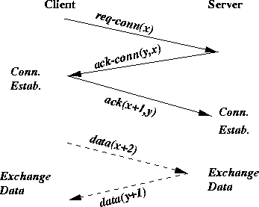
Three-Way Handshake

Slide 17
Three-way handshake (cont’d)
Old message
client
server
req-conn(x)
Connection
Not established
ack-conn(y,x)
ignored

Slide 18
Connection Setup: Summary
How to deal with old and duplicate messages?
Receiver also chooses its own unique identifier y
Requires sender to reply back using y
Allows receiver to detect old sender messages without timers

Slide 19
Closing a Connection
Reaching agreement: two approaches
Abort: send close msg to peer, delete state info
What if close() message lost?
Graceful: send close msg, but before deleting state
Wait for peer to acknowledge close()
Problem solved?
Can I decide to close, knowing that
Other entity also agreed to close and knows that I will close
Can two armies coordinate their attacks
If communication is unreliable?

Slide 20
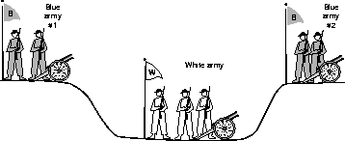
Two-Army Problem

Slide 21
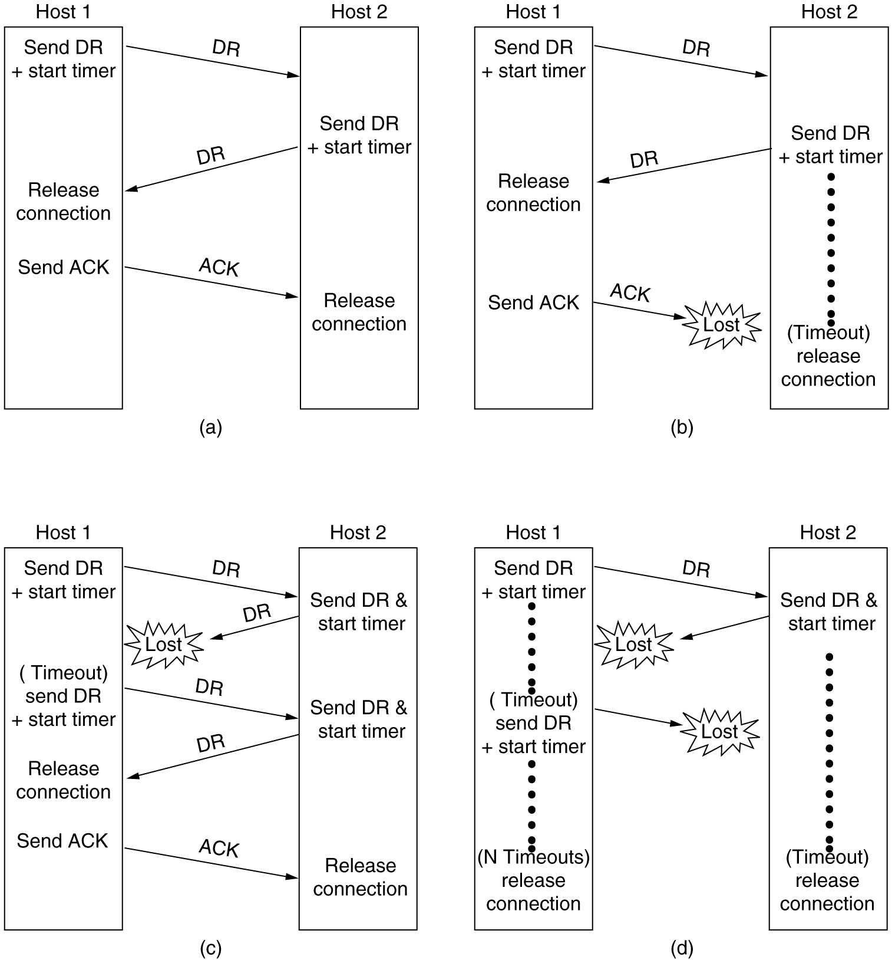
Connection Release
6-14, a, b
Four protocol scenarios for releasing a connection. (a) Normal case of a three-way handshake. (b) final ACK lost.

Slide 22
Connection Release
6-14, c,d
(c) Response lost. (d) Response lost and subsequent DRs lost.

