Slide 1
Chapter 5: Network Layer (Part III)
Routing Protocols in the Internet
RIP, OSPF, BGP
More on IP
Fragmentation and Reassembly
ICMP
Readings
Sections 5.5-5.6

Slide 2
Hierarchical Routing
aggregate routers into regions, “autonomous systems” (AS)
routers in same AS run same routing protocol
“intra-AS” routing protocol
routers in different AS can run different intra-AS routing protocol
gateway routers
special routers in AS
run intra-AS routing protocol with all other routers in AS
also responsible for routing to destinations outside AS
run inter-AS routing protocol with other gateway routers

Slide 3
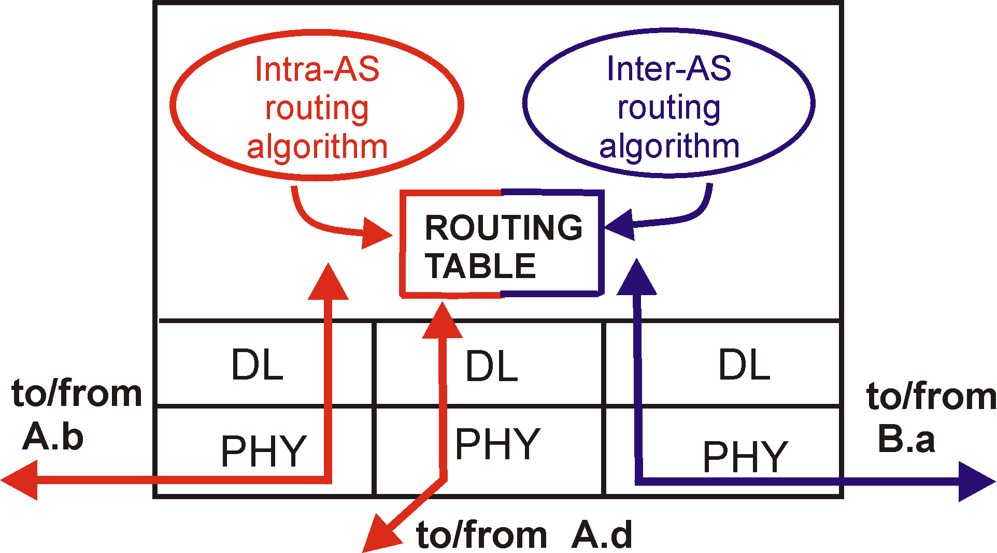
Intra-AS and Inter-AS routing
C.b
Gateways:
perform inter-AS routing amongst themselves
perform intra-AS routing with other routers in their AS
B.a
A.a
b
A.c
c
a
C
a
b
a
B
d
c
A
b
network layer
inter-AS, intra-AS routing in
gateway A.c
link layer
physical layer

Slide 4
Intra-AS and Inter-AS routing
Inter-AS
routing
between
A and B
C.b
B.a
A.a
Host
h2
b
A.c
c
a
C
a
b
a
B
Host
h1
d
c
Intra-AS routing
within AS B
A
b
Intra-AS routing
within AS A

Slide 5
Why different Intra- and Inter-AS routing ?
Policy:
Inter-AS: admin wants control over how its traffic routed, who routes through its net.
Intra-AS: single admin, so no policy decisions needed
Scale:
hierarchical routing saves table size, reduced update traffic
Performance:
Intra-AS: can focus on performance
Inter-AS: policy may dominate over performance

Slide 6
Intra-AS Routing
Also known as Interior Gateway Protocols (IGP)
Most common IGPs:
RIP: Routing Information Protocol
OSPF: Open Shortest Path First
IGRP: Interior Gateway Routing Protocol (Cisco proprietary)

Slide 7
RIP ( Routing Information Protocol)
Distance vector algorithm
Included in BSD-UNIX Distribution in 1982
Distance metric: # of hops (max = 15 hops)
Can you guess why?
Distance vectors exchanged
every 30 sec (plus a jitter) via Response Message (also called advertisement)
When network topology changes
Each advertisement: route to up to 25 destination nets

Slide 8
RIP: Link Failure and Recovery
If no advertisement heard after 180 sec → neighbor/link declared dead
routes via neighbor invalidated
new advertisements sent to other neighbors
neighbors in turn send out new advertisements (if tables changed)
link failure info quickly propagates to entire net

Slide 9
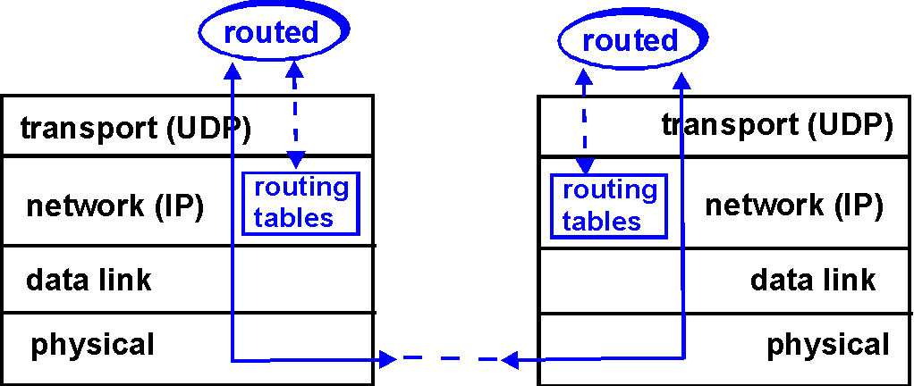
RIP Table processing
RIP routing tables managed by application-level process called routed (daemon)
advertisements sent in UDP packets, periodically repeated

Slide 10
OSPF (Open Shortest Path First)
“open”: publicly available
Gated
Uses Link State algorithm
LS packet dissemination
Topology map at each node
Route computation using Dijkstra’s algorithm
OSPF advertisement carries one entry per neighbor router
Advertisements disseminated to entire AS (via controlled flooding)

Slide 11
Neighbor Discovery and Maintenance
OSPF Hello protocol
Sends Hello packets on all its interfaces
Every Hello Interval (default 10 sec)
Helps detect the failure of neighbors
Neighbor is designated as failed
If no Hello for Dead Interval (40 sec)

Slide 12
OSPF “advanced” features (not in RIP)
Security: all OSPF messages authenticated (to prevent malicious intrusion);
Multiple same-cost paths allowed (only one path in RIP)
For each link, multiple cost metrics for different TOS (eg, satellite link cost set “low” for best effort; high for real time)
Integrated uni- and multicast support:
Multicast OSPF (MOSPF) uses same topology data base as OSPF
Hierarchical OSPF in large domains.

Slide 13
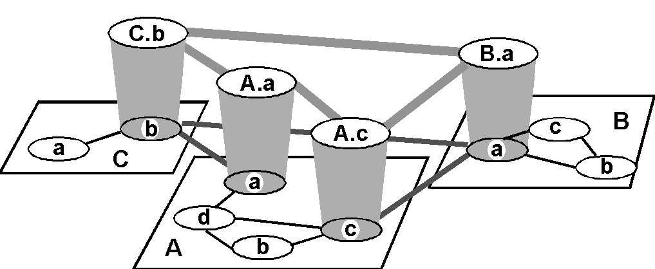
Inter-AS routing

Slide 14
Internet Inter-AS routing: BGP
BGP (Border Gateway Protocol): the de facto standard
Path Vector protocol:
similar to Distance Vector protocol
each Border Gateway broadcast to neighbors (peers) entire path (I.e, sequence of ASs) to destination
E.g., Gateway X may send its path to dest. Z:
Path (X,Z) = X,Y1,Y2,Y3,…,Z

Slide 15
Internet Inter-AS routing: BGP
BGP messages exchanged using TCP.
BGP messages:
OPEN: opens TCP connection to peer and authenticates sender
UPDATE: advertises new path (or withdraws old)
KEEPALIVE keeps connection alive in absence of UPDATES; also ACKs OPEN request
NOTIFICATION: reports errors in previous msg; also used to close connection

Slide 16
Internet Inter-AS routing: BGP
Suppose: gateway X send its path to peer gateway W
W may or may not select path offered by X
cost, policy (don’t route via competitors AS), loop prevention reasons.
If W selects path advertised by X, then:
Path (W,Z) = W, Path (X,Z)
Note: X can control incoming traffic by controlling its route advertisements to peers:
e.g., don’t want to route traffic to Z → don’t advertise any routes to Z

Slide 17
BGP: an example
[3210]*
[4210]
[7610]
NLRI=128.186.0.0/16
ASPATH=[0]
NLRI=128.186.0.0/16
ASPATH=[10]
NLRI=128.186.0.0/16
ASPATH=[210]
NLRI=128.186.0.0/16
ASPATH=[3210]
128.186.0.0/16
NLRI=128.186.0.0/16
ASPATH=[4210]
NLRI=128.186.0.0/16
ASPATH=[210]
NLRI=128.186.0.0/16
ASPATH=[53210]
NLRI=128.186.0.0/16
ASPATH=[10]
NLRI=128.186.0.0/16
ASPATH=[7610]
NLRI=128.186.0.0/16
ASPATH=[610]
NLRI=128.186.0.0/16
ASPATH=[610]

Slide 18
A feature of BGP
Avoid looping problem in distance vector algorithms
[YZ]*
[WYZ]
[YZ]
[Z]
X
Y
Z
[XYZ]
[WYZ]
[YZ]
W
[YZ]*
[XYZ]

Slide 19
Shortcoming of BGP
May still take long time to converge
Invalid routes can still be selected/propagated
[3210]*
[4210]
[7610]
NLRI=128.186.0.0/16
ASPATH=[57610]
NLRI=128.186.0.0/16
ASPATH=[54210]
NLRI=128.186.0.0/16
Withdrawal
Situation can be worse on global Internet
Up to 15 minutes converging time observed in Internet
O(k!) alternative paths explored theoretically

Slide 20
Solving BGP Path Exploration
Idea is simple, but extremely hard
Scalability
Confidentiality
Simple AS graph vs. actual Internet topology
Each network has multiple BGP routers
Intra-domain vs. inter-domain errors
Two Ases may have multiple peering links
Single link failure vs. mulit-link failure
Links have diff prop delays and events occur in short duration
Which update is newer?

Slide 21
BGP Security
Accidents (caused by human errors)
Most of them not malicious
June 2015, Malaysian route leak
2010, Chinese hijack (affects cnn.com, amazon.de, and rapidshare.com etc)
24 Feb 2008, Pakistan knocked Youtube offline
07 May 2005, AS 174 took Google’s 64.233.161.0/24
24 Dec 2004, Anatomy of a Leak: AS9121
100K+ routes announced
6 Apr 2001: C&W routing instability
25 Apr 1997: 7007 Explanation and Apology
Check NANOG mailing list for more accidents

Slide 22
The Internet Network layer
Transport layer: TCP, UDP
Routing protocols
path selection
RIP, OSPF, BGP
IP protocol
addressing conventions
datagram format
packet handling conventions
Network
layer
routing
table
ICMP protocol
error reporting
router “signaling”
Link layer
physical layer

Slide 23
More on IP

Slide 24
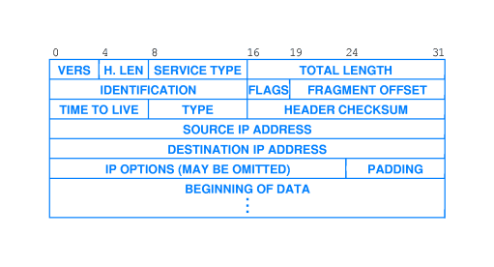
IP Packet Format

Slide 25
Fields in IP Packet
IP protocol version
Current version is 4
Header length
Number of 32-bit quantities in the header
Type of Service
3-bit Priority
Delay, Throughput, Reliability bits
Total length
Including header (maximum 65535 bytes)

Slide 26
Fields in IP Packet
Identification
All fragments of a packet have same identification
Flags
Don’t Fragment, More Fragments
Fragment offset
Where in the original packet (count in 8 byte units)
Time to live
Life time of packet
Protocol Type
TCP, UDP etc

Slide 27
IP Fragmentation & Reassembly
Each subnet has its own MTU size
Maximum Transmission Unit
An IP packet is chopped into smaller pieces if
Packet size is greater than network MTU, and
Don’t fragment option is not set
Each datagram has unique identification
All fragments carry original datagram id
All fragments except the last have more flag set

Slide 28
IP Fragmentation &Reassembly
Datagram assembly done only at destination
Why not at a router?
Use datagram id to put pieces together
The last piece indicated with more bit 0
Offset plus the length tell whether any
Holes missing in the middle
Setup a reassembly timer after first fragment
If all pieces in time, pass the pkt to upper layer
If some do not arrive in time, discard the fragments
No recovery from lost fragments (why?)

Slide 29
IP Fragmentation & Reassembly
large IP datagram fragmented within net
one datagram becomes several datagrams
“reassembled” only at final destination
IP header bits used to identify, order related fragments
reassembly

Slide 30
IP Fragmentation and Reassembly
length
=4000
ID
=x
moreflag
=0
offset
=0
One large datagram becomes
several smaller datagrams
length
=1500
ID
=x
moreflag
=1
offset
=0
length
=1500
ID
=x
moreflag
=1
offset
=1480
length
=1040
ID
=x
moreflag
=0
offset
=2960

Slide 31
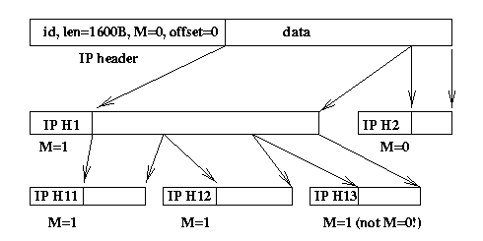
Fragmentation Example

Slide 32
Internet Control Message Protocol
An error reporting mechanism
Time exceeded
Packet discarded because TTL was 0
Destination unreachable
Router cannot locate destination
Source quench
Buffer overflow, request source to reduce rate
Redirect
Suggest a better router

Slide 33
ICMP Message Transport
ICMP messages carried in IP datagrams
Treated like any other datagram
But no error message sent if
ICMP message causes error
Message sent to the source
Original Internet header, plus
8 bytes of the original datagram’s data included
For source to match original process.

Slide 34
ICMP Usage
Testing reachability
ICMP echo request/reply
ping
Tracing route to a destination
Time-to-live field
Traceroute
Path MTU discovery
Don’t fragment bit

Slide 35
Other Internet Control Protocols
ARP solves problem
Given IP address, find MAC address
Reverse Address Resolution Protocol (RARP)
Given MAC address, find IP address, and more …
Used by, e.g., diskless machines
Items to be configured
IP address
Default router address
Subnet mask
DNS server address

Slide 36
IP addresses: how to get one?
Hard-coded by system admin in a file
Dynamic Host Configuration Protocol
dynamically get address: “plug-and-play”
host broadcasts “DHCP discover” msg
DHCP server responds with “DHCP offer” msg
host requests IP address: “DHCP request” msg
DHCP server sends address: “DHCP ack” msg

Slide 37
Network Layer Summary
Network service
datagram vs virtual circuit
Routing protocols
Link state and distance vector
RIP, OSPF, BGP
Fragmentation and Reassembly
Case studies
IPv4

