Slide 1
Chapter 5 Network Layer
Routing Algorithms/Protocols
Link state routing
Distance vector routing
Readings
Section 5.2

Slide 2
Routing Table: Issues
How are routing tables determined?
Who determines table entries?
What info used in determining table entries?
When do routing table entries change?
Where is routing info stored?
How to control table size?
Answer these and we are done!

Slide 3
Routing Algorithms/Protocols: Issues
Route selection may depend on different criteria
Performance. Example: choose route with smallest delay
Policy. Example: choose a route that doesn’t cross the .gov network
Adapt to changes in topology or traffic
Self-healing: When the network topology changes, little or no human intervention is needed.
Scalability
Must be able to support large number of hosts, routers

Slide 4
Hop-by-Hop Routing vs Source Routing
Source routing
Sender selects the path to destination precisely
Routers forward packet to next-hop as specified
Example: IP’s loose/strict source route (slow path)
Hop-by-hop routing
Each packet contains destination address
Each router chooses next-hop to destination
Example: IP (fast path)
Pros and cons of these two approaches?
Header overheads
Network consistency
Routing constraints

Slide 5
Distributed Routing Algorithms
Routers cooperate using a distributed protocol
To create mutually consistent routing tables
Two standard distributed routing algorithms
Link state routing
Distance vector routing

Slide 6
Link State vs Distance Vector
Both assume that
The address of each neighbor is known
The cost of reaching each neighbor is known
Both find global information
By exchanging routing info among neighbors
Differ in info exchanged and route computation
LS: tells all other nodes about its distance to neighbors
DV: tells neighbors about its distance to all other nodes

Slide 7
Link State Algorithm
Basic idea: all routers collect the distances to their neighbors and distribute the information to all routers
All routers receive information from all other routers and form the topology of the network
Cost of each link in the network
Each router independently computes optimal paths
From itself to every destination
Routes are guaranteed to be loop free if
Each router sees the same cost for each link
Uses the same algorithm to compute the best path

Slide 8
Topology Dissemination
Each router creates a set of link state packets
Describing its links to neighbors
LSP contains
Router id, neighbor’s id, and cost to its neighbor
Copies of LSPs are distributed to all routers
Using controlled flooding
Each router maintains a topology database
Database containing all LSPs

Slide 9
Dijkstra’s Algorithm
Given the network topology
How to compute shortest path to each destination?
Some notation
X: source node
N: set of nodes to which shortest paths are known so far
N is initially empty
D(V): cost of known shortest path from source X from V
C(U,V): cost of link U to V
C(U,V) = ∞ if not neighbors

Slide 10
Algorithm (at Node X)
Initialization
N = {X}
For all nodes V
If V adjacent to X, D(V) = C(X,V) else D(V) = ∞
Loop
Find U not in N such that D(U) is smallest
Add U into set N
Update D(V) for all V not in N
D(V) = min{D(V), D(U) + C(U,V)}
Until all nodes in N

Slide 11
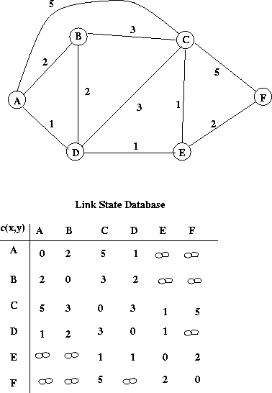
Link state distributed by router A.

Slide 12
Dijkstra’s algorithm: example
Step
0
1
2
3
4
5
start N
A
AD
ADE
ADEB
ADEBC
ADEBCF
D(B),p(B)
2,A
2,A
2,A
D(C),p(C)
5,A
4,D
3,E
3,E
D(D),p(D)
1,A
D(E),p(E)
infinity
2,D
D(F),p(F)
infinity
infinity
4,E
4,E
4,E
5
B
3
C
2
5
A
2
1
F
3
1
2
D
E
1

Slide 13
Routing Table Computation
5
3
B
C
2
5
A
2
F
1
3
1
2
D
E
1

Slide 14
Distance Vector Routing
A router tells neighbors its distance to every router
Communication between neighbors only
Each router maintains a routing table
A row for each possible destination
Each row has two parts: an estimated distance and the next hop for the destination
Based on Bellman-Ford algorithm
Computes “shortest paths”
Exchanges distance vector with neighbors
Distance vector: current least cost to each destination – the routing table.

Slide 15
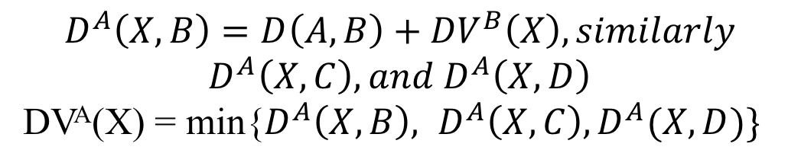
Distance Vector Routing: Intuition
A
B
C
D
DV^{X} (Y) = cost from X to each destination Y
D(A, B) = cost from A to B (a known value)
$$D^{A}\left(X, B\right)=D\left(A, B\right)+{DV}^{B}\left(X\right), similarly$$
$$D^{A}\left(X, C\right), and D^{A}\left(X, D\right)$$
DV^{A}(X) = min{$D^{A}\left(X, B\right), D^{A}\left(X, C\right), D^{A}(X, D)\}$

Slide 16
Distance vector routing example, assume the network just “reboot”
Initial vectors:
1
A
B
C
D
E
A
(0, -)
(7, B)
(∞, -)
(∞, -)
(1, E)
B
(7, A)
(0, -)
(1, C)
(∞, -)
(8, E)
C
(∞, -)
(1, B)
(0, -)
(2, D)
(∞, -)
D
(∞, -)
(∞, -)
(2, C)
(0, -)
(2, E)
E
(1, A)
(8, B)
(∞, -)
(2, D)
(0, -)
B
C
7
A
8
2
1
E
D
2

Slide 17
Next iteration A receives from its neighbors and update its routing table
A
B
C
D
E
A
(0, -)
(7, B)
(∞, -)
(∞, -)
(1, E)
B
(7, A)
(0, -)
(1, C)
(∞, -)
(8, E)
C
(∞, -)
(1, B)
(0, -)
(2, D)
(∞, -)
D
(∞, -)
(∞, -)
(2, C)
(0, -)
(2, E)
E
(1, A)
(8, B)
(∞, -)
(2, D)
(0, -)
B
1
C
7
A
8
2
1
E
D
2
A
B
C
D
E
A
(0, -)
(7, B)
(8, B)
(3, E)
(1, E)
Self
min(7+0, 1+8) -- B is winner, (7, B)
min(7+1, 1+ ∞) -- B is the winner (8, B)
min(7+∞, 1+2) -- E is the winner (3, E)
Min (7+8, 1+0) – E is the winner (1, E)

Slide 18
What is B’s update routing table after the exchange?
A
B
C
D
E
A
(0, -)
(7, B)
(∞, -)
(∞, -)
(1, E)
B
(7, A)
(0, -)
(1, C)
(∞, -)
(8, E)
C
(∞, -)
(1, B)
(0, -)
(2, D)
(∞, -)
D
(∞, -)
(∞, -)
(2, C)
(0, -)
(2, E)
E
(1, A)
(8, B)
(∞, -)
(2, D)
(0, -)
B
1
C
7
A
8
2
1
E
D
2

Slide 19
What about C?
A
B
C
D
E
A
(0, -)
(7, B)
(∞, -)
(∞, -)
(1, E)
B
(7, A)
(0, -)
(1, C)
(∞, -)
(8, E)
C
(∞, -)
(1, B)
(0, -)
(2, D)
(∞, -)
D
(∞, -)
(∞, -)
(2, C)
(0, -)
(2, E)
E
(1, A)
(8, B)
(∞, -)
(2, D)
(0, -)
B
1
C
7
A
8
2
1
E
D
2

Slide 20
Problems with DV Routing
Link cost changes:
good news travels fast – a new link will be known to all routers quickly.
bad news travels slow
“count to infinity” problem!
A
B
C
D
E
1
1
1
1

Slide 21
Count-to-Infinity Problem
A
B
C
D
E
1
1
1
1
A
B
C
D
E
A
(0, -)
(1, B)
(2, B)
(3, B)
(4, B)
B
(1, A)
(0, -)
(1, C)
(2, C)
(3, C)
C
(2, A)
(1, B)
(0, -)
(1, D)
(2, D)
D
(3, C)
(2, C)
(1, C)
(0, -)
(1, E)
E
(4, D)
(3, D)
(2, D)
(1, D)
(0, -)

Slide 22
Count-to-Infinity Problem
A
B
C
D
E
1
1
1
1
Let us look at A’s reachability, here is what we want:
A
B
(∞, -)
C
(∞, -)
D
(∞, -)
E
(∞, -)
A
B
C
D
E
B
(∞, -)
(0, -)
(1, C)
(2, C)
(3, C)
C
(2, B)
(1, B)
(0, -)
(1, D)
(2, D)
D
(3, C)
(2, C)
(1, C)
(0, -)
(1, E)
E
(4, D)
(3, D)
(2, D)
(1, D)
(0, -)
Distance vector will
get this:

Slide 23
Count-to-Infinity Problem
A
B
C
D
E
1
1
1
1
Let us look at A’s reachability
A
B
(∞, -)
C
(2, B)
D
(3, C)
E
(4, D)
A
B
(3, C)
C
(4, D)
D
(3, C)
E
(4, D)
Step 1
A
B
(5, C)
C
(4, B)
D
(5, C)
E
(4, D)
Step 2
A
B
(5, C)
C
(6, B)
D
(5, C)
E
(6, D)
Step 3

Slide 24
Count-to-Infinity Problem
A
B
C
D
E
1
1
1
1
A
B
(5, C)
C
(6, B)
D
(5, C)
E
(6, D)
Step 3
A
B
(7, C)
C
(6, B)
D
(7, C)
E
(6, D)
Step 4
When can we reach
the correct state?
A
B
(∞, -)
C
(∞, -)
D
(∞, -)
E
(∞, -)

Slide 25
Fixes to Count-to-Infinity Problem
Split horizon
A router never advertises the cost of a destination to a neighbor if this neighbor is the next hop to that destination

Slide 26
Link State vs Distance Vector
Tells everyone about neighbors
Controlled flooding to exchange link state
Dijkstra’s algorithm
Each router computes its own table
May have oscillations
Open Shortest Path First (OSPF)
Tells neighbors about everyone
Exchanges distance vectors with neighbors
Bellman-Ford algorithm
Each router’s table is used by others
May have routing loops
Routing Information Protocol (RIP)

