Slide 1
Chapter 5: Network Layer (Part I)
Network Layer
Introduction
Addressing
Address resolution
Network service models
Readings
Sections 5.1, 5.5, 5.6

Slide 2
Network Layer: Introduction
A network-wide concern!
Data link layer
Between two physically connected hosts
Transport layer
Between two end hosts
Network layer
Involves every router, host in the network

Slide 3
Network Layer Functions
Addressing
Globally unique address for each routable device
Logical address, unlike MAC address
Assigned by network operator
Need to map to MAC address
Router functionality
Forwarding – how to get through a router
From input port to appropriate output port in a router
Routing – how to get through the network
Which path to use to forward packets from src to dest

Slide 4
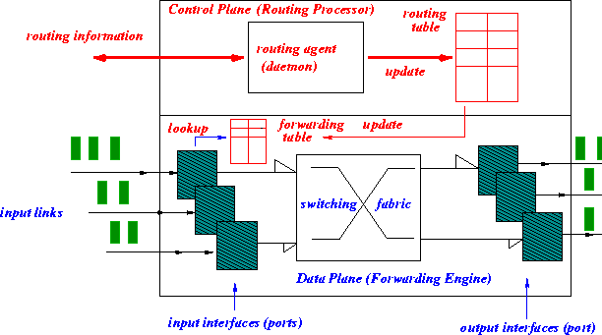
Router Architecture: control plane and data plane

Slide 5
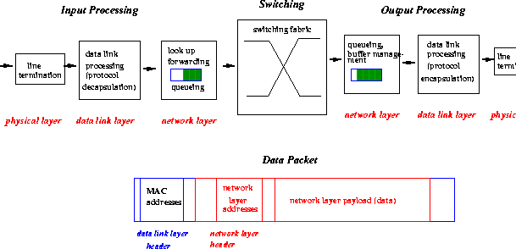
Router Input/Output Processing

Slide 6
A question
Data plane speed: Consider a router with 24 10Gbps ports. Let packet size be 100 Bytes. How much time does the router have to process and move the packet (from the input port to the output port)?
Can we realize such a router with a computer?
PCIe v5.0: 64GB/s
RAM access time: 70ns
Control plane speed: corresponding to network topology changes. How often does a network topology change?

Slide 7
Internet Protocol (IP)
Universal service in a heterogeneous world
IP over everything
Virtual overlay network
Globally unique logical address for a host
Address resolution
logical to physical address mapping

Slide 8
IP Addressing
A 32-bit number that uniquely identifies a location
Written using dotted decimal notation
Two-level hierarchy: network id and host id
Network IDs administered by
Internet Assigned Number Authority (IANA)
Host IDs administered locally

Slide 9
IP Addressing
IP address is assigned to each network interface
Routers connect two or more physical networks
Each interface has its own address
Multi-homed host
A host having multiple connections to Internet
Multiple addresses identify the same host
Does not forward packets between its interfaces

Slide 10
IP “Classful” Addressing Scheme
Three unicast address classes: A, B, and C
One multicast: class D
class
A
0
network
host
1.0.0.0 to
127.255.255.255
B
10
network
host
128.0.0.0 to
191.255.255.255
C
110
network
host
192.0.0.0 to
223.255.255.255
D
1110
multicast address
224.0.0.0 to
239.255.255.255
32 bits

Slide 11
Classless Inter-Domain Routing
Classful addressing scheme wasteful
IP address space exhaustion
Class B net allocated enough for 65K hosts
Even if only 2K hosts in that network
Solution: CIDR
Eliminate class distinction
No A,B,C
Keep multicast class D

Slide 12
Classless Addressing
Addresses allocated in contiguous blocks
Number of addresses assigned always power of 2
Network portion of address is of arbitrary length
Address format: a.b.c.d/x
x is number of bits in network portion of address
network
part
host
part
11001000 00010111 00010000 00000000
200.23.16.0/23

Slide 13
IP Addressing
223.1.1.1
223.1.2.1
223.1.1.2
223.1.1.4
223.1.2.9
223.1.2.2
223.1.1.3
223.1.3.27
LAN
first 24 bits are network address
Three networks (subnets) in this example: 223.1.1.0/24, 223.1.2.0/24, 223.1.3.0/24.
A network is a finest granuarity unit in the Internet that can be routed toward.
223.1.3.1
223.1.3.2

Slide 14
IP Addressing
223.1.1.1
223.1.1.2
223.1.1.4
Interconnected
system consisting
of six networks
223.1.1.3
223.1.9.2
223.1.7.0
223.1.9.1
223.1.7.1
223.1.8.1
223.1.8.0
223.1.2.6
223.1.3.27
223.1.2.1
223.1.2.2
223.1.3.1
223.1.3.2

Slide 15
Special IP Addresses
Network address: host id = all 0’s
Directed broadcast address: host id = all 1’s
Local broadcast address: all 1’s
Local host address (this computer): all 0’s
Loopback address
network id = 127, any host id (e.g. 127.0.0.1)

Slide 16
Address Resolution
IP address is virtual
Not understood by underlying physical networks
IP packets need to be transmitted by the underlying physical network
Address resolution
Translating IP address to physical address
Address Resolution Protocol (ARP)

Slide 17
ARP Cache
Each computer maintains a cache table
IP address → hardware address mapping
Only about computers on the same network
Try out “/usr/sbin/arp –a” command
Exchanges ARP messages
To resolve IP addresses with unknown hardware addresses
Encapsulated in DLL frame (e.g., Ethernet data frame)

Slide 18
ARP Protocol
When a node sends an IP packet to another node on the same physical network
Look up destination address in the ARP table
If not found
Broadcast a request to the local network
Whose IP address is this?
What info should the request message contain?

Slide 19
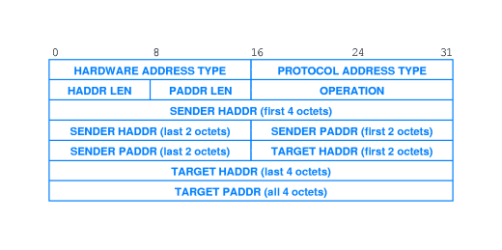
ARP Message

Slide 20
ARP Response
The target node responds to sender (unicast?)
With its physical address
Adds the requester into its ARP table (why?)
On receiving the response
Requester updates its table
Other nodes upon receiving the request
Refresh the requester entry if already there
No action otherwise (why?)
Table entries deleted if not refreshed for a while

Slide 21
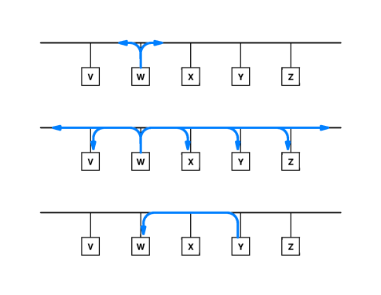
ARP Example

Slide 22
A point
IP assumes that its underlying physical network has the broadcast capability!
Can this be a problem? Sometimes

Slide 23
Network Service Models
Datagram
Packets forwarded independently
Connectionless
Virtual Circuit (VC)
Packets of the same VC follow the same path
Need VC setup before packets can be sent

Slide 24
Network Layer Service: Datagram
No notion of connection in network layer
No path or connection setup
Packets routed independently
No guarantee of reliable or in-order delivery
Packet loss recovery at end-systems
Advantages
No connection state in routers
Robust with respect to link failures

Slide 25
Datagram networks: the Internet model
no call setup at network layer
routers: no state about end-to-end connections
no network-level concept of “connection”
packets typically routed using destination host ID
packets between same source-dest pair may take different paths
application
transport
network
data link
physical
application
transport
network
data link
physical
1. Send data
2. Receive data

Slide 26
Case Study: IP
IP datagram delivery model
Each packet carries source and destination
IP tries its best to deliver every packet
Best effort service
No guarantees

Slide 27
Forwarding/Routing IP Datagrams
Routing and IP address
Routing based on network id
Only delivers packet to the appropriate network
Once on destination network, direct delivery using the host id
IP destination-based next-hop routing paradigm
Hop-by-hop forwarding
Each host/router has IP forwarding table
Entries like <network prefix, next-hop, output interface>
How big can a routing/forwarding table be?
Try out “/usr/bin/netstat –rn” command
The forwarding/routing table entries are maintained through the routing algorithm.

Slide 28
Getting a datagram from source to dest.
routing table in A
Dest. Net. next router Nhops
223.1.1 1
IP datagram:
223.1.2 223.1.1.4 2
223.1.3 223.1.1.4 2
misc
fields
source
IP addr
dest
IP addr
A
data
223.1.1.1
datagram remains unchanged, as it travels source to destination
addr fields of interest here
223.1.2.1
223.1.1.2
223.1.1.4
223.1.2.9
B
223.1.2.2
E
223.1.1.3
223.1.3.27
223.1.3.1
223.1.3.2

Slide 29
Getting a datagram from source to dest.
Dest. Net. next router Nhops
misc
fields
223.1.1 1
223.1.1.1
223.1.1.3
data
223.1.2 223.1.1.4 2
Starting at A, given IP datagram addressed to B:
look up net. address of B
find B is on same net. as A
link layer will send datagram directly to B inside its frame
B and A are directly connected (use ARP to resolve the physical address)
One LAN corresponds to one IP networks. (What does this mean? And Why?)
223.1.3 223.1.1.4 2
A
223.1.1.1
223.1.2.1
223.1.1.2
223.1.1.4
223.1.2.9
B
223.1.2.2
E
223.1.1.3
223.1.3.27
223.1.3.1
223.1.3.2

Slide 30
Getting a datagram from source to dest.
Dest. Net. next router Nhops
misc
fields
223.1.1.1
223.1.2.2
data
223.1.1 1
223.1.2 223.1.1.4 2
Starting at A, dest. E:
look up network address of E
E on different network
A, E not directly attached
routing table: next hop router to E is 223.1.1.4
link layer sends datagram to 223.1.1.4 inside its frame
datagram arrives at 223.1.1.4
What are the physical addresses (and IP addresses) in the frame sent?
223.1.3 223.1.1.4 2
A
223.1.1.1
223.1.2.1
223.1.1.2
223.1.1.4
223.1.2.9
B
223.1.2.2
E
223.1.1.3
223.1.3.27
223.1.3.1
223.1.3.2

Slide 31
Getting a datagram from source to dest.
Dest. next
misc
fields
network router Nhops interface
223.1.1.1
223.1.2.2
data
223.1.1 - 1 223.1.1.4
Arriving at 223.1.4, destined for 223.1.2.2
look up network address of E
E on same network as router’s interface 223.1.2.9
router, E directly attached
link layer sends datagram to 223.1.2.2 inside link-layer frame via interface 223.1.2.9
datagram arrives at 223.1.2.2!!! (hooray!)
223.1.2 - 1 223.1.2.9
223.1.3 - 1 223.1.3.27
A
223.1.1.1
223.1.2.1
223.1.1.2
223.1.1.4
223.1.2.9
B
223.1.2.2
E
223.1.1.3
223.1.3.27
223.1.3.1
223.1.3.2

Slide 32
Network Layer Service: Virtual Circuit
Connection-oriented network service
Virtual circuit: looks like a circuit but isn’t.
Circuit .vs. Virtual circuit -- bandwidth usage, statistical multiplexing
All packets with the same VC or connection follow the same route
Establishment of VC
Setup request flows from sender to receiver
Forwarding tables updated at intermediate nodes

Slide 33
Pros and Cons of Virtual Circuit
Key issue: Per-VC state at each router/switch
Stateful router .vs. stateless router
Router’s perspective: the frequency of network state change
The control plane in a stateful router is more complex
Suitable for traffic engineering
Multipath routing between source-destination pair
Can support Quality of Service
Reserve resources per VC
Accept/Reject VC setup request based on resource availability along a path

Slide 34
Virtual Circuit: How Does It Work
Two phases
VC setup before data transmission
Signaling to setup forwarding table
Packet transmission after VC has been setup
Each router looks up forwarding table
Finds the outgoing port using incoming VCI (identifier)
Performs incoming VCI to outgoing VCI translation

Slide 35
Virtual circuits: signaling protocols
used to setup, maintain teardown VC
used in ATM, frame-relay, X.25
MPLS (Multi-Protocol Label Switching)
application
transport
network
data link
physical
5. Data flow begins
6. Receive data
application
transport
network
data link
physical
4. Call connected
3. Accept call
1. Initiate call
2. incoming call

Slide 36
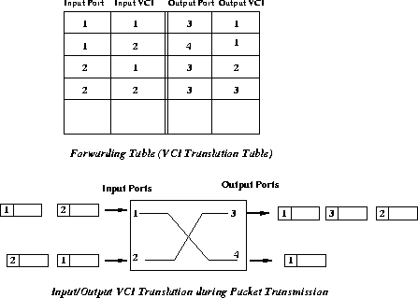
Which one is bigger: VC forwarding table or routing table?

Slide 37
Virtual Circuit Setup
Select a path from source to destination
Send VC setup request control packet
Each router along the path
Choose a local VC id (VCI) for the connection
Need to ensure that no two distinct VCs leaving the same output port have the same VCI
Update forwarding table
Mapping between incoming VCI & port no. and outgoing VCI & port no.

Slide 38
Case Study: ATM Networks
Asynchronous Transfer Mode
Single technology for handling voice,video, and data
Connection-oriented service using virtual circuits
In-sequence but unreliable
Cell switching using fixed-size cells: 53 bytes
Statistical multiplexing of cells of different circuits
Provide QoS guarantees/assurance
Variety of services such as CBR, VBR, ABR etc

Slide 39
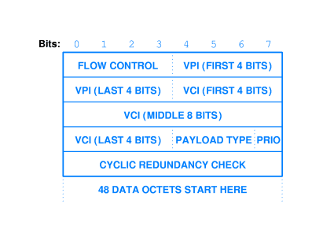
ATM Cell Format

Slide 40
Virtual Circuit Switching
VCI: 16 bits, local to a link
VCI of each VC must be unique on each link
Incoming VCI to outgoing VCI translation
Using a forwarding table
(in VCI, in port) → (out VCI, out port)

Slide 41
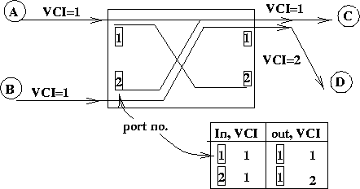
VC Switching Example

Slide 42
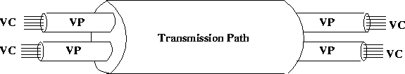
Virtual Paths and VP Switch
Why use Virtual Paths (VPs)?
VCs of different VPs can have same VCIs
VPI/VCI translation
Cells are routed using VPI/VCI pairs in the header
VP Switch
Routing based on VPI only, VCI not translated

Slide 43
Datagram vs Virtual Circuit
Internet
data exchange among computers
“elastic” service, no strict timing req.
“smart” end systems (computers)
can adapt, perform control, error recovery
simple inside network, complexity at “edge”
many link types
different characteristics
uniform service difficult
ATM
evolved from telephony
human conversation:
strict timing, reliability requirements
need for guaranteed service
“dumb” end systems
telephones
complexity inside network

Slide 44
Datagram or Virtual Circuit?
Burning question: to VC or not to VC?
Support both service models
Best effort service: datagrams
QoS guarantees: virtual circuits
New IP Forwarding Paradigm
Multiple Protocol Label Switching (MPLS)
VC-based layer 2+1/2 switching
Resides between layer 2 & 3
For traffic engineering and QoS

