Slide 1
Chapter 4 Data Link Layer Switching
Interconnecting at different layers
Transparent bridges
Spanning tree algorithm
Virtual LAN (VLAN)
Reading
Section 4.8

Slide 2
Interconnecting LANs
Why?
When too many machines are in a single LAN, the bandwidth may not be sufficient to support all the machines, need to partition one LAN into multiple LANs to get higher aggregate throughput.
1Gbps for all machines .vs. 1Gbps for each machine
When the area is too big for a single LAN (e.g. 5km for Ethernet)? We can create multiple collision domains and interconnect the LANs.
For security reasons. Ethernet cards support a promiscuous mode which allows a station to get all frames received.

Slide 3
Interconnecting at Different Layers
Repeaters/hubs:
physical layer,
copy signals from one network to another network.
Bridges/switches:
data link layer,
(selectively) copy frames from one network to another network.
Routers/ network layer gateways:
network layer,
routing and forwarding.
application gateway or converter:
application layer,
translate between OSI mail and SMTP mail

Slide 4
Question
What is the main difference among repeater/hub, bridge/switch, and router?

Slide 5
Question
What is the main difference among repeater/hub, bridge/switch, and router?
Repeater: physical layer (Layer 1) device, sees 1’s and 0’s, naively forwards what it sees in a port to all other ports
Switch: data link layer (Layer 2) device, sees frames with layer 2 destination address in a port and may forward a frame only to the port toward the Layer 2 destination
Router: network layer (Layer 3) device, sees packets with IP (layer 3) destination addresses, route the packet toward the layer 3 address

Slide 6
Interconnecting with Hubs
Backbone hub interconnects LAN segments
Extends max distance between nodes
But individual segment collision domains become one large collision domain
Can’t interconnect 10BaseT & 100BaseT
hub
hub
hub
hub

Slide 7
Switch
Data Link layer device
stores and forwards Ethernet frames
examines frame header and selectively forwards frame based on MAC destination address
when frame is to be forwarded on segment, uses CSMA/CD to access segment
transparent
hosts are unaware of presence of switches
plug-and-play, self-learning
switches do not need to be configured

Slide 8
Forwarding
switch
1
2
3
hub
hub
hub
How to determine onto which LAN segment to forward frame?
Looks like a routing problem...

Slide 9
Self Learning
A switch has a switch table (hash table in the book)
Entry in switch table:
(MAC Address, Interface, Time Stamp)
Stale entries in table dropped (TTL can be 60 min)
Switch learns which hosts can be reached through which interfaces
When a frame is received, switch “learns” location of sender: incoming LAN segment
records sender/location pair in switch table

Slide 10
Filtering/Forwarding
When switch receives a frame:
index switch table using MAC dest address
if entry found for destination then {
if dest on segment from which frame arrived then
drop the frame
else forward the frame on interface indicated
}
else flood
forward on all but the interface
on which the frame arrived

Slide 11
An Example
Suppose C sends frame to D
switch
address
interface
1
A
B
E
G
1
1
2
3
2
3
hub
hub
hub
A
I
D
F
B
C
G
H
E
Switch receives frame from from C
notes in switch table that C is on interface 1
because D is not in table, switch forwards frame into interfaces 2 and 3
frame received by D

Slide 12
Switch Example
Suppose D replies back with frame to C.
address
interface
switch
A
B
E
G
C
1
1
2
3
1
hub
hub
hub
A
I
D
F
B
C
G
H
E
Switch receives frame from from D
notes in switch table that D is on interface 2
because C is in table, switch forwards frame only to interface 1
frame received by C

Slide 13
Looping Problem
This simple self-learning mechanism does not work for complex network topology. What happens when the switches form loops?
Solution: don’t allow loops to occur in the forwarding path by constructing a spanning tree.
A spanning tree of a graph G is a subgraph of G such that all nodes are connected without a loop.
How to build a spanning tree of a graph G?
One way to do it is to fix a root and compute the shortest paths from the root to all other nodes.
For example, the switch will smallest MAC address can be chosen as the root.
All other switches keep the interfaces active if they are on shortest path, and turn off other interfaces.

Slide 14
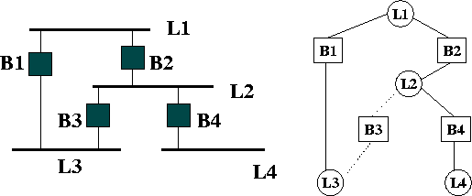
Spanning Tree Example

Slide 15
Switch: Traffic Isolation
Switch installation breaks subnet into LAN segments
Switch filters packets:
Same-LAN-segment frames not usually forwarded onto other LAN segments
Segments become separate collision domains
switch
collision domain
hub
hub
hub
collision domain
collision domain

Slide 16
Switches: Dedicated Access
Switch with many interfaces
Hosts have direct connection to switch
No collisions; full duplex
Switching: A-to-A’ and B-to-B’ simultaneously, no collisions
A
C’
B
switch
C
B’
A’

Slide 17
Institutional network
mail server
to external
network
router
web server
switch
IP subnet
hub
hub
hub

Slide 18
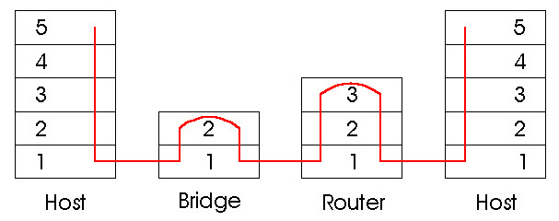
Switches vs. Routers
both store-and-forward devices
routers: network layer devices (examine network layer headers)
switches are link layer devices
routers maintain routing tables, implement routing algorithms
switches maintain switch tables, implement filtering, learning algorithms, cannot use redundant path.

Slide 19
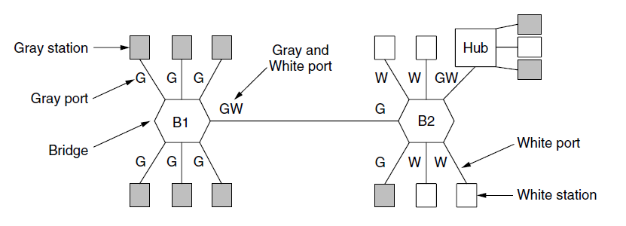
Virtual LANs
VLANs (Virtual LANs) splits one physical LAN into multiple logical LANs to ease management tasks
Ports are “colored” according to their VLAN

Slide 20
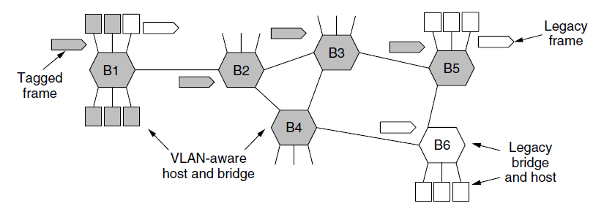
Virtual LANs – IEEE 802.1Q
Bridges need to be aware of VLANs to support them
In 802.1Q, frames are tagged with their “color”
First VLAN switch adds tag, last VLAN switch removes tag.
Legacy switches with no tags are supported

Slide 21
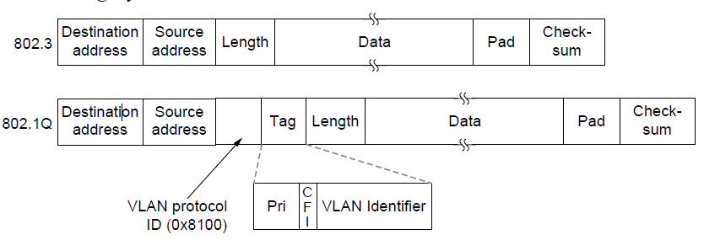
Virtual LANs – IEEE 802.1Q
802.1Q frames carry a color tag (VLAN identifier)
Length/Type value is 0x8100 for VLAN protocol
0x8100 is not a legitimate length for Ethernet frames
Tag is only needed by the switches, but end host.

