Slide 1
Error correction and detection
What is an error? Bits missed or altered.
How to find an error?
The receiver does not know what the sender sent – the only way to detect errors is to make sure that when errors occur, the resulting message is (or has a very very high probability of being) invalid.
E.g: two bits message, what happens if all four words (00, 01, 10, 11) are valid? What if the sender can only send 00 or 11?
The foundation of error correction and detection is to introduce redundancy in messages -- in the previous example, we use 2 bits to carry 1 bit information.
Massage = information bits + redundant bits (also called checksum)

Slide 2
General approaches of error correction and detection
How to design codes that have error correction and detection capability?
To detection n-bit errors, we must make sure that after n-bit are altered in a message, the resulting message is invalid (something that sender will never send).
To be able to correct n-bit errors, we must make sure that for a valid message, for each of the 1 to n bits altercations, the resulting message must have no overlap with other valid messages as well as the potential n-bit errors from any other valid message.
We need to have a way to measure the “spacing” between valid messages (which are sometimes called valid codewords – all possible messages that the sender can send): Hamming distance

Slide 3
Hamming distance
Hamming distance between two codewords: how many bits need to be changed in order for a codeword to become the other.
The number of different bits between two codewords
E.g. What is the hamming distance between 010101 and 111000?
Let a code be the set of all valid codewords. Hamming distance of a code is the minimum Hamming distance between any of the two codewords in the code.
Example: What is the Hamming distance of Code {010101, 111000, 000111, 111111}?

Slide 4
Hamming distance and the error detection/correction capability
Let the Hamming distance of a code be N.
How many bits of errors can be detected?
How many bits of errors can be corrected?
Given code {00000000, 00001111, 11110000, 11111111}. Compute the Hamming distance. How many bits of errors can be detected? How many bits of errors can be corrected?
What is Hamming distance of the Even parity code?

Slide 5
Error correction code
How many (r) redundant bits do we need to correct a single error for the m information bits?
A message contains m+r bits
total number of possible codewords: 2^{m+r}
total number of valid codewords = 2^{m}
To correct single error, each single error must results in a different (invalid) codeword.
Total number of (invalid) codewords for one bit error = (m+r)2^{m}
total number of valid codewords plus the total number of (invalid) codewords for single bit error must be less than the total number of possible codewords.
2^{m}+(m+r)2^{m} <= 2^{m+r}
m+r+1 <= 2^{r}

Slide 6
Error correction code
How many (r) redundant bits do we need to correct single error for the m information bits?
m+r+1 <= 2^{r}
m = 1, r = 2
m = 2, r = 3
m = 3, r = 3
……
m = 1000, r = 10
This formula gives the lower bound of the redundant bits to correct a single error. Hamming code achieves this lower bound (Chapter 3.2.1)
How many redundant bits are needed to detect a single error?

Slide 7
Error control
Two options
Use error correction code
Use error detection code with retransmission
Which option is better?
Intuition?
Example: assume an error rate of 10⁻⁶ . Each packet carries 1000 bits information. The system will only have single bit errors. Quantitatively compare the two options.
From the example, can you derive when should error correction code be used, and when should error detection code with retransmission be used?

Slide 8
Error detection code
Parity code: detect single bit error
In communication system, this is not good enough.
We must be able to detect more errors.
The most commonly used error detection code is called polynomial code or cyclic redundancy code (CRC code)

Slide 9
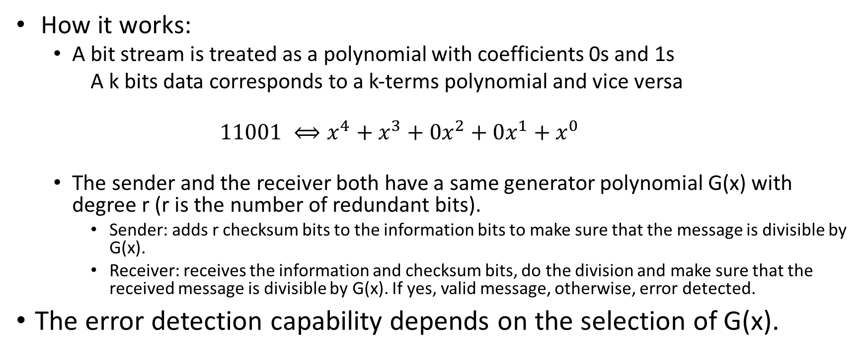
CRC code
How it works:
A bit stream is treated as a polynomial with coefficients 0s and 1s
A k bits data corresponds to a k-terms polynomial and vice versa
$$11001 ⟺x^{4}+x^{3}+{0x}^{2}+0x^{1}+x^{0}$$
The sender and the receiver both have a same generator polynomial G(x) with degree r (r is the number of redundant bits).
Sender: adds r checksum bits to the information bits to make sure that the message is divisible by G(x).
Receiver: receives the information and checksum bits, do the division and make sure that the received message is divisible by G(x). If yes, valid message, otherwise, error detected.
The error detection capability depends on the selection of G(x).

Slide 10
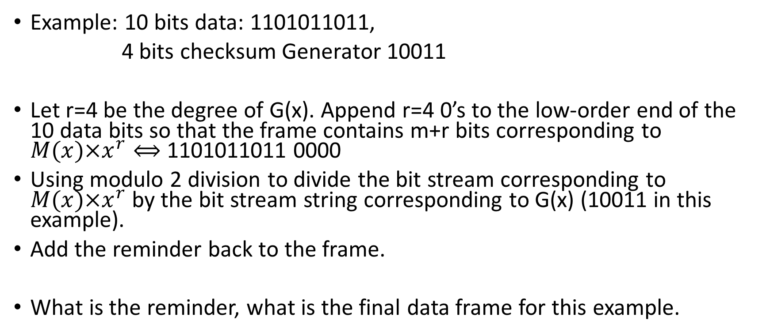
How does the sender compute the checksum?
Example: 10 bits data: 1101011011,
4 bits checksum Generator 10011
Let r=4 be the degree of G(x). Append r=4 0’s to the low-order end of the 10 data bits so that the frame contains m+r bits corresponding to $M(x)×x^{r}⟺$ 1101011011 0000
Using modulo 2 division to divide the bit stream corresponding to $M(x)×x^{r}$ by the bit stream string corresponding to G(x) (10011 in this example).
Add the reminder back to the frame.
What is the reminder, what is the final data frame for this example.

Slide 11
How does the receiver check to see if a received frame has error?
Divide the data frame 1101011011 1110 by the generator 10011
Divisible: no error
Not divisible: error

Slide 12
Exercise
Generator: 1001
Data: 10000011
What is the data frame to be sent?
Received 1101100. Is this a valid packet?

Slide 13
Power of the CRC code
Depending on the selection of G(x)
Let T(x) be the frame polynomial, E(x) be the error polynomial and G(x) be the generator polynomial
We want to make sure that when E(x) is not zero, (T(x) + E(x)) / G(x) = E(x)/G(x) is not zero.
Detect single bit error E(x) = x^{j} : if G(x) has more than two terms, guarantee to detect all single bit errors
Detect two errors: E(x) = x^{j}+x^{k}=x^{k}(x^{j-k}+1): x^{k}+1 (k<32768) cannot be divisable by x¹⁵+x¹⁴+1
Detect odd numbers of errors: no polynomial with an odd number of terms has x+1 as a fac

Slide 14
CRC code use case
Ethernet generator polynomial (CRC-32)
x³²+x²⁶+x²³+x²²+x¹⁶+x¹²+x¹¹+x¹⁰+x⁸+x⁷+x⁵+x⁴+x²+x¹+1
Detects all bursts of 32 bits or less, all bursts affecting an odd number of bits, etc.
Hamming distance of 4.

