Slide 1
Chapter 2: Physical Layer
Know the basics of physical layer design, constraints, solutions
Data communication theoretical basis
Analog vs digital signal and transmission
Reading
Chapter 2

Slide 2
Physical Layer – How bits are sent
Concerned with transmitting raw bits over a communication channel
Defining mechanical, electrical, and timing interfaces to physical network
Cable type
Cable connector
What are 0’s and 1’s over the wire or wireless channel
How long a bit last (on media)
…

Slide 3
Physical layer
Physical layer design goal:
send out bits as fast as possible with acceptable low error ratio (whatever sent can be received with a reasonable successful rate)
Some simple schemes
There is a wire between A and B. If A wants to send a bit `1’, it connects the wire to the positive end of a battery. Otherwise he disconnects it from the battery.
Or A can hold a radio, if `1’, he sends at frequency f1 and if `0’ he sends at frequency f2.
Or there is an optical fiber between A and B and if `1’ A lit up a light and if `0’ A does nothing.

Slide 4
The Limit of Transmission Speed – Bandwidth and Noise
What prevent us from sending at an infinite speed?

Slide 5
Bandwidth and noise
Bandwidth basically means how fast your signal can change or how fast can you send out symbols.
Symbol is something you send out to represent bit (s)
Noise means that although you sent 1 to me, I may receive something like 1+x, where x is the noise added by the medium.

Slide 6
Bandwidth and Noise
The bandwidth is always limited because of many reasons
The wire itself, if too long, is a capacitor and slows down voltage transition
In wireless transmissions, the whole spectrum shared by many communication parties and each can have only a limited chunk of it
Noise is always there

Slide 7
Concepts of Bandwidth and Capacity
Bandwidth
width of the frequency range of signal or transmission (Hz)
e.g. human voice: 100 ~ 3300 Hz, bandwidth 3200,
twisted pair: 4kHz.
Capacity: rate in bits per second
Baud rate = how many symbols/samples per second
High bandwidth ➔ high baud rate
Bit rate = number of bits / symbol * Baud rate
How to determine the number of bits per symbol?
Number of bits/symbol = log_2(number of symbols)
E.g: eight-level voltage outputs, how many bits per symbol?
In computer science, bandwidth often refers to capacity

Slide 8
Ideal case
If the bandwidth is infinite and absolutely no noise, how fast can you send/receive data?
baud rate?
Number of bits per symbol?
bit rate?

Slide 9
Bandwidth
If the media is of infinite bandwidth but with some noise, how fast can you send/receive data? Assuming that your device is fast enough.
baud rate?
Number of bits per symbol?
bit rate?

Slide 10
Noise
If there is absolutely no noise but the bandwidth is limited, how fast can you send/receive data? Assuming that your device is fine enough to tell the slightest differences of signal voltage.
baud rate?
Number of bits per symbol?
bit rate?

Slide 11
Reality
The bandwidth is always limited because of many reasons:
The wire itself, if too long, is a capacitor and slows down voltage transition
In wireless transmissions, the whole spectrum shared by many communication parties and each can have only a limited chunk of it
Noise is always there
It would be useful to have a way to decide the theoretical maximum capacity for wires with limited bandwidth and noise!
Nyquist’s theorem
Shannon’s theorem

Slide 12
Maximum Date Rate of a Channel
Nyquist's theorem
maximum baud rate for noiseless channel
max baud rate = 2 * Bandwidth
Implication:
max bit rate = 2 * Bandwidth * # of bits /symbol
= 2 * Bandwidth * log_2(number of symbols)
Example: A 10kHz bandwidth channel is used to send binary signals, what is the maximum bit rate?
Nyquist’s theorem motivated engineers look for clever coding to increase capacity
Can we obtain arbitrarily high capacity by clever coding?

Slide 13
Shannon’s Theorem
Noisy channel
Signal-to-Noise Ratio (SNR)
Ratio of the signal power S to the noise power S/N
Measured in dB or decibels
10 log₁₀ (S/N)
S/N=10 →10 dB, S/N=100 → 20dB
For noisy channel with bandwidth H and SNR S/N
Max data rate = H log₂(1+S/N)
➔ Max. data rate = min(H log₂(1+S/N), 2H log₂M)

Slide 14
Constellation
Noise determines how close the constellation points can be
For binary systems, the constellation lies in a line and is {-1, 1} where -1 is 0V and 1 is 5V, for example. One bit being modulated at a time is called BPSK.
The constellation can also be in a plane and take complex numbers when we send two voltages simultaneously, one representing the real component and the other representing the imaginary component, like {1+j, -1+j, -1-j, 1-j} , which allows log4=2 bits to be modulated at a time (QPSK). More points on the plane will result in something like 16QAM, 64QAM, 256QAM.

Slide 15
Review question
True or False: A communication link should always send bits as fast as possible.
Notes:
False, need to worry about error

Slide 16
Review question
True or False: Communication is achieved by changing the medium in certain detectable pattern.
Notes:
True

Slide 17
Review question
True or false: Bandwidth is a metric about how large the signal strength should be.
Notes:
False, how fast the signal can change

Slide 18
Review question
True or false: Noise is added to the signal and is a constant.
Notes:
First half true, second false

Slide 19
Review question
True or false: The speed of a link is 10,000,000 bps, it means that the sender can send to the receiver 10,000,000 bits per second reliably
Notes:
True

Slide 20
Review question
True or false: If the capacity of a link is 10,000,000 bps according to the Shannon’s theorem, the sender can send to the receiver 10,000,000 bits per second reliably
Notes:
False, it is an upper limit

Slide 21
Review question
A Wi-Fi link has bandwidth 20 MHz. Suppose the Signal to Noise Ratio is 63. The capacity is?
Notes:
20*log_2(1+63) = 120

Slide 22
Review question
True or false: A QPSK system has 4 constellation points. Therefore, it has 4 bits.
Notes:
False, 2

Slide 23
Review question
True or false: A QPSK system has 4 constellation points. A 16-QAM system has 16 constellation points. So we should always use 16-QAM.
Notes:
False, when signal is weak, you cannot

Slide 24
More on noise and signal detection

Slide 25
More on Noise
In communication systems, we usually take a sample from the received waveform to determine what the transmitted data is.
With noise, the signal is added with noise.
For example, let’s say 0 is 0 volt 1 is 5 volts. When we send a `0’, the receiver could receive 0.6v, when we send `1’, the receiver could receive 4.2v. The receiver has to output a bit to the upper layer. So the problem is, given the received voltage, what bit should be output?

Slide 26
More on Noise
It’s all about guessing, because you don’t know what the noise is when this symbol is sent as noise is random.
You may know some statistics of the noise, based on which you make your best guess.
For example, suppose you know that very rarely the noise exceeds 2.5 volts. If you received a 2.2 volts, you would guess it to be 0 or 1? What is the chance that you got it right/wrong?

Slide 27
Detection
Detection – given a received signal, determine which of the possible original signals was sent. There are finite number of possible original signals (2 for the binary case – 0 or 1)
Among the finite number of possible original signals, which one has the largest probability? This is called Maximum Likelihood Detection.

Slide 28
Detection – An Example
Detection really depends on the noise. In the binary case when the transmitted signal is either 0 or 5V with equal probability, if we know that noise takes values -3V and 2V with probability 0.7 and 0.3, respectively. How would you design the detector?

Slide 29
Detection – An Example
Detection really depends on the noise. In the binary case when the transmitted signal is either 0 or 5V with equal probability, if we know that noise takes values -3V and 2V with probability 0.7 and 0.3, respectively. How would you design the detector?
First step, check the possible outcomes:
If send 0V, two possible outcomes:
-3V. Prob: 0.7.
2V. Prob: 0.3.
If send 5V, two possible outcomes:
2V. Prob: 0.7.
7V. Prob: 0.3.
So, a total of only 3 possible outcomes: -3V, 2V, 7V

Slide 30
Detection – An Example
Detection really depends on the noise. In the binary case when the transmitted signal is either 0 or 5V with equal probability, if we know that noise takes values -3V and 2V with probability 0.7 and 0.3, respectively. How would you design the detector?
First step, check the possible outcomes:
If send 0V, two possible outcomes:
-3V. Prob: 0.7.
2V. Prob: 0.3.
If send 5V, two possible outcomes:
2V. Prob: 0.7.
7V. Prob: 0.3.
So, a total of only 3 possible outcomes.
Second step, check for each outcome, what should the output be.
No ambiguity when received -3V and 7V, 0 and 1, respectively.
What should we say when received 2v? From 0V, probability 0.5*0.3= 0.15. From 5V, 0.5*0.7=0.35. So will say when received 2V, the bit is 1.
What is the probability that we give the wrong detection result? When received 2V and was from bit 0 and we say it is from bit 1, so it is 0.15.

Slide 31
Maximum Likelihood Detection
There are two inputs, x1 and x2. Noise is n. What we receive is y.
If sent x1, we receive y=x1 + n. If sent x2, we receive y=x2+n. We don’t know
what was sent
how large n is.
The rule is to compare the conditional probability:
if P(Y=y|X=x1) > P(Y=y|X=x2), output x1, else output x2.

Slide 32
Maximum Likelihood Detection
The noise n follows some probability distribution known beforehand.
Note that
P(Y=y|X=x1) = P(n=y-x1)
P(Y=y|X=x2) = P(n=y-x2)
So the detection rule is
if P(n=y-x1)>P(n=y-x2)
output x1
else
output x2
This will tell us for any received y whether to guess as x1 or as x2.

Slide 33
Data Communication and Digital Signal
Signals propagate over a physical medium
Digital signal (discontinuous signal, changing in discrete steps)
Analog signal (a continuous signal)
Data can be either digital or analog
Some data naturally represented as digital signals
Letter ‘A’: 01000001 in ASCII
Other data need to be converted from analog to digital
Voice, video etc
We are interested in digital signals/data
Better storage, manipulation, and transmission properties

Slide 34
Analog vs. digital
Generally speaking
Analog: continuous; Digital: discrete
Specific meaning depends on context
 | Analog | Digital
data | voice | text
signal | Continuously varying electromagnetic waves | Sequence of pulses (0s, 1s)
transmission | Propagating waves | Propagating pulses (0s, 1s)

Slide 35
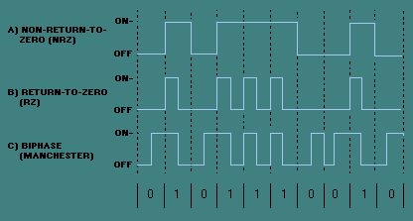
Data Encoding
Mapping data into signals
Digital data to digital signal
NRZ (non-return-to-zero): high 1, low 0
RZ (return-to-zero): high-low transition 1; low 0
Manchester: high-low transition 1; low-high transition 0

Slide 36
Data Encoding
Digital data to analog signals (example: dial-up modem)
Square wave (digital signal) suffers from strong attenuation and delay distortion.
modulation: -- make analog signals.
Amplitude modulation: use two different voltage levels to represent 0 and 1.
Frequency modulation: use two different tones to represent 0 and 1.
Phase modulation: carrier wave is shifted at different intervals to represent 0 and 1.

Slide 37
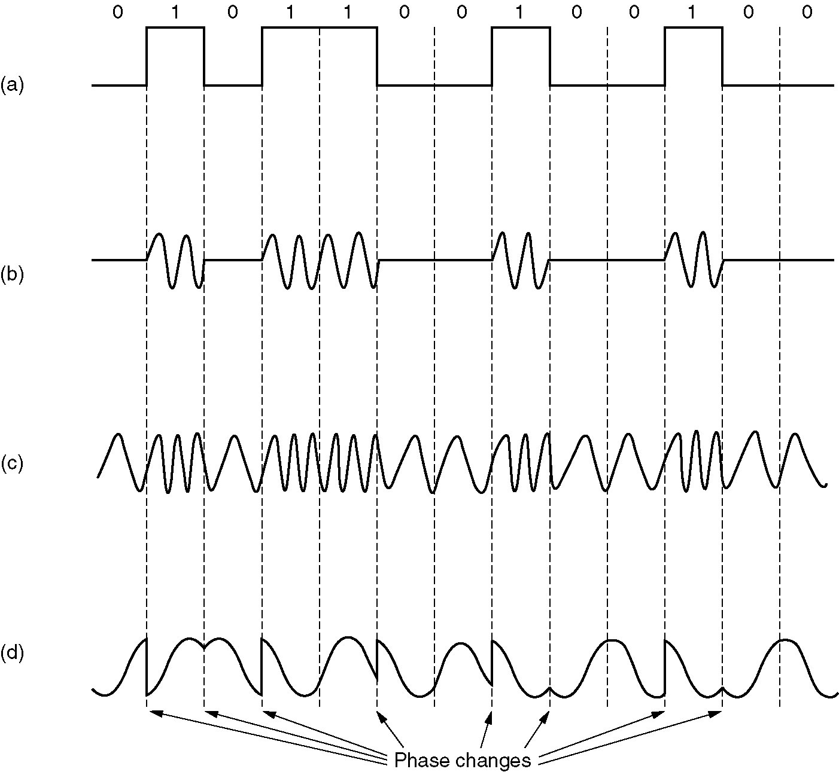
Data Encoding (analog signal)

Slide 38
High speed modem
Bandwidth in the local loop: 3000HZ,
maximum baud rate ???,
how to achieve higher speed (56Kbps modem)?
many bits per baud,
a combination of modulation techniques.
more amplitude levels and more phase intervals, QAM (Quadrature Amplitude Modulation)
Using 2400 baud rate, how many symbols are needed to achieve 56kbps?

Slide 39
Data Encoding
Analog data to digital signal
Example: digital voice
300 - 3400 HZ human voice
PCM: 4000 HZ channel: Nyquist Theorem: 8000 samples per second
Digitization: 8 or 7 bits per sample (logarithmically spaced) 64 kbps or 56 kbps
Analog data to analog signals
radio, TV, telephone

Slide 40
Physical media direction
simplex communication
data travel in one direction
half-duplex communication
data travel in either direction, but not simultaneously
full-duplex communication
data travel in both direction simultaneously.

Slide 41
Sharing Resources/Channel
Combine slow channels (connections) into faster channel (physical medium)
two basic schemes:
Time Division Multiplexing
time domain is divided into slots, put channels in different time domain.
Frequency division Multiplexing
frequency spectrum is divided into logical channels.
Others
Wavelength division multiplexing
A variant of FDM for fiber optic channels
Code division multiplexing

Slide 42
Code Division Multiplexing
Often referred to as CDMA (Code division multiple access)
Allows all stations to transmit on entire frequency bandwidth at the same time (on same frequency band)
Each bit time is sub-divided into m short interval called chips
Each station has a unique m-bit code called chip sequence
To transmit 1, send the chip sequence, to send 0, send the negate of the chip sequence.
Different chip sequences for different stations are orthogonal with the following property

Slide 43
Code Division Multiplexing
Often referred to as CDMA (Code division multiple access)
All transmitted signals (digits) superimposed
Station A, B, C have Code A, B, and C respectively. A wants to send 1, B sends 0, and C send 0. The signal sent is
To receive data from a sending station, multiply the received signal with the corresponding sequence (inner product)
E.g. To receive data sent by A, do the following:

Slide 44
CDMA (Cont’d)
Sender A (with key A_{k} -1 -1 -1 +1 +1 -1 +1 +1)
sends 1,
sending signal (-1, -1, -1, +1, +1, -1, +1, +1)
Sender B (with key B_{k} -1 -1 +1 -1 +1 +1 +1 -1)
sends 0
sending signal (+1, +1, -1, +1, -1, -1, -1, +1)
Both signals superimpose in space
(0, 0, -2, +2, 0, -2, 0, +2)
Receiver wants to receive signal from sender A
To receive data from A
Received • A_{k} = (0 + 0 + 2 + 2 + 0 + 2 +0 +2)/8 = 8/8=1
result greater than 0, therefore, original bit was 1
receiving B
Received • B_{k} = (0 + 0 -2 - 2 - 0 -2 +0-2)/8 = -8/8=-1,
Smaller than 0, original bit was 0

Slide 45
Transmission media
Guided media
Twisted pair, Coaxial cable, Optical fiber
Unguided media
Radio, microwave, infrared

Slide 46
Readings
Chapter 3

