Slide 1
Chapter 1: Introduction
What is a computer network?
Classification of computer networks
Switching schemes
Network performance metrics: latency and bandwidth
Layered software architecture
OSI model and TCP/IP model
Reading: Chapter 1

Slide 2
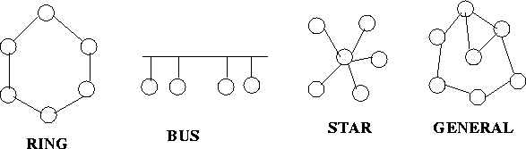
What is a Computer Network?
Network provides connectivity
  A set of computers/switches connected by communication links
Many possible topologies
Many different physical media (links)
  Coaxial cable, twisted pair, fiber optic, radio, satellite
Many different sizes: Local area networks and Wide area networks

Slide 3
Elements of a Network
Hosts, end-systems
  pc’s, workstations, servers
  PDA’s, phones, toasters
  running network apps
Communication links
  Point-to-point, multiaccess
  fiber, copper, radio, satellite
Routers, switches, and middleboxes: forward packets (chunks) of data thru network
router
workstation
server
mobile
local ISP
regional ISP
company
network

Slide 4
Classification of Computer Networks
Based on physical scope
  Network-on-chip (NoCs)
    Within a chip
  Interconnection networks, system area networks:
    within one cluster
  Personal Area Networks (PANs)
  Local Area Networks (LANs)
    Campus, building, room
  Metropolitan Area Networks (MANs)
    Cover a city – up to perhaps 50 miles in length
  Wide Area Networks (WANs)
    Cover a larger area typically beyond a city or state

Slide 5
LAN EXAMPLE
Regional Backbone
DENEB
140.222.565
EE subnet 128.226.9.3
128.226.9.14
128.226.9.1
UNIV-GATE
EE-GATE
128.226.1.15
MAIL
128.226.1.1
University backbone subnet 128.226.1.0
128.226.1.8
128.226.1.72
SUNS
128.226.3.1
CS subnet 128.226.3.0
128.226.3.5
128.226.3.2
RIGEL
HOME
ALISTAIR
128.226.3.4
128.226.3.3
slip connection

Slide 6
The Internet
The Internet :
  collection of networks and routers that span the world and use the TCP/IP protocols to form a single, cooperative virtual network
intranet: connection of different LANs within an organization like the example in the previous example.
  private
  may use leased lines
  usually small, but possibly hundreds of routers
  may be connected to the Internet (or not), often by firewall

Slide 7
Internet Architecture
International lines
NAP
Provider-subscriber relation
national network
regional
network
on-line services
ISP
company
university
ISP
access via modem
company
LANs

Slide 8
NAPs, NSPs, ISPs
NSP: National Service Provider (Tier 1 Backbones)
  Example: AT&T, Sprint , Verizon
NAP: Network Access Point
National Provider
NAP
POP
NAP
NAP
NAP
National Provider
Regional
Provider
customers

Slide 9
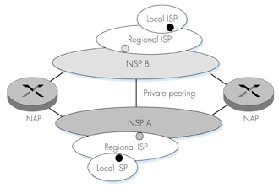
NAP and Private Peering

Slide 10
Other types of Classifications
Based on Technology and Features
  Using Wireless (Example: Wireless LAN)
  Using Satellites
  Using Radio
  Public Switched Telephone Network
  The Mobile Telephone System 1G, 2G, 3G, 4G
  Cable Television
  Sensor Network

Slide 11
Based on traffic type
  Telephone / voice, PSTN, leased lines
  Data networks
  Converged networks

Slide 12
Based on Topology
  Bus based
  Ring
  Star
  Mesh
  Fully connected, point-to-point, broadcast
  Ad hoc

Slide 13
Bus Topology
5 µ seconds
12 µ seconds
S1
S2
S3
Hub vs
Switch?
Ring Topology
Star Topology

Slide 14
Internet’s topology: hierarchical topology

Slide 15
Internet’s topology: hierarchical topology
Provider-subscriber relationship and peering relationship

Slide 16
Based on switching technology (how packets pass a router)
  Circuit Switched
  Message Switched
  Packet Switched
  Virtual Circuit

Slide 17
Circuit Switching
Path is set up end-to-end before any data is sent. Then a dedicated path from source to destination is maintained until teardown
  Connection phase: some setup delay
  Information transfer phase: transmission delay
  Disconnection phase: some delay
tel
tel

Slide 18
Timing Diagram
Call request
Ack
Message

Slide 19
Message Switching
The whole message is sent in a Store-and-Forward – No setup or disconnection delay, but queuing delay, overhead in message for routing
message
message
message

Slide 20
Packet Switching
  Message is broken down into packets
  Each packet is sent in a Store-and-Forward manner
  Pipelining and multiple paths
  Retransmission of erroneous packets easier
  More overhead, fragmentation & reassembly, sequencing
Packet s

Slide 21
Virtual Circuit
Virtual circuit mimics a circuit switched connection (to some extent) by using packet switching technology
  Virtual circuit is set up, typically by the initial packet(s)
    Packet size in a VC network is usually much smaller than that in a packet switched network.
  Subsequent packets (do not have the header) follow the virtual circuit
  Switches do more work to maintain VC information

Slide 22
Latency (delay) and bandwidth
Latency (delay) of a link: how much time it takes for one bit to travel from one end of the link to the other end of the link.
  Typically in the units of milliseconds (ms = 0.001 second) and microseconds (us = 0.000001 second).
  Sometime latency is treated as overhead and ignored. When sending large messages, this may be reasonable.
Bandwidth of a link: how many bits can be injected into the link in one unit of time.
  1Mbps: 1,000,000 bits per second
  1Gbps: 1,000,000,000 bits per second
Example: A link has a latency of 10 micro-second and a bandwidth of 1Gbps, how much time to send a data of 100,000 bits over the link?

Slide 23
An example
A link has a latency of 10 micro-second and a bandwidth of 1Gbps, how much time to send a data of 100,000 bits over the link?
First bit
Latency = 10us
Last bit
Time = datasize/bandwidth = 100,000/1Gbps = 100us
Total time = 10us + 100us = 110us

Slide 24
A question
A
D
Assuming that A is sending to D a message of size 100,000 bits. Each link has a latency of 10us and a bandwidth of 1Gbps. What is the time to send the message using circuit switching (control packet size = 1 bit)? With message switching? What is the time to send the message using packet switching with packet size 10,000 bits? What is the time to send the message using virtual circuit with packet size of 100 bits? Assume that other times such as packet processing time at switches are negligible.

Slide 25
A question
A
D
Assuming that A is sending to D a message of size 100,000 bits. Each link has a latency of 10us and a bandwidth of 1Gbps. What is the time to send the message using circuit switching (control packet size = 1 bit)? With message switching? What is the time to send the message using packet switching with packet size 10,000 bits? What is the time to send the message using virtual circuit with packet size of 100 bits? Assume that other times such as packet processing time at switches are negligible.
How to change question parameters to make circuit switching look bad? message switching? packet switching?
  # of hops, message size, latency, bandwidth, packet size, flit size

Slide 26
Circuit switching:
  good when message duration is long; switch reconfiguration is long.
  Bad: short message with short reconfiguration time
Packet switching:
  Good for short message, and network resource sharing
Virtual circuit:
  Somewhat similar to packet switching, good for latency, not very good for sharing (useful in over-provisioned network)

Slide 27
Use of switching techniques
Circuit switching: PTSN, optical networks
Message switching: ???
Packet switching: Most computer networks like the Internet
Virtual circuit switching: high performance networking (supercomputers, on-chip networks)

Slide 28
Summary
What is a computer network?
Typical components of a computer network?
Classify networks by physical scope
Classify networks by switching scheme
Describe circuit switching, packet switching, and virtual circuit switching
Define latency and bandwidth
Revisit the question in the last class – when can a packet be forwarded in the middle router.

Slide 29
  Layered Architecture
  Why layering?
    Network software is very complex: naming or addressing, fragmentation/reassembling of packets, multiplexing of packets, forwarding and routing, handling error, handling speed mismatch, handling congestion, ……
      How to deal with complex software? Divide-and-conquer
      The layered model simplifies the design
    Heterogeneity in the network environment
      Different machines, switches, links, interfaces from different vendors.
      Solution: break up the system into different layers. Each layer provides an abstraction for its upper layer.
      E.g. connections: modem, Ethernet, Token ring--> a link in the second layer. Third layer will then only be concerned with links. In OS, we have device drivers.

Slide 30
    Layering is a useful abstraction
    Another example of abstraction: programming languages.
      Machine language (low level, works only on one machine)
      Assembly language (higher level, works for several machines)
      C++ (works on almost all machines).
    Differences between layering in the network software and layering in programming language?
      Programming language:
        interface between upper layer and lower layer
      Network software:
        Interface between upper layer and lower layer
        Flow of information up and down
        Interface between peers in the same layer.

Slide 31
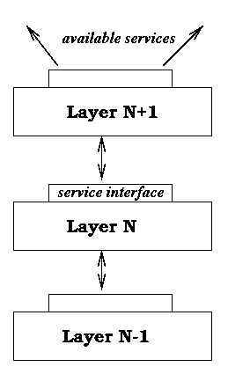
Layered Architecture
Layering simplifies the architecture of complex system
Layer N relies on services from layer N-1 to provide a service to layer N+1
Interfaces define the services offered
Service required from a lower layer is independent of it’s implementation
  Layer N change doesn’t affect other layers
  Information/complexity hiding
  Similar to object oriented methodology
Layer N+1 Protocol
Layer N Protocol

Slide 32
  Some terminology:
    entity: an active element in a layer (machine, procedure, process, I/O chip).
    Peer entities: entities on the corresponding layers on different machines. Exchange well-defined pieces of information
    Message, packet, frame: structured sequence of bits that are exchanged
    Protocol: a set of coordination rules governing the communication between two peer entities.
      Each layer has a protocol -- layer n protocol.
    Service interface: the interface between upper layer and lower layer.
      Upper layer: service user. Lower layer: service provider.

Slide 33
Service types:
    connection-oriented service & connectionless service -- order of packets
      Connection-oriented -- like the telephone.
        Establish the connection, use the connection, then release the connection. Even when multiplexed, minimal header information
        The packets received are in the same order as the packets sent.
      Connectionless (datagram) -- like the postal system.
        Each message carries its destination’s address and is routed to the destination independently.
        The packets received may not be in the same order as the packets send.
    reliable and unreliable – loss or no loss of packets
      reliable: all packets sent are received correctly
      unreliable: packets sent may not be received

Slide 34
Four combinations of service types:
    Reliable connection-oriented
    Reliable connectionless
    Unreliable connection-oriented
    Unreliable connectionless
    Example:
      send 1 2 3 4 5
      receive: 1 2 3 4 5 – 4
      1 3 2 5 4 – 2
      1 2 4 – 2
      3 1 4 – 1
    Why not just reliable connection-oriented?
      too costly to support connection-oriented services at all layers.
      Sometimes applications may not need such service:
        telephone: unreliable connection-oriented.
        video streaming: late packets are useless

Slide 35
Elements of a protocol:
    Rules by which each network entity at the same layer on different devices communicate
    syntax: what is a valid message in terms of structure?
    semantics: what is a valid message in terms of meaning?
    Is timing important?: relative order of messages.
Network architecture: a set of layers/protocols/service interfaces that define how functionality is divided up.

Slide 36
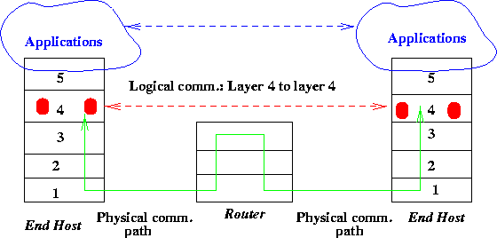
Protocols and Services
Protocols are used to implement services
  Peering entities in layer N provide services by communicating with each other using the service provided by layer N-1
Logical vs physical communication

Slide 37
Reference models:
  ISO: International Standards Organization
  OSI: Open Systems Interconnection.
  Seven layers ISO/OSI reference model:
    Application Application
    Presentation Presentation
    Session Session
    Transport Transport
    Network Network Network
    Data Link Data link Data link
    Physical Physical Physical

Slide 38
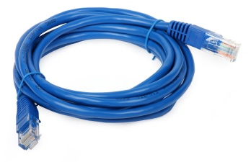
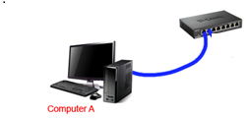
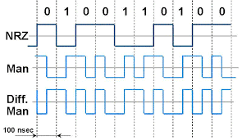
  Physical layer: how to transfer bits correctly
    conversion of bits into signals, what is 0, 1? How long does a bit lasts? How many pins in a connection?
Cable and connector to connect devices
How to send 0’s and 1’s
Physical layer protocol: (1) physically connects two devices; and (2) when the sending device sends a bit stream (e.g. 0100110100), the receiving device would receive what was sent.

Slide 39
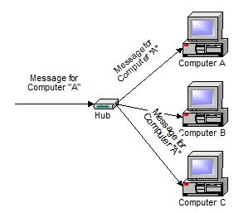
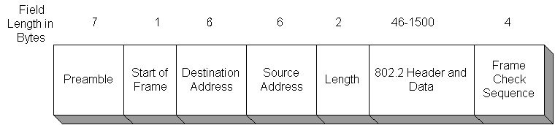
  Data link layer: how to transfer frames correctly
    Send frames (a unit of data that has a logical meaning)
      frame .vs. bit stream, why frame?
      Deal with errors, manipulate based on structure.
    Reliably transfer frames over a link, how to identify a frame, error control, speed mismatch between senders and receivers.
    Divided into Media Access Control (MAC) and Logical Link Control (LLC) layers
Computer A, B, and C are directly connected by
a “link”.
transmit formatted data (Ethernet frame)
Capable of detecting transmission errors
Must decide when a computer can transmit data:
media access control

Slide 40
  Data link layer
    Below data link layer, the functionality is usually done in the hardware.
    Above data link layer, the functionality is usually done in the software.
    Ethernet (data link layer) service interface would be something like this:
      Eth_send (Eth_dst, data, …);
      Eth_recv(Eth_src, data, …); // such routines form the service interface
    For two machine connected over the same Ethernet domain, software can call the service interface functions to communicate.
Eth_src
Eth_dst
Eth_send
Eth_recv

Slide 41
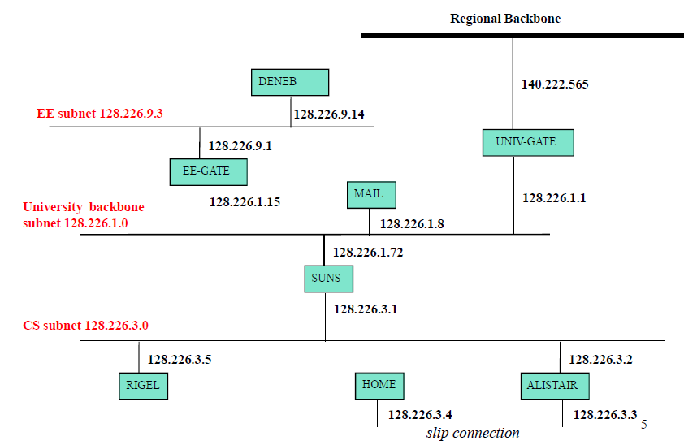
  Network layer: how to send a packet to the destination (hop by hop)?
    “directly connected domains” cannot be very large. Larger networks are formed with routers separating directly connected domains.
    Forwarding, routing, congestion control, format conversion (internetworking), accounting, etc
    Service interface: ip_send(ip_dst, data), ip_recv(ip_src, data)
      E.g. on DENEB (128.226,9,14), call ip_send(128.226.3.5, data)

Slide 42
      E.g. on DENEB (128.226.9.14), call ip_send(128.226.3.5, data)
ip_send(128.226.3.5,data)
ip_recv(128.226.9.14,data)
Network layer
Data link layer
Physical layer
Network layer
Data link layer
Physical layer
Network layer
Data link layer
Physical layer
Network layer
Data link layer
Physical layer
DENEB
EE-GATE
SUNS
RIGEL
EE-GATE network layer:
Eth_recv(Eth(DENEB),
XXX);
128.226.9.14 is not in
my network, route to SUNS
Eth_send(Eth(SUNS),
128.226.9.14+data)
EE-GATE network layer:
Eth_recv(Eth(EE-GATE),
YYY);
128.226.9.14 is in my
network, send to RIGEL
Eth_send(Eth(RIGEL),
128.226.9.14+data)
RIGEL network layer
Eth_recv(Eth(SUNS),
YYY);
I am 128.226.9.14;
Pass data up –
ip_recv returns
DENEB network layer:
Eth_send(Eth(EE-GATE),
128.226.9.14+data)
Original header+data

Slide 43
  Transport: end to end communication.
    First layer that runs at end points but not at intermediate hops.
    Connection establishment/management/termination, error control/flow control/multiplexing
    Reliability, probing data rate, deal with congestions, etc
    Service interface: tcp_send(ip+port, data), tcp_recv(ip+port, data);
tcp_send(128.226.3.5:80,data)
tcp_recv(XXX:YYY,data)
Transport layer
Transport layer
Network layer
Data link layer
Physical layer
Network layer
Data link layer
Physical layer
Network layer
Data link layer
Physical layer
Network layer
Data link layer
Physical layer
DENEB
EE-GATE
SUNS
RIGEL
DENEB transport layer:
ip_send(128.226.3.5,
80+data)
RIGEL transport layer
ip_recv(XXX,
YYY);
Data is for port 80;
Give data to httpd (80)
This is the basic end-to-end
communication, the actual transport
layer protocol is much more complex.

Slide 44
  Session layer: allows users to establish session, enhanced services.
    Checkpointing.
  Presentation layer: provides general solutions to users.
    Compression, syntax conversion, cryptography
  Application layer: variety of protocols that are commonly used.
    Email, FTP, Telnet: these are all network applications that call tcp_send, and tcp_recv routines to perform communications.
Functionality of the network software are partitioned into different layers.
  Flow control (speed mismatch between two machines): data link and transport
  Routing: network layer
  addressing: almost all layers
  …...

Slide 45
  Data transmission using the OSI model:
  Application application
  presentation presentation
  session session
  transport transport
  network network network
  data link data link data link
  physical physical physical
  Upper layer protocol header becomes data at the lower level.
  Assuming 100Mbps Ethernet is used to send 30 bytes (user) data, let AH=PH=SH=TH=NH=DH=10 bytes, what is the maximum throughput the application can observe?
data
AH data
.
.
.
DH NH TH SH PH AH Data

Slide 46
OSI model was not very successful!!
  The TCP/IP protocols became the de facto network software standard.
  From the TCP/IP protocols, people derived the TCP/IP reference model.
TCP/IP reference model:
    Application layer (Telnet, FTP SMPT, DNS, NNTP, HTTP)
    Transport layer (TCP, UDP)
    Internet layer (IP)
    Host to Network layer (Ethernet, FDDI, X.25)

Slide 47
TCP/IP reference model:
    Application layer (Telnet, FTP SMPT, DNS, NNTP, HTTP)
      No session and presentation layers.
    Interface – socket programming: (TCP_send, TCP_recv, UDP_send, UDP_recv)
    Transport layer (TCP, UDP)
      Allow entities at end hosts to communicate
      TCP (transmission control protocol): reliable connection-oriented
      UDP (user datagram protocol): unreliable connectionless
    Interface: (IP_send, IP_recv)
    Internet layer (IP)
      A packet switching network based on connectionless communication. Hosts send packets into the network and then the packets travel independently to their destinations.
      Format conversion: for different networks.
      Packet format and protocol: IP
    Interface – network dependent, Ethernet: (Eth_send, Eth_recv)
    Host to Network layer (Ethernet, FDDI, X.25)
      Undefined, rely on the existing technology - must be able to send IP packets over this layer.

Slide 48
Encapsulation & Decapsulation
Get/Infocom/index.html HTTP/1.0
TCP (20)
Get/Infocom/index.html HTTP/1.0
IP (20)
TCP (20)
Get/Infocom/index.html HTTP/1.0
Ethernet (14)
IP (20)
TCP (20)
Get/Infocom/index.html HTTP/1.0
(4)
Ethernet header exclude preamble and start frame of 8 bytes

Slide 49
TCP/IP model vs. OSI model:
    similarity:
      based on the concept of the stack of independent protocols.
      Similar functionality
    Differences:
      The concepts of services/interfaces/protocols are clear in the OSI model, but not as much in the TCP/IP model.
      The OSI model was devised before the protocols were invented, it misses some important issues. The TCP/IP model was devised after the protocols were designed, so the model may not fit other protocols.
      Difference in the network layer:
        TCP/IP: only connectionless (the IP protocol)
        OSI: connectionless and connection-oriented.

Slide 50
The five-layer hybrid model:
  Application
  Transport
  Network
  Data Link
  Physical

