Slide 1
SDN controller scalability issue
Fundamental issue: the speed gap between data plane and control plane.
SDN controller
Switch OS
Switch OS
Switch OS
Switch HW
Switch HW
Switch HW
10-100 Gbps
10-100 0Mbps
???

Slide 2
SDN controller scalability issue
Control plane
1. Stress controller resources
2. Stress the control channel
Data plane
Data plane can overwhelm control plane by design
  Control channel or controller resources
SDN controller has a fundamental scalability issue

Slide 3
Solutions 1: Increase controller capacity - distributed controllers
Control plane
Control plane
Control plane
1. Stress controller resources
2. Stress the control channel
Data plane
Flat structure multiple controllers
  ONIX (OSDI’10)
  ONOS(HostSDN’14)

Slide 4
Solutions 2: reduce traffic to controller -- Hierarchical controller
Root Control
Control plane
1. Stress controller resources
Local Control
2. Stress the control channel
Data plane
Data plane
Hierarchical controller design
  Kandoo (HotSDN’12)

Slide 5
Solutions 2: Reduce traffic to controller – offload control to switch
Root Control
Control plane
1. Stress controller resources
offload Control
2. Stress the control channel
Data plane
Data plane
Offload to switch control plane
  Diffane (SIGCOMM’10)
  DevoFlow(SIGCOMM’11)

Slide 6
ONIX
ONIX’s view of network components
  Physical infrastructure: switches, routers, etc
  Connectivity infrastructure: channels for messages.
  Onix: A distributed system running the controller
  Control logic: network management applications running on top on Onix

Slide 7
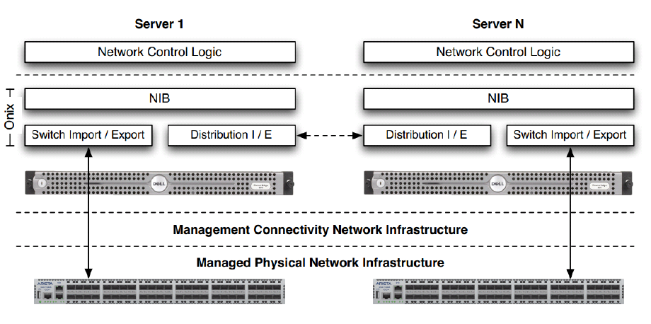
Onix architecture

Slide 8
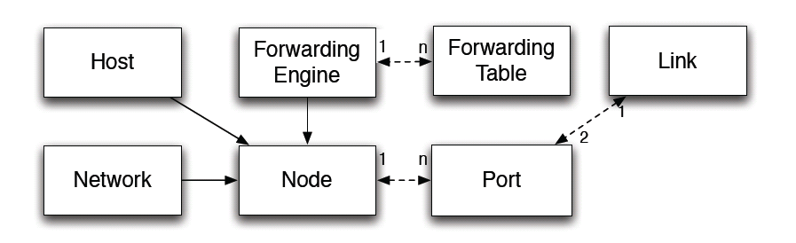
Onix NIB
Holds a collection of network entities
  Can be viewed as a centralized graph with notification mechanism
Updates to the NIB are asynchronous.

Slide 9
Onix NIB API
Query: find entities
Create/destroy: create and remove entities
Access attributes: inspect and modify entities
Notification: receive update about changes
Synchronize: wait for updates being export to network elements and controllers
Configuration: configure how state is imported to and exported from the NIB
Pull: ask entities to be imported on-demand

Slide 10
Onix abstraction
Global view: Observe and control a centralized network view (NIB) which contains all physical network elements
Flow: the first packet and subsequent packets with the same header are treated in the same way.
Switch: with flow tables <header: counters, actions>
Event-based operation: the controller operations are triggered by routers or applications.

Slide 11
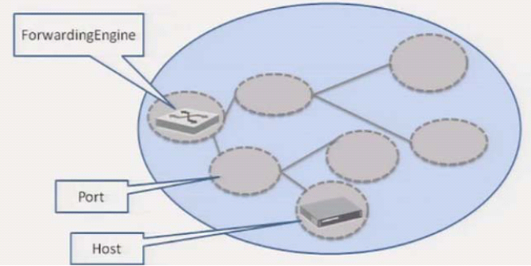
Onix API
The global view is represented as a network graph
Nodes represent physical network entities
Developers program over the network graph
Write flow entry
List ports
Register for updates
……

Slide 12
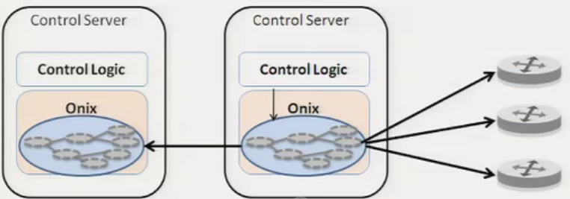
Network Information Base
The NIB is the focal point of the system
  State for applications to access
  External state changes imported into it
  Local state changes exported from it

Slide 13
Onix scalability
A single physical controller won’t work for large network
  NIB will overrun the memory in one server
  CPU and bandwidth for one server will not be enough
Onix solution: Partition, aggregation, and consistency.
  Partition:
    Each Onix instance may have connections to a subset of network elements
    Network control logic can configure to keep a subset of the NIB in memory

Slide 14
Onix scalability
Partition, aggregation, and consistency.
  Aggregation:
    Each Onix instance can be configured to expose a subset of elements in its NIB as an aggregate element (reduce fidelity) to another Onix instance.
  Consistency and durability
    Control logic dictates the consistency requirement of the network state it manages
      Two storage options
        Replicated transactions (SQL) storage
        One-hop memory-based DHT
    Control logic resolve conflicts when necessary.

Slide 15
Onix reliability
Network element and link failures
  Control logic reconfigures to deal with such failures
Management connectivity infrastructure failures
  Assumed reliable (remember Google B4 issue?)
Onix failures:
  Distributed coordination facilities to provide failover

Slide 16
Onix Summary
Onix provides state distribution capability
The developers of management applications still have to understand the scalability implications of their design
One of the earlier SDN controllers: the controller functionality and application functionality are not clearly partitioned.

Slide 17
Distributed SDN controller Research issues?

Slide 18
Distributed SDN research issues
Network abstraction for distributed SDN
  Need concrete understanding of network abstraction in the current systems
Exploit existing distributed system techniques to address distributed network abstraction issues
  Consistency, usability, synchronization, fault tolerance, etc
Adapting distributed system techniques specifically to SDN controller
  No need to reinvent the wheel

Slide 19
ONOS: Towards an Open, Distributed SDN OS
Earlier NOS dodges the distributed system issues.
Earlier distributed NOS may try to reinvent the wheel.
ONOS is a second generation of distributed NOS, separating distributed systems issues with network management issues
  We know how to distribute and maintain information in a distributed manner. Many systems are available.
  Distributed NOS can utilize the existing distributed information systems and focus on network management issues.

Slide 20
Distributed system building blocks
Distributed storage system
  Cassandra
  RAMcloud (in memory storage)
Distributed graph database (Titan)
Distributed event notification(HazelCast)
Distributed coordination service (Zookeeper)
Distributed system data structures and algorithms
  Distributed hash table (DHT)
  Consensus algorithm
  Failure detector
  Checkpointing
  Transaction

Slide 21
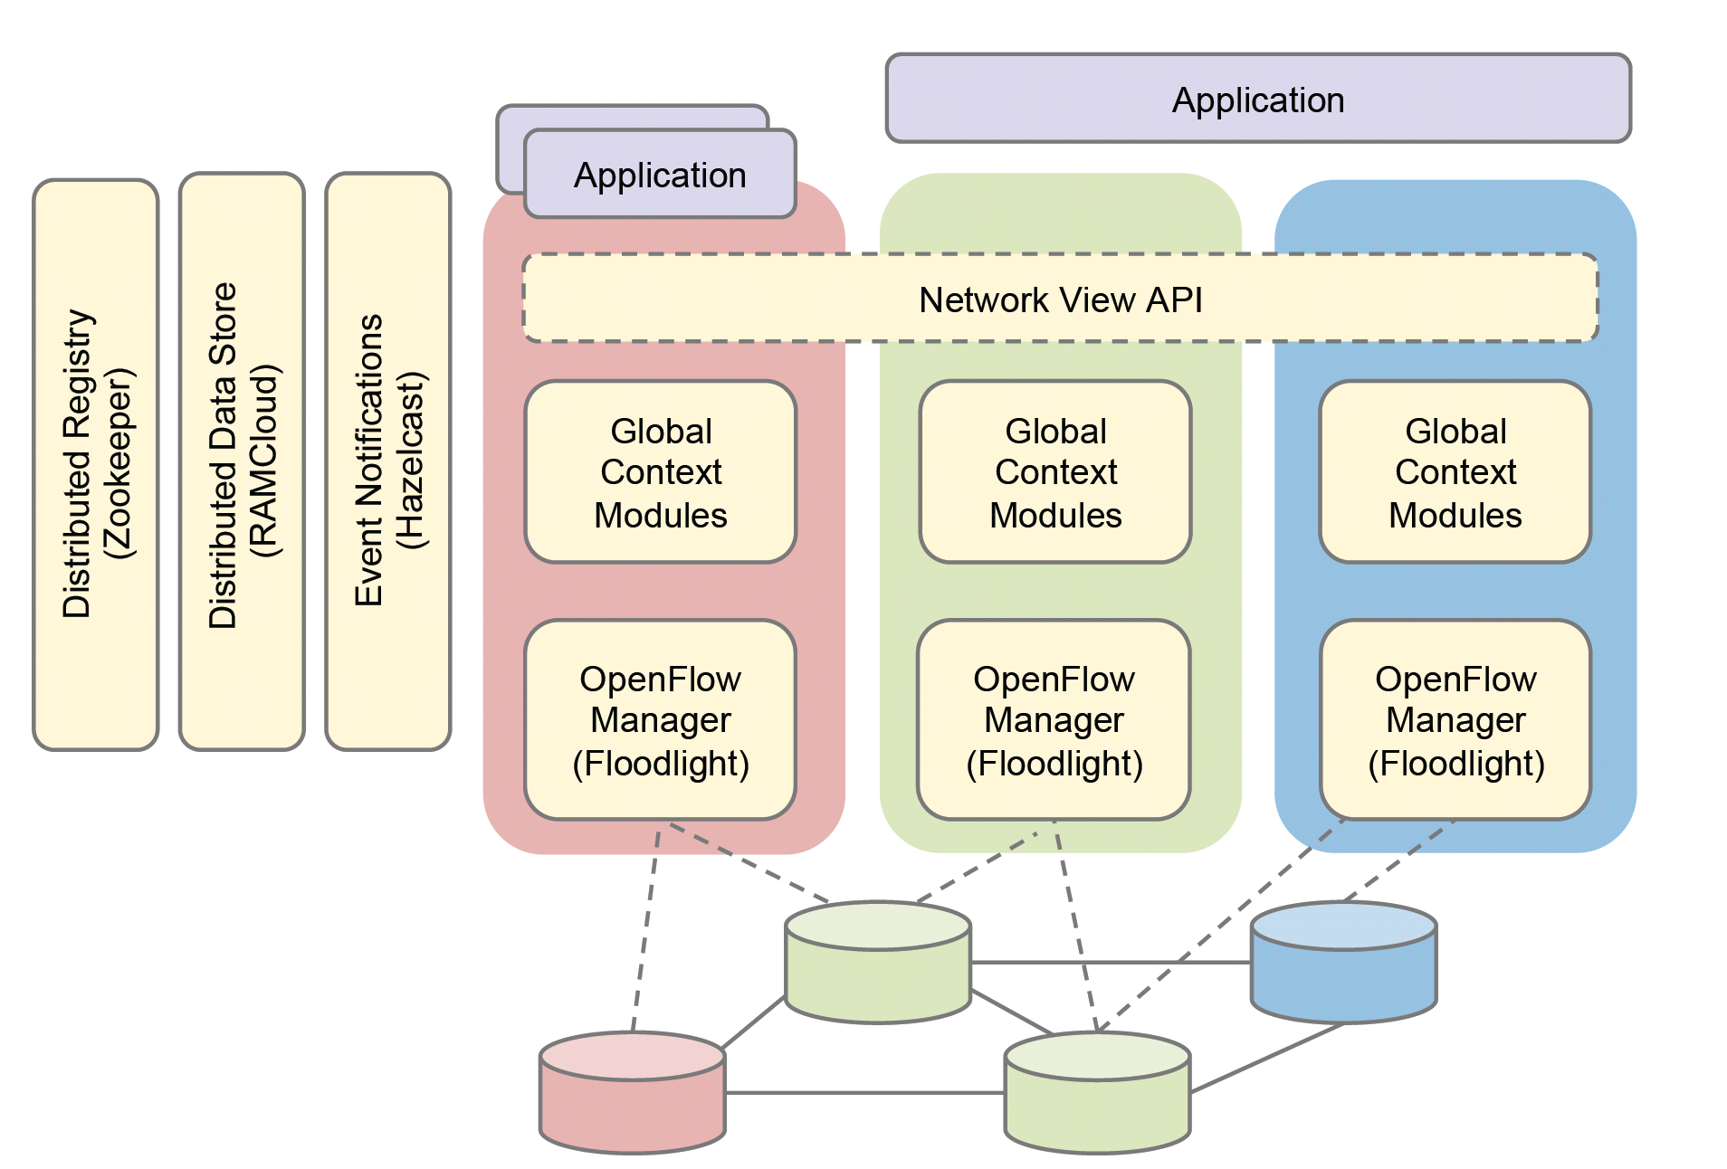
Onos architecture

Slide 22
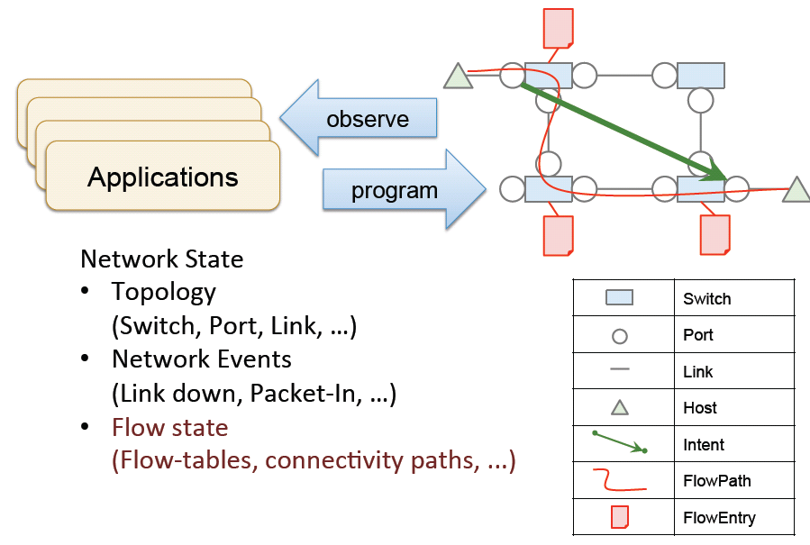
Onos abstraction: Global network view

Slide 23
Onos summary
Use existing distributed system infrastructure.
Focus on making it efficient with known distributed system applications.
  E.g. how to maintain, lookup, and update the topology effectively

Slide 24
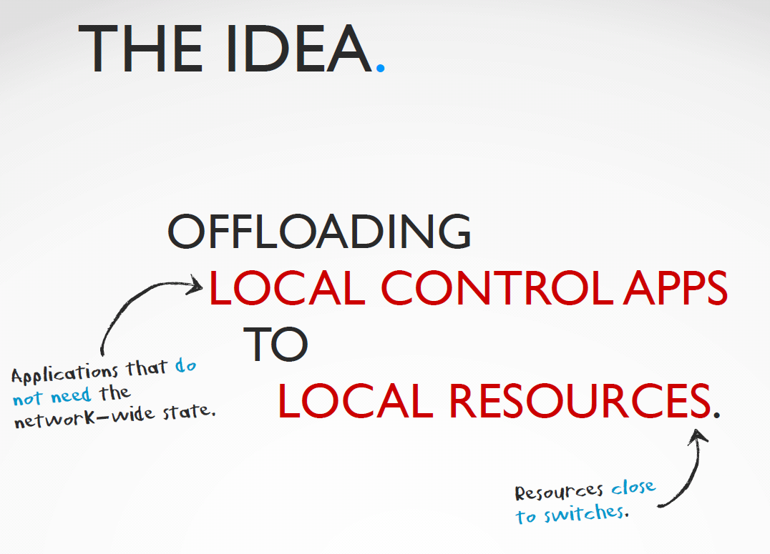
Kandoo: A framework for efficient and scalable offloading of control applications

Slide 25
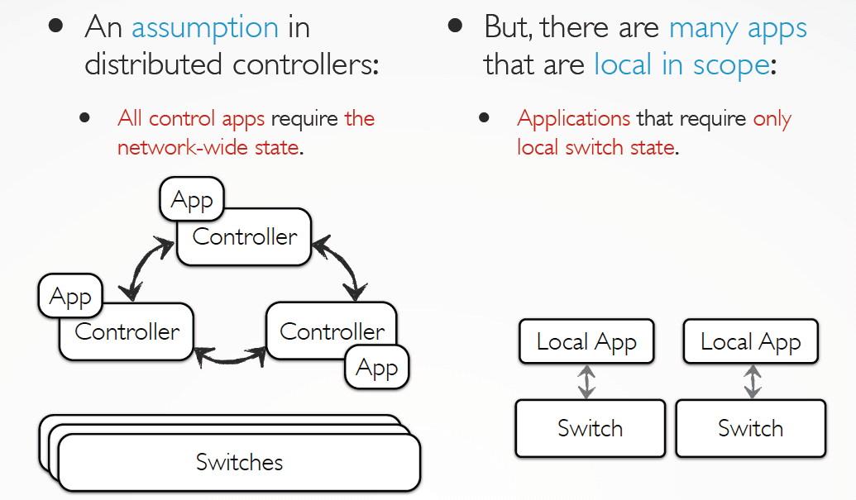
Local Apps

Slide 26
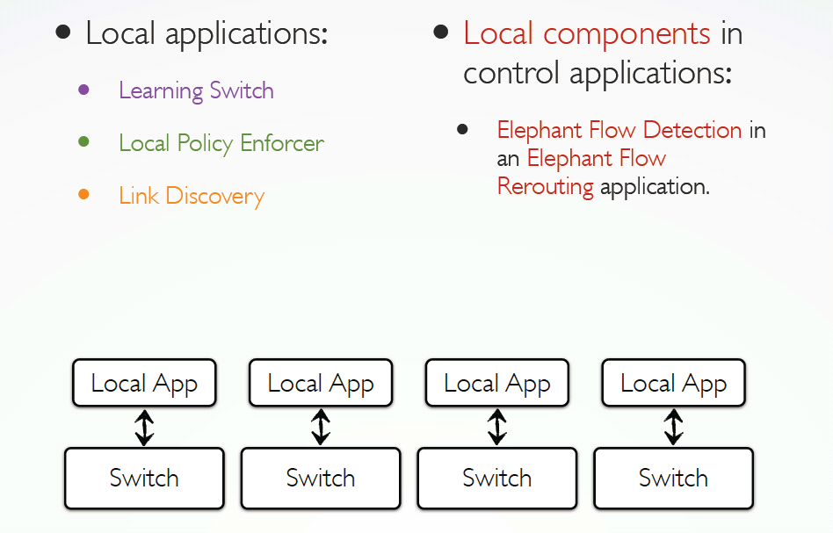
Local Apps

Slide 27
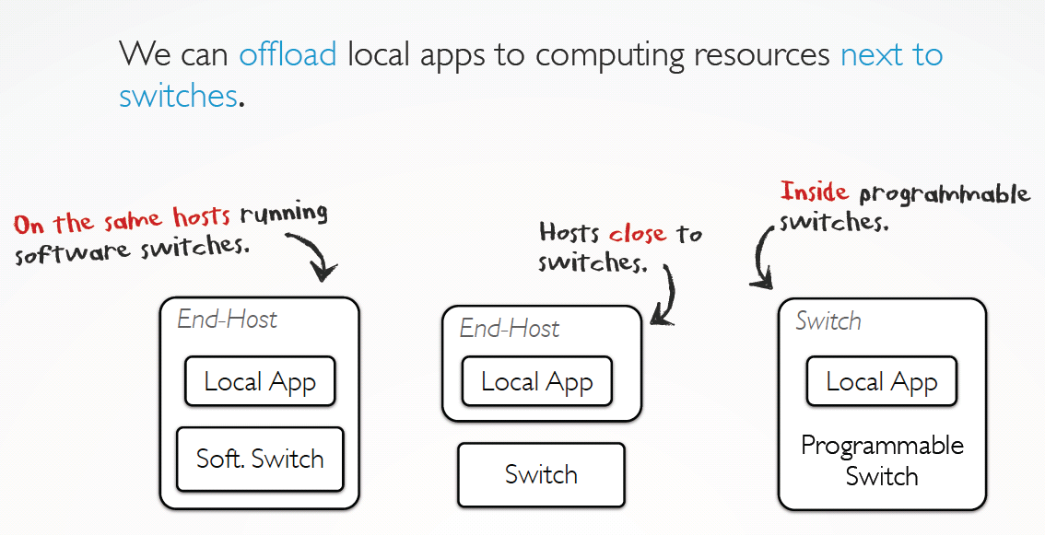
Where to run the local apps

Slide 28
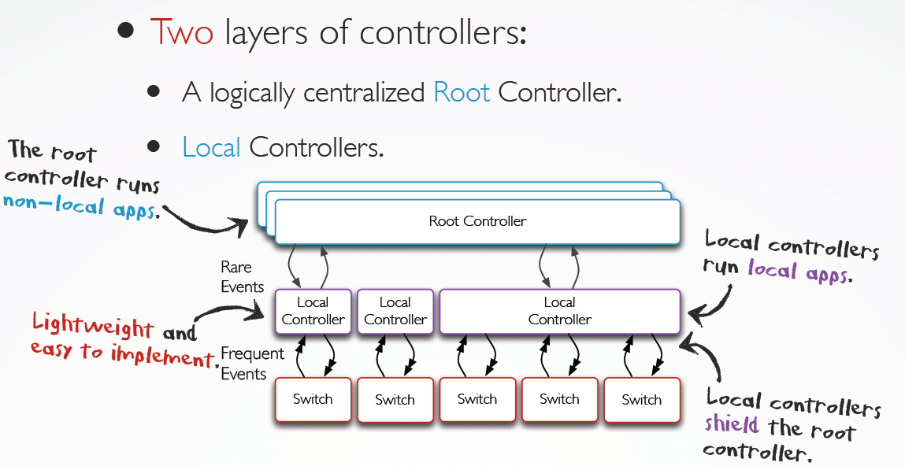
Kandoo

Slide 29
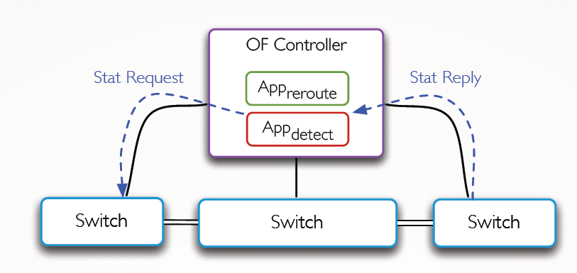
An example: Elephant flow rerouting

Slide 30
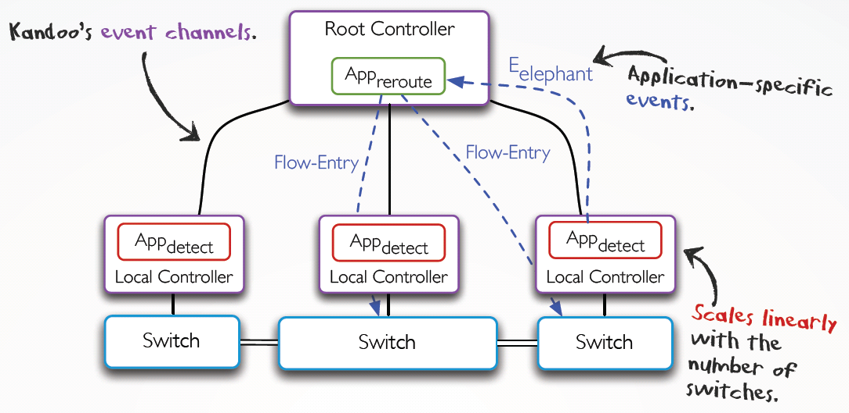
An example: Elephant flow rerouting

Slide 31
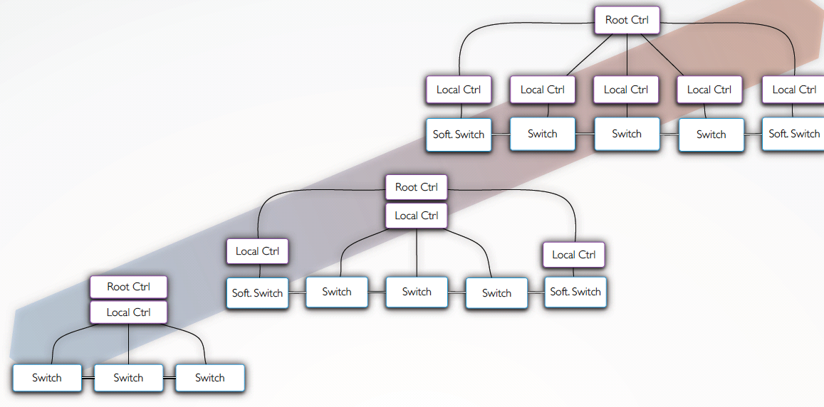
Kandoo variations

Slide 32
Kandoo summary
2 levels of controller
Deal with the scalability issue by moving software closer to the data plane
Future: a generalized hierarchy
  Filling the gap between local and non-local apps
  Finding the right scope is quite challenging

Slide 33
Devoflow
DevoFlow: scaling flow management for high-performance networks, SIGCOMM’2011.
OpenFlow is good; but fine-grain per flow management creates too much overhead
  Flow setup
  Statistics collection
Devoflow – a new paradigm to reduce the control and overhead while providing fine control for important flows.

Slide 34
Dilemma
Control dilemma:
  Role of controller: visibility and mgmt capability
  however, per-flow setup too costly
  Flow-match wildcard (existing hardware), hash-based:
  much less load, but no effective control
Statistics-gathering dilemma:
  Pull-based mechanism: counters of all flows
  full visibility but demand high BW
  Wildcard counter aggregation: much less entries
  but lose trace of elephant flows
Aim to strike in between

Slide 35
Main Concept of DevoFlow
Devolving most flow controls to switches
  Use the default wildcard match
Maintain partial visibility
Keep trace of significant flows
Default v.s. special actions:
  Security-sensitive flows: categorically inspect
  Normal flows: may evolve or cover other flows
  become security-sensitive or significant
  Significant flows: special attention
Collect statistics by sampling, triggering, and approximating

Slide 36
Design Principles of DevoFlow
Try to stay in data-plane, by default
Provide enough visibility:
  Esp. for significant flows & sec-sensitive flows
  Otherwise, aggregate or approximate statistics
Maintain simplicity of switches

Slide 37
Mechanisms
Control
  Rule cloning
  Local actions
Statistics-gathering
  Sampling
  Triggers and reports
  Approximate counters

Slide 38
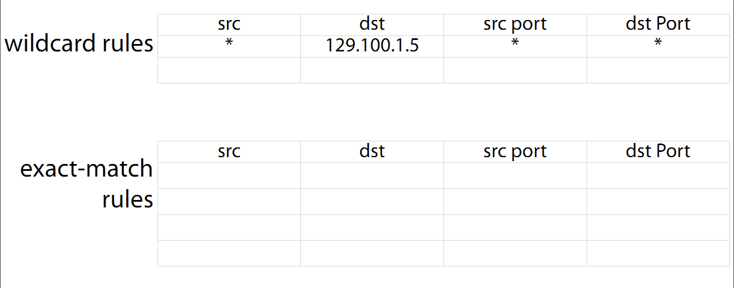
Rule Cloning – identify elephant flow
ASIC clones a wildcard rule as an exact match rule for new microflows
  Timeout or output port by probability

Slide 39
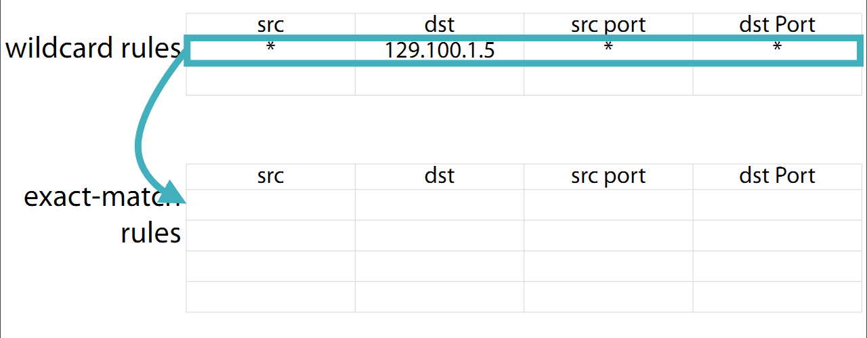
Rule Cloning
ASIC clones a wildcard rule as an exact match rule for new microflows
  Timeout or output port by probability

Slide 40
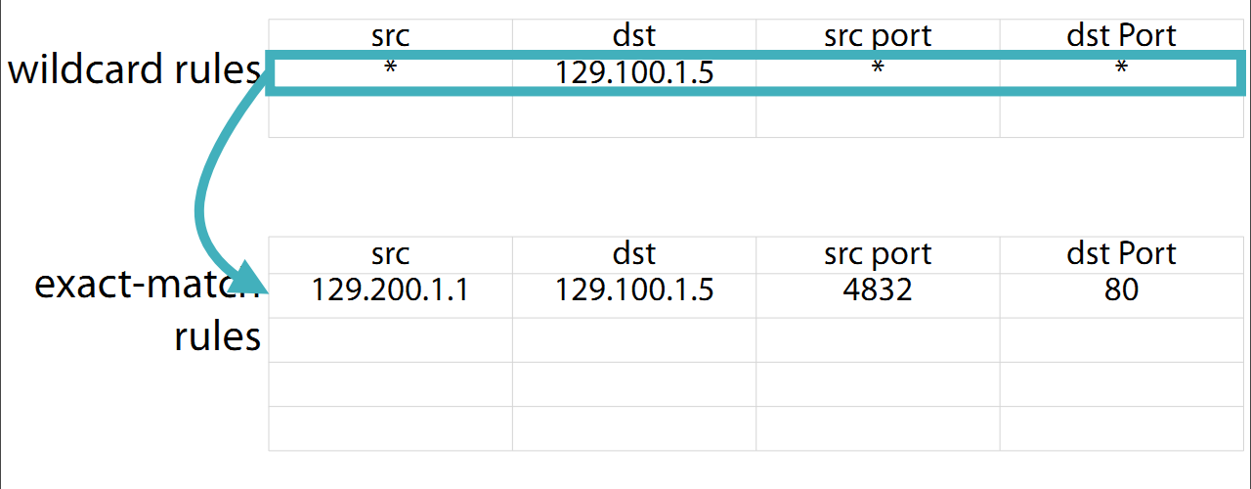
Rule Cloning
ASIC clones a wildcard rule as an exact match rule for new microflows
  Timeout or output port by probability

Slide 41
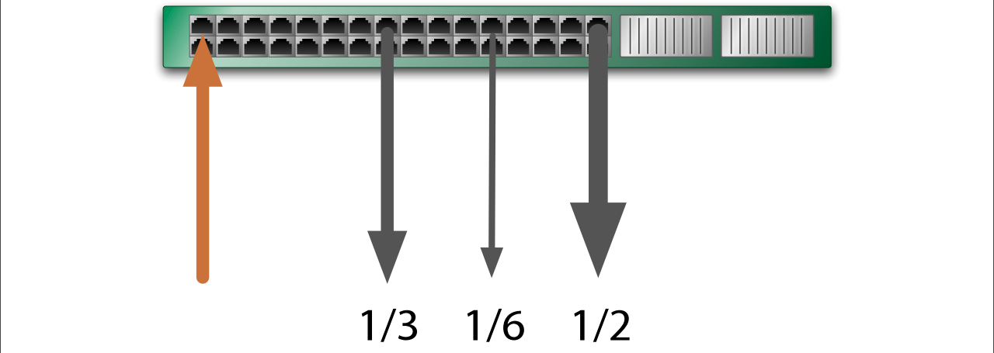
Local Actions
Rapid re-routing: fallback paths predefined
⇒Recover almost immediately
Multipath support: based on probability dist.
Adjusted by link capacity or loads

Slide 42
Statistics-Gathering
Sampling
  Pkts headers send to controller with1/1000 prob.
Triggers and reports
  Set a threshold per rule
  When exceeds, enable flow setup at controller
Approximate counters
  Maintain list of top-k largest flows

Slide 43
DevoFlow Summary
Per-flow control imposes too many overheads
Balance between
  Overheads and network visibility
  Effective traffic engineering, network management
Switches with limited resources
  Flow entries, control-plane BW
  Hardware capability, power consumption

