Slide 1
SDN challenges
Deployment challenges
  Device heterogeneity
  Interoperation with legacy systems
  Controller and apps scalability
Infrastructure research challenges
  NOS issue: network abstraction
  To make SDN accessible to a typical user
    Programming abstraction
    Configuration abstraction
  Programming abstraction support
    Update abstraction
    Modular composition abstraction
    Correctness verification, debugging, and testing
  Security

Slide 2
Device heterogeneity
Heterogenous switches
  Number of packet-handling rules
  Range of matches and actions
  Multi-stage pipeline of packet processing
  Offload some control-plane functionality
Legacy systems: how to interoperate
access
control
MAC
look-up
IP
look-up

Slide 3
SDN Scalability
Controller scalability
  Controller is much slower than the switch (in processing packets)
  Processing packets leads to delay and overhead
  Need to keep most packets in the “fast path”
packets

Slide 4


SDN scalability: distributed controller, distributed apps
For scalability and reliability
Controller Application
Controller Application
Partition and replicate state
Network OS
Network OS

Slide 5
NOS: Network abstraction
Centralized network view (global network graph)
Levels of details:
  Topology, flows, link usage statistics, where to cut off?
  Frequency of control updates, collecting statistics introduces overhead
  Does the data structure for NIB make a difference?

Slide 6
Programming Abstractions
Controller APIs are low-level
  Thin veneer on the underlying hardware
Need better languages
  Algorithmic programming
  Composition of modules
  Managing concurrency
  Querying network state
  Network-wide abstractions
  Debugging and testing
  Formal verification
Controller
Switches

Slide 7
Configuration abstraction?
Is programming abstraction in its perfect form good enough?
Users are system administrators.

Slide 8
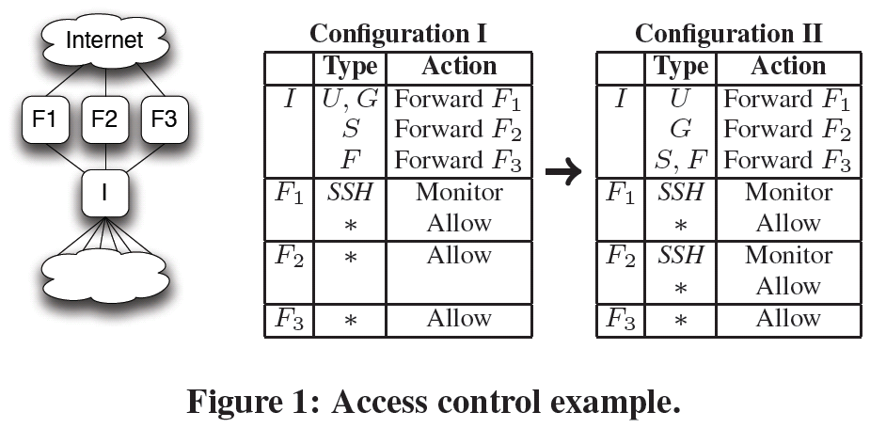
Implementation software challenges: Update abstraction
How to install new rules and remove old rules so that a packet will only experience one consistent network state?
  Need theory (update consistency model) and implementation (working system based on theory)
Example:

Slide 9
Update abstraction
1. update I to forward S traffic to F3 while continuing to forwarding U and G traffic to F1 and F traffic to F3
2. Wait until in-flight packets have been processed by F2
3. update F2 to deny SSH packets
4. update I to forward G traffic to F2 while continuing to forwarding U traffic to F1 and S and F traffic to F3.

Slide 10
Composition of modules
Many network tasks: routing, access control, traffic monitoring, etc
All require packet handling rules installed in the same flow table
  These rules may interact with one another, making it very difficult to decoupling the high level tasks from implementation.
Significant challenges in specifying the tasks and realizing the tasks.

Slide 11
Testing and Debugging
OpenFlow makes programming possible
  Network-wide view at controller
  Direct control over data plane
Plenty of room for bugs
  Still a complex, distributed system
Need for testing techniques
  Controller applications
  Controller and switches
  Rules installed in the switches

Slide 12
SDN security issues
Can the SDN programming system provide some security features, what should they be?
Can NOS provide process like protection among SDN applications?
Can we have an integrated security mechanism for SDN?

