Slide 1
B4: Experience with a Globally-Deployed Software WAN

Slide 2
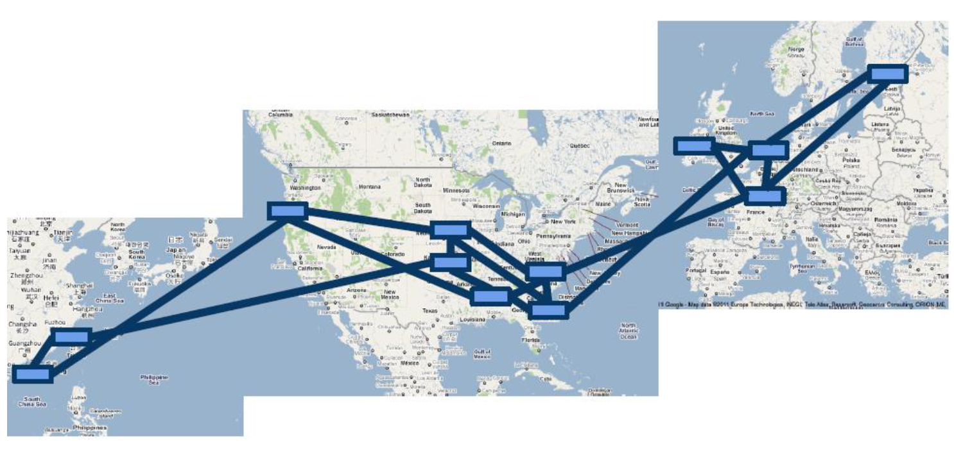
B4: Google’s Software Defined WAN

Slide 3
B4: Google’s Software Defined WAN
Google’s private WAN connecting its data centers
Elastic bandwidth demands
Can tolerate periodic failures with temporary BW reduction
Small number of sites
Allows special optimization
Complete control of end application
Application priorities and control bursts
Cost Sensitivity
Unsustainable cost projection with traditional approach (2-3x cost of a fully utilized WAN).

Slide 4
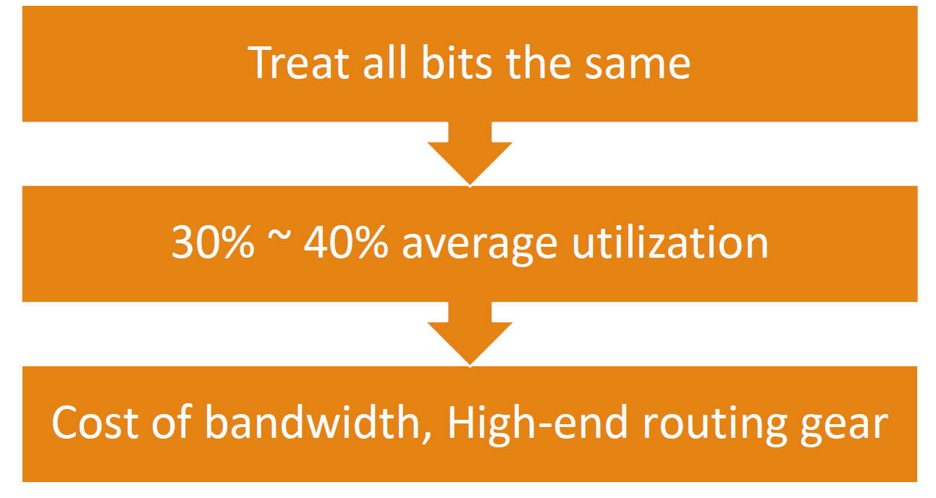
Traditional WAN routing

Slide 5
Traffic priority
User data copies to remote data centers for availability/durability (lowest volume, most latency intensive, highest priority)
Remote storage access for computation over distributed data sources
Large-Scale data push synchronizing state across multiple data centers (highest volume, least latency intensive, lowest priority)
Centralized traffic Engineering (TE)
Near 100% utilization
Fast, global convergence for failures.

Slide 6
B4 design decisions
B4 routers built from merchant switch silicon
APPS trade bandwidth for fault tolerance
Edge control →reduced the buffer size, number of B4 site → small forwarding table
Low router cost → scale network capacity
Drive links to 100% utilization
Effective use of expensive long haul transport
High average bandwidth over predictability: largest bandwidth consumers can adapt to bandwidth availability
Centralized traffic engineering
Multipathing
Application classification and priority
Improved over traditional TE schemes
Faster, deterministic global convergence for failures
Separate hardware from software
Customized routing
Rapid iterating of software protocols
Easier to protect against common case software failures
Agnostic to range of hardware deployment

Slide 7
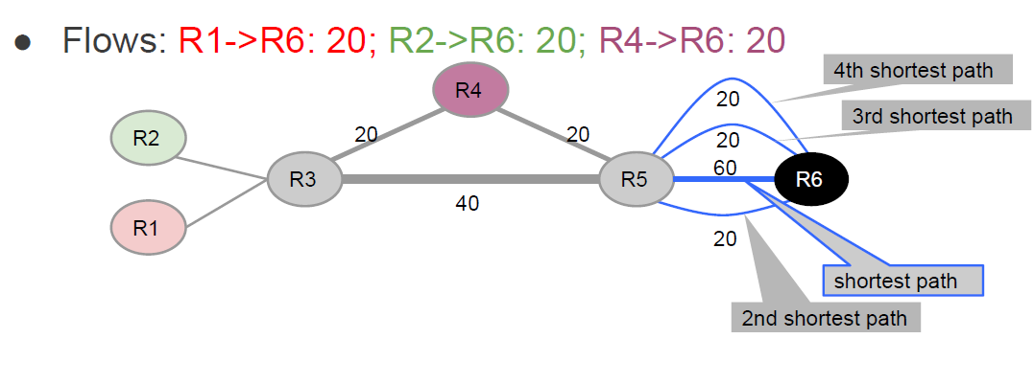
Centerlized TE: convergence after failure

Slide 8
Centerlized TE: convergence after failure

Slide 9
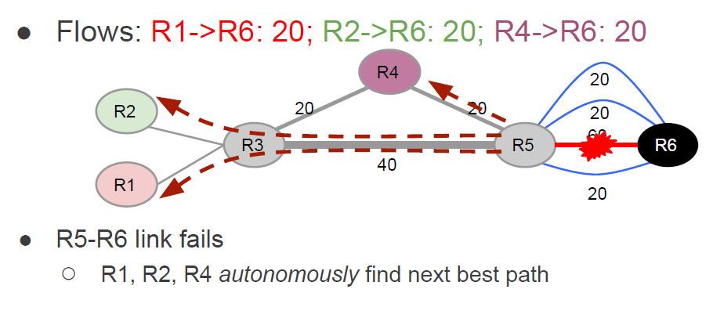
Centerlized TE: convergence after failure

Slide 10
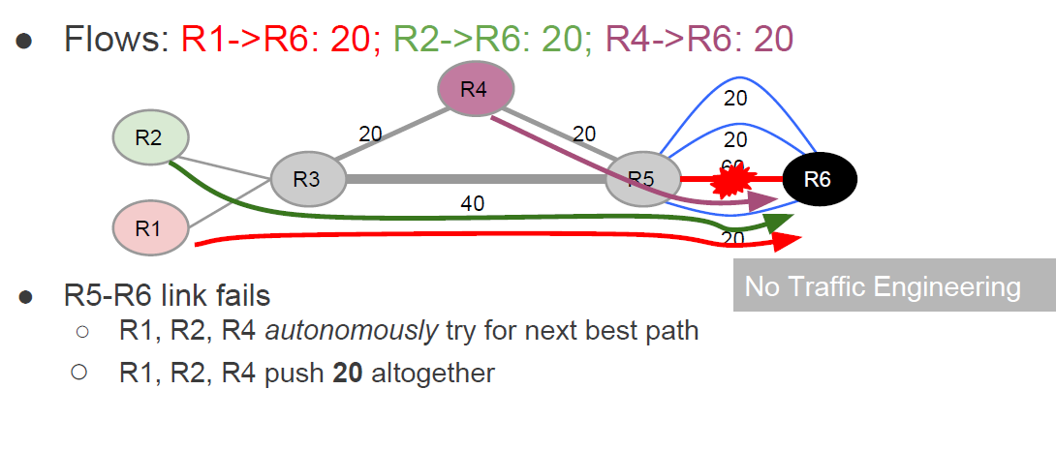
Centerlized TE: convergence after failure

Slide 11
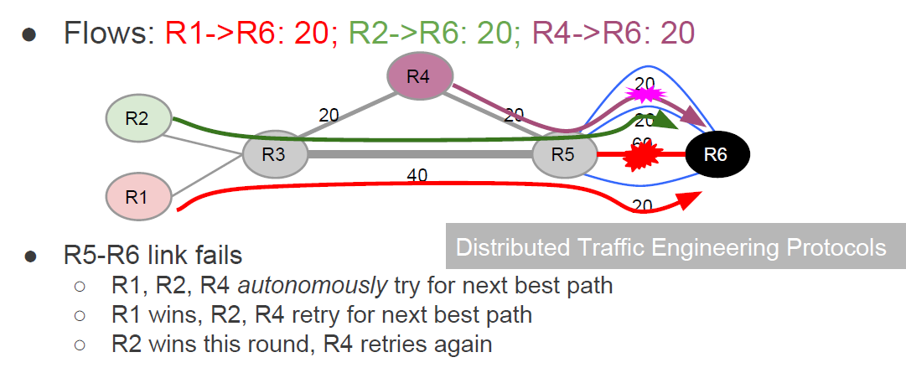
Centerlized TE: convergence after failure

Slide 12
Centerlized TE: convergence after failure

Slide 13
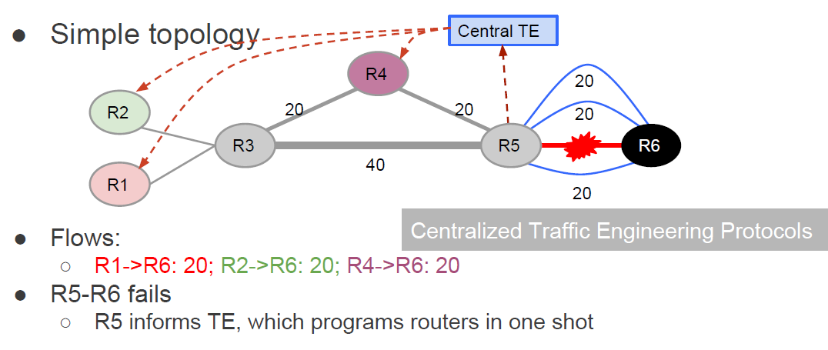
Centerlized TE: convergence after failure

Slide 14
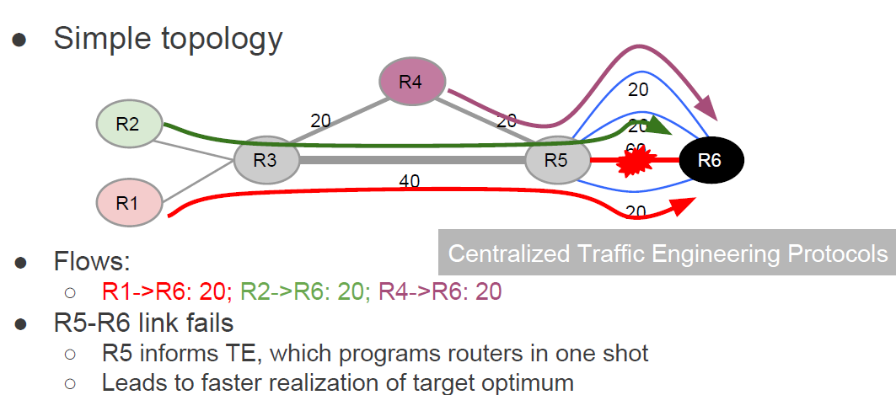
Centerlized TE: convergence after failure

Slide 15
Advantage of Centralized TE
Better network utilization with global pictures
Converges faster to target optimum on failure
Allows more control and specifying intend
Deterministic behavior simplifies planning .vs. overprovisioning for worst cast variability
Can mirror production event streams for testing
Controller uses modern server hardware – better performance (50x!)

Slide 16
B4 SDN architecture
Switch hardware (Google custom designed with commodity silicon)
Forwards traffic
No complex control software
OpenFlow controllers (OFC – ONIX based)
Maintain network state based on network control application directive and switch events
Instruct switches to set forwarding entries
Central application
Central control of the entire network

Slide 17
B4 site: SDN architecture
Traditional WAN integrated with SDN, still speaking ISIS/BGP

Slide 18
B4 site: SDN architecture
Traditional WAN integrated with SDN, still speaking ISIS/BGP

Slide 19
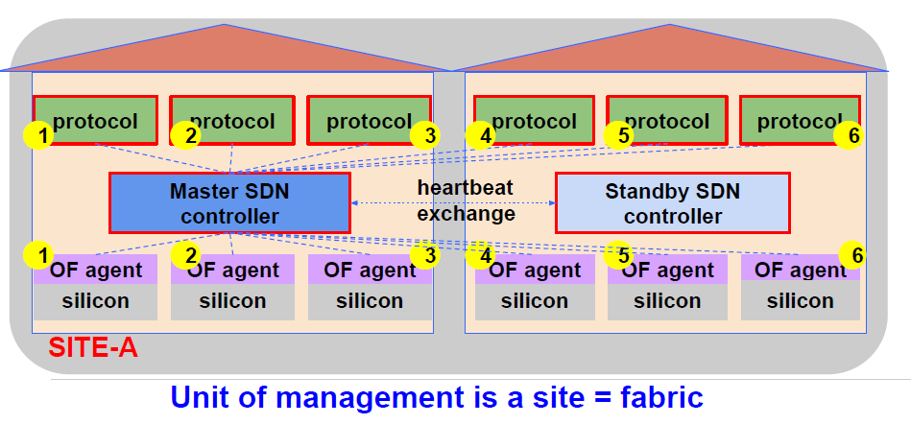
B4 site: SDN architecture
Traditional WAN integrated with SDN, still speaking ISIS/BGP

Slide 20
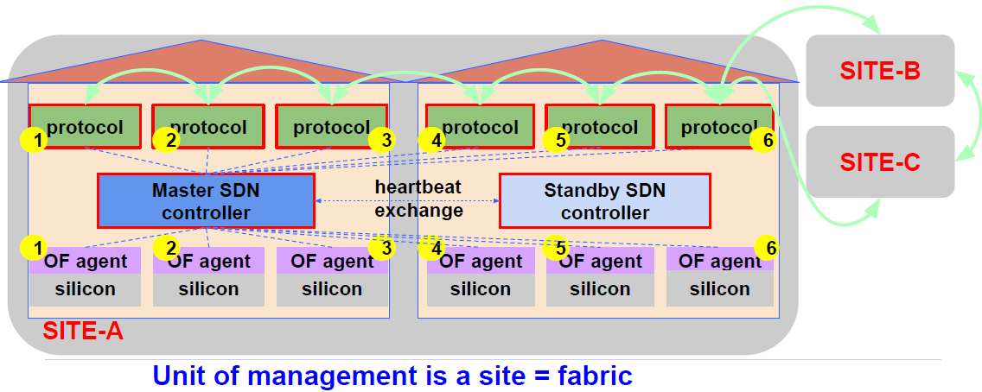
B4 site: SDN architecture
Traditional WAN integrated with SDN, still speaking ISIS/BGP

Slide 21
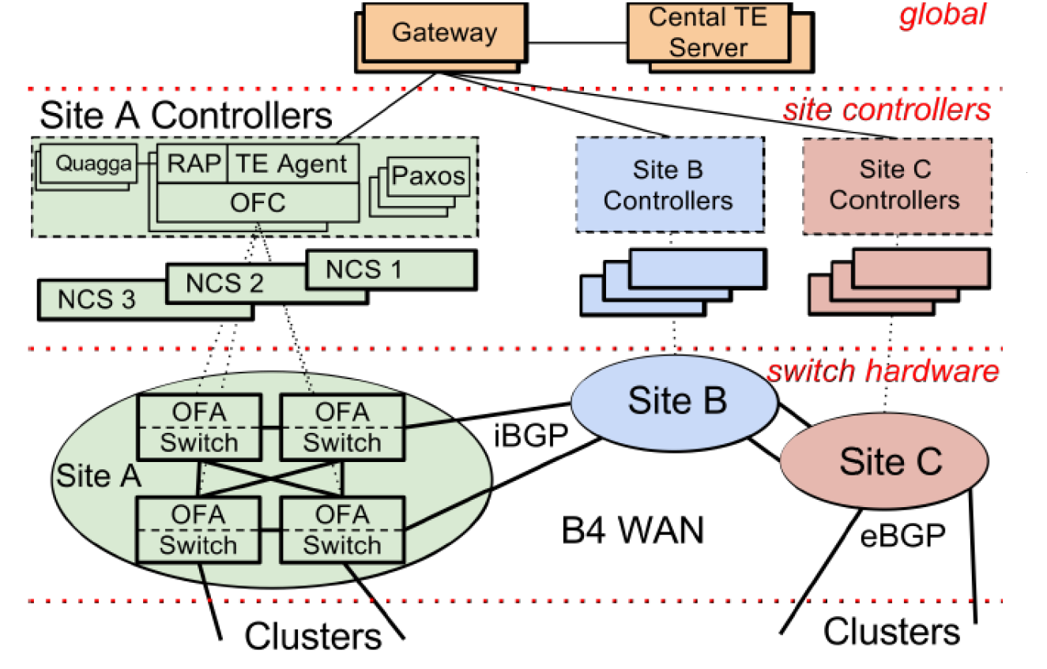
B4 architecture overview

Slide 22
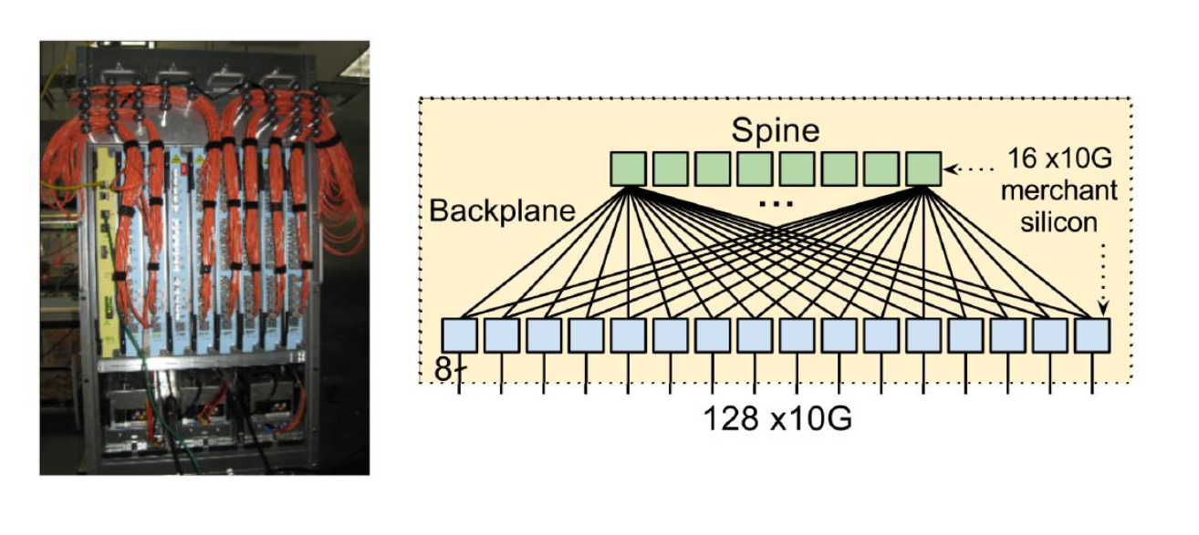
Switch design
Embedded processor running Linux; OpenFlow Agent running over Linux

Slide 23
Network control functionality
Runs on NCS in the site
Paxos for leader election
Modified Onix for OpenFlow control
Network information Base (NIB)
Topology, trunk configuration, link status.
OFC replicas standby
Static state from local configuration, dynamic network state by synchronizing with switches

Slide 24
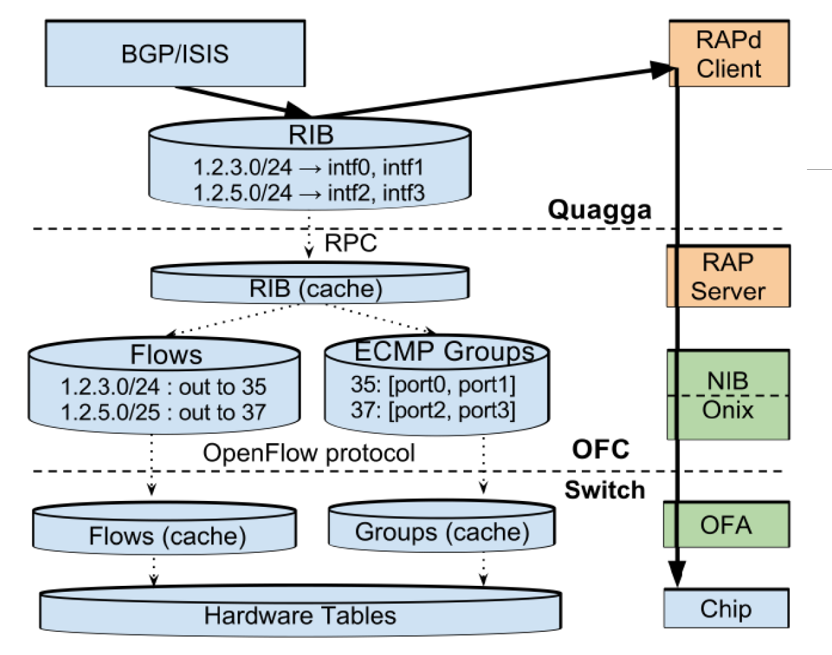
Routing: integrating OpenFlow with existing network deployment

Slide 25
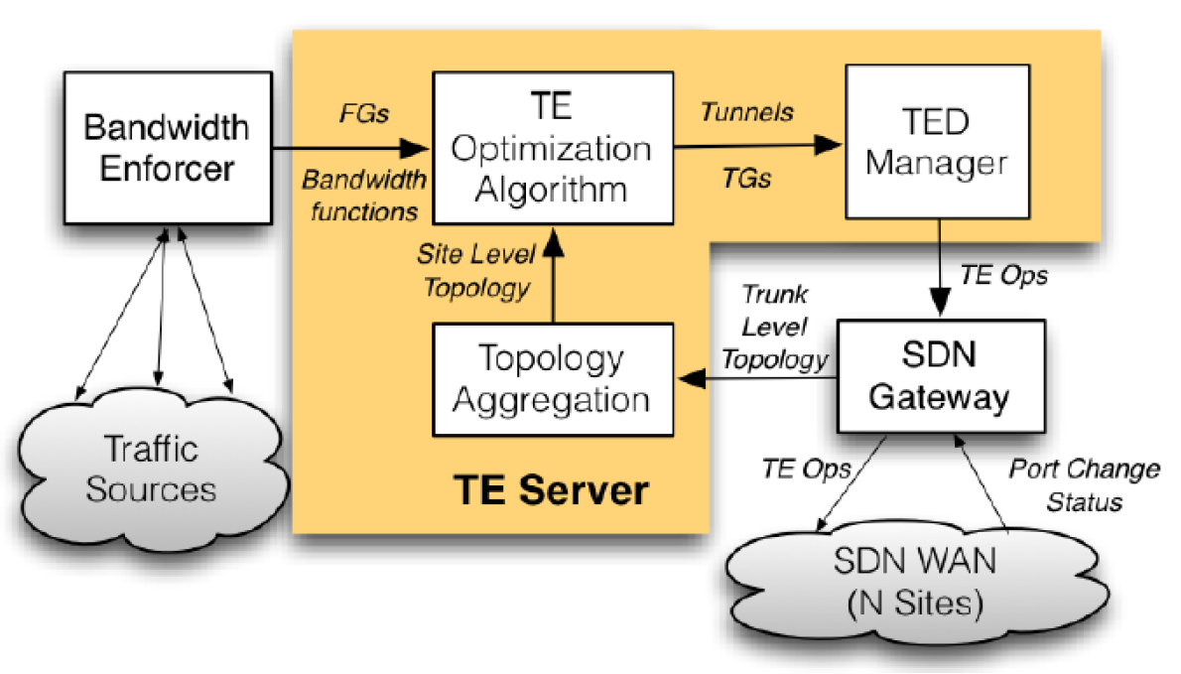
Traffic Engineering
Forming site topology
Applications are aggregated to flow group: {source site, destination site, QoS}
Tunnel represents site-level path
Tunnel group for a set of tunnels and weights
Bandwidth function linear to application weight

Slide 26
TE optimization algorithm
Target: Achieve max-min fairness
LP can get it in one shot, but too expensive the compute.
Approximate solution with bandwidth function (See the paper for details)
Tunnel Selection selects the tunnels to be considered for each flow group
Tunnel Group Generation allocates bandwidth to FGs using bandwidth functions to prioritize at bottleneck links
Tunnel Group Quantization changes split ratios in each FG to match the granularity supported by switch hardware tables.

Slide 27
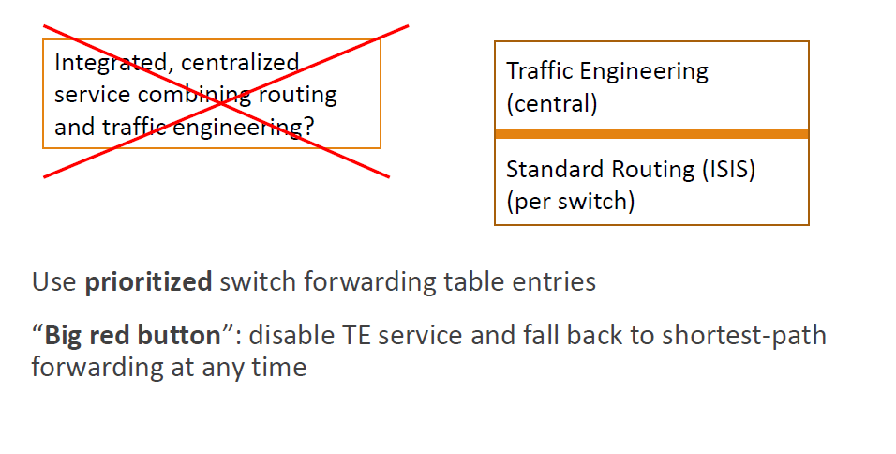
Composing routing and TE: TE as overlay

Slide 28
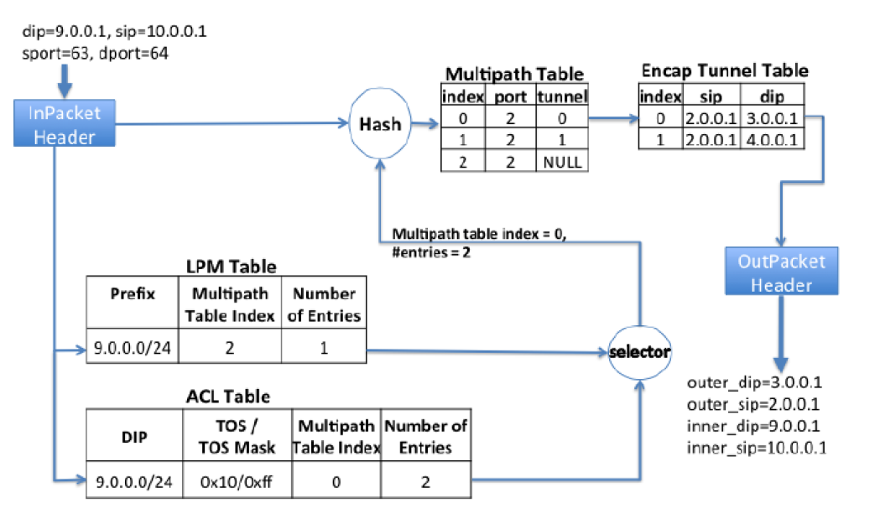
TE as overlap with tunnel

Slide 29
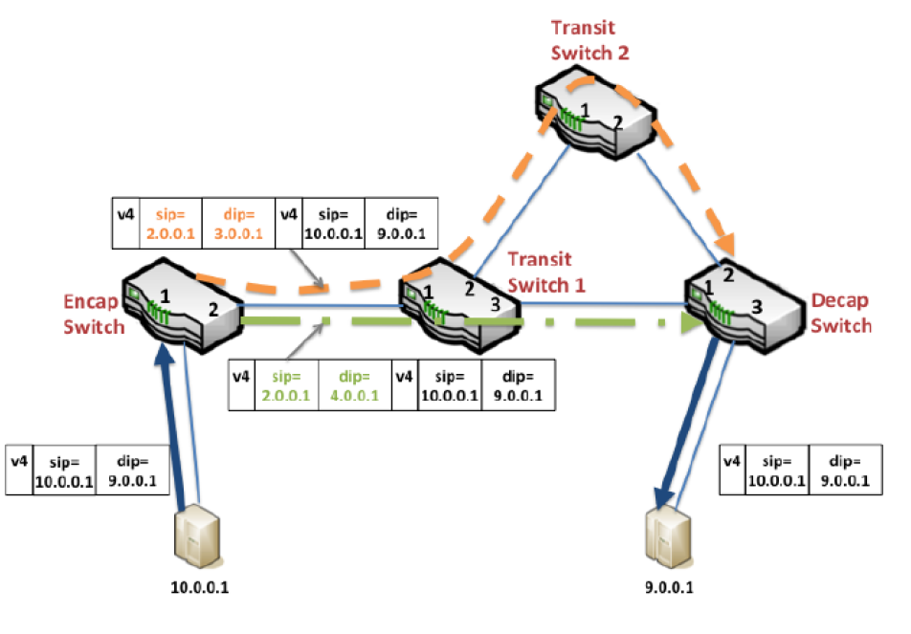
Multipath WAN routing

Slide 30
Dealing with operation dependency
Network configuration operations must be issued in some order to avoid packet drops
Rules:
Configure a tunnel at all affected sites before sending TG and FG
A Tunnel cannot be deleted until all referencing entries are removed.
Enforcing dependencies
OFC maintains the highest session sequence number
OFC rejects operatios with smaller sequence number
TE server retries any rejected ops after a timeout

Slide 31
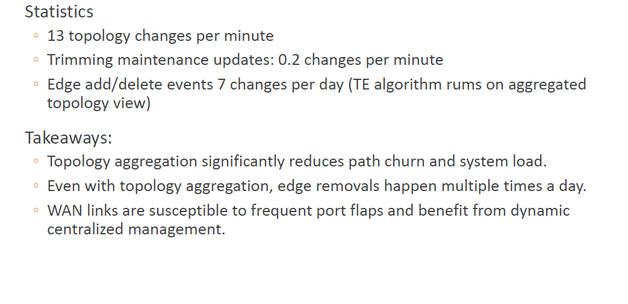
Deployment

Slide 32
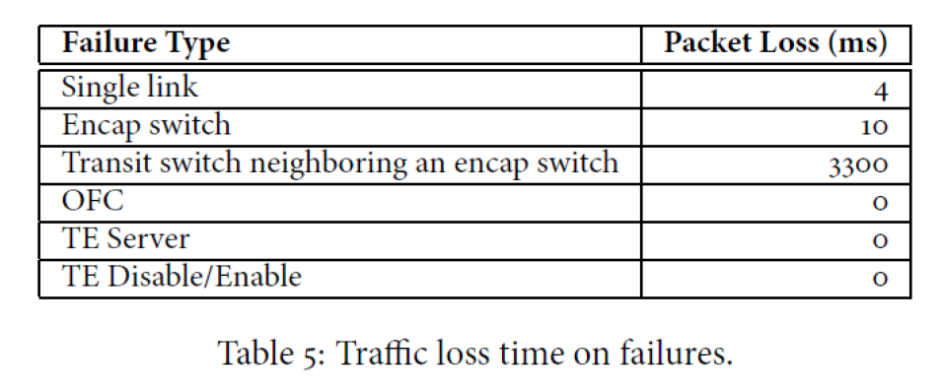
Impact of failures

Slide 33
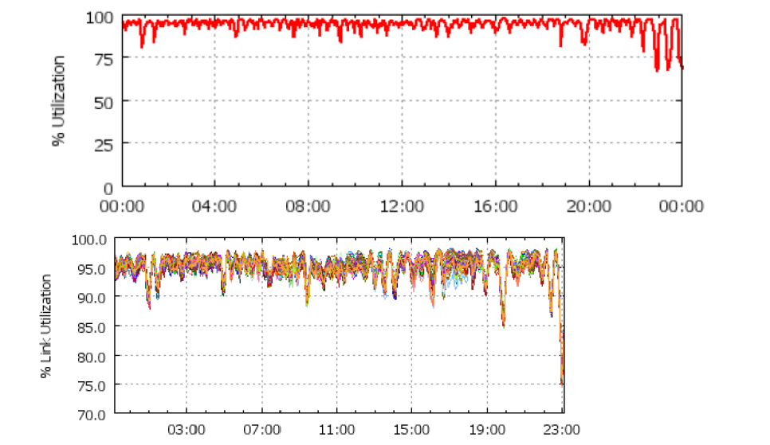
Link utilization

Slide 34
B4 Experience and Lesson

Slide 35
Message backlogged and delayed

Slide 36
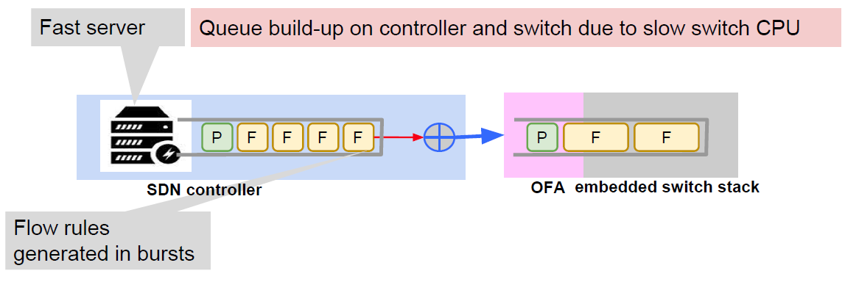
Message backlogged and delayed

Slide 37
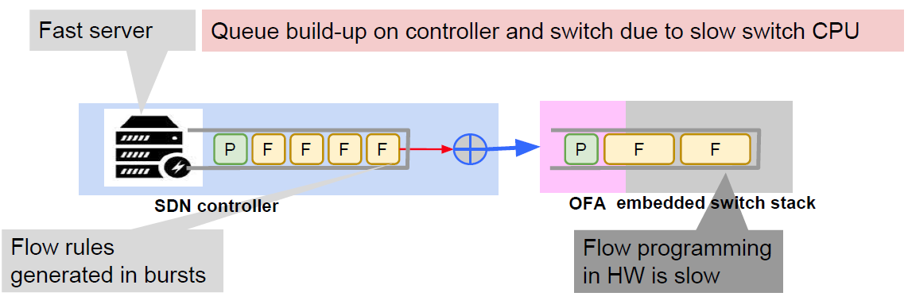
Message backlogged and delayed

Slide 38
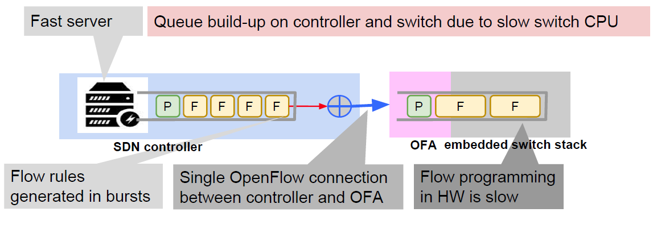
Message backlogged and delayed

Slide 39
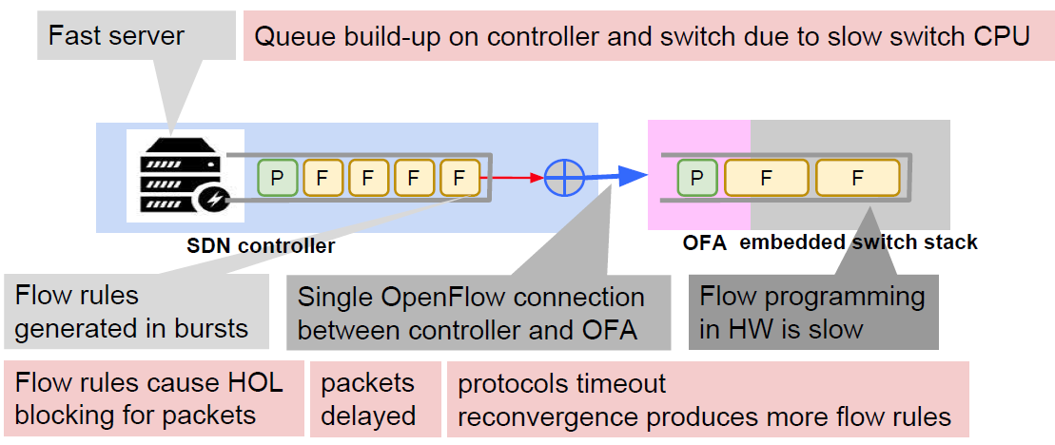
Message backlogged and delayed
Vicious cycle of protocol instability

Slide 40
Lesson: Mitigation with flow control

Slide 41
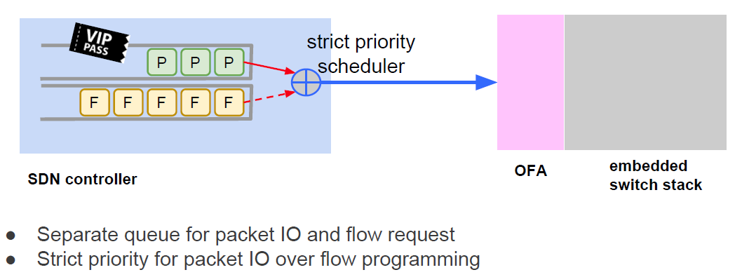
Lesson: Mitigation with flow control

Slide 42
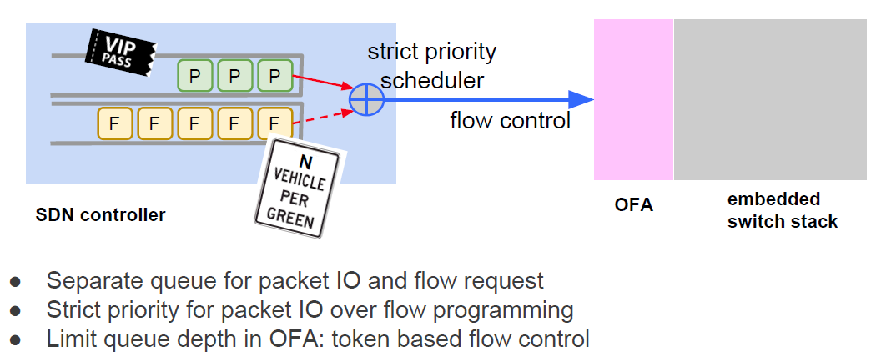
Lesson: Mitigation with flow control

Slide 43
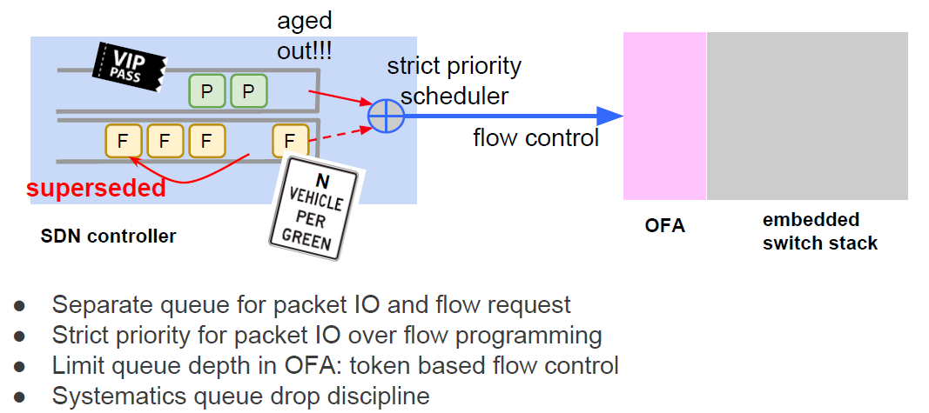
Lesson: Mitigation with flow control

Slide 44
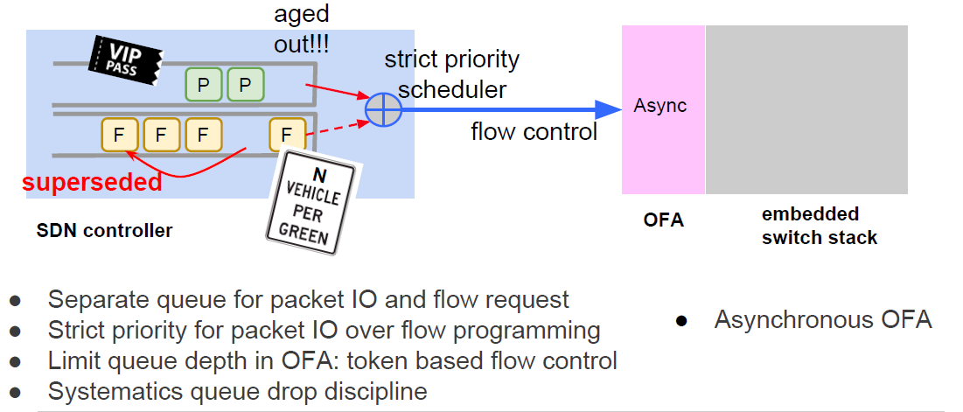
Lesson: Mitigation with flow control

Slide 45
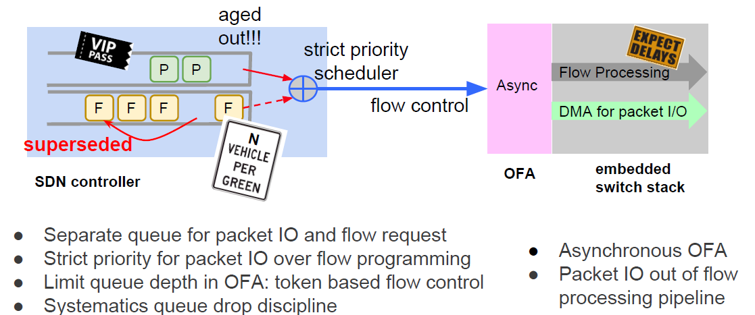
Lesson: Mitigation with flow control

Slide 46
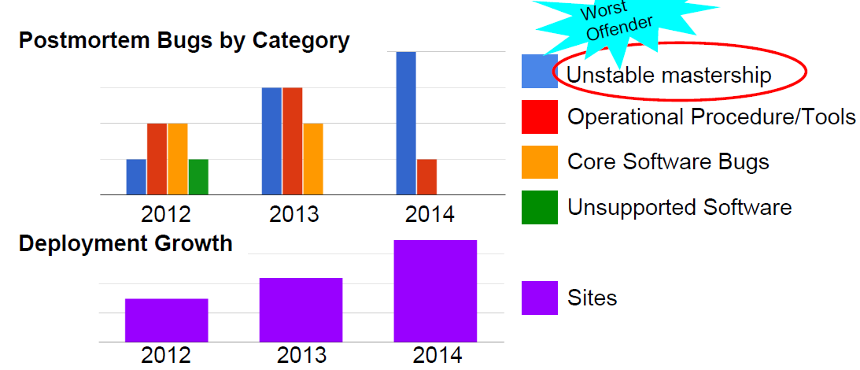
Lesson from availability: Outages

Slide 47
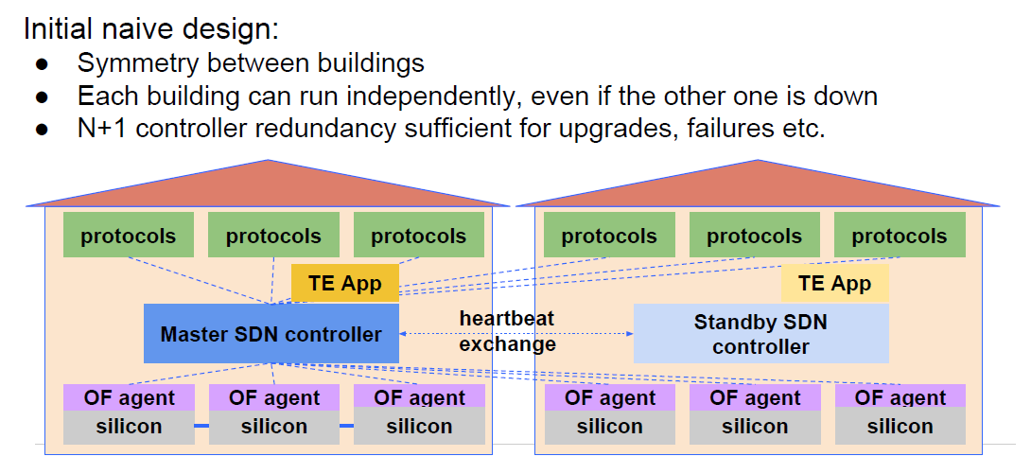
Control plan connectivity: mastership

Slide 48
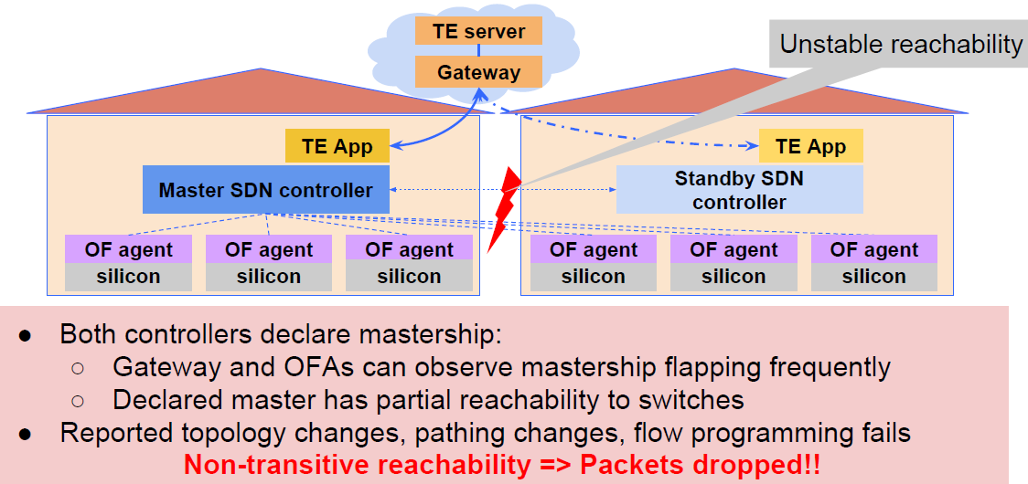
Control network: unstable mastership

Slide 49
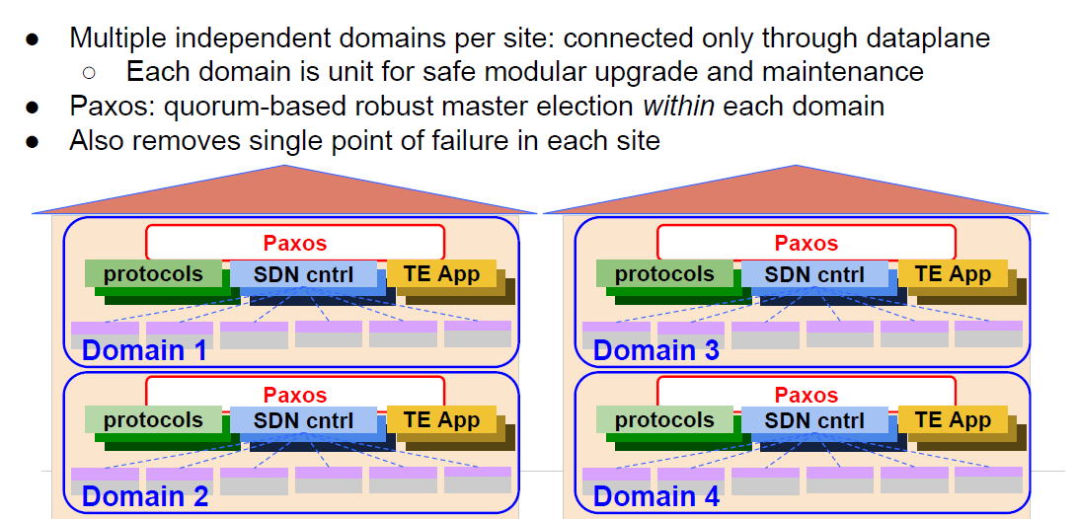
Lesson: Robust Control Reachability

Slide 50
Lesson on scaling
Flat Topology scales poorly
As B4 grows: more sites deployed
As compute per site grows: more capacity required per site
Larger switches or more switches
Larger switches: loss of large capacity on switch failure
More switches: more nodes and links tomanage
ISIS and TE will hit scaling issues, converge too slowly.

Slide 51
Lesson: Hierarchical topology

Slide 52
Lesson: Hierarchical topology

Slide 53
Conclusions
SDN is beneficial in real-world
Centralized TE delivered up-to 30% additional throughput
Decoupled software hardware rollout
Lessons to work in practice
System performance: Flow control between components
Availability: Robust reachability for master election
Scale: hierarchical topology abstraction.

