Slide 1
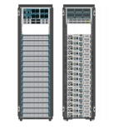
SDN controllers
App
App
App
App
App
App
App
App
App
App
App
Network elements has two components: OpenFlow client, forwarding hardware with flow tables.
The SDN controller must implement the network OS functionality
  Provide abstraction to the upper layer
  Provide control to the underlying hardware
  Managing the resources
Northbound Interface
SDN controller
OpenFlow

Slide 2
SDN controllers (NOS) .vs. OS
OS
Network OS
Resources managed
  CPU, memory, disk, IO devices, etc
Applications:
  User programs that use the resources
OS functionality (abstraction):
  CPU virtualization
  Memory virtualization
  IO virtualization
  File systems
Resources managed
  Connected switches/routers/NICs
Applications
  Firewall, migration, network virtualization, NAT, TE, etc
NOS functionality?
  Network abstraction – this is a new thing that is not well understood.

Slide 3
NOS functionality
From: “NOX: towards an Operating System to Networks”
  NOS should present application programs with a centralized programming model
  Programs should be written in terms of high level abstractions, not low-level parameters

Slide 4
Existing SDN controllers
NOX/POX
Ryu
Floodlight
Pyretic
Frenetic
Open Daylight
And many more
Some artificial differences: language
More important differences:
  API
  Functionality

Slide 5
SDN controller: NOX/POX
Originally developed by Nirica
NOX: C++ version; POX: python version
  Nox for performance; Pox for rapid prototyping.
POX comes with Mininet – the simulation infrastructure
OpenFlow v.1.0
Programming model:
  Controller registers for events (PacketIn, ConnectionUP, etc).
  Programmer write event handler
NOS does little for the applications

Slide 6
NOX/POX component
NOX/POX controller
Connection
Manager
Event
dispatcher
OpenFlow
Manager
DSO
Deployer
Input/output Socket
Asynchronous File
OpenFlow
API
Threading and event
management
Other
utilities

Slide 7
NOX/POX Events
FlowRemoved
ConnectionUP
PacketIn
etc
User write event handlers
  E.g. ConnectionUp: record in the database, PacketIn: compute the route, setup flow table along the path, etc
Abstraction? Global view build from control program, fairly low level.

Slide 8
Open Daylight controller
Industrial strength SDN controller
Heavy industry involvement and backing
Focuses on having an open framework for SDN/NFV innovations
  Not limited to OpenFlow

Slide 9
What is OpenDaylight?
OpenDaylight is an open source project under the Linux Foundation with the mutual goal of furthering the adoption and innovation of Software Defined Networking (SDN) through the creation of a common industry supported framework.
Enjoyed broad industry support
Information from: https://wiki.opendaylight.org/view/OpenDaylight_Controller:[Overview|Architectural_Framework|...]

Slide 10
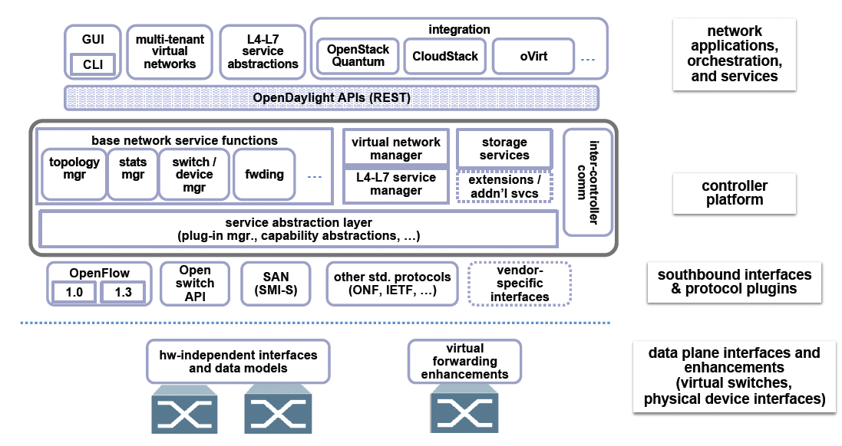
OpenDaylight Architectural Framework

Slide 11
Some Notes on the Architectural Framework
Extensible south-bound interface beyond OpenFlow through SAL (service abstraction layer)
  Benefit?
North-bound interface: REST API.
Controller platform seems to provide more than other controllers.

Slide 12
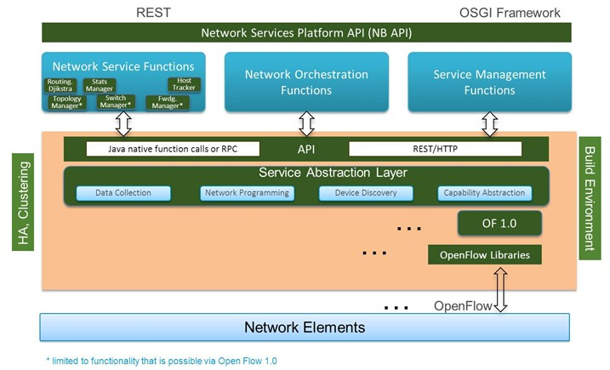
Open Daylight Controller
Written in Java and runs on anything that supports Java.
Southbound support multiple protocols as plugins.
Modules linked dynamically into a Service Abstraction layer (SAL)
Main function in the controller: topology manager – topology, device capabilities, and reachability, etc with many supporting modules

Slide 13
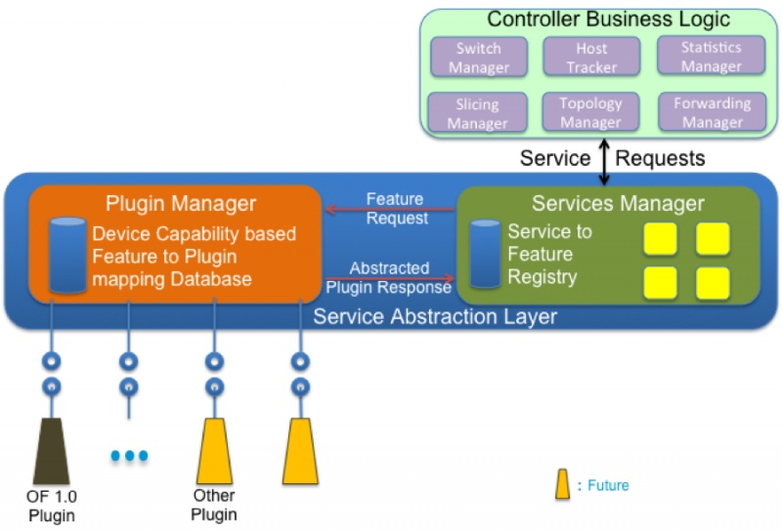
Service Abstraction Layer
Supports multiple protocols on the southbound and provides consistent services for other modules and Apps.
SAL exposes basic services from the plugins
SAL maps service request to the appropriate plugins.
Plugins are independent and loosely coupled with SAL.

Slide 14
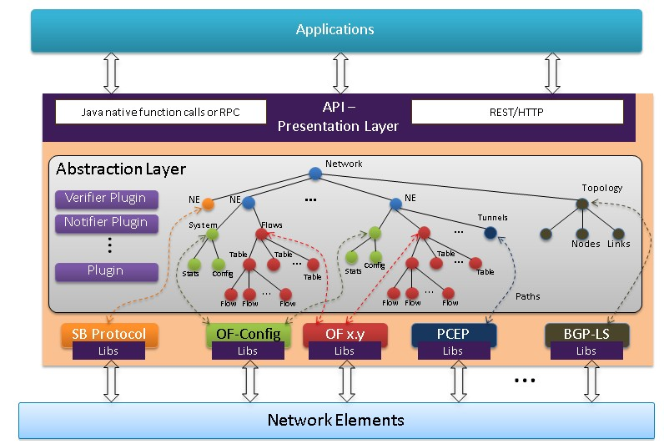
Plugins provide portions of the overall network model tree

Slide 15
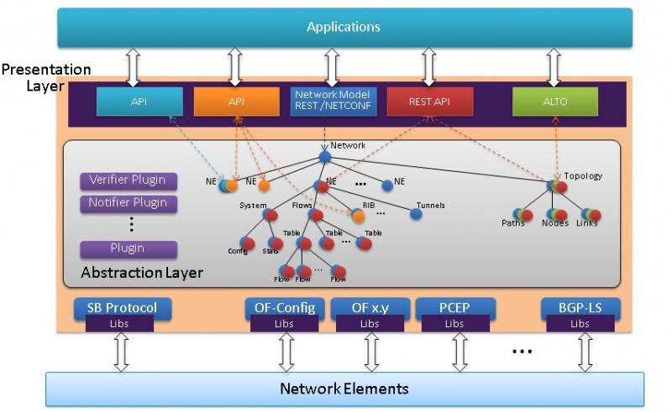
Access information in the network model tree

Slide 16
The REST API
A REST API is not a protocol, language, or standard.
The concept of a REST API or an API that is RESTful means that API adhere to the contrains of REST (defined by Roy Fielding)
  Client-Server: maximize the portability of server-side functions to other platforms.
  Stateless: states are kept in the client side.
  Caching
  Layered System: client only interacts with its neighbor (not two layers apart)
  Uniform interface
  Code-on-demand

Slide 17
OpenDaylight REST API
https://wiki.opendaylight.org/view/OpenDaylight_SDN_Controller_Platform_(OSCP):Rest_Reference
The REST API provides access to the network database that includes configuration data for the controller (e.g. static flow table entries), data for dynamically discovered network entities (e.g. switches, hosts), and statistics and logging data.

Slide 18
OpenDaylight REST API
Querying items
  HTTP GET method
  URL form: "http://<domain-or-ip-address>/rest/v1/model/<data-type>/<optional-id>?<optional-query-params>“
  Example:
    http://<host-name-or-ip>/rest/v1/model/switch/00:00:00:00:00:00:00:01
    Return Text {"tables": 1, "socket-address": "/192.168.2.104:50663", "connected-since": "2012-07-16 03:46:28.572000", "capabilities": 71, "active": true, "controller": "02a32314-7a75-44fe-9412-6bcb36b25367", "actions": 2367, "ip-address": "192.168.2.104", "dpid": "00:00:00:00:00:32:90:11", "tunneling-capable": false, "buffers": 256}

Slide 19
OpenDaylight REST API
Creating and updating items
  HTTP PUT method
  URL form: "http://<domain-or-ip-address>/rest/v1/model/<data-type>“
  The PUT data is in the JSON format, each item is a JSON object.
Such HTTP JSON REST API can then be mapped to different languages such as java, python, etc.

Slide 20
Classes or OpenDaylight REST API
Topology REST APIs
Host Tracker REST APIs
Flow Programmer REST APIs
Static Routing REST APIs
Statistics REST APIs
Subnets REST APIs
Switch Manager REST APIs
User Manager REST APIs
Container Manager REST APIs
Connection Manager REST APIs
Bridge Domain REST APIs
Neutron ML2 / Network Configuration APIs

Slide 21
Example of REST API binding to
Check out
  http://hp-sdn-client.readthedocs.io/en/latest/api/of.html

Slide 22
Conclusion
SDN controller’s basic function is to create the global view of the network, mainly by maintaining the global topology/routing information.
  Getting the information
  Maintaining the information
  Allow access and update of the information
Network operation logics should be built in SDN applications.

