Slide 1
Road to SDN
Review the main features of SDN
Discuss the timeline of SDN techniques in the past
Gain awareness about the ideas and principles behind SDN
Recognize architectural themes in computer networking where SDN originated
Materials from
Nick Feamster, Jennifer Rexford, and Ellen Zegura, “The Road to SDN: An intellectual history of programmable networks,” ACM queue, 11(12), 2013.
Dr. Nick Feasmter’s lecture notes in his SDN class at Georgia Tech.

Slide 2
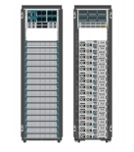
Main features of SDN
App
App
App
App
App
App
App
App
App
App
App
Separation of control plane and data plane
Centralized global view
Programmability in networks
Open Interface
Net Windows
Net Linux
Net Mac
OS
or
or
Open Interface

Slide 3
Evolution of the SDN supporting technologies: centralized global view
Dating back to 1980: AT&T’s Network Control Point (NCP).
S. Horing, et.al., “Stored Program Controlled Network: Overview”, The Bell System Technical Journal, 61(7), 1982.
To overcome the issue with earlier networks with in-band signaling for fast deployment of new services.
Without NCP, new services require new equipment

Slide 4
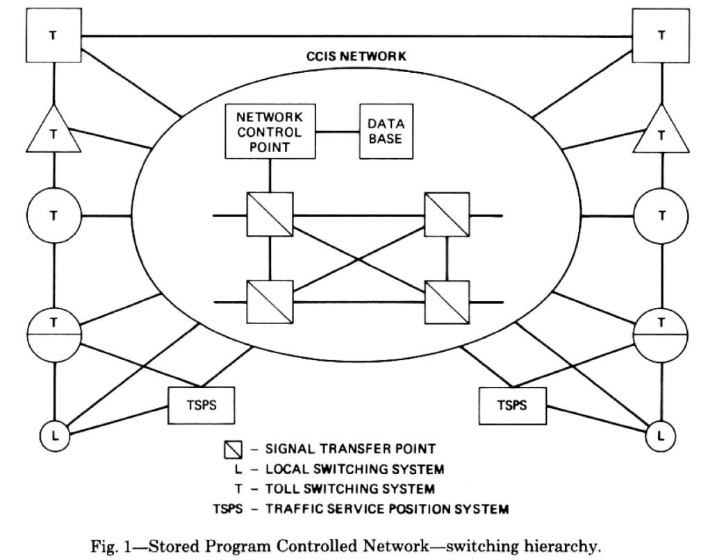
Network Control Point
A network-wide global view
New apps template:
Collect N digits phone number
Send a message to NCP
Make a billing record
Provide the service
Used to route 800 numbers

Slide 5
Network Control Point
A network-wide global view
Direct observe rather than infer network wide behavior
Know the busy/idle status before requesting a path
Independent evolution of infrastructure, data, and services
Services and resource allocation decisions can be updated based on customer data, network load, etc, not the network infrastructure.

Slide 6
Evolution of SDN technologies: Programmability in Networks
Active networks (mid 90’s to early 2000)
The original active networks idea came from the parallel processing community.
Add processing code to packet header. Receiver can process the packet by running the code: reduce the OS involvement in the receiving end.
In the Internet domain, active network meaning using some mechanism to actively process packets by intermediate switches
Packet carrying program directly (integrated approach, Capsules)
Packet carrying a code and the active node running program based on packet header. (discrete approach, programmable switches)
Network become more intelligent with programmability
D.L. Tennenhgouse and d. J. Wetherall, “Towards an Active Network Architecture,” ACM SIGCOMM CCR, 26(2):5-18, 1996.
Wetherall, D., Guttag, J., Tennenhouse, D. 1998. ANTS: a toolkit for building and dynamically deploying network protocols. In Proceedings of IEEE OpenArch.

Slide 7
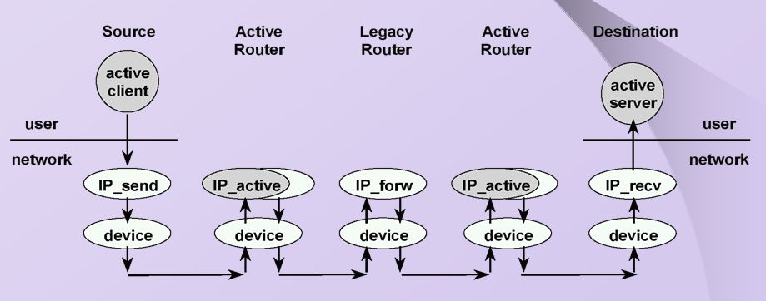
Active networks: how it work
Networks where switches perform custom computations on packets
Examples: Tracing, firewalls, proxies, application services (multicasting, etc)
Active routers coexist with legacy routers
Active routers perform additional processing

Slide 8
Motivation for active networks
Problem in today’s network (1994-1995)
Difficulty of integrating new technology
Poor performance due to redundant operations at several protocol layers
Difficulty accommodating new services
Accelerating innovation
User pulls (demand)
Proliferation of middleboxes (firewall, NAT, proxies, transcoder, etc) – a lot of processing in the middle of networks
Replace ad hoc approaches for processing in the middle of networks.
Technology push (enablers)
Safe execution of mobile code, Java applets
OS support
Scout: real-time communications
Exokernel: safe access to low-level resources
SPIN: trustworthy code generation

Slide 9
Results
Deployment: failed, network is still passive.
Timing
No clear application
Hardware support not cheap – using ASICs (no TCAMs, FPGAs, NPUs)
Missteps
Security, special languages for safe code, packet carrying code
End user as programmers (not network operators)
Interoperability
Some good ideas remain
Programmable functions in networks to enable innovation
Demultiplexing programs on packet headers
Paying attention to middleboxes and how the functions are composed.

Slide 10
Evolution of SDN technology: Separation of control plane and data plane
Why separate control?
More rapid innovation: control logic is not tied to hardware
Network-wide view: Easier to infer and reason about network behavior
More flexibility: can introduce new services more easily
Efforts:
Separate control channels: ForCES (2003)
In-band protocols: Routing control platform (2004)
Open hardware: Ethane (2007) and OpenFlow (2008)

Slide 11
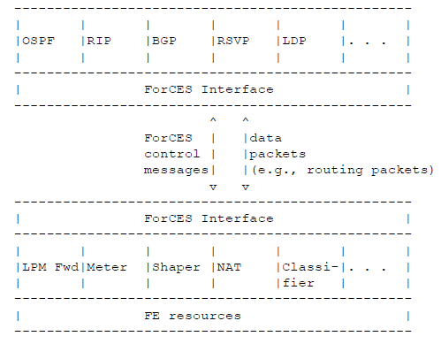
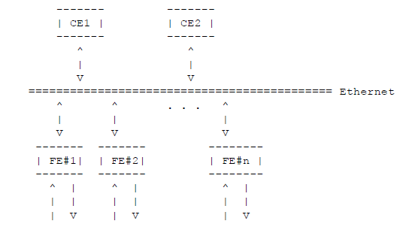
Custom control: IETF FORCES (2003)
Attempt to standardize the protocol between control elements and forwarding elements
RFC 3654, “Requirements for Separation of IP Control and Forwarding”, November 2003.
RFC 3746, “Forwarding and Control Element Separation (ForCES) Framework,” April 2004.

Slide 12
Custom control: IETF FORCES (2003)
Problem: requires standardization adoption, deployment of new hardware
Same old problems.
Not completely solving the problem

Slide 13
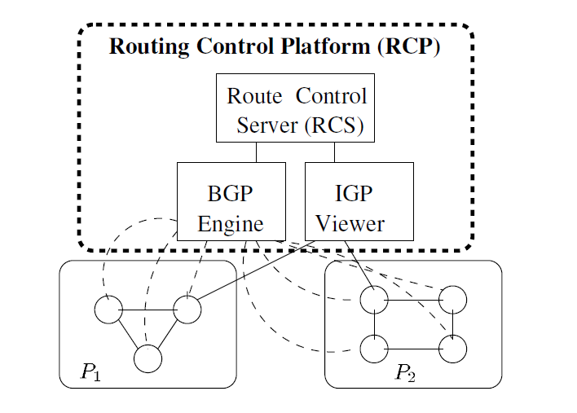
Routing control platform
Matthew Caesar, et. Al, “Design and Implementation of a routing control platform,” NSDI 2005.
What is new? A centralized controller with global view
Deployment compromise: Using existing routing protocols to interact with routers (IGP to get the view, BGP to distribute routes). Move route computation to a different box.

Slide 14
Routing control platform
Advantage: Offload routing from routers without additional support. The system can be deployed in the current networks
Limitations: Control is limited by what existing protocols can do.

Slide 15
Ethane
M. Casado, “Ethane, Taking control of the enterprise.” ACM SIGCOMM CCR, 37(4), 2007.
Predecessor of OpenFlow
Problems: too much manual configurations in enterprise networks.
Middleboxes at network choke points
additional tools, protocols, and layers
Need to make it more manageable!

Slide 16
Three principles
The network should be governed by policies declared over high level names
Policy should determine the path that packets follow
The network should enforce a strong binding between a packet and its origin.

Slide 17
Ethane design
Central controller
Global network policy and topology view
Ethane switches
Simple flow tables
Packets from unknown flows are forwarded to controller for decision
Actions can be added to flow table
Names and policy language
All users, hosts, switches, protocols have names that are used in the rules for the controller

Slide 18
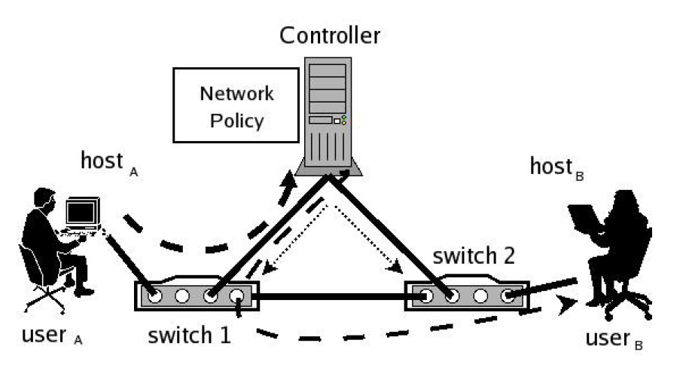
Flow setup and forward
Flow setup
UserA initiates connection to userB
Switch 1 has no matching entry in flow table, forward the packet to controller
If controller accepts, computes path and updates all switches along path
Forwarding
Controller sends packet back to switch 1, which forwards it and adds new entries in the table for subsebsequent packets from the flow to be processed.

Slide 19
Summary
SDN features are the results of numerous tries to (1) simplify the network control and management and to (2) make it easier to introduce new services (innovation).
Separation of control plane and data plane
Centralized global view
Programmability in networks

