Slide 1
SDN and Virtualization
“Can the Production Network Be the Testbed?” (Flowvisor), OSDI, 2010
“Network Virtualization in Muti-tenant Datacenters,” NSDI 2014

Slide 2
Flowvisor Overview
App
App
App
App
App
App
Controller 1
Controller
2
Windows
(OS)
Linux
Mac
OS
Controller 1
Controller
2
Windows
(OS)
Linux
Mac
OS
Controller 1
Controller
2
Windows
(OS)
Linux
Mac
OS
Virtualization
Virtualization (FlowVisor)
x86
(Computer)
OpenFlow
Simple, common, stable, hardware substrate below
+ Programmability
+ Strong isolation model

Slide 3

Flowvisor Overview (Cont’d)
• Divide the production network into logical slices
o each slice/service controls its own packet forwarding
o users pick which slice controls their traffic: opt-in
o existing production services run in their own slice
▪e.g., Spanning tree, OSPF/BGP
• Enforce strong isolation between slices
o actions in one slice do not affect another
• Allows the (logical) slice to mirror the production network
o real hardware, performance, topologies, scale, users

Slide 4
Network slice and flowspace
A network slice controls a subset of traffic
The subset is defined by a collection of packet headers.
  n-bit headers has n-dimension space – flowspace
Example:
  HTTP traffic – TCP port = 80
  All traffic from node 127.2.1.12 – IP_SRC=127.2.1.12
A subset of flowspace + a subset of topology = network slice

Slide 5
Substrate: “Flowspace”
Ethernet
DA, SA, etc
IP
DA, SA, etc
TCP
DP, SP, etc
Payload
Collection of bits to plumb flows
(of different granularities)
between end points
Header
User-defined flowspace
Payload
“OpenFlow++”

Slide 6
Properties of Flowspace
Backwards compatible
  Current layers are a special case
  No end points need to change
Easily implemented in hardware
  e.g. TCAM flow-table in each switch
Strong isolation of flows
  Simple geometric construction
  Can prove which flows can/cannot communicate

Slide 7
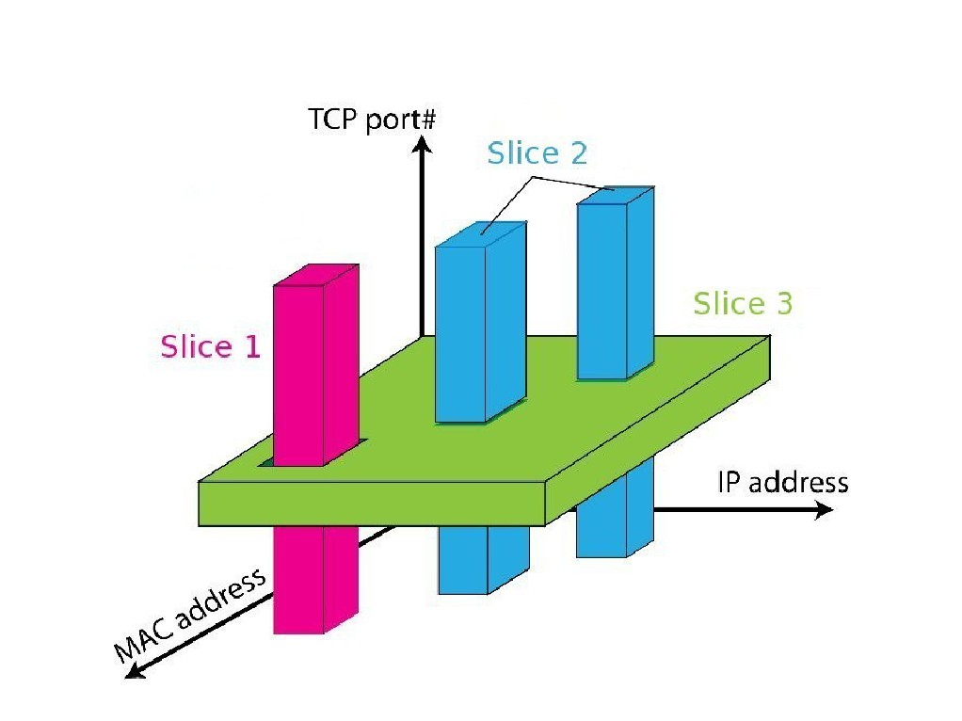
FlowSpace: Maps Packets to Slices

Slide 8
Real User Traffic: Opt-In
• Allow users to Opt-In to services in real-time
o Users can delegate control of individual flows to
Slices
o Add new FlowSpace to each slice's policy
• Example:
o "Slice 1 will handle my HTTP traffic"
o "Slice 2 will handle my VoIP traffic"
o "Slice 3 will handle everything else"
• Creates incentives for building high-quality services

Slide 9
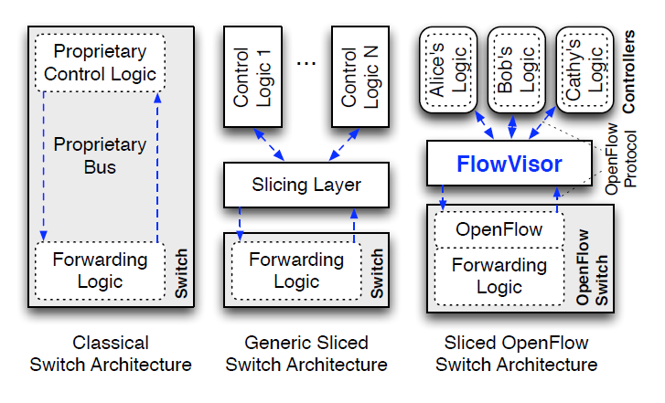
Slicing control & data planes

Slide 10
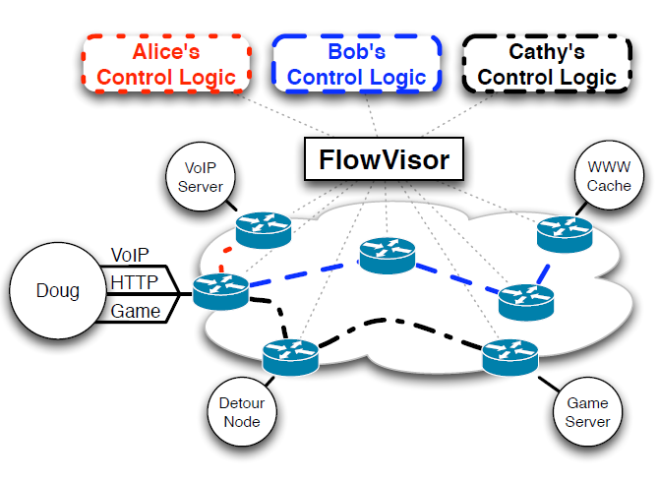
Slicing OpenFlow

Slide 11
Network Slicing Architecture
A network slice is a collection of sliced switches/routers
• Data plane is unmodified
- Packets forwarded with no performance penalty
- Slicing with existing ASIC
• Transparent slicing layer
- each slice believes it owns the data path
- enforces isolation between slices
• i.e., rewrites, drops rules to adhere to slice police
- forwards exceptions to correct slice(s)

Slide 12
Slicing Policies
The policy specifies resource limits for each slice:
- Link bandwidth
- Maximum number of forwarding rules
- Topology
- Fraction of switch/router CPU
FlowSpace: which packets does the slice
control?

Slide 13



FlowVisor Slicing Example
Bob’s
Controller
Alice’s
Controller
OpenFlow
Protocol
OpenFlow
Switch
FlowVisor
OpenFlow
Protocol
OpenFlow
Switch
OpenFlow
Switch

Slide 14



FlowVisor Slicing Example (Cont’d)
http
Load-balancer
Broadcast
Multicast
OpenFlow
Protocol
OpenFlow
Switch
FlowVisor
OpenFlow
Protocol
OpenFlow
Switch
OpenFlow
Switch

Slide 15
FlowVisor Slicing Example (Cont’d)
LTE-WiFi
Handover
Tricast Lossless
Handover
Learning
switch
Mobile VMs
New BGP
Bob’s
FlowVisor
Alices’s
FlowVisor
GENI’s
FlowVisor
Production
Network
Controller
OpenFlow Protocol
Network Administrator’s
FlowVisor
OpenFlow Protocol
OpenFlow
Switch
OpenFlow
Switch
OpenFlow
Switch

Slide 16
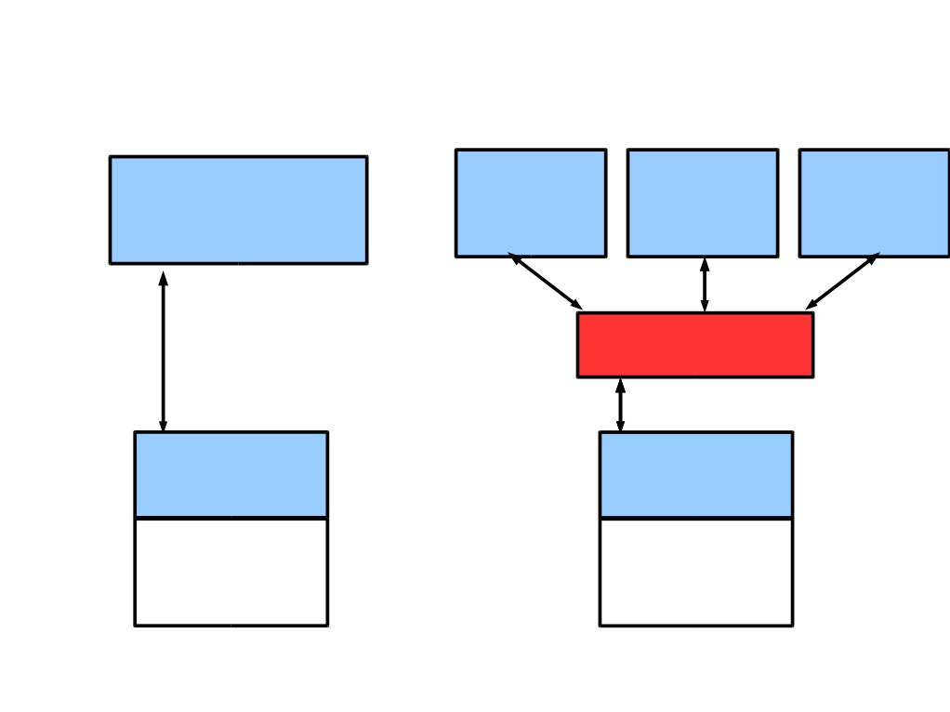
FlowVisor Implemented on OpenFlow
Server
Servers
Custom
OpenFlow
Controller
OpenFlow OpenFlow OpenFlow
Control
Controller Controller Controller
Plane
OpenFlow
Network
OpenFlow
FlowVisor
Protocol
OpenFlow
Stub
Control
OpenFlow
OpenFlow
Plane
Firmware
Firmware
Data
Plane
Data Path
Data Path
Switch/
Switch/
Router
Router

Slide 17
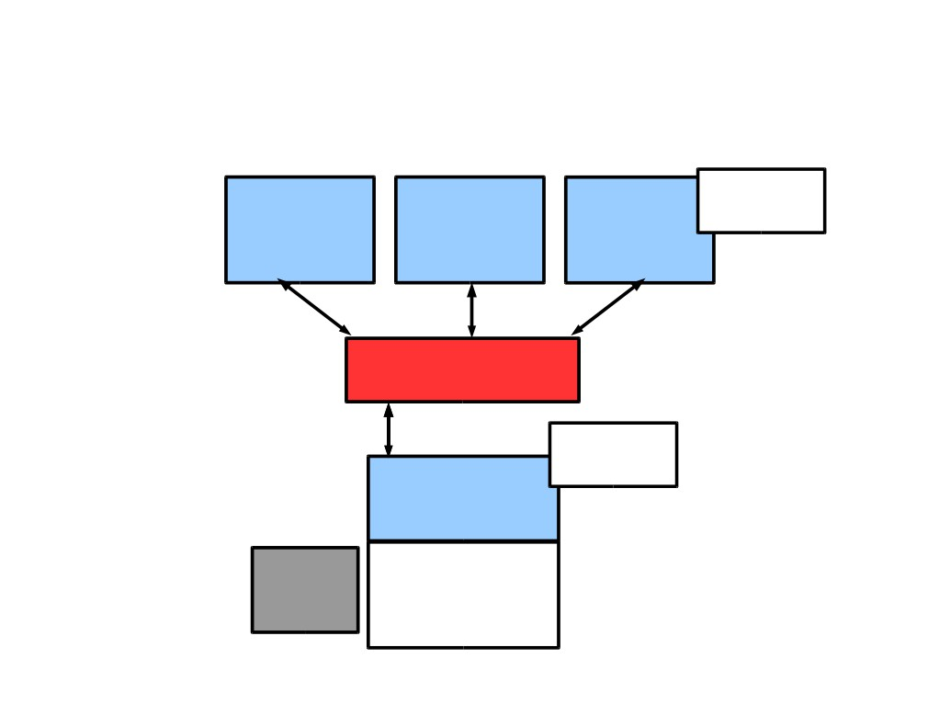
FlowVisor Message Handling
Alice Bob
Rule
Cathy
Controller Controller
Controller
OpenFlow
Policy Check:
Policy Check:
Is this rule
allowed?
FlowVisor
Who controls
this packet?
OpenFlow
Full Line Rate
Forwarding
Exception
OpenFlow
Firmware
Packet
Data Path
Source: R. Sherwood

Slide 18
Flowvisor implementation
Message to control plane
Message to forwarding plane
Bandwidth isolation
Device CPU isolation
Flow entry isolation

Slide 19
Flowvisor implementation
Message to control plane
  Rewrites message from OpenFlow switch to slice controller for transparency
  only send message when switch is in slice topology
  slice controller only sees the ports that appears in the slice
  port up/down message only to affected slices
Message to forwarding plane
  rewrite the insert and delete flow table messages
  only to the switches in the slice

Slide 20
Flowvisor implementation
Bandwidth isolation
  per-port queues in switch hardware
  Flowvisor creates a per-slice queue on each port
  queue is configured for a certain bandwidth as defined in slice definition
  rewrite rules from “send out port X” to “send out queue Y on X”.

Slide 21
Flowvisor implementation
CPU isolation
  Device CPU on commodity network hardware are low-power embedded processors, easily overloaded, no isolation mechanism
  Work around: no slice monopolizes device CPU
  Limiting rule insertion rate from controller
  Use periodic drop rules to throttle exceptions
Flow table entry isolation
  Enforce what is defined by the slice

Slide 22
Conclusion
• Network slicing can help perform more realistic
evaluations and support multiple tenants
• FlowVisor allows experiments to run concurrently
but safely on the production network
• Currently limited to subsets of actual topology
  - Add virtual links, nodes support

Slide 23
SDN and Virtualization
“Can the Production Network Be the Testbed?” (Flowvisor), OSDI, 2010
“Network Virtualization in Multi-tenant Datacenters,” NSDI 2014

Slide 24
Multi-tenant datacenter challenges
Tenants want to move their code from their enterprises directly to datacenters without modification
  Different services require different topologies – flat L2, some L3, multiple levels of services
  Address space: virtualized workload should not operate in the same address space as the physical network (VM’s IP is learned from the first L3 router!)
    Cannot move MV to arbitrary locations
    Tenant cannot manage its own IP
    Operator cannot change the addressing type.

Slide 25
Multi-tenant datacenter challenges
Ideal multi-tenant datacenter:
  Arbitrary network topologies and addressing architectures could be overlayed over the same physical network.
  Network virtualization: not clear what it is
    a network virtualization layer allows for the creation of virtual networks, each with independent service models, topologies, and addressing architectures, over the same physical network. Tenants can configure its virtual network
    Existing mechanisms all fall short: VLAN, NAT, MPLS, VRB (Virtualized L3 FIB),

Slide 26
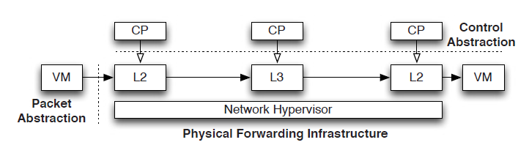
Network hypervisor
Network virtualization platform
  Control abstraction: allow tenants to define logical network elements that can be configured
  Packet abstraction: Packets from the end hosts to have the same switching, forwarding, and filtering behavior as configured by the tenant

Slide 29
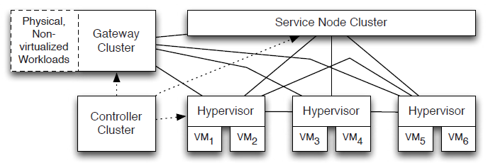
Virtualization architecture
Implement the logical data path in the host vswitch inside the host hypervisor for point-to-point traffic – tunnel between hypervisor
  Use SDN controller to set the first-hop vswitch.
Use service node to support broadcast/multicast
Use gateway node to support communication with outside

Slide 31
Computation challenges
Most maintain O(N^2) flows for N end-points with frequent dynamic changes.
  Controllers learn the location of VMs
  Controllers proactively compute and push all forwarding state required to connect the VMs
    Forwarding State = F(configuration, VM locations)

Slide 32
Solution to computation challenges
Incremental computation and pushing for quick updates.
  Share the computation across controller cluster.
Use a language to program F
  avoid handwritten finite state machines, all are generated

Slide 36
Conclusion
Openflow can facilitate network virtualization
The current practice of network virtualization is not ideal. This paper presents a limited form of network virtualization for special cases.

