Slide 1
SDN Forwarding Abstractions
Programmable data plane
“Forwarding Metamorphosis: Fast Programmable Match-Action Processing in Hardware for SDN”, SIGCOMM’2013.
“P4: Programming Protocol-Independent Packet Processors”, SIGCOMM Computer Communications Review, July 2014.

Slide 2
Forwarding Metamorphosis
The problem addressed in this paper: The current hardware switches are rigid, what is the cost to make them flexible to support OpenFlow forwarding abstraction.
Conventional switch chips are inflexible
SDN demands flexibility…sounds expensive…
How do we do it: The Reconfigurable Match Table (RMT) switch model
Flexibility costs less than 15%

Slide 3
Flexible match-action
Single Match table
All header in one table
To support flexibility, the table needs to store all combination in the header.
Wasteful
Multiple Match Tables
Smaller tables with a subset of headers in a pipeline of stages
Stage j can be made depend on stage i, i<j.
Existing switches has a small (4-8) number of tables whose widths, depths, and execution order are fixed.

Slide 4
A fixed function switch
L2: 128k x 48
Exact match
L3: 16k x 32
Longest prefix
match
ACL: 4k
Ternary match
X
X
X
X
X
?????????
L2 Stage
L3 Stage
ACL Stage
Queues
In
L2 Table
L3 Table
ACL Table
Out
Action: set L2D
Action: set L2D, dec TTL
Action: permit/deny
Parser
Deparser
Stage 1
Stage 2
Stage 3
Data

Slide 5
What flexibility does OpenFlow need?
Multiple stages of match-action
Flexible resource allocation
Flexible header fields
Flexible actions

Slide 6
Other alternatives for SDN to get the flexibility?
Software? 100x slower
NPUs? 10x slower, expensive
FPGAs? 10x slower, expensive
Need to keep up with 1Tb/s speed!!

Slide 7
What is in this paper?
How to design a flexible switch chip?
What does the flexibility cost?

Slide 8
Reconfigurable Match Tables (RMT)
Ideal RMT should allow a set of pipeline stages each with a match table of arbitrary depth and width.
RMT goes beyond fixed function MMT in four ways
field definitions can be changed and new fields can be added.
The number, topology, widths and depths of match tables can be specified, subject only to the overall resource limit on the number of matched bits.
New actions can be defined.
Arbitrarily modified packets can be placed in specified queue(s).
The configuration should be done by an SDN controller.

Slide 9
RMT model, and header field flexibility
The parser specifies the header fields of interests, and generates a 4kb header vector (put the fields in a specific location in the vector).
change header field, add new header

Slide 10
The RMT model: flexibility in the number, topology, widths and depths of match tables
More physical stages than logical stages. A logical stages can be mapped to the physical stage.
Logical stage specified by table graph.

Slide 11
The RMT model: flexibility in the number, topology, widths and depths of match tables
Restrictions for realizability
Physical pipeline stage
Match restriction: a fixed number stages (32)
Packet header limits: the packet header vector has a fixed size (4kb)
Memory restriction: identical number of entries for all
Action restrictions: number of complexity of instructions
Not generic inst., just modify headers.

Slide 12
The RMT model: flexible actions and header update

Slide 13
RMT abstract model
Controlling the configuration
Parse graph
Table Flow Graph

Slide 14
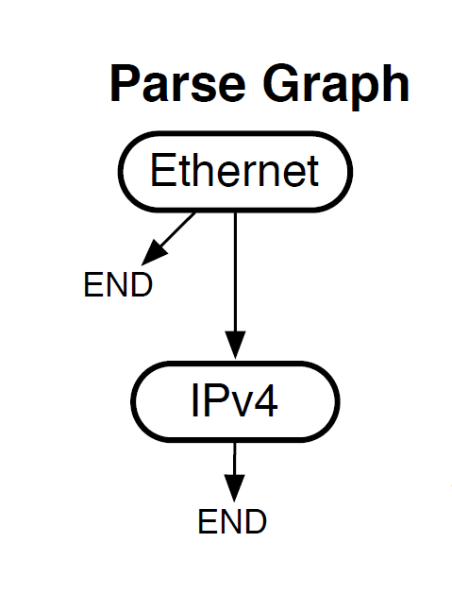
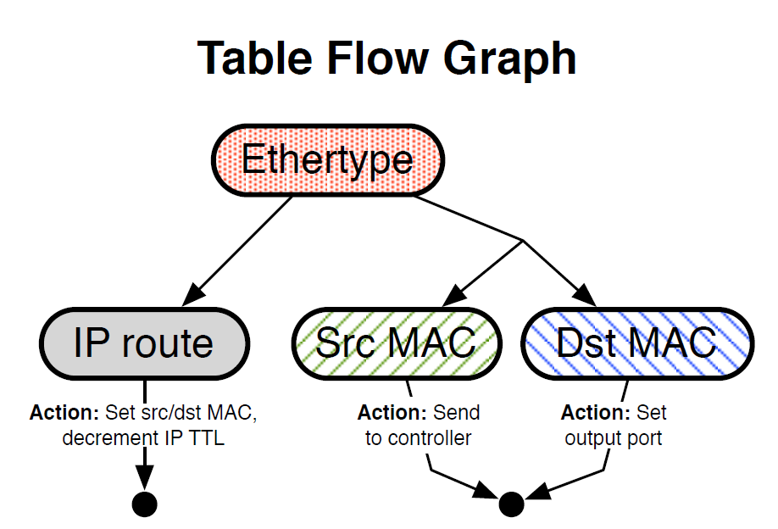
L2/L3 switch

Slide 15
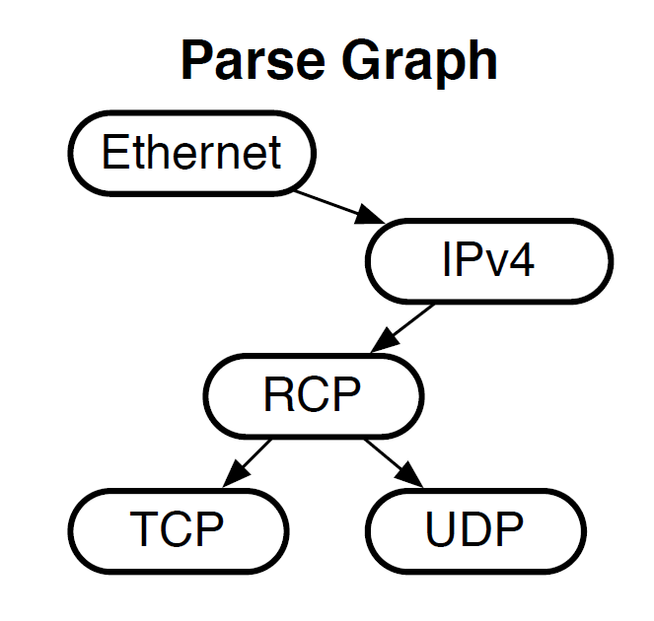
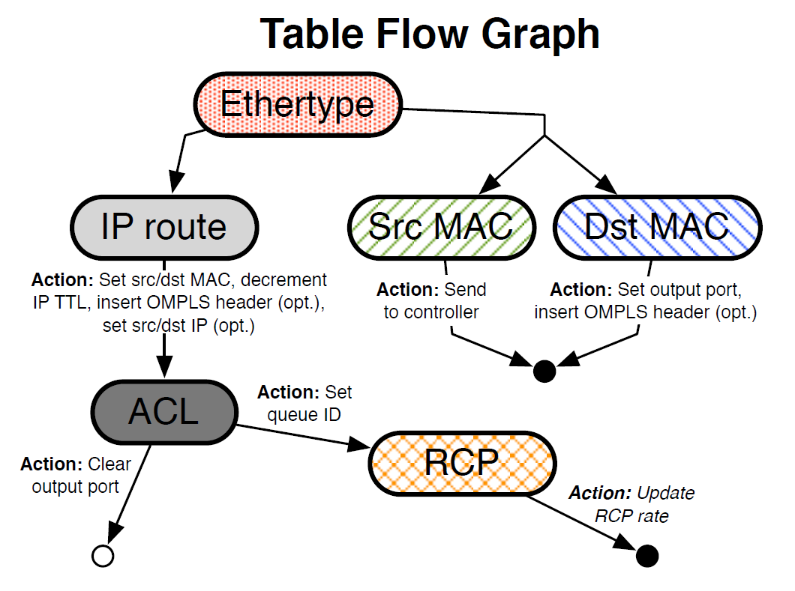
RCP and ACL support

Slide 16
Chip design

Slide 17
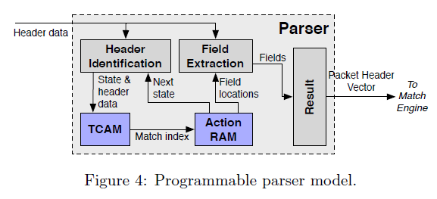
Configurable Parser
Input: packet data, parser graph stored in TCAM
Output 4kb header vector

Slide 18
RMT Switch Design
64 x 10Gb ports
960M packets/second
1GHz pipeline
Programmable parser
32 Match/action stages
Huge TCAM: 10x current chips
64K TCAM words x 640b
SRAM hash tables for exact matches
128K words x 640b
224 action processors per stage
All OpenFlow statistics counters

Slide 19
Cost of Configurability: Comparison with Conventional Switch
Many functions identical: I/O, data buffer, queueing…
Make extra functions optional: statistics
Memory dominates area
Compare memory area/bit and bit count
RMT must use memory bits efficiently to compete on cost
Techniques for flexibility
Match stage unit RAM configurability
Ingress/egress resource sharing
Table predication allows multiple tables per stage
Match memory overhead reduction
Match memory multi-word packing

Slide 20
Chip Comparison with Fixed Function Switches
Area
Section | Area % of chip | Extra Cost
IO, buffer, queue, CPU, etc | 37% | 0.0%
Match memory & logic | 54.3% | 8.0%
VLIW action engine | 7.4% | 5.5%
Parser + deparser | 1.3% | 0.7%
Total extra area cost |  | 14.2%
Power
Section | Power % of chip | Extra Cost
I/O | 26.0% | 0.0%
Memory leakage | 43.7% | 4.0%
Logic leakage | 7.3% | 2.5%
RAM active | 2.7% | 0.4%
TCAM active | 3.5% | 0.0%
Logic active | 16.8% | 5.5%
Total extra power cost |  | 12.4%

Slide 21
Conclusion
How do we design a flexible chip?
The RMT switch model
Bring processing close to the memories:
pipeline of many stages
Bring the processing to the wires:
224 action CPUs per stage
How much does it cost?
15%
Lots of the details how this is designed in 28nm CMOS are in the paper
Source: P. Bosshart, TI

Slide 22
SDN Forwarding Abstractions
Programmable data plane
“Forwarding Metamorphosis: Fast Programmable Match-Action Processing in Hardware for SDN”, SIGCOMM’2013.
“P4: Programming Protocol-Independent Packet Processors”, SIGCOMM Computer Communications Review, July 2014.

Slide 23
In the Beginning…
OpenFlow was simple
A single rule table
Priority, pattern, actions, counters, timeouts
Matching on any of 12 fields, e.g.,
MAC addresses
IP addresses
Transport protocol
Transport port numbers

Slide 24
Over the Past Five Years…
Proliferation of header fields
Version | Date | # Headers
OF 1.0 | Dec 2009 | 12
OF 1.1 | Feb 2011 | 15
OF 1.2 | Dec 2011 | 36
OF 1.3 | Jun 2012 | 40
OF 1.4 | Oct 2013 | 41
Multiple stages of heterogeneous tables
Still not enough (e.g., VXLAN, NVGRE, STT, …)
Notes:
OF 1.4 did stop for lack of wanting more, but just to put on the breaks.
This is natural and a sign of success of OpenFlow:
enable a wider range of controller apps
expose more of the capabilities of the switch
E.g., adding support for MPLS, inter-table meta-data, ARP/ICMP, IPv6, etc.
New encap formats arising much faster than vendors spin new hardware

Slide 25
Future SDN Switches
Configurable packet parser
Not tied to a specific header format
Flexible match+action tables
Multiple tables (in series and/or parallel)
Able to match on all defined fields
General packet-processing primitives
Copy, add, remove, and modify
For both header fields and meta-data
Notes:
This may sound like a pipe dream, and certainty this won’t happen overnight.
But, there are promising signs of progress in this direction…

Slide 26
We Can Do This!
New generation of switch ASICs
Intel FlexPipe: programmable parser,
RMT [SIGCOMM’13]
Cisco Doppler
But, programming these chips is hard
Custom, vendor-specific interfaces
Low-level, akin to microcode programming
Notes:
Offering this kind of functionality at reasonable cost…

Slide 27
We need a higher-level interface
To tell the programmable switch how we want it to behave

Slide 28
Three Goals for the language
Protocol independence
Configure a packet parser
Define a set of typed match+action tables
Target independence
Program without knowledge of switch details
Rely on compiler to configure the target switch
Reconfigurability
Change parsing and processing in the field

Slide 29
“Classic” OpenFlow (1.x)
SDN Control Plane
Installing and querying rules
Target Switch

Slide 30
“OpenFlow 2.0”
SDN Control Plane
Configuring:
Parser, tables, and control flow
Populating:
Installing and querying rules
Compiler
Parser & Table Configuration
Rule Translator
Target Switch
Notes:
Two modes: (i) configuration and (ii) populating
Compiler configures the parser, lays out the tables (cognizant of switch resources and capabilities), and translates the rules to map to the hardware tables
The compiler could run directly on the switch (or at least some backend portion of the compiler would do so)

Slide 31
P4 Language
Programming Protocol-Independent Packet Processing
Telling programmable switches what to do

Slide 32
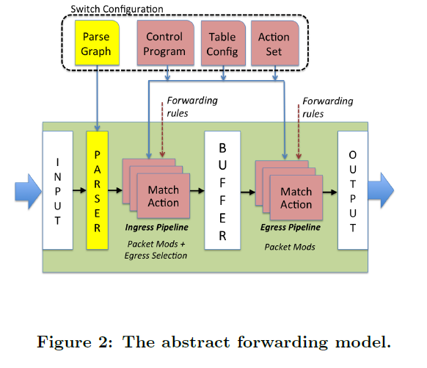
Abstract forwarding model (target abstraction)

Slide 33
P4 Concepts
A P4 program contains definitions of the following
Headers: describes the sequence and structure of a series of fields (fields width and constraints on field values)
Parsers: A parser definition specifies how to identify headers and valid header sequence within packets
Tables: Match+action tables are the mechanism for performing packet processing. P4 program defines the fields on which a table may match and the actions it may execute.
Actions: P4 supports construction of complex actions from simpler protocol-independent primitives. Actions are available within match-action tables.
Control programs: the control program determines the order of match-action tables that are applied to a packet, describing the flow of control between match+action tables.

Slide 34
P4 language by example
Data-center routing
Top-of-rack switches
Two tiers of core switches
Source routing by ToR
Hierarchical tag (mTag)
Pushed by the ToR
Four one-byte fields
Two hops up, two down
up2
down1
up1
down2
ToR
ToR

Slide 35
Header Formats
Header
Ordered list of fields
A field has a name and width
header ethernet {
fields {
dst_addr : 48;
src_addr : 48;
ethertype : 16;
}
}
header vlan {
fields {
pcp : 3;
cfi : 1;
vid : 12;
ethertype : 16;
}
}
header mTag {
fields {
up1 : 8;
up2 : 8;
down1 : 8;
down2 : 8;
ethertype : 16;
}
}

Slide 36
Parser
State machine traversing the packet
Extracting field values as it goes
parser start { parser vlan {
ethernet; switch(ethertype) {
} case 0xaaaa : mTag;
case 0x800 : ipv4;
parser ethernet { . . .
switch(ethertype) { }
case 0x8100 : vlan;
case 0x9100 : vlan; parser mTag {
case 0x800 : ipv4; switch(ethertype) {
. . . case 0x800 : ipv4;
} . . .
} }
}

Slide 37
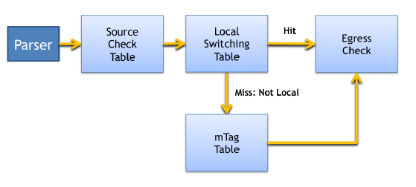
Match-action Tables
Describe each packet-processing stage
What fields are matched, and in what way
What action functions are performed
(Optionally) a hint about max number of rules
table mTag_table {
reads {
ethernet.dst_addr : exact;
vlan.vid : exact;
}
actions {
add_mTag;
}
max_size : 20000;
}
table local_switching {
// read destination and checks if local
// if miss occurs, goto mtag table
}
table local_switching {
//verify egress is resolved
// do not retag packets received with tag
// read egress and whether packet was mtagged
}
Notes:
Compiler uses this to
- determine what kind of memory (width, height), and what kind (TCAM, SRAM)
- reject rules that violate the type
The “add_mTag” is an “action function”.
In other kinds of tables, multiple different action functions may be allowed.

Slide 38
Action Functions
Custom actions built from primitives
Add, remove, copy, set, increment, checksum
action add_mTag(up1, up2, down1, down2, outport) {
add_header(mTag);
copy_field(mTag.ethertype, vlan.ethertype);
set_field(vlan.ethertype, 0xaaaa);
set_field(mTag.up1, up1);
set_field(mTag.up2, up2);
set_field(mTag.down1, down1);
set_field(mTag.down2, down2);
set_field(metadata.outport, outport);
}
Notes:
Push mTag on the packet
Copy the ethertype of the VLAN header to correctly identify the next level of header
Make the VLAN header point to the mTag
Set the four fields of the mTag
Ensure the packet goes to the right egess port

Slide 39
Control Flow
Flow of control from one table to the next
Collection of functions, conditionals, and tables
For a ToR switch:
From core
(with mTag)
Source
Check
Table
Local
Switching
Table
Egress
Check
ToR
Miss: Not Local
mTag
Table
From local hosts
(with no mTag)
Notes:
Source check (one rule per port): verify mTag only on ports to the core (actions: fault, strip and record metadata, pass)
Local switching: checks if destination is local, and otherwise goes to mTag table
mTag table: add mTag
Egress check: has someone set the outport

Slide 40
Control Flow
Flow of control from one table to the next
Collection of functions, conditionals, and tables
Simple imperative representation
control main() {
table(source_check);
if (!defined(metadata.ingress_error)) {
table(local_switching);
if (!defined(metadata.outport)) {
table(mTag_table);
}
table(egress_check);
}
}
Notes:
Source check (one rule per port): verify mTag only on ports to the core (actions: fault, strip and record metadata, pass)
Local switching: checks if destination is local, and otherwise goes to mTag table
mTag table: add mTag
Egress check: verify egress is resolved, do not retag packets received with tag, reads egress, etc.

Slide 41
P4 Compilation
Notes:
This is a rich area, and so far we have only touched the surface…

Slide 42
P4 Compiler
Parser
Programmable parser: translate to state machine
Fixed parser: verify the description is consistent
Control program
Target-independent: table graph of dependencies
Target-dependent: mapping to switch resources
Rule translation
Verify that rules agree with the (logical) table types
Translate the rules to the physical tables
Notes:
Parser:
Programmable parser: translate parser description into a state machine
Fixed parser: verify that the parser description is consistent with the target processor
Control program
Table graph: dependencies on processing order, opportunities for parallelism
Mapping to switch resources: physical tables, types of memory, sizes, combining tables
Rule translation
Verify rules agree with the types
Translate rules into the physical tables

Slide 43
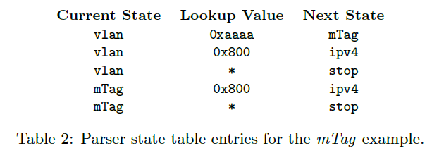
Compiling packet parser
Compile into a state machine

Slide 44
Compiling control programs
control main() {
table(source_check);
if (!defined(metadata.ingress_error)) {
table(local_switching);
if (!defined(metadata.outport)) {
table(mTag_table);
}
table(egress_check);
}
}
And then to a target specific back-end

Slide 45
Conclusion
OpenFlow 1.x
Vendor-agnostic API
But, only for fixed-function switches
An alternate future
Protocol independence
Target independence
Reconfigurability in the field
P4 language: a straw-man proposal
To trigger discussion and debate
Much, much more work to do!

