Slide 1
SDN Network Updates
Minimum updates within a single switch
Network-wide Consistent updates

Slide 2
Updates within a single switch
Current State-of-the-art OpenFlow Switches can process tens to a few hundreds of flow-mod’s per second
Rewriting the whole flow-table will take a while
Minimum update
Given a configuration change (e.g. add and remove flows), how to issue the smallest number of flow-mod to achieve the objective
Should do incremental update, but the current high-level language compiler mostly re-write the whole flow-table

Slide 3
The minimum update problem
An example of Flow table (rules) before and after
 | Pattern | Priority | Action
A | [1, 2, *] | 5 | Port 1
B | [*, 2, 3] | 4 | Port 2
C | [1, *, 4] | 4 | Port 3
D | [1, *, 3] | 3 | Port 4
E | [*, *, 4] | 3 | Port 5
F | [*, *, 3] | 2 | Port 6
 | Pattern | Priority | Action
A | [1, 2, *] | 5 | Port 1
B | [*, 2, 3] | 4 | Port 2
G | [*, 2, 4] | 3 | Port 7
C | [1, *, 4] | 2 | Port 3
D | [1, *, 3] | 3 | Port 4
E | [*, *, 4] | 1 | Port 5
F | [*, *, 3] | 2 | Port 6
Inserting rule G [*, 2, 4] in the table with high priority, above all but rule A

Slide 4
The minimum update problem
Inserting rule G [*, 2, 4] in the table with high priority, above all but rule A.
Insert the rule with the right priority
Adjust the priority of other rules if necessary
How to set the priority?
 | Pattern | Priority | Action
A | [1, 2, *] | 5 | Port 1
B | [*, 2, 3] | 4 | Port 2
C | [1, *, 4] | 4 | Port 3
D | [1, *, 3] | 3 | Port 4
E | [*, *, 4] | 3 | Port 5
F | [*, *, 3] | 2 | Port 6

Slide 5
The minimum update problem
Rule G: Pattern [*, 2, 4] above all but Rule A.
Rules with overlapping patterns have interdependence
Changing priority would change the dependence
[*, 2, 4] overlaps with Rule A, C, and E.
 | Pattern | Priority | Action
A | [1, 2, *] | 5 | Port 1
B | [*, 2, 3] | 4 | Port 2
C | [1, *, 4] | 4 | Port 3
D | [1, *, 3] | 3 | Port 4
E | [*, *, 4] | 3 | Port 5
F | [*, *, 3] | 2 | Port 6

Slide 6
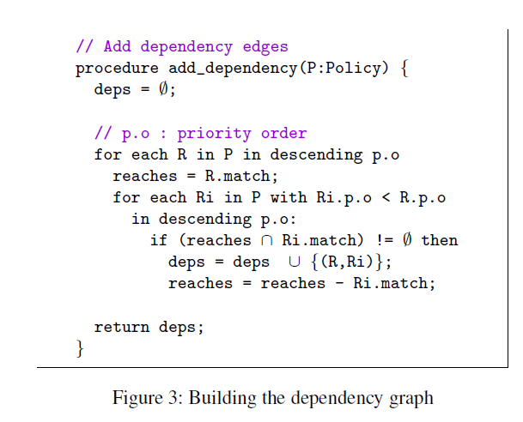
Capturing the dependence in the flow table – build the dependence graph
Finding the exact dependence can be tricky:
Two rules may be independent even if their patterns overlap.
Two rules are directly independent iff the patterns are disjoint or if the the joint of the pattern is shadowed by other rules they both depend on.

Slide 7
The minimum update problem
Represent the minimum dependency in a flow table with a DAG
 | Pattern | Priority | Action
A | [1, 2, *] | 5 | Port 1
B | [*, 2, 3] | 4 | Port 2
C | [1, *, 4] | 4 | Port 3
D | [1, *, 3] | 3 | Port 4
E | [*, *, 4] | 3 | Port 5
F | [*, *, 3] | 2 | Port 6
A
B
C
D
E
F

Slide 8
The minimum update problem
Insert G into the DAG
A
A
 | Pattern | Priority | Action
A | [1, 2, *] | 5 | Port 1
B | [*, 2, 3] | 4 | Port 2
C | [1, *, 4] | 2 | Port 3
D | [1, *, 3] | 3 | Port 4
E | [*, *, 4] | 1 | Port 5
F | [*, *, 3] | 2 | Port 6
G | [*, 2, 4] | 3 | Port 7
B
C
B
D
E
D
G
F
F
C
E

Slide 9
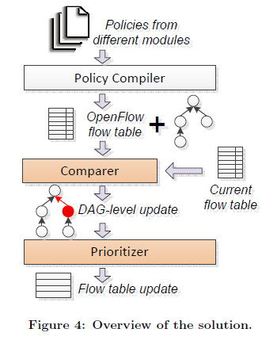
The system
Building DAG from prioritized flowtable entries
Incurs complicated header space computation

Slide 10
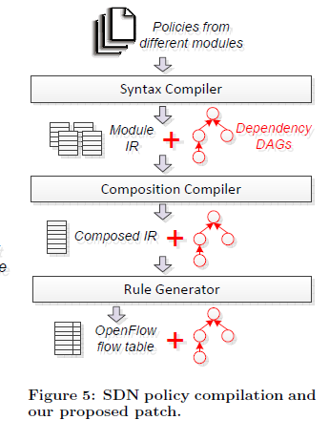
The system
Building DAG along with policy compilation
Rule dependency can be recursively inferred from policy composition process
Incurs little additional overhead over compilation

Slide 11
Priority Value Distribution
Discrete priority values
Integers ranging [0-65535] for OpenFlow
If new rule is inserted between adjacent priority values, we have to shift existing rules to make room for them
How to assign priority values for priority levels
Minimize the estimation of priority shifts
Online strategy
Unknown future policy update sequence

Slide 12
Some things unclear
How to compute exact dependence DAG?
How to allocate priority value for each rules so as to minimize the priority changes?
Is there a way to rewrite the priority values to minimize future changes?

Slide 13
Whole network consistent updates
“Abstractions for Network Updates”, SIGCOMM 2012.

Slide 14
Background
Network updates happen when the network configuration changes
Maintenance
Failures
ACL updates
Etc
With traditional distributed protocol – the system will converge to a new stable, consistent state; but the transient state is hard to reason and guarantee
Black-holes
Loops
Security violations
With SDN and a consistent network update abstraction, even the transient state can be managed.

Slide 15
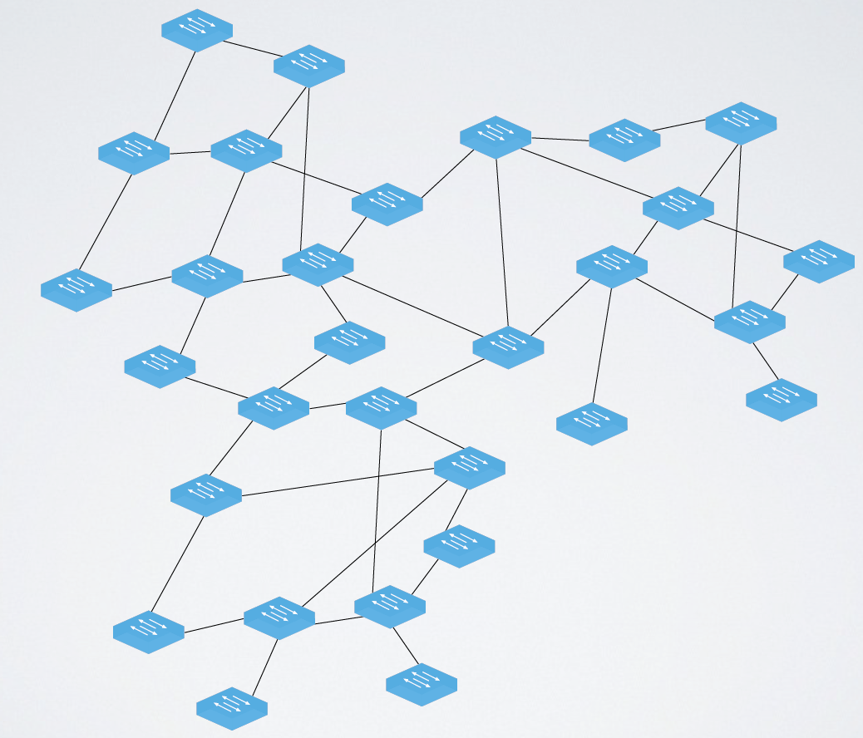
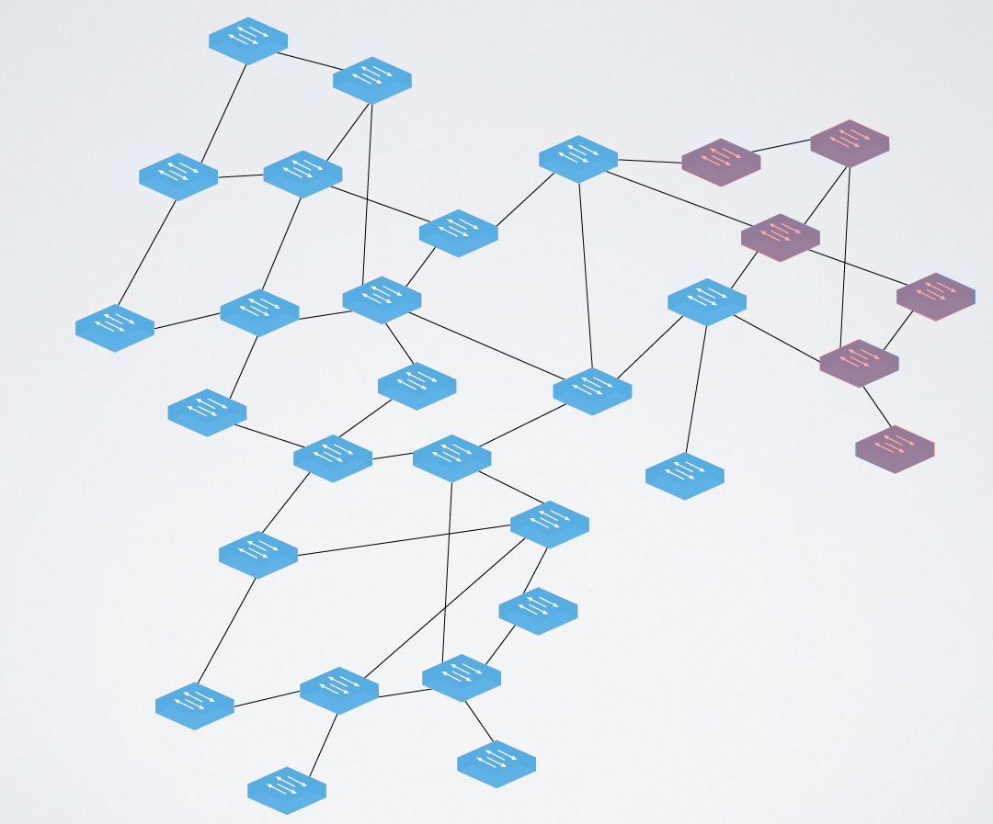
Network Updates challenges
Global network updates may affect many routers, must define and solve a distributed computing problem.

Slide 16
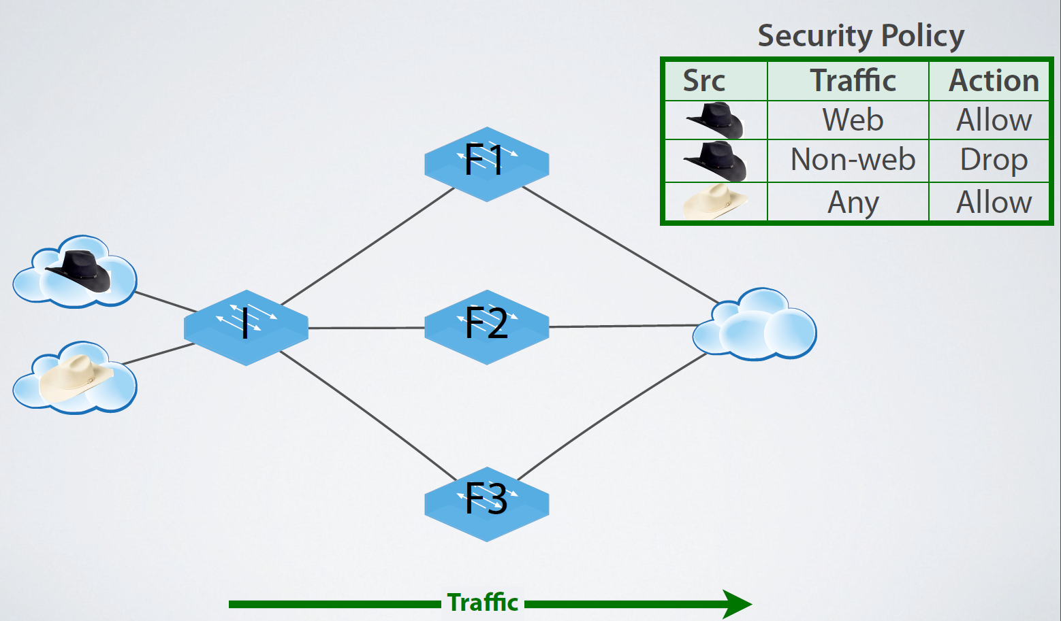
An example

Slide 17
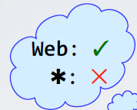
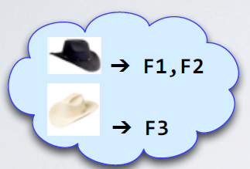
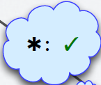
An example

Slide 18
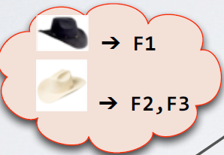
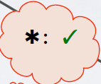
An example

Slide 19
Naïve Update: F1->F2->F3->I, security policy failed!

Slide 20
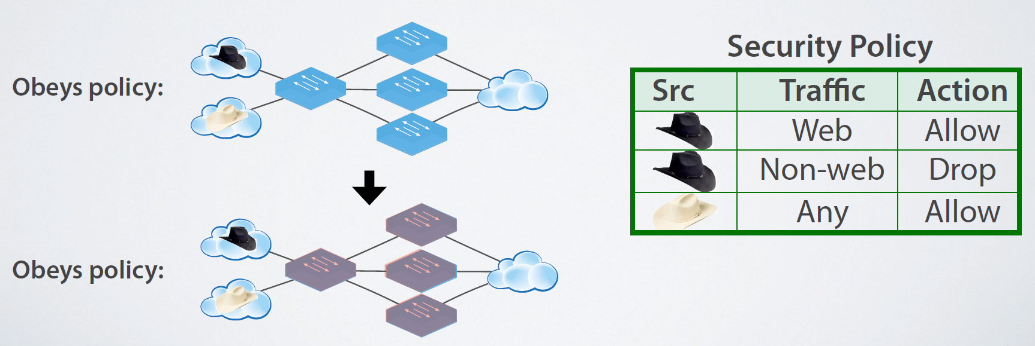
An abstraction: Per-packet consistent update
Per-packet consistent update: each packet processed with old or new configuration, but not a mixture of the two.

Slide 21
Universal Property Preservation
Theorem: Per-packet consistent update preserves all trace properties.
Trace property of a single packet’s path through the network
Example of trace Properties: Loop freedom, access control, etc

Slide 22
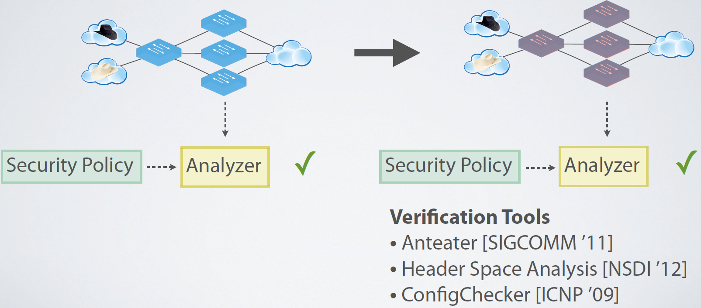
Formal Verification
Corollary: to check an invariant, verify the old and new configurations.

Slide 23
Mechanism: 2-phase update
Runtime instruments configurations
Edge rules stamp packets with version
Forwarding rules match on version
Algorithm:
Install new rules on internal switches, leave old configuration in place
Install edge rules that stamp with the new version number

Slide 24
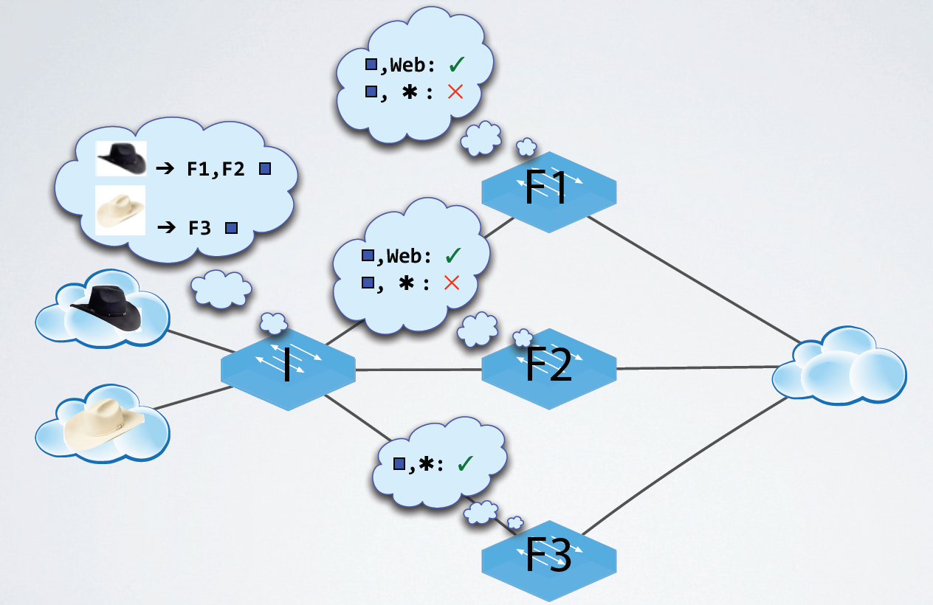
2-phase update example

Slide 25
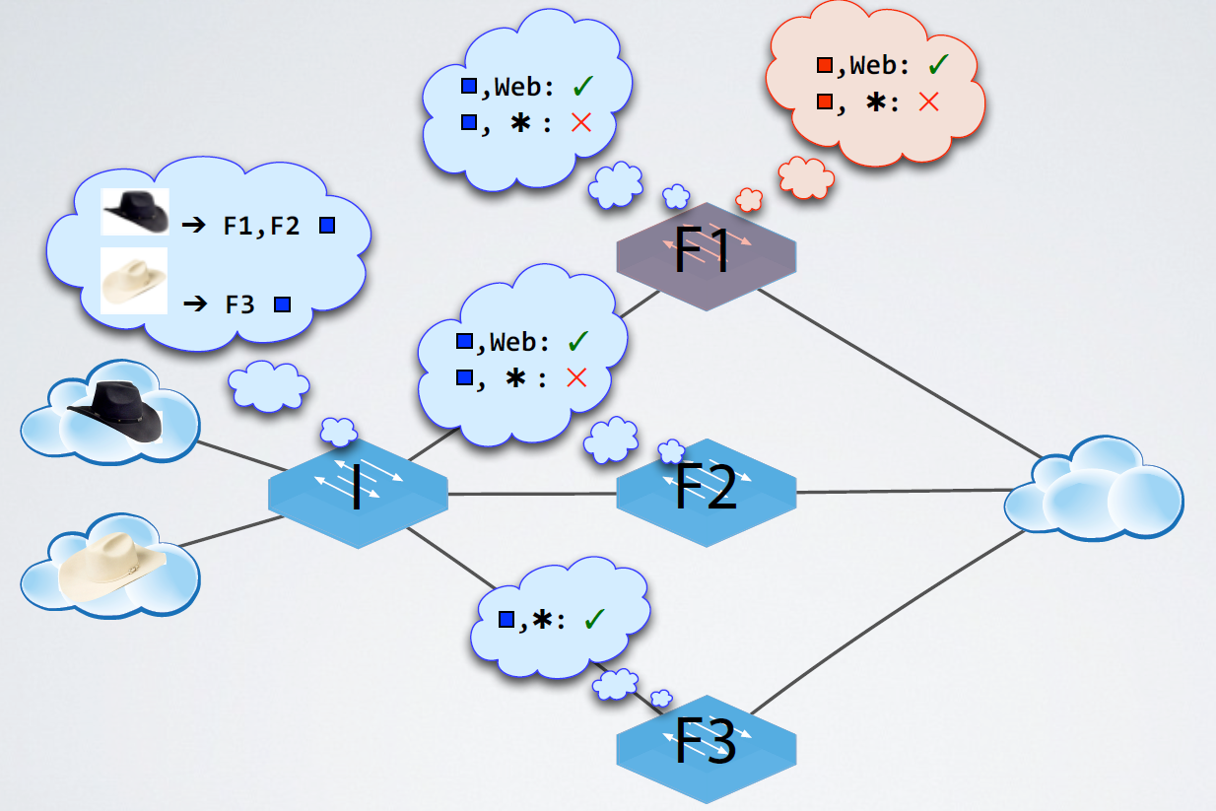
2-phase update example

Slide 26
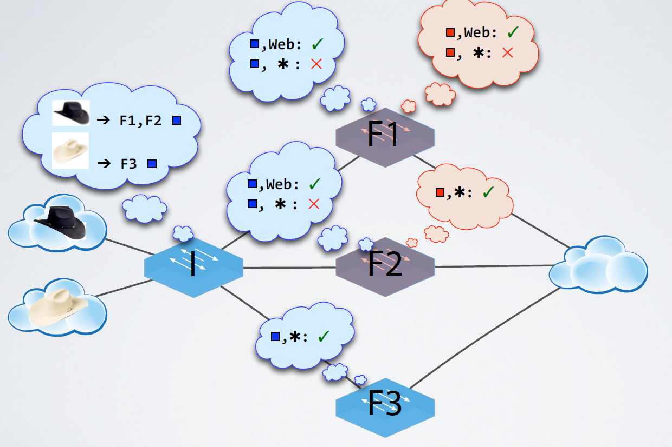
2-phase update example

Slide 27
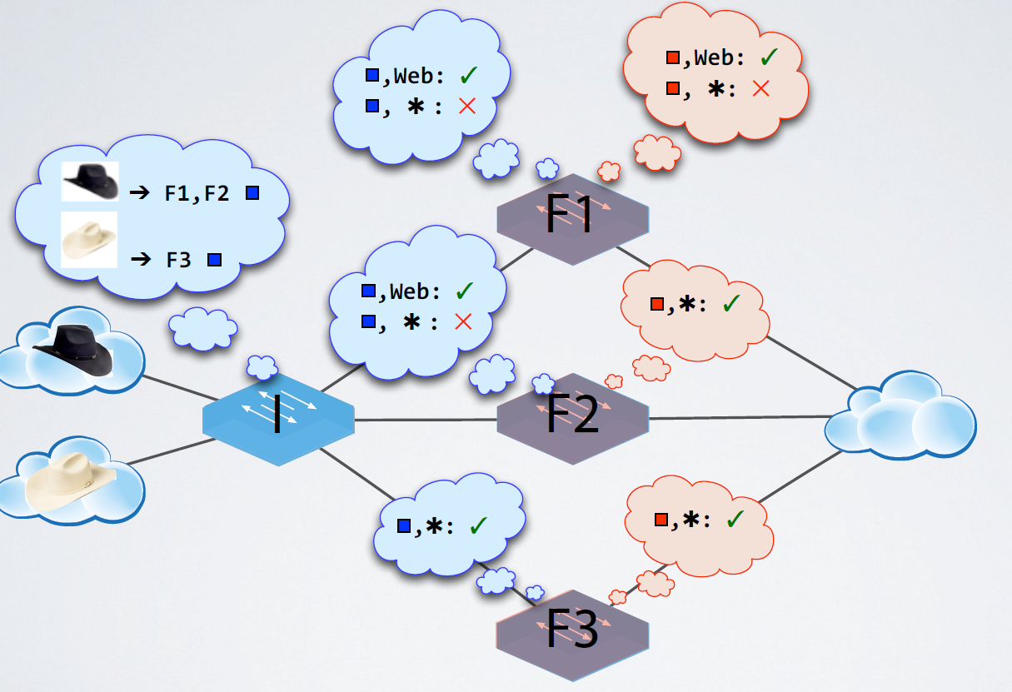
2-phase update example

Slide 28
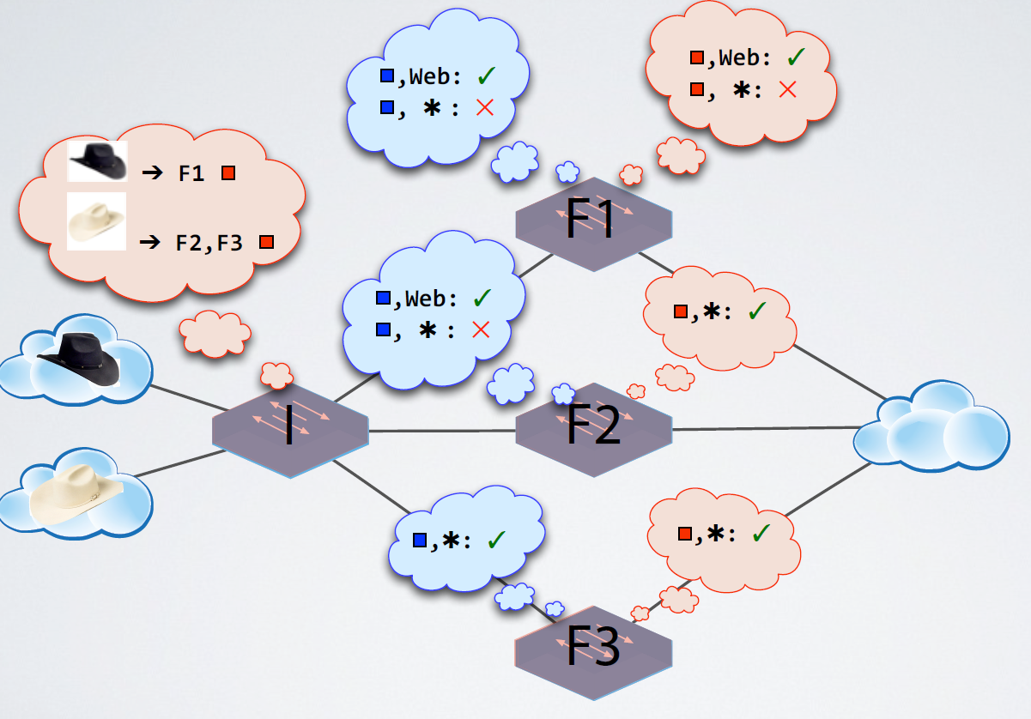
2-phase update example

Slide 29
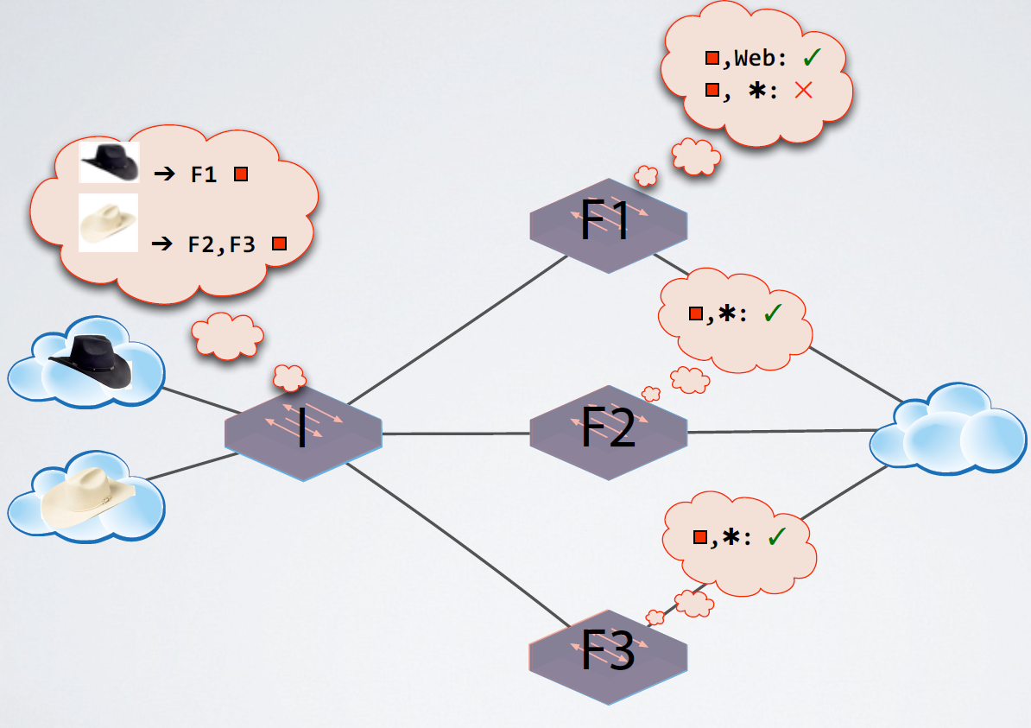
2-phase update example

Slide 30
Optimizations
Add a path: install rules internally and then at the edge, no version.
Remove a path: update the edge, wait for all to drain, update the internal
Modify a path: subset optimization to affect the smallest number of paths.

Slide 31
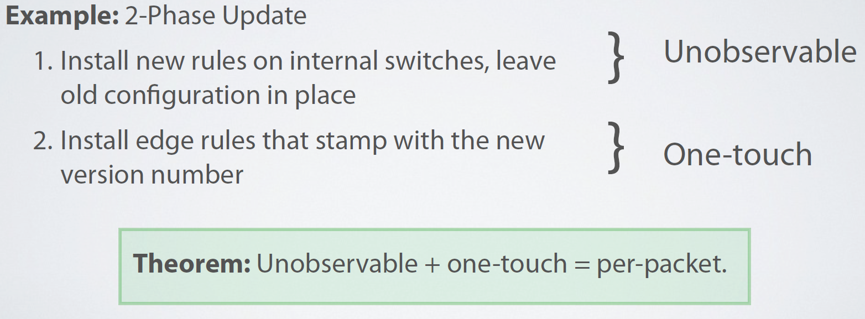
Correctness
Build an operational semantics, formalize the mechanism and prove them correct.

Slide 32
Conclusion
Update abstractions
Per-packet consistency
Per-flow consistency
Mechanisms
2-phase update
Optimizations
Formal model
Network operational semantics
Universal property preservation

