Slide 1
Programming SDN
Newer proposals
Frenetic (ICFP’11)
Maple (SIGCOMM’13)

Slide 2
Programming SDN
Directly programming over NOX/POX does not have enough abstraction
The global network view by itself does not help
It is almost like assembly programming
Reasoning at the flow table level is too difficult
Need higher level language for SDN programming
C++, python for Net apps.
High level software should have better properties.
Program at a higher level and then compile into the lower level API.

Slide 3
Issues with Programming on POX/NOX
Not modular
Two tiered model
Network race condition
Reason: no effective abstractions from reading network state

Slide 4
Frenetic: A Network Programming Language
Frenetic’s solution to the problem
Separate network programming into two parts: reading from writing
Abstractions for querying network state
Reading: specify querying network state
Reads have no effect on forwarding policy
Reads see every packet
Abstractions for specifying a forwarding policy
Writing: specify forwarding policies
Forwarding policy must be separated from implementation mechanism (not rule installation details)
Compose multiple tasks
Write each task once and combine with others
Prevent race conditions
Automatically apply forwarding policy to extra packets

Slide 5
Frenetic Language
Abstractions for querying network state
An integreated query language
Select, filter, group, sample sets of packets or statistics
Designed so that computation can occur at data plane
Abstractions for specifying a forwarding policy
A functional stream processing library
Generate streams of network policies
Transform, split, merge, filter policies and other streams
Implementation
A collection of Python libraries on top of NOX

Slide 6
Frenetic Query Language

Slide 7
Frenetic Query and use examples
Measure total traffic on port 2, every 30 seconds
Query semantics is independent of other program parts

Slide 8
Frenetic Query and use examples
Per host traffic specification and query composition

Slide 9
Frenetic Query and use examples
Query for a learning switch

Slide 10
Frenetic Query Summary
Independent query for each switch, allowing program composition
Not collaborative query among multiple switches, is this high level enough?
Expressiveness is customized for network queries
Packets | sizes| counts forces programmers to be cost aware.

Slide 11
Frenetic forwarding policy programming
Based on the frenetic network policy management library
Construct rules using the rule constructor, which takes a pattern and a list of actions as argument.
Must associate rules with switches – network policies (dictionaries mapping switches to the list of rules)
High enough level?
Installation of policies are done through policy events – infinite, time-indexed policy events.
Register listener is the consumer of the policy events that actually install the policies.

Slide 12
Frenetic Forwarding program examples
The repeater example

Slide 13
Forwarding program examples
The repeater + monitor example: the runtime must enforce the query semantics: see every packet and query does not modify the networks.

Slide 14
Forwarding program examples
A simple load balancing

Slide 15
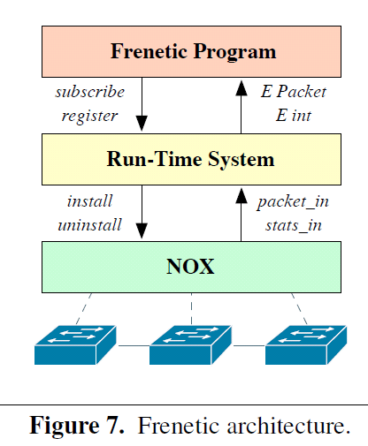
Frenetic system
High-level language
Query language
Composition of forwarding policies
Run-time system
Interprets queries and policies
Installs rules and tracks statistics

Slide 16
Frenetic discussion
This is an early attempt to develop high level language for programming SDN.
What problems are solved?
What are still not ideal?

Slide 17
Maple: Simplifying SDN programming using algorithmic policies
Objective:
A high level abstraction for SDN programming
high level programming to describe network wide algorithmic policies
Removing details such as rule installation over multiple flow tables
Easily understandable semantics:
program runs from scratch on the centralized controller for every packet
Focus on abstraction, not performance for now, optimize later.
Only discuss to routing application (packet, env)->forwardingpath in the paper

Slide 18
Algorithmic Policies
Function in a general purpose language that describes how a packet should be routed, not how flow tables are configured.
Conceptually invoked on every packet entering the network; may also access network environment state; hence it has the form:
Written in a familiar language such as Java, Python, or Haskell

Slide 19
Example Algorithmic Policy in Java
Does not specify flow table configuration
Route f(Packet p, Env e) {
if (p.tcpDstIs(22))
return null();
else {
Location sloc = e.location(p.ethSrc());
Location dloc = e.location(p.ethDst());
Path path = shortestPath(e.links(), sloc,dloc);
if (p.ethDstIs(2) return null();
else return unicast(sloc,dloc,path);
}
}

Slide 20
Implement algorithmic policies
Naive solution -- process every packet at controller or use only exact match rules -- perform poorly
Static analysis to determine layout of flow tables is possible, but has drawbacks:
Static analysis of program in a general-purpose language is hard and is typically conservative
System becomes source-language dependent
Not all situation can be handled by static analysis.

Slide 21
Implement algorithmic policies
Maple’s approach: runtime tracing
Detect and utilize reusable executions of a program (f) by recording the dynamic execution of the program
Keep track of its decision dependencies
Each execution creates a trace
Merge the traces for each program (f) in a trace tree.

Slide 22
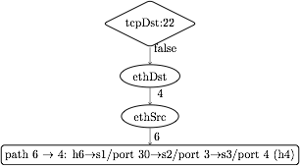
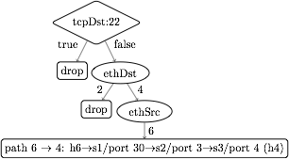
1. Maple observes the dependency of f on packet data.
Prio | Match | Action
1 | tcpDst:22 | ToController
0 | ethDst:2 | discard
0 | ethDst:4, ethSrc:6 | port 30
2. Build a trace tree (TT), a partial decision tree for f.
3. Compile flow tables (FTs) from a trace tree for each switch
Prio | Match | Action
1 | tcpDst:22 | ToController
0 | ethDst:2 | discard
0 | ethDst:4, ethSrc:6 | port 30

Slide 23
Policy
EthDest:1,
TcpDst:80
Route f(Packet p, Env e) {
if (p.tcpDstIs(22))
return null();
else {
Location dloc =
e.location(p.ethDst());
Location sloc =
e.location(p.ethSrc());
Path path =
shortestPath(
e.links(),sloc,dloc);
if (p.ethDstIs(2)
return null();
else
return unicast(sloc,dloc,path);
}
}
TcpDst=22?
false
Read(EthDst)
false
Read(EthSrc)
4
ethDstls=2?
6
false
path1

Slide 24
Policy
EthDst:1,
TcpDst:22
Trace Tree
Route f(Packet p, Env e) {
if (p.tcpDstIs(22))
return null();
else {
Location dloc =
e.location(p.ethDst());
Location sloc =
e.location(p.ethSrc());
Path path =
shortestPath(
e.links(),sloc,dloc);
if (p.ethDstIs(2)
return null();
else
return unicast(sloc,dloc,path);
}
}
Assert(TcpDst,22)
false
true
Read(EthDst)
Assert(TcpDst,22)
?
false
Read(EthSrc)
true
null
4
Assert(ethdesls,2)
6
false
path1
Notes:
Maple then uses this trace to begin generating the Trace Tree. In this case, Maple still doesn’t know what will happen if the assertion is true, and it therefore adds a placeholder under the true branch.
Now, if we execute f on a packet to tcp destination 22, the assertion is true, and the packet is dropped. Maple logs this new trace and uses it to refine its Trace Tree, filling in the true branch of the assertion.

Slide 25
Policy
Trace Tree
Route f(Packet p, Env e) {
if (p.tcpDstIs(22))
return null();
else {
Location dloc =
e.location(p.ethDst());
Location sloc =
e.location(p.ethSrc());
Path path =
shortestPath(
e.links(),sloc,dloc);
if (p.ethDstIs(2)
return null();
else
return unicast(sloc,dloc,path);
}
}
Assert(TcpDst,22)
false
true
Read(EthDst)
drop
false
Read(EthSrc)
4
Assert(ethdesls,2)
true
6
false
drop
path1
Notes:
Maple then uses this trace to begin generating the Trace Tree. In this case, Maple still doesn’t know what will happen if the assertion is true, and it therefore adds a placeholder under the true branch.
Now, if we execute f on a packet to tcp destination 22, the assertion is true, and the packet is dropped. Maple logs this new trace and uses it to refine its Trace Tree, filling in the true branch of the assertion.

Slide 26
Trace trees
A trace provides an abstract, partial representation of an algorithmic policy – cover all paths that have been executed.
Trace trees are logically maintained in all switches

Slide 27
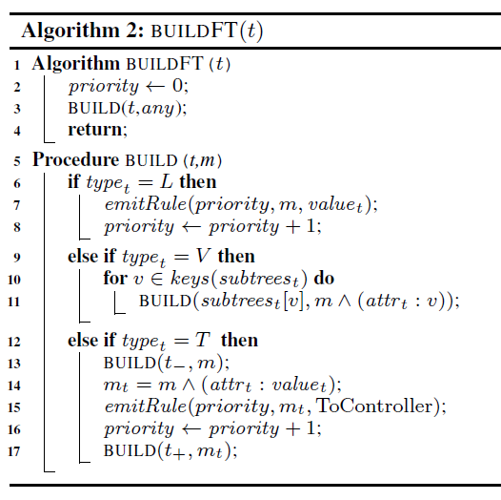
Compiling trace tree to flow table entries for each switch

Slide 28
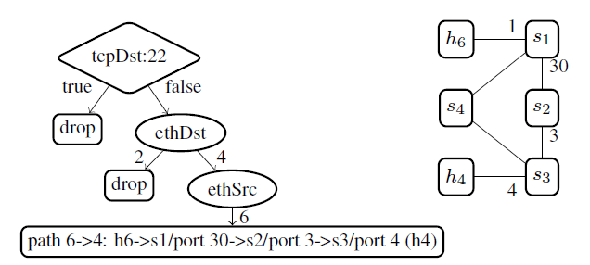
Example
Rules on s1:

Slide 29
Optimizations
Minimize the number of rules and the number of priorities
No effect
Priority 0
Optimize for distributed flow tables
Eliminate tocontroller message
Route aggregation
Maple multicore scheduler: multi-threading

Slide 30
Other features
Maple has been implemented in Haskell using the McNettle Openflow controller, which implements Openflow 1.0.
The implementation includes several other features:
Incremental TT compilation, to avoid full recompilation on every update.
Trace reduction, to ensure traces and trace trees do not contain redundant nodes.
Automatic and user-specified invalidation, to support removing and updating TT and FT when network state changes.

Slide 31
Summary
Algorithmic policies provide a simple, expressive programming model for SDN, eliminating a key source of errors and performance problems.
Maple provides a scalable implementation of algorithmic policies through several novel techniques, including:
runtime tracing of algorithmic policies,
maintaining a trace tree and compiling TT to flow tables to distribute processing to switches;
using TT annotations to implement compiler optimizations such as rule and priority reductions.

Slide 32
Maple discussion
Higher level than Frenetic
Not complete
Shows the challenges in having an abstraction with the right implementation

