Slide 1
Programming SDN 1
Problems with programming with POX

Slide 2
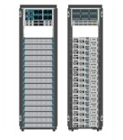
Programming SDN
App
App
App
App
App
App
App
App
App
App
App
How to specify the functionality in network applications
Net apps: routing, access control, monitoring NAT, TE, etc
History solution: ad hoc, by configuring individual routers to achieve the objective
SDN promises: new solution based on the global network view provided by the SDN controller.
How?? This is a brand new domain!!!
It does not help that northbound API is not fixed.
Northbound interface
SDN Controller
Openflow

Slide 3
Programming SDN with NOX/POX
Event driven programming paradigm
Application writer register the events and write the event handlers.
API
Events:
packet_in(switch, port, packet)
stats_in (switch, xid, pattern, packets, bytes)
flow_removed (switch, pattern, packets, bytes)
switch_join(switch)
Port_change(switch, port, up)
Control and query openflow switches
Install(switch, pattern, priority, timeout, actions)
uninstall(switch, pattern)
Query_stats(switch, pattern)

Slide 4
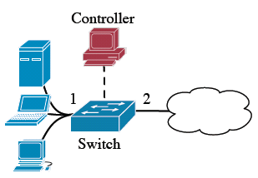
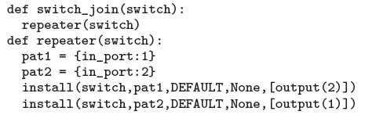
Programming SDN with POX: a repeater application
Network app: when the switch is up, install rules for repeater (port 1 to port 2, port 2 to port1)

Slide 5
Programming SDN with NOX/POX
NOX/POX API is very low level, exposing detailed OpenFlow interface with the forwarding elements
install and remove OpenFlow rules on a switch
Programming with other controllers is similar, although with different features.
SDN controllers expose the switch capability, but do not make programming SDN easier.

Slide 6
What is your perfect programming paradigm for SDN?
Properties?

Slide 7
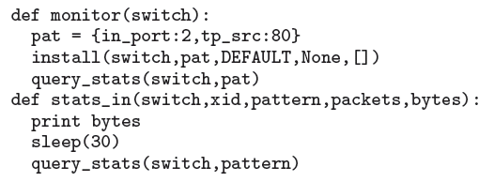
Issue with NOX programming: components not composable
Monitoring capability
Ideal solution: if the program is composable

Slide 8
Issue with NOX programming: components not composable
Pattern priority timeout action count
p1 output(p2)
p2 output(p1)
p2,tp_src(80)
Rules can interact: p2,tp_src(80) also matches the
rule for p2. The counter will be wrong in this case.

Slide 9
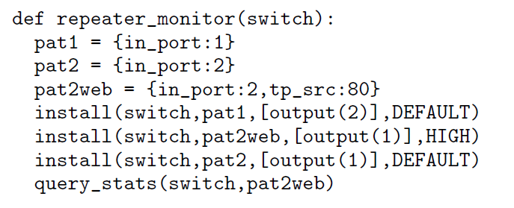
Issue with NOX programming

Slide 10
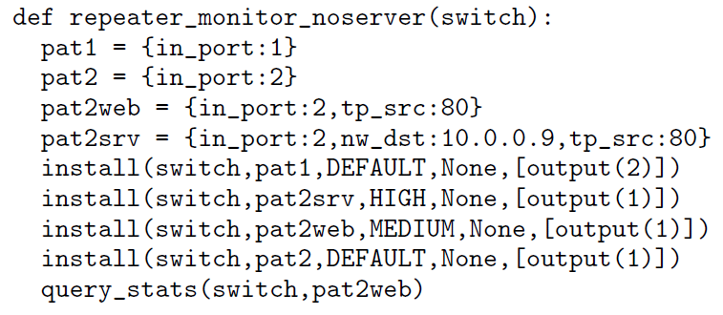
Issues with NOX programming: low level API, very hard to reason
Keep track of web traffic except our web server at 10.0.0.9.
This level of reasoning involves a lot of details, making the programs cumbersome and error-prone.

Slide 11
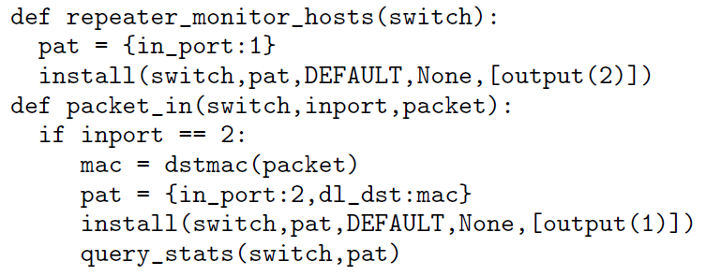
Issues of NOX programming: two-tiered architecture
Extend the repeater program to monitor traffic by each destination host.
Two programs, one on the controller, one on the switch, almost impossible to reason.

Slide 12
Issues of NOX programming: two-tiered architecture
What if multiple packets arrive before the rule is installed?
Network race conditions.

Slide 13
Programming SDN
Directly programming over NOX/POX does not have enough abstraction
The global network view by itself does not help
It is almost like assembly programming
Need higher level language for SDN programming
C++, python for Net apps.
Program at a higher level and then compile into the lower level API.
Need better abstraction at the language level
Like all other high level languages, the abstraction needs to be sufficiently expressive for network applications
A good abstraction needs to have some properties that other programming language has (software reuse, etc).
We need to be able to implement them efficiently over NOS API.

