Slide 1
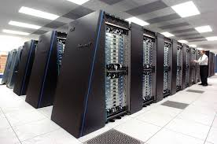
Extreme-scale computing systems
High performance computing systems
Current No. 1 supercomputer Tianhe-2 at 33.86 petaflops
Pushing toward exa-scale computing by 2020, 32 times bigger than Tianhe-2 (almost need to double the speed every year).
Many issues ranging from applications to systems such power, resilience, networking, applications.

Slide 2
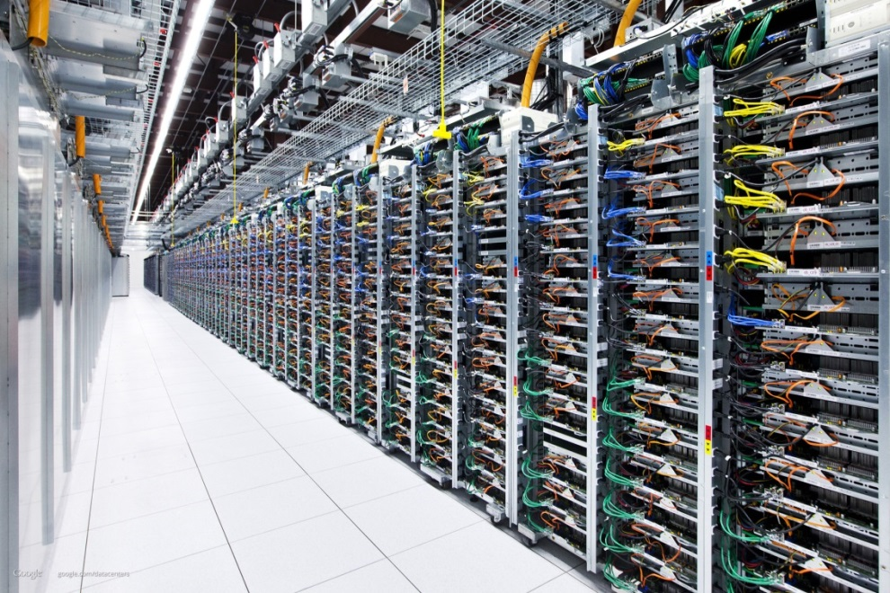
Extreme scale computing systems
Cloud computing data centers: Amazon EC2
Hugh push to move computing/storage to the cloud computing infrastructure
Extreme scale to achieve the scale of economics
Applications are more diverse
Networking infrastructure needs significant improvement
Security

Slide 3
Extreme scale computing systems
Hadoop cluster – with huge IO bandwidth
Beyond traditional HPC
May fit into cloud computing infrastructure

Slide 4
Interconnection Networks
The networking system that connects all nodes in these extreme scale systems.
Can easily be the main performance limiting factor in this type of systems.
Nodes are getting bigger (64 cores, 128 cores)
Total cores counts increases.
Network capacity needs to increase at least proportionally.
Network complexity is super-linear to the total port count.
Reaching a stage that drastic changes are needed.

Slide 5
Extreme-scale systems are getting bigger every year
HPC clusters are pushing towards exa-scale computing (from 10 peta-scale)
A lot of pressure to build more efficient, more reliable, and power-efficient interconnects.
Many new proposals are showing up at this stage.

Slide 6
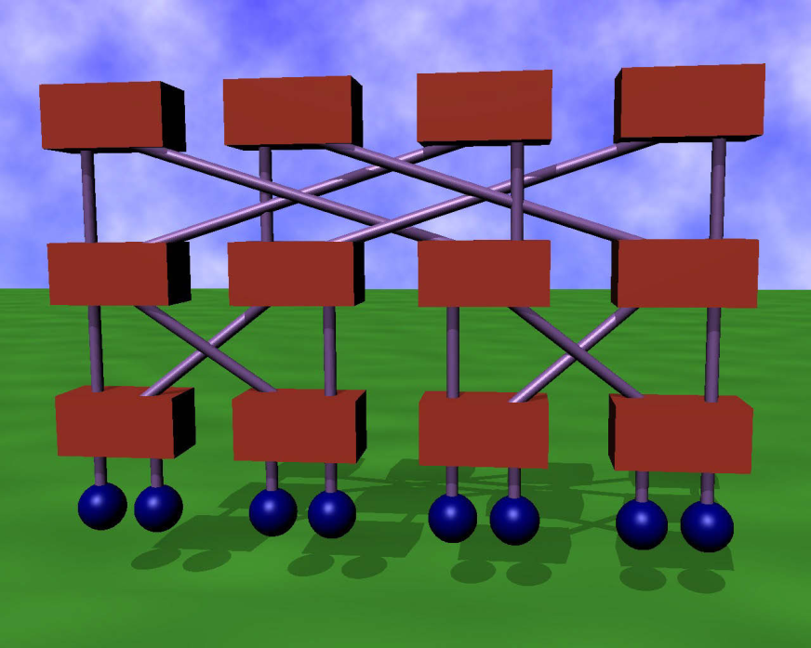
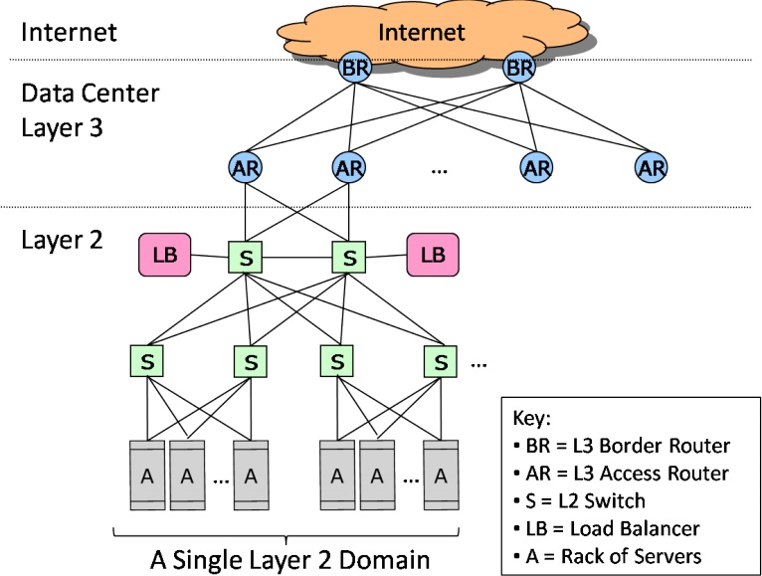
interconnects
Extreme-scale PDSs are Internet-in-a-building
Traditional networking issues: topology, routing, flow control, congestion control
Recent topology/routing proposals for extreme scale systems
Achieving performance requirement with the budget constraints.

Slide 7
Network technology
Open standards
1/10/100-G Ethernet
InfiniBand – low latency communication
Openflow and software defined networks
Proprietary technology
IBM Bluegene
Cray Aries

Slide 8
System software, communication sub-systems, and applications
Parallel IO systems
Topology aware job allocation and node mapping
Communication protocols
One-sided .vs. two-sided communications
Collective communication algorithms
All of these can affect the traffic in the networks – must be considered in the interconnect design.

Slide 9
Performance models and evaluation methods
Performance modeling techniques for networks/systems/applications.
Workload characterization.
Application tracing
Simulating and modeling of large scale systems using realistic workloads is very challenging.

Slide 10
Resilience and power-awareness
System and application resilience techniques and analysis
Fault tolerance techniques in hardware and software
Resource management for system resilience and availability.
Energy efficient HPC
Energy efficient data centers
Trade-offs among performance, power, and resilience is the key for the future interconnect design
insufficient tools to investigate the trade-offs.

Slide 11
This course
Targets students who are interested in research in the interconnection networks area
Go through a large amount of recent papers to bring the students up-to-date in research in this area in general.
Practice network simulation and modeling.
Introduce necessary techniques, algorithms, math background to perform research in this area.

