Slide 1
Ethernet

Slide 2
Ethernet standards milestones
1973: Ethernet Invented
1983: 10Mbps Ethernet
1985: 10Mbps Repeater
1990: 10BASE-T
1995: 100Mbps Ethernet
1998: 1000Mbps Ethernet
2002: 10Gbps Ethernet
2010: 40Gbps and 100Gbps Ethernet

Slide 3
Ethernet Usage
Most widely used networking technology.
Everything generic computer has one or more Ethernet port.
Data center machines are mostly connected with Ethernet.

Slide 4
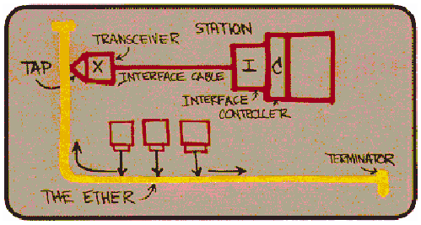
The original Ethernet
Robert Metcalfe’s design
Multiple stations tap into a shared communication medium called the Ether.

Slide 5
The original Ethernet
Robert Metcalfe’s design
Multiple station tapped into a shared medium call the Ether.
Since the communication medium is shared, only one station can communicate: need a Medium Access Protocol (MAC), Carrier Sense Multiple Access (CSMA) with collision detection (CD), CSMA/CD.
CSMA: sense the medium; if nobody is talking, talk
Two stations can start talking at the same time due to signal propagation delay.
CD: monitor the medium while talking, if as soon as a garbled message is heard, stop talking, exponential back-off.

Slide 6
Topologies: logically the same
Bus topology
Coax Cable
(10Base2, 10Base5)
around 1985
Repeater
Star topology
10Base-T,
Half-duplex
Dominates in later for easy management

Slide 7
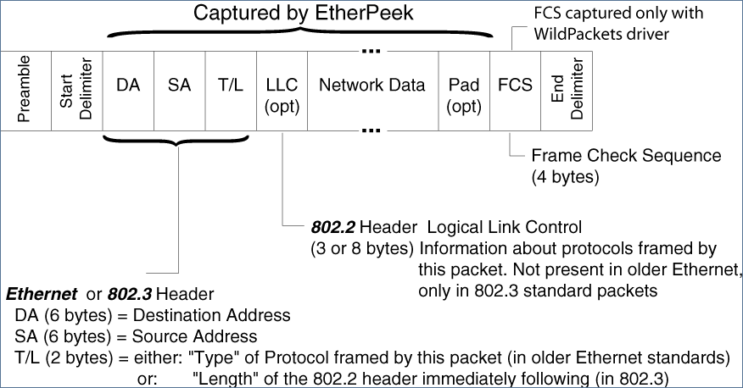
Standard
IEEE std 802.3, CSMA/CD
Packet size: 64Bytes to 1500 Bytes
Why minimum and maximum sizes?
Packet format:
Speed:
10Mbps
Network size
< 2500m

Slide 8
100Mbps Ethernet (Fast Ethernet)
Same protocol, same packet format/size, faster speed
100Mbps
Other impact besides technology advances?
Network size?

Slide 9
1000Mbps Ethernet
Better cable quality
Jumbo frame for large messages
Retain CSMA/CD
If do nothing in the minimum frame size, the network size can only be 250/10 = 25m!!
Solution: Carrier extension to make minimum frame size to 4096 bits (512 bytes) to keep the size to 250m.
Nobody uses the CSMA/CD mode at 1Gbps. All switched.

Slide 10
Switched Ethernet
In 1992/1993, change the repeater to a switch
Repeater: always broadcast
Switch: only send to the targeted port
Switched Ethernet is contention free.
Today, wired Ethernet are mostly switched Ethernet.
CSMA is still used in Wireless Ethernet, evolved to CSMA/CA
Collision
No collision
Repeater
Switch
Collison free
Full duplex 10/100Base-T

Slide 11
Switched Ethernet
Topology management
Not doing broadcast anymore, how do we make sure that all packets can reach their destinations?
Fall-back mode
If a switch does not know what to do with a packet (destination not in the forwarding table), do broadcast (send to all ports except the incoming port).
Normal mode
Backward learning algorithm
If a switch sees a packet from A at port X, put (A, X) in the forwarding table. Now, it knows what to do with packet to A.

Slide 12
Switched Ethernet
Fall-back mode, broadcast will cause problem in a topology with a loop.
One packet with unknown destination will trigger a packet storm that would saturate all links in the loop.
Solution: using a spanning tree algorithm to make a topology without any loop (single path from one switch to any other switch).
Switched Ethernet only supports a tree topology.
Switch
Switch
Switch

Slide 13
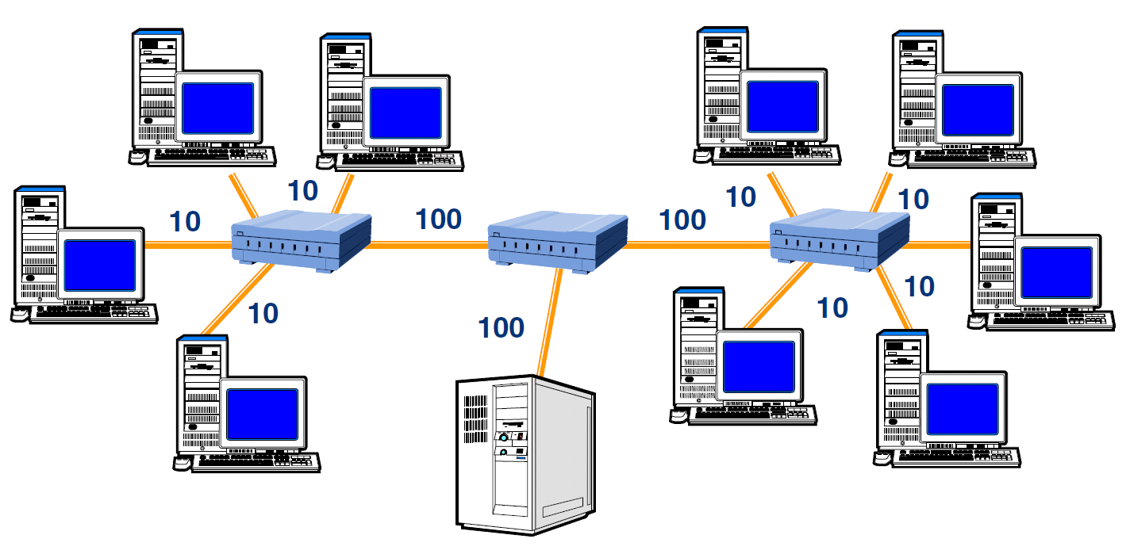
Switched Ethernet allows a topology with multiple speeds.

Slide 14
Ethernet and the upper level
Internet hosts typically runs TCP/IP/Ethernet protocol stack.
Ethernet is designed for the cost.
Ethernet card is low-cost without much logic
Need to use CPU to move data into and out of the buffers in the card.
There is typically a parameter in the OS to set the minimum time interval to generate interrupts.
Too much interrupt can consume the whole CPU, seen even in 1Gbps Ethernet. If uncontrolled, the card can generate more than 1000000 interrupts per second.
Communication Latency is very large with the traditional Ethernet

Slide 15
Ethernet development trend
Leave the MAC alone
10X performance at 3-4X the cost
Keep Interoperability: “plug and play”

Slide 16
10 Gigabit Ethernet
A lot of focuses on the physical medium – big difference in 1Gbps and 10Gbps links.
Fibers cabling only.
MAC protocol: still an Ethernet
802.3 frame format
802.3 min/max frame size
Full duplex operation only, no more CSMA/CD
LAN and WAN -- Runs long distance

Slide 17
Ethernet enhancements for data centers
Traffic differentiation: Priority groups
End-to-end traffic differentiation, not longer pure “best-effort”
Multiple queues for different priority groups.
Lossless fabric: reliable transport
Like traditional HPC networks (e.g. InfiniBand)
Transient congestion: priority based flow control
Persistent congestion: backward congestion notification
Fat-tree topology: shortest-path bridging
No longer spanning tree algorithms
L2-multi-pathing

Slide 18
Shortest path bridging
Incremental advance to MSTP
Builds a spanning tree for each bridge
Using the spanning tree rooted at the source switch for shortest path bridging.
Data center bridging – a more newer extension.
Switch
Switch
Switch

Slide 19
Ethernet Hardware Acceleration
Interrupt coalescing
Improves throughput, but hurts latency
Jumbo frames
Segmentation offload engine (virtual MTU)
CPU sends jumbo frames, adapter splits the frame into regular sized frame
Server side optimization
Good for server connecting to regular clients

Slide 20
Ethernet Hardware Acceleration
TCP offload Engines
Hardware Acceleration for the entire TCP/IP stack
The network adapter supports the whole TCP/IP
Internet Wide-Area RDMA protocol (iWARP)
Support RDMA over Ethernet

Slide 21
40GB, 100GB Ethernet
Standardized in 2012
Just buff up the speed.
Features:
Full duplex operation only
Preserve 802.3 frame format
Preserve 802.3 minimum and maximum frame size
Maintain the bit error rate 10^{-12} – use forward correction code.
40Gbps or 100Gbps over certain distances
Mostly focus on the physical layer issues and technology to achieve the rate.
Ethernet is becoming a link technology.

