Slide 1
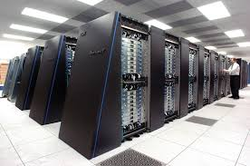
Extreme scale parallel and distributed systems
High performance computing systems
Current No. 1 supercomputer Tianhe-2 at 33.86 petaflops
Pushing toward exa-scale computing by 2020, 32 times bigger than Tianhe-2 (almost need to double the speed every year).
Many issues ranging from applications to systems such power, resilience, networking, applications.

Slide 2
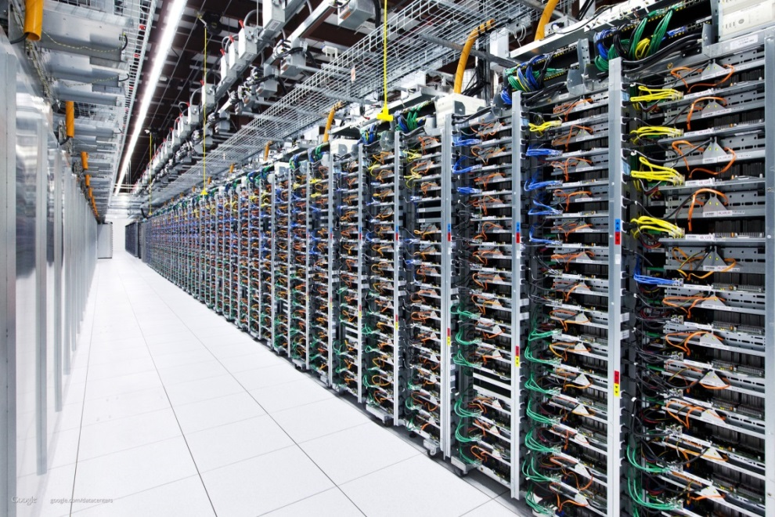
Extreme scale parallel and distributed systems
Cloud computing data centers: Amazon EC2
Hugh push to move computing/storage to the cloud computing infrastructure
Extreme scale to achieve the scale of economics
Applications are more diverse
Networking infrastructure needs significant improvement
Security

Slide 3
Extreme scale parallel and distributed systems
Big data platforms: hadoop cluster?
Huge hype
Not clear what is beyond the traditional HPC and cloud computing platforms.

Slide 4
Issues related to extreme scale systems
How to use the systems
Programming paradigms
What changes when the scale becomes big?
How to build the systems
Hardware and systems issues
What changes when the scale becomes big?

Slide 5
Programming for extreme scale PDS
Ease of use .vs. performance
Distributed memory programming
Message Passing Interface (MPI)
Mapreduce (Hadoop)
Hybrid shared memory and distributed memory programming
Matching the architecture -- CMP+SMP clusters
Hybrid OpenMP+MPI
GPU/MIC programming and hybrid programming
More potential to achieve exa-scale within power limit
GPU, MIC
Hybrid GPU/MIC + MPI

Slide 6
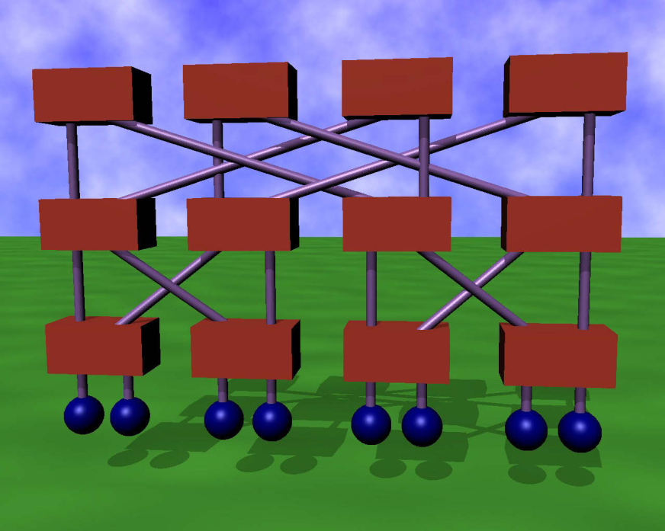
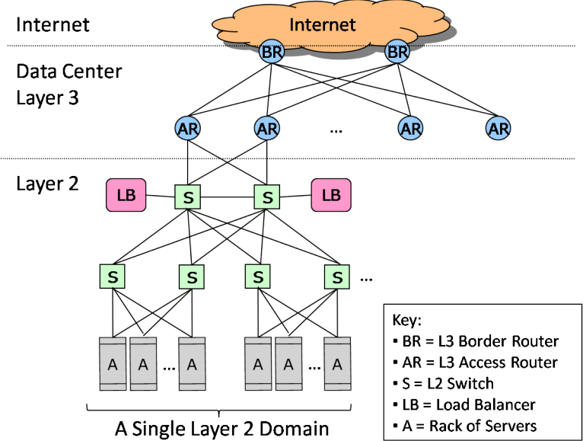
Architecture/interconnects
Extreme-scale PDSs are Internet-in-a-building
Traditional networking issues: topology, routing, flow control, congestion control

Slide 7
Architecture/interconnects
Current and Emerging network architectures
InfiniBand and 10/100-G E (technology)
Openflow and software defined networks (network architecture)
Recent topology/routing proposals for extreme scale systems
Achieving performance requirement with the budget constraints.

Slide 8
System software and communication sub-systems
Parallel IO systems
Topology aware job allocation and node mapping
Communication protocols
One-sided .vs. two-sided communications
Collective communication algorithms

Slide 9
Performance models and evaluation methods
Performance modeling techniques for networks/systems/applications.
Workload characterization.
Application tracing
Challenges in simulation and modeling of large scale systems using realistic workloads

Slide 10
Resilience and power-awareness
System and application resilience techniques and analysis
Fault tolerance techniques in hardware and software
Resource management for system resilience and availability.
Energy efficient HPC
Energy efficient data centers

Slide 11
This course
Targets students who are interested in research and development in large scale sytems.
Go through the recent advances in these subjects, and bring you up-to-date in research in this area in general.
Introduce software, algorithmic, and analytical tools and techniques that are necessary to perform research in this area.

