Slide 1
SDN and Openflow

Slide 2
Motivation
Since the invention of the Internet, we find many innovative ways to use the Internet
Google, Facebook, Cloud computing, etc
All achieved through software innovations.
Internet infrastructure, however, is virtually unchanged in the past 30-40 years.
We get higher speed, but not much more. E.g. Ethernet at 400Gbps!!
We start to see the gap between network applications and network infrastructure.
Cloud computing data centers cannot be effectively supported using the traditional networking infrastructure
Lots of proposals, but hard to make it into the real network.

Slide 3
Motivation
Why Internet (network) application is exploding while the network infrastructure is not?
Applications are software that allows many people to work on – this facilitates innovation.
Network infrastructure is basically hardware – only a handful of companies can really work on the network infrastructure – this limits the innovation.
We now see a need to innovate the network infrastructure
We can continue to do what we used to do – patching up the network and putting off the fires
A big idea that allows for continuous innovation: open up the network infrastructure and make it behave like software so as to facilitate continuous innovations.
The is the core idea of Software Defined Network (SDN).

Slide 4
Basic functions in a traditional router
For a packet at its input port
Decide what to do this the packet – control plane
Which output should this packet go to?
Software system running protocols (OSPF, RIP)
Move the packet from the input port to the output port – data plane
This has to be done by hardware, why?
40Gbps line speed, 1500 bytes packet, need to complete the move every 300 nano-seconds.
A router
Control plane (software)
Data plane (hardware)

Slide 5
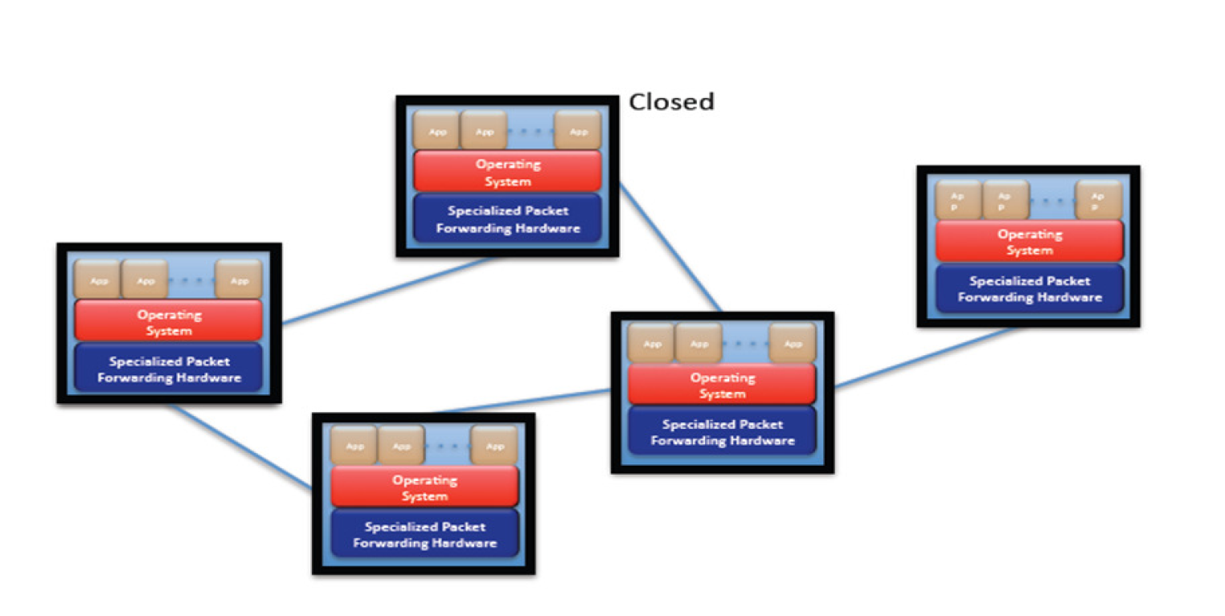
Current network: Closed boxes, fully distributed protocols.

Slide 6
Some drawbacks
Bundling the forwarding hardware with control plane software
Effectively makes it a closed system (the whole thing behaves like hardware)
No way to perform experiments for any innovation on production networks – This kills the innovation.
Innovative limited to interface – only the networking company can do anything meaningful
Hardware centric
Forwarding gets faster and faster using custom ASICs

Slide 7
Software Defined Network
Keep the data plane hardware, open up the control plane software.
SDN Server
Control plane (software)
Data plane (hardware)
SDN client (Openflow)
Data plane (hardware)

Slide 8
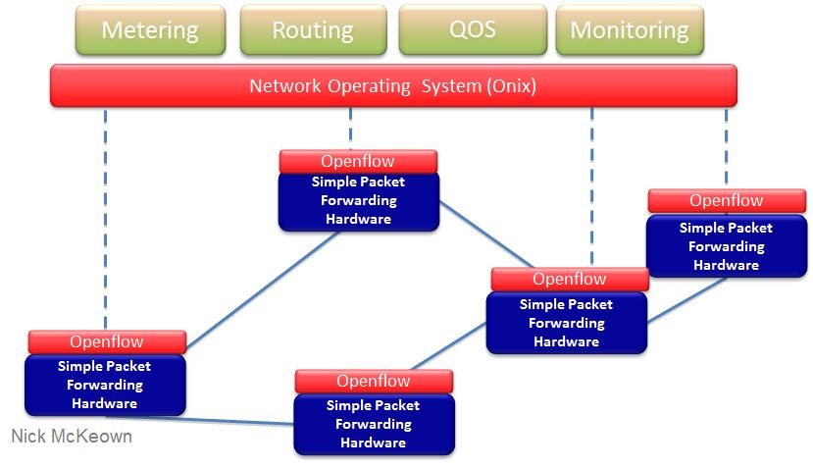
Software Defined Networks architecture
Network functionalities become software about the network OS,
which control the clients.

Slide 9
SDN
SDN principles
Separate control plane from data plane
Execute control plane software on general purpose servers
Decouple from specific networking hardware
Use commodity servers
An architecture to control the entire network as whole instead of individual device.

Slide 10
SDN – Software-centric networks
Network devices expose SDKs (through Openflow)
Anyone can now develop network software (if the network OS holds up to its promises).
Network application developers can design the network for the application.
E.g. application specific routing.

Slide 11
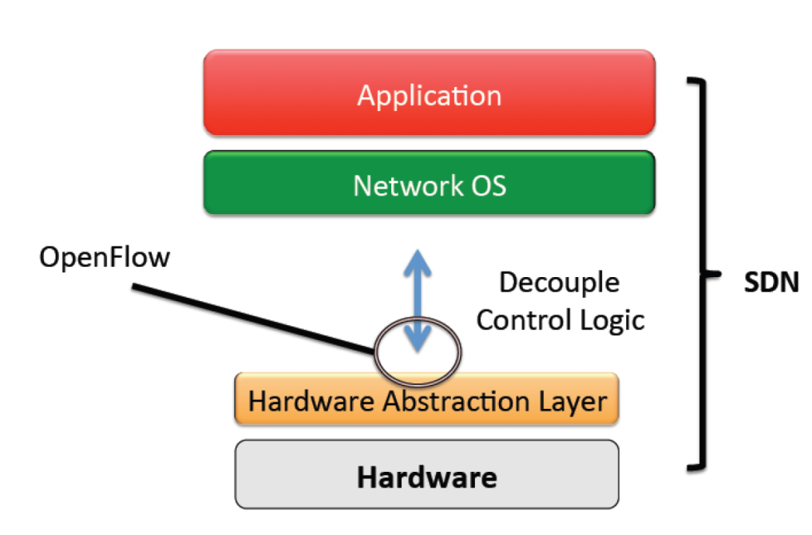
Open Flow
Openflow is an Open API that provides a standard Interface for programming a switch
Basic function – install routes on the switch
Analogy: ISA for computer architecture

Slide 12
Openflow
An Openflow switch (Ethernet switch) has an internal flow table.
If a packet matches an entry in the flow table, perform the actions (e.g. forward to port 10) according to the flow table.
If a packet does not match any entry in the flow table. Send it to the Openflow controller
The controller will figure out what to do with such packet
The controller will then respond to the switch, informing how to handle such a packet so that the switch would know how to deal with such packets next time.
For each flow, ideally the controller will be queried once.
Openflow defines the standard interface to add and remove flow entries in the table.

Slide 13
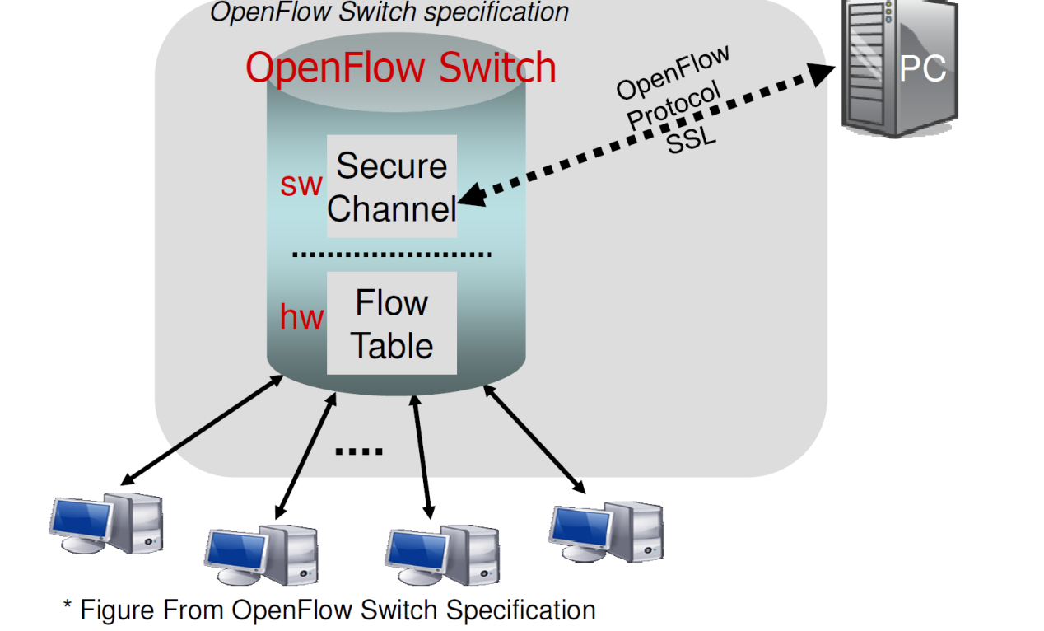
Openflow
An Openflow switch use s secure channel to connect to a controller
Authentication in channel set up
Communicate through the channel

Slide 14
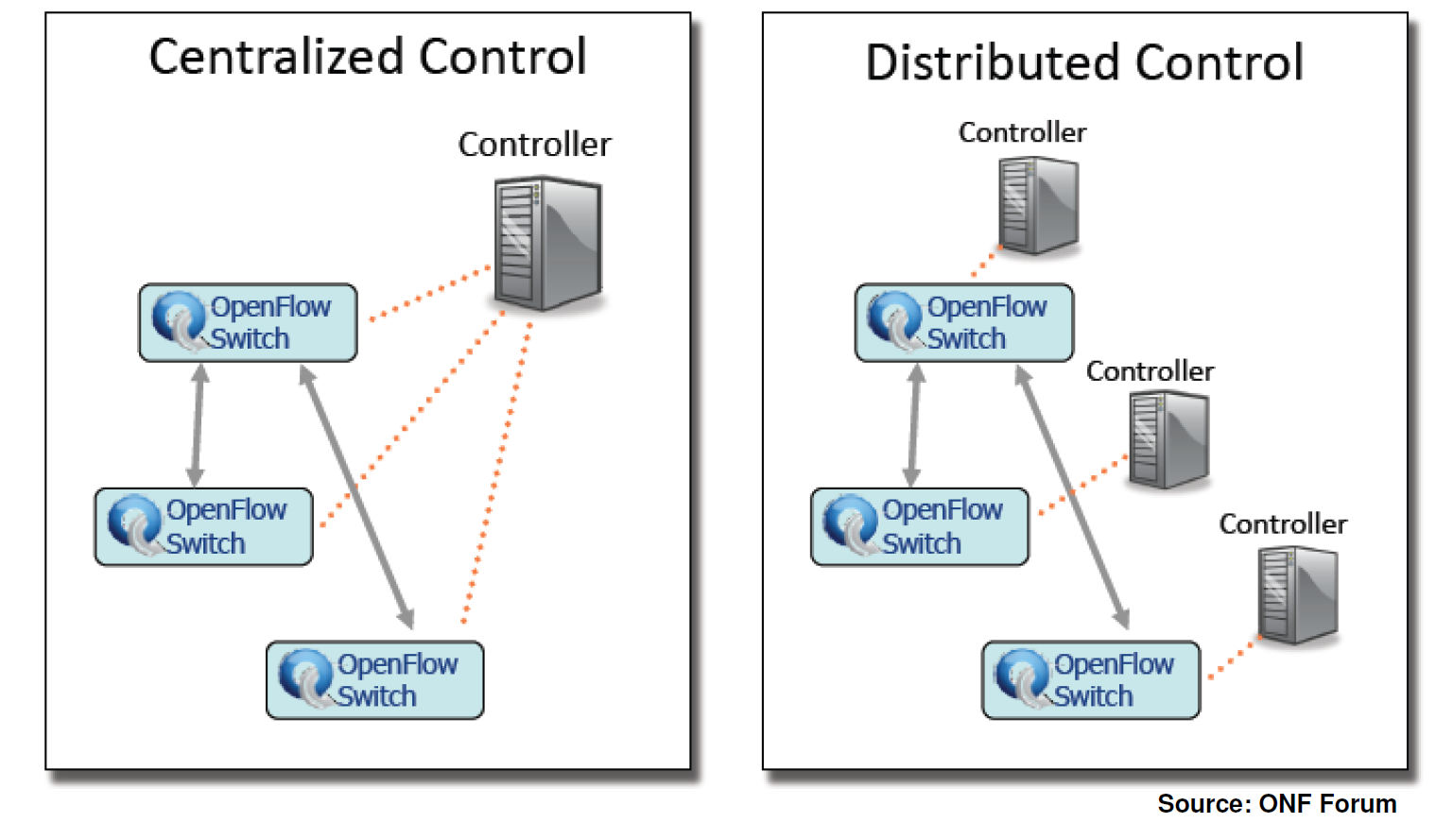
Centralized and distributed control of Openflow switches

Slide 15
Open Flow Protocol Messages
Controller-to-switch: from the controller to manage or inspect the switch state
Features, config, modify state, read state, packet-out, etc
Asynchronous: send from switch without controller soliciting
Packet-in, flow removed/expired, port status, error, etc
Symmetric: symmetric messages without solicitation in either direction
Hello, Echo, etc.

Slide 16
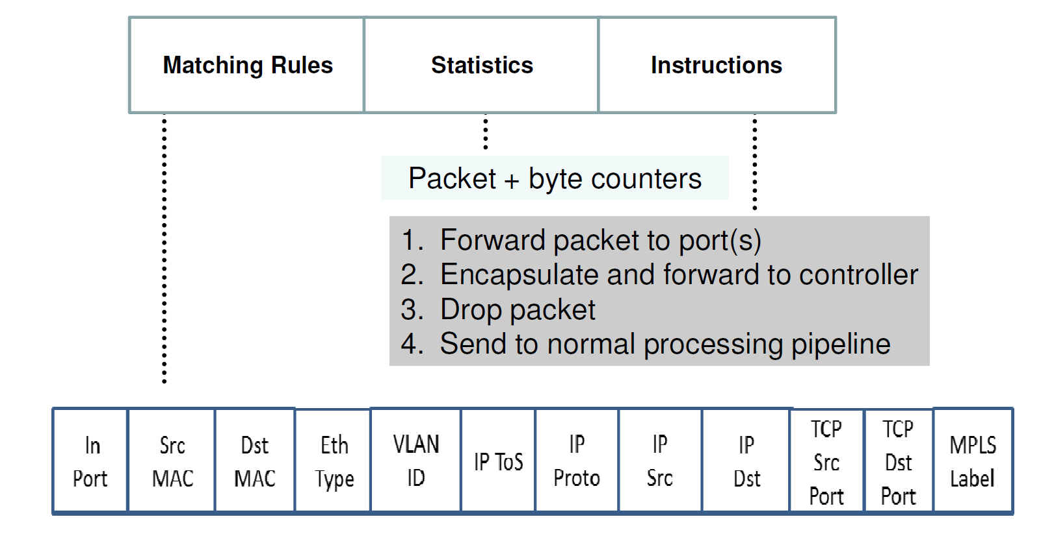
Flow table entry

Slide 17
Flow switching and routing
Layer 4
Each individual field + meta data
Wild Card aggregation
E.g. IP-subnet: 192.168.*/24

Slide 18
Pipeline processing
A switch can have many flow table that are matched in a pipeline fashion.

Slide 19
Per table packet processing

Slide 20
Instructions and action set
Each flow entry contains a set of instructions that are executed when a packet matches the entry
Instructions can have a set of actions to add to the action set, a list of actions to apply immediately to the packet, or modify pipeline processing
An action set is associated with each packet

Slide 21
Actions
Required:
Output – forward to a port
Drop
Group
Optional
Set-Queue
Push/pop tag
Set Field

Slide 22
Most important function of Openflow
Setting up routes dynamically
Flexible routing -- new routing scheme for data centers?
Application specific routing
Dynamic load balancing
Network virtualization

Slide 23
Some challenges in SDN
A complete paradigm shift, many unknowns
Network OS abstraction, to clear what should and should not be done there? What is the right level of abstraction provided by the network OS?
Flexibility .vs. performance: Can SDN keep up with the speed?
Scalability: How can the controller be enabled to provide a global network view
Security: how can we prevent misuse of network or defend against attack?
Software defined network can have software bugs!!

Slide 24
SDN and HPC
Can SDN help HPC?
SDN needs to be incorporated into Infiniband
Some claim that InfiniBand is already a SDN
Can use user supplied subnet manager to do custom routing – not dynamic though
Does it have the same capability as openflow?
SDN can help in some case
Application specific networking
SDN-enabled collective communication?

Slide 25
Going further
Openflow is implemented in MiniNet (mininet.org)
Related resources
Open Networking Foundation: https://www.opennetworking.org/
This lecture materials are based on various resources in the net, in particular this file
https://www.clear.rice.edu/comp529/www/papers/tutorial_4.pdf

