Slide 1
The Who, What, Why and How of High Performance Computing Applications in the Cloud
Soheila Abrishami

Slide 2
Introduction
Cloud computing is emerging as an alternative to supercomputers for some of the high-performance computing (HPC) applications that do not require a fully dedicated machine
Advantages of using cloud computing in HPC applications
cost effective alternative
reduces the risks caused by under-provisioning
reduces the underutilization of resources caused by overprovisioning
the built-in virtualization support in the cloud support flexibility, customization, security, migration and resource control

Slide 3
Motivation
It still remains unclear whether, and when, HPC in the cloud can become a feasible substitute or complement to supercomputers.
Based on the expansion of clouds to HPC applications, HPC users and cloud providers faced with the problem of choosing the best platform by having a limited knowledge about application characteristics, platform capabilities and cost
why and who should choose (or not choose) cloud for HPC
for what applications, and how should cloud be used for HPC

Slide 4
Contribution
For answering what HPC applications are suitable for cloud
By analyzing the performance of HPC applications on a range of platforms varying from supercomputer to cloud
For answering how to use cloud for HPC
By analyzing the impact of virtualization on HPC applications
By using multiple platforms (dedicated and in the cloud) and use a smart application aware mapping of applications to platforms
For answering why it is challenging to make a profitable business for clouds provider and also who can benefits from a HPC_cloud
By investigating the economic aspects of running in cloud vs. supercomputer

Slide 5
Experimental Testbed

Slide 6
Benchmarks and Applications
Benchmarks and applications are selected from different scientific domains and which differ in nature, amount, and pattern of inter-processor communication.
Benchmarks are chosen which are written in two different parallel programming environments - MPI and CHARM++.
These benchmark are:
NAS Parallel Benchmarks (NPB) class B
Jacobi2D
NAMD
ChaNGa
Sweep3D
NQueens

Slide 7
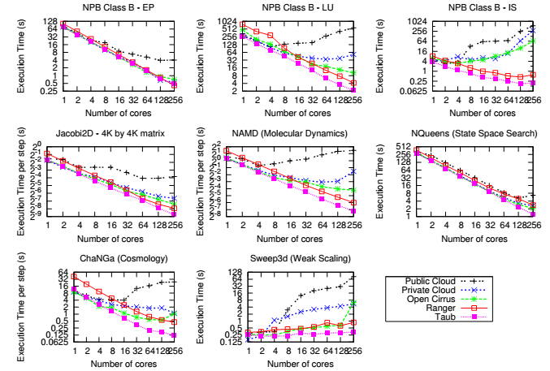
The scaling behavior of platforms for the selected applications

Slide 8
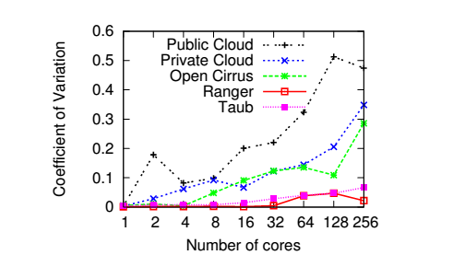
Performance Variation for ChaNGa

Slide 9
Latency and Bandwidth vs. Message Size on all platforms

Slide 10
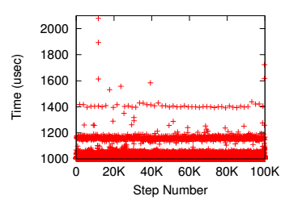
System noise has detrimental impact on performance

Slide 11
Optimizing Cloud Virtualization for HPC
To mitigate the overhead of cloud platform two ways is considered
Lightweight virtualization : reduces the latency overhead of network virtualization by granting virtual machines native accesses to physical network interfaces
CPU affinity: instructs the operating system to bind a process (or thread) to a specific CPU core

Slide 12
Lightweight virtualization
Two lightweight virtualization techniques
thin VMs configured with PCI pass-through for I/O
containers that is OS-level virtualization
Thin VM:
Definition: a physical network interface is allocated exclusively to a thin VM
Problem: under utilization when the thin VM generates insufficient network load
Containers:
Definition: share the physical network interface with its sibling containers and its host.
Problem: containers must run the same operating system as their underlying host

Slide 13
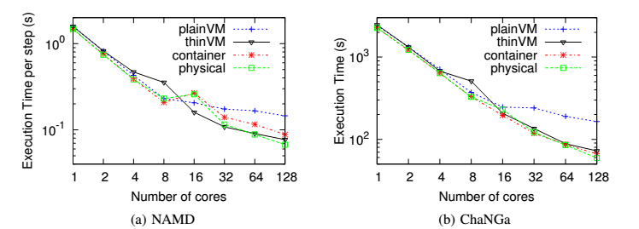
Impact of Virtualization on Application Performance

Slide 14
CPU Affinity
Prevent migration of process
Prevent multi process share a core
Improving cache locality
In cloud CPU affinity can be enforced in two levels:
Application level: binding process of to the virtual CPUs of a VM
Hypervisor level: binding virtual CPUs to physical CPUs

Slide 15
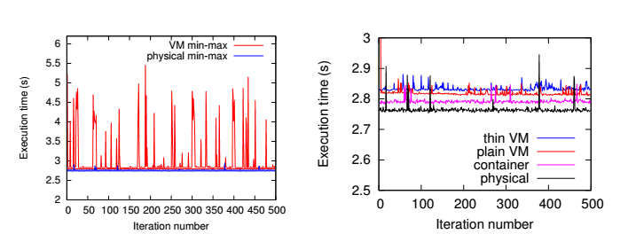
Impact of CPU Affinity on CPU Performance
$\text{200 }\text{million} \text{of} y = y +\frac{rand\left(\right)}{c}$operations
12 process

Slide 16
Application Performance with various CPU Affinity Settings, using thin VM and plain VM

Slide 17
HPC Economic in the Cloud
Why it is challenging to make a profitable business for cloud providers for HPC:
Utilization of resources on HPC system is high
HPC cloud user would want a dedicate instance
The performance of HPC applications is very sensitive to the interconnect

Slide 18
Cost ratio of running in cloud and a dedicated supercomputer by assuming different per-core-hour cost ratio from 1x to 5x

Slide 19
Cloud Bursting and Benefit
How to find a mapping between application and available resources to makes best use of the dedicated HPC-optimized resources, minimizes the cost of bursting to the cloud, and meet the performance targets?
By an intelligent mapping algorithms
Which aware of application characteristics
Understand that application which scale poorly on cloud should be allocated to dedicated resources first

Slide 20
Mapping of HPC applications to platforms with varying resources (e.g., different processor types and speed, interconnection networks, and virtualization overhead)
parallel efficiency $(E): E = S/P$
where $P$ is the number of processors, and Speedup $(S)$ is defined as:
$S =\frac{T_{s}}{T_{p}}$
where $T_{s}$ is the sequential execution time and $T_{p}$ is the parallel execution time

Slide 21
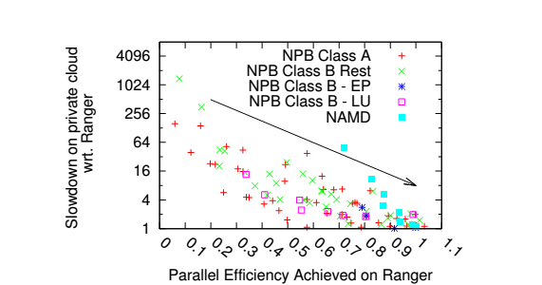
Applications with high parallel efficiency are good candidates for cloud

Slide 22
Using of smart mapping algorithm in different scenarios
A smart mapping algorithm by using the application signature and platform characteristic can recommend the best platform for a given application under different scenarios
Minimize Cost with Performance Guarantees
Maximize Performance with Constrained Budget

Slide 23
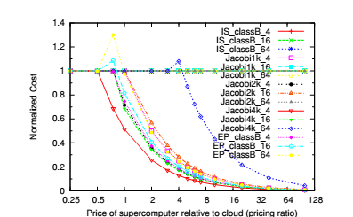
Cost with Performance Guarantees

Slide 24
Summary
Lightweight virtualization is important to remove overheads for HPC in cloud.
A hybrid cloud-supercomputer platform environment can outperform its individual constituents
Application characterization in the HPC-cloud space is challenging but the benefits are substantial

