Slide 1
Dragonfly Topology and Routing

Slide 2
Outline
Background
Motivation
Topology description
Routing
  Minimal Routing
  Valiant Routing
  UGAL/G Adaptive Routing
  Indirect Adaptive Routing
    Credit Round Trip
    Reservation
    Piggyback
    Progressive
  Performance Comparison

Slide 3
Background
As memory and processor performance increases, interconnect networks are becoming critical
Topology of an interconnect network affects the performance and cost of the network
A good interconnect network, exploits emerging technologies

Slide 4
Motivation
Increasing router pin bandwidth
  High-radix routers
Development of active optical cables
  Longer links with less cost per unit distance
Using above technology advancements, we can build networks with higher performance. How?

Slide 5
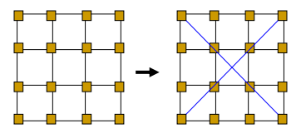
Motivation
Reduced network diameter and latency

Slide 6
Motivation
Problem 1: Number of ports in each router is limited (64, 128, …)
  We want much higher radices (8K – 1M nodes)
Problem 2: Long global links between groups are expensive and dominate network cost
  We should minimize number of global channels traversed by an average packet

Slide 7
Motivation
Solution: use group of networks connected to a sub-network as a virtual high-radix router
  All minimal routes traverse at most only one global link
  Length of global links are increased to reduce the cost

Slide 8
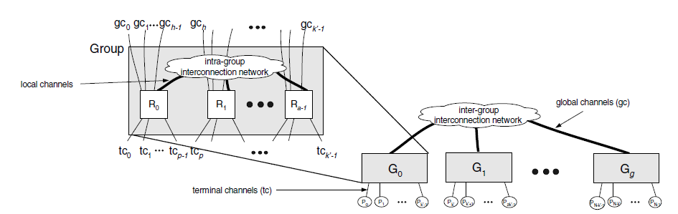
Dragonfly Topology
K = radix of each router = p + a + h - 1
K’ = virtual router radix = a(p + h)
N = ap(ah + 1)
  [Kim et al. ISCA08]

Slide 9
Topology Description
Three-level architecture:
  Router, Group, System
Arbitrary networks can be used for inter-group and intra-group networks
K’ >> K
  Very high radix virtual routers
  Enables very low global diameter (=1)
To balance channel load on load balanced traffic:
  a = 2p = 2h

Slide 10
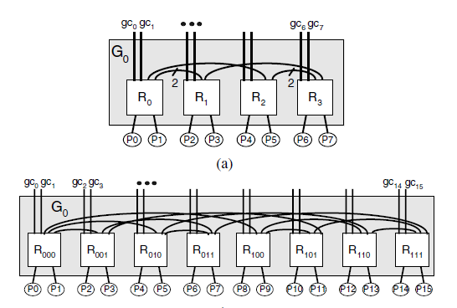
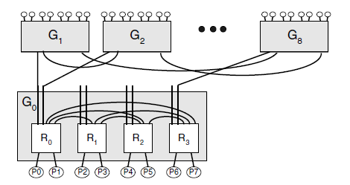
Topology Variations
  [Kim et al. ISCA08]

Slide 11
Minimal Routing
Step 1 : If G_{s} ≠ G_{d} and R_{s} does not have a connection to G_{d}, route within G_{s} from R_{s} to R_{a}, a router that has a global channel to G_{d}.
Step 2 : If G_{s} ≠ G_{d}, traverse the global channel from R_{a} to reach router R_{b} in G_{d}.
Step 3 : If R_{b} ≠ R_{d}, route within G_{d} from R_{b} to R_{d}.

Slide 12
Minimal Routing

Slide 13
Minimal Routing
Good for uniform traffic
  All links are used evenly
Link saturation happens on adversarial traffic
  Global ADV
  Local ADV
Load balancing mechanism needed to distribute traffic

Slide 14
Valiant Randomized Routing
Step 1 : If G_{s} ≠ G_{i} and R_{s} does not have a connection to G_{i}, route within G_{s} from R_{s} to R_{a}, a router that has a global channel to G_{i}.
Step 2 : If G_{s} ≠ G_{i} traverse the global channel from R_{a} to reach router R_{x} in G_{i}.
Step 3 : If G_{i} ≠ G_{d} and R_{x} does not have a connection to G_{d}, route within G_{i} from R_{x} to R_{y}, a router that has a global channel to G_{d}.
Step 4 : If G_{i} ≠ G_{d}, traverse the global channel from R_{y} to router R_{b} in G_{d}.
Step 5 : If R_{b} ≠ R_{d}, route within G_{d} from R_{b} to R_{d}.

Slide 15
Valiant Routing

Slide 16
Valiant Routing
Balances use of global links
Increases path length by at least one global link
Performs poorly on benign traffic
Maximum throughput can be 50%

Slide 17
UGAL-G/L Adaptive Routing
Choose between MIN and VAL on a packet by packet basis to load balance the network
Path with minimum delay is selected:
  Queue length
  Hop count
UGAL-L uses local queue info at the current router node
UGAL-G uses queue info for all global channels in G_{s}

Slide 18
UGAL Adaptive Routing
Measuring path queue length is unrealistic (UGAL-G)
Use local queue length to approximate path queue length
Local queues only sense congestion on a global channel via backpressure over the local channel
  Requires stiff backpressure

Slide 19
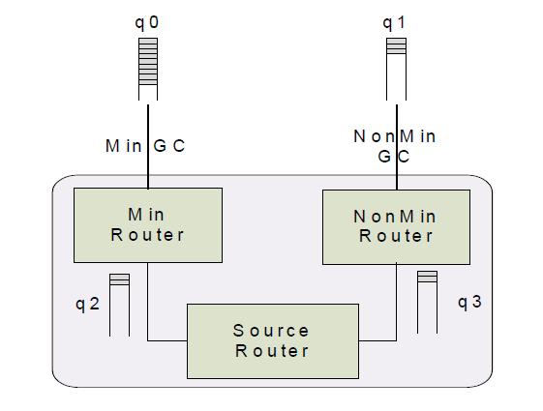
Adaptive Routing
  [Jiang et al. ISCA09]

Slide 20
Indirect Adaptive Routing
Improve routing decision through remote congestion information
Four methods:
  Credit Round Trip
  Reservation
  Piggyback
  Progressive

Slide 21
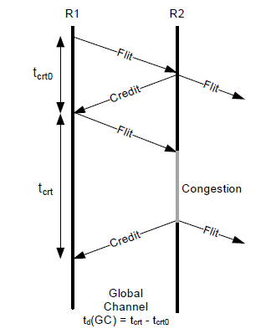
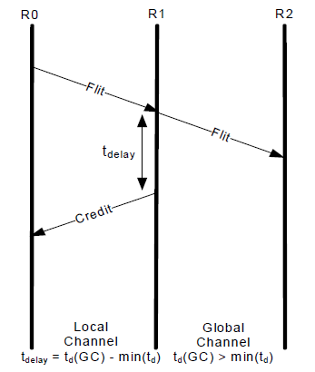
Credit Round Trip
  [Jiang et al. ISCA09]

Slide 22
Credit Round Trip
Delay the return of local credits to the congested router
Creates the illusion of stiffer backpressure
Drawbacks:
  Remote Congestion is still sensed through local queue
  Info is not up to date
MIN
VAL
GC
GC
Congestion
Delayed
Credits
Credits
Source
Router
  [Jiang et al. ISCA09]

Slide 23
Reservation
Reserve bandwidth on minimal global channel
If successful send the packet minimally
If not, route non-minimally
Drawbacks:
  Needs buffer at source router to hold waiting packets
  Packet latency increased by round-trip time of RES flit
  RES flits can create significant load on source group
MIN
VAL
GC
GC
Congestion
RES
Failed
RES
Flit
Source
Router
  [Jiang et al. ISCA09]

Slide 24
Piggyback
Broadcast link state info of GCs to adjacent routers
Each router maintains the most recent link state information for every GCs in its group.
routing decision is made using both global state information and the local queue depth
congestion level of each GC is compressed into a single bit (S_{GC})
Drawbacks:
  Consumes extra bandwidth
  Congestion information not up to date due to broadcast delay
MIN
VAL
GC
GC
Congestion
GC
GC
Busy
Free
Source
Router
  [Jiang et al. ISCA09]

Slide 25
Progressive
Re-evaluate the decision to route minimally at each hop in the source group
Non-minimal routing decisions are final
The packet is routed minimally until congestion encountered. Then it routes non-minimally
Drawbacks:
  Adds extra hops
  Needs an additional virtual channel to avoid deadlocks
MIN
VAL
GC
GC
Congestion
Source
Router
  [Jiang et al. ISCA09]

Slide 26
Steady State Traffic: Uniform Random
300
Piggyback
280
Credit Round Trip
Progressive
260
Reservation
Minimal
240
220
Packet Latency (Simulation cycles)
200
180
160
140
120
100
0
0.1
0.2
0.3
0.4
0.5
0.6
0.7
0.8
0.9
Throughput (Flit Injection Rate)
  [Jiang et al. ISCA09]

Slide 27
Steady State Traffic: Worst Case
450
Piggyback
Credit Round Trip
400
Progressive
Reservation
350
Valiant’s
300
Packet Latency (Simulation cycles)
250
200
150
100
0
0.1
0.2
0.3
0.4
0.5
Throughput (Flit Injection Rate)
  [Jiang et al. ISCA09]

