Slide 1
GPGPU overview

Slide 2
Graphics Processing Unit (GPU)
  GPU is the chip in computer video cards, PS3, Xbox, etc
  Designed to realize the 3D graphics pipeline
    Application → Geometry → Rasterizer→ image
GPU development:
  Fixed graphics hardware
  Programmable vertex/pixel shaders
  GPGPU
    general purpose computation (beyond graphics) using GPU in applications other than 3D graphics
    GPGPU can be treated as a co-processor for compute intensive tasks
      With sufficient large bandwidth between CPU and GPU.

Slide 3
CPU and GPU
GPU is specialized for compute intensive, highly data parallel computation
  More area is dedicated to processing
  Good for high arithmetic intensity programs with a high ratio between arithmetic operations and memory operations.
Control
ALU
ALU
ALU
ALU
Cache
DRAM
DRAM
CPU
GPU

Slide 4
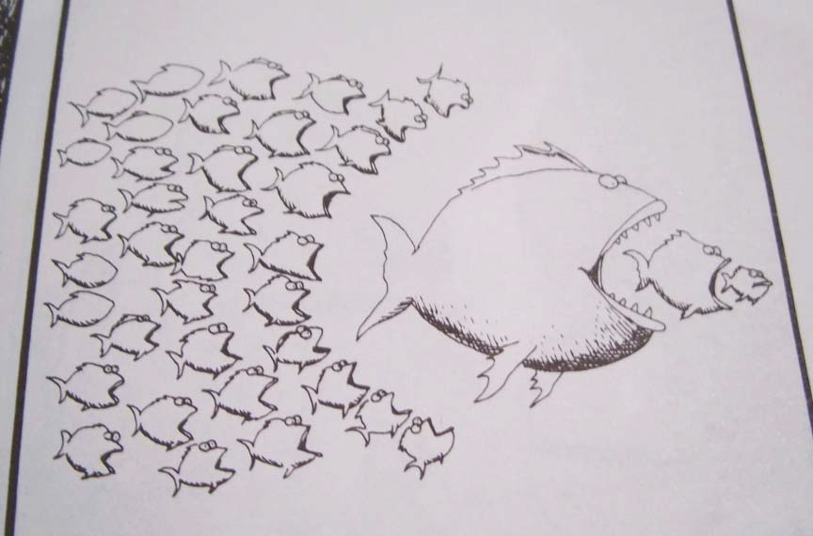
A powerful CPU or many less powerful CPUs?

Slide 5
Flop rate of CPU and GPU
Single Precision
Double Precision
GFlop/Sec

Slide 6
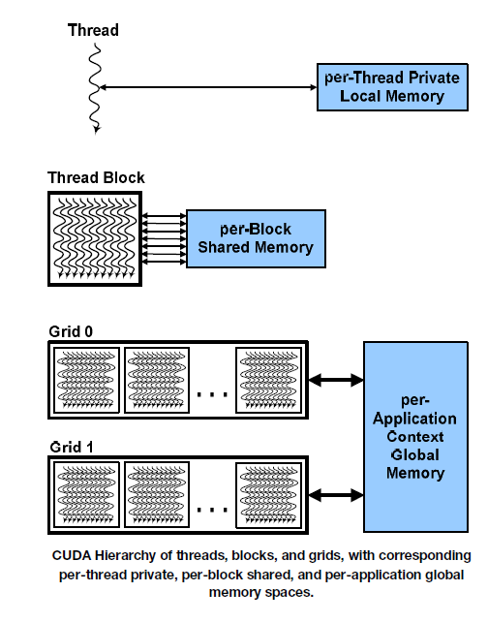
Compute Unified Device Architecture (CUDA)
Hardware/software architecture for NVIDIA GPU to execute programs with different languages
  Main concept: hardware support for hierarchy of threads

Slide 7
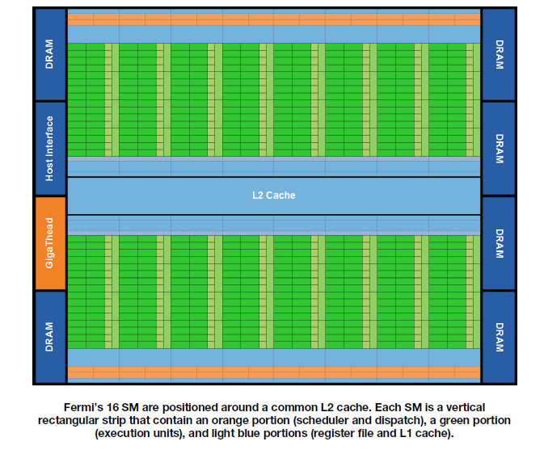
Fermi architecture
First generation (GTX 465, GTX 480, Telsa C2050, etc) has 512 CUDA cores
  16 stream multiprocessor (SM) of 32 processing units (cores)
  Each core execute one floating point or integer instruction per clock for a thread

Slide 8
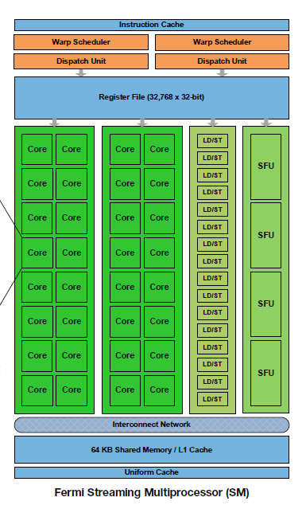
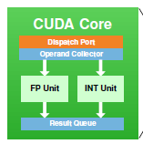
Fermi Streaming Multiprocessor (SM)
32 CUDA processors with pipelined ALU and FPU
  Execute a group of 32 threads called warp.
  Support IEEE 754-2008 (single and double precision floating points) with fused multiply-add (FMA) instruction).
  Configurable shared memory and L1 cache

Slide 9
SIMT and warp scheduler
SIMT: Single instruction, multi-thread
  Threads in groups (or 16, 32) that are scheduled together call warp.
  All threads in a warp start at the same PC, but free to branch and execute independently.
  A warp executes one common instruction at a time
    To execute different instructions at different threads, the instructions are executed serially
      To get efficiency, we want all instructions in a warp to be the same.
  SIMT is basically SIMD without programmers knowing it.

Slide 10
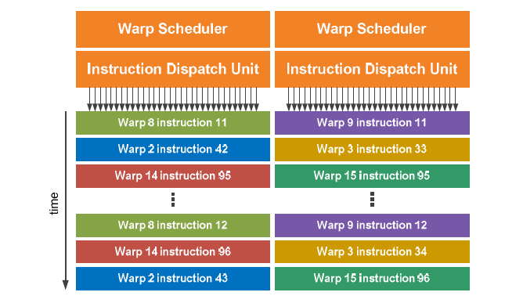
Warp scheduler
2 per SM: representing a compromise between cost and complexity

Slide 11
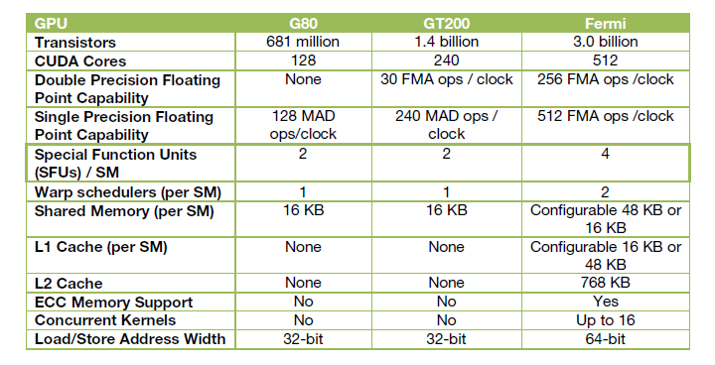
NVIDIA GPUs (toward general purpose computing)
Control
ALU
ALU
ALU
ALU
Cache
DRAM
DRAM

Slide 12
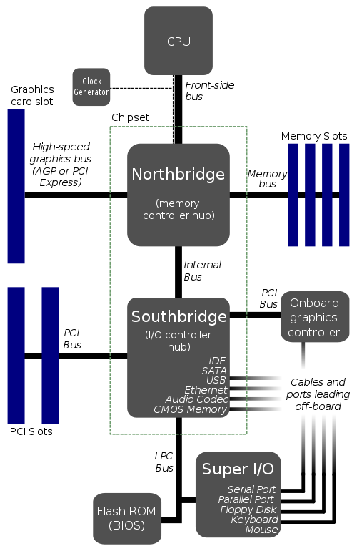
Typical CPU-GPU system
Main connection from GPU to
CPU/memory is the PCI-Express (PCIe)
  PCIe1.1 supports up to 8GB/s (common systems support 4GB/s)
  PCIe2.0 supports up to 16GB/s

Slide 13
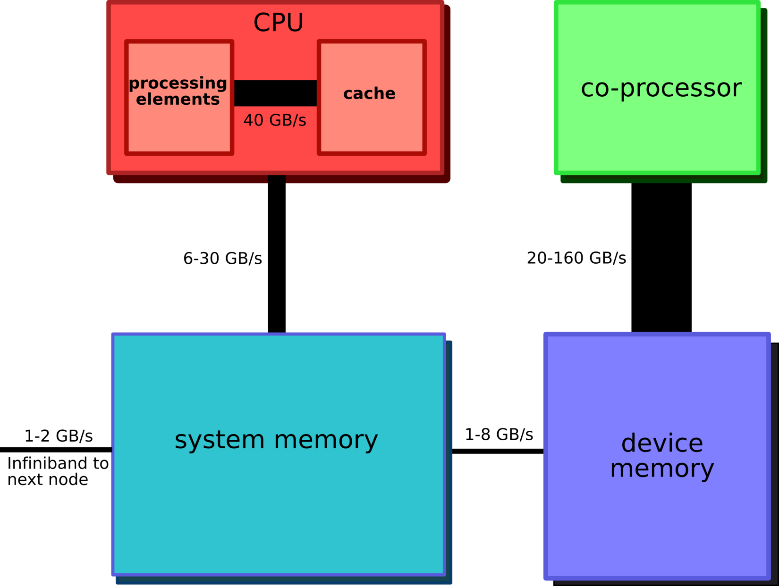
Bandwidth in a CPU-GPU system

Slide 14
GPU as a co-processor
CPU gives compute intensive jobs to GPU
CPU stays busy with the control of execution
Main bottleneck:
  The connection between main memory and GPU memory
    Data must be copied for the GPU to work on and the results must come back from GPU
    PCIe is reasonably fast, but is often still the bottleneck.

Slide 15
GPGPU constraints
Dealing with programming models for GPU such as CUDA C or OpenCL
Dealing with limited capability and resources
  Code is often platform dependent.
Problem of mapping computation on to a hardware that is designed for graphics.

