Slide 1
Vector processing in CPU core
Vector processing in modern CPU core
SIMD extensions to the x86 instruction set architecture from Intel: MMX, SSE, AVX, AVX2, AVX512, etc
Intrinsics

Slide 2
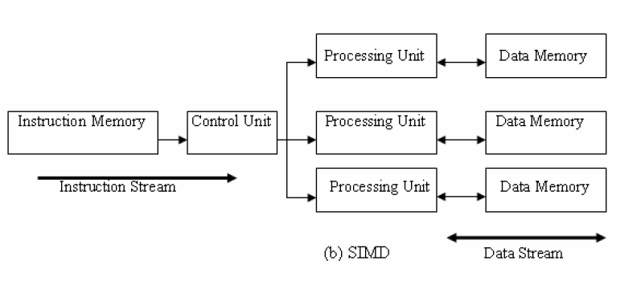
SIMD architectures
A data parallel architecture
Applying the same instruction to many data
  SIMD and vector architectures offer higher performance for vector operations.
  SIMD logic has been built in contemporary CPUs. Check /proc/cpuinfo, look for mmx, sse, avx.

Slide 3
Scalar processing and vector processing
Vector processing is a form of data parallelism
  Same operation simultaneous executes on multiple elements of a vector.

Slide 4
Examples of vector operation
Vector addition Z = X + Y
  for (i=0; i<n; i++) z[i] = x[i] + y[i];
Vector scaling Y = a * X
  for(i=0; i<n; i++) y[i] = a*x[i];
Dot product
  for(i=0; i<n; i++) r += x[i]*y[i];

Slide 5






Scalar processing .vs. SIMD processing
$\vec{c}= \vec{a}+\vec{b}$: For (i=0;i<n; i++) c[i] = a[i] + b[i]
$$\vec{c}$$
$$\vec{a}$$
9.0 8.0 7.0 6.0 5.0 4.0 3.0 2.0 1.0
Scalar
+
10 9.0 8.0 7.0 6.0 5.0 4.0 3.0 2.0
$$\vec{b}$$
1.0 1.0 1.0 1.0 1.0 1.0 1.0 1.01.0
5.0 1.0
6.0 2.0
7.0 3.0
8.0 4.0
$$\vec{a}$$
$$\vec{c}$$
SIMD
+
+
+
+
6.0 2.0
7.0 3.0
8.0 4.0
9.0 5.0
1.0 1.0
1.0 1.0
1.0 1.0
1.0 1.0
$$\vec{b}$$

Slide 6
x86 architecture SIMD support
Both current AMD and Intel’s x86 processors have ISA and microarchitecture support SIMD operations.
x86 SIMD support
  Intel: MMX, SSE (Streaming SIMD extensions), SSE2, SSE3, SSE4, AVX (Advanced Vector Extensions), AVX2, AVX512
    See the flag field in /proc/cpuinfo
  AMD CPU supports most, but a bit behind. No AVX512 yet?
Micro architecture support
  Many functional units
  64-bit, 128-bit, 256-bit, 512-bit vector registers

Slide 7
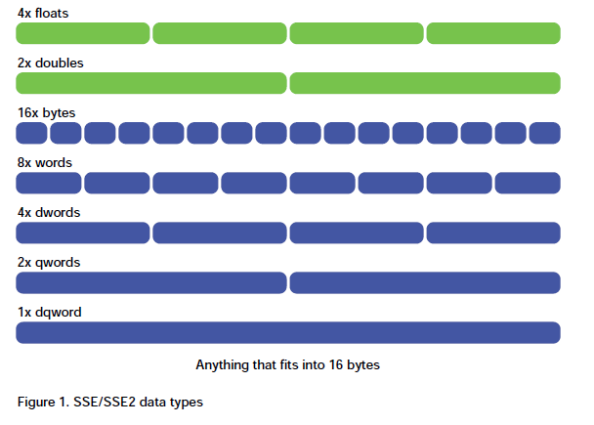
Intel’s SIMD extensions
MMX (1997)
  64-bit vector operations
  Data types: 8-, 16-, 32-bit integers
SSE (Streaming SIMD Extensions, 1999)
  128-bit vector operations
  Data types
    8-, 16-, 32-, 64-bit integers
    32- and 64-bit floats
AVX (Advanced Vector eXtensions, 2011)
  256-bit vector operations
AVX-512(2016)
  512-bit vector operations
[Klimovitski 2001]

Slide 8
Microarchitecture support for SIMD processing
1-per cycle 64-, 128-, 256-, 512-bit operations (multiply, add, shuffle)
Fast loading data from cache to vector registers

Slide 9
How to use vector extensions?
-O3 or -ftree-vectorize
Many levels
  Use vendor libraries (e.g Intel MKL library)
  Compiler automatic vectorization feature (mostly in vendor compilers)
  Use vector intrinsics
    Like functions that can be called in C/C++ programs
  Assembler code
  gcc has automatic vectorization support. –O3 or –ftree-vectorize and –mavx
    Not able to see any differences in my program.

Slide 10
SIMD assembler instructions
Data movement instructions
  moving data in and out of vector registers
Arithmetic instructions
  Arithmetic operation on multiple data (2 doubles, 4 floats, 16 bytes, etc)
Logical instructions
  Logical operation on multiple data
Comparison instructions
  Comparing multiple data
Shuffle instructions
  move data around SIMD registers
Miscellaneous
  Data conversion: between x86 and SIMD registers
  Cache control: vector may pollute the caches
  etc

Slide 11
AVX assembler instruction examples
MOVAPD – Move Aligned Packed Double-Precision Floating-Point Values.
ADDPD - Add Packed Double-Precision Floating-Point Values
CMPPD - Compare Packed Double-Precision Floating-Point Values
Double-precision floating point
Packed
Normal operation: MOV, ADD, SUB, AND, OR, CMP, etc

Slide 12
SIMD programming in C/C++
Map to intrinsics
  An intrinsic is a function known by the compiler that directly maps to a sequence of one or more assembly language instructions. Intrinsic functions are inherently more efficient than called functions because no calling linkage is required.
  Intrinsics provides a C/C++ interface to use processor-specific enhancements
  Supported by major compilers such as gcc.
  Documentation: Intel Intrinsics Guide (https://www.intel.com/content/www/us/en/docs/intrinsics-guide/index.html#ig_expand=481,957,133,27)

Slide 13
SIMD intrinsics
Header files to access SEE intrinsics
  #include <mmintrin.h> // MMX
  #include <xmmintrin.h> // SSE
  #include <emmintrin.h> //SSE2
  #include <pmmintrin.h> //SSE3
  #include <tmmintrin.h> //SSSE3
  #include <smmintrin.h> // SSE4.1
  #include <immintrin.h> // AVX, AVX2
Not all extensions are supported by all processors. Check /proc/cpuinfo to see what are supported.
When compile, use –msse, -mmmx, -msse2, -mavx (machine dependent code)
  Some are default for gcc.

Slide 14
Data types
Depending on the extensions used.
  __m128: (SSE) 128-bit packed single-precision floating point
  __m128d: (SSE) 128-bit packed double-precision floating point
  __m128i: (SSE) 128-bit packed integer
  __m256: (AVX) 256-bit packed single-precision floating point
  __m256d: (AVX) 256-bit packed double-precision floating point
  __m256i: (AVX) 256-bit packed integer
  64bit, 512-bit

Slide 15
Example intrinsic routines
See Intel Intrinsics guide for more details
Data movement and initialization
  __m128d _mm_loadu_pd (double const* mem_addr): (SSE) load unaligned packed double-precision floating point
  __m256i _mm256_load_si256 (__m256i const * mem_addr): (AVX) Load 256-bits of integer data from memory into dst. mem_addr must be aligned on a 32-byte boundary or a general-protection exception may be generated.
Arithmetic intrinsics
  __m256d _mm256_add_pd (__m256d a, __m256d b): (AVX) Add packed double-precision (64-bit) floating-point elements in a and b, and store the results in dst.
See ex1.c and sapxy.c for examples.

Slide 16
High performance timer
We have used gettimeofday() – the precision is in microseconds
  Sufficient most of the time.
To get nanosecond precision, use clock_gettime()
  The hardware tick counter, rdtsc, used to be good. No longer reliable.
See ex1_clock.c and sapxy_clock.c for examples
Compile sapxy_clock.c with gcc flags: ‘-O2’, ‘-O3’, and ‘-O3 –mavx’, explain the timing results.

Slide 17
Data alignments
Data alignment issue
  Some intrinsics may require memory to be aligned to 16, 32 bytes.
    May not work when memory is not aligned.
  See sapxy1.c
Writing more generic SSE routine
  Check memory alignment
  Slow path may not have any performance benefit with SSE
  See sapxy2.c

Slide 18
Matrix multiplication with SSE2
See lect9/my_mm_sse.c

Slide 19
Summary
Contemporary CPUs have SIMD support for vector operations
Vector extension can be accessed at high level languages through intrinsic functions.
Programming with SIMD extensions needs to be careful about memory alignments
  Both for correctness and for performance.

