Slide 1
Review
Speedup, efficiency
Strong scaling, Amdahl’s law
Weak scaling, Gustafson’s law

Slide 2
Single Thread Performance and Loop optimizations
Architecture features of a modern CPU core
Locality and array reference pattern
Dependence
Loop optimizations

Slide 3
Hardware features in modern CPU core
Acknowledgement: Some information is from a presentation in Intel’s architecture day 2021. (https://download.intel.com/newsroom/2021/client-computing/intel-architecture-day-2021-presentation.pdf) The features relate to how to write efficient programs for today’s CPU cores.
More details about CPU core design can be found in a computer architecture book.

Slide 4
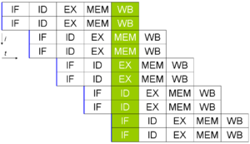
Hardware features in modern CPU core
Superscalar architecture
  Instruction pipelining
    Multiple instructions are in the pipeline at different stages
    Pipeline hazards: an operand of an instruction is not available when needed.
      Many causes: the operand has not been calculated by another instruction. Load from memory not complete, etc
      Solution: stall the pipeline (delay the stage for the instruction).
    The impact of branch instruction.

Slide 5
Hardware features in modern CPU core
Superscalar architecture
  Multiple issues: allowing more than one instruction to be issued at the same time.
    More instruction level parallelism.
  The execution stage may use many execution units (ALU, Load, Store, etc), sometimes called ports.
    different operations can be executed simultaneously.

Slide 6
Hardware features in modern CPU core
Branch prediction based on history.
Out of order execution
  Dual three wide out of order decoders in the Intel presentation: allowing 6 instructions per cycle
  Instructions in the out of order window (256 entries in the Intel talk) can be executed out of order to exploit more parallelism.
Many execution ports (17 in the Intel talk)
  4 integer ALUs, 2 jump ports, 2 Load ports, 2 Store ports, 2 FP/vec store ports, 2 FP/vec stacks, etc.

Slide 7
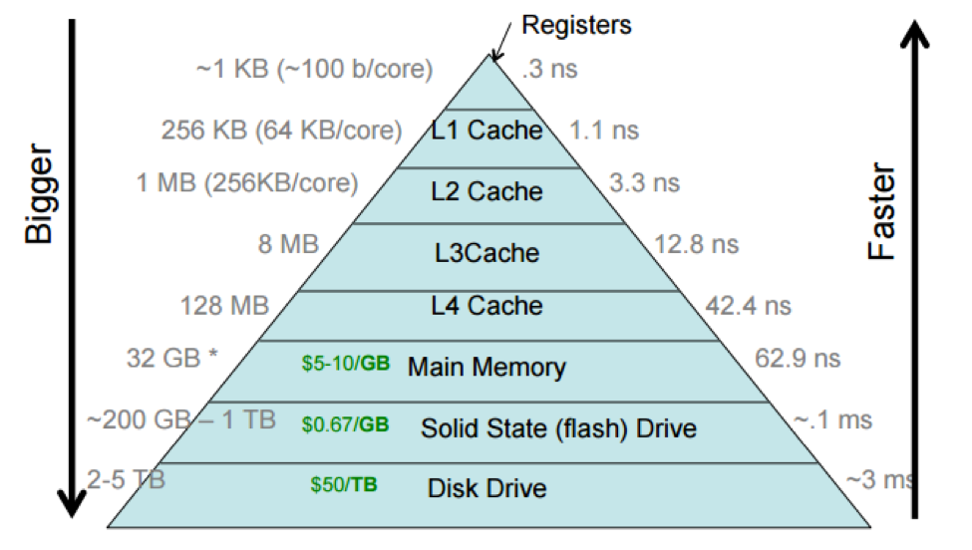
Memory hierarchy
Reduce the average memory access cycle:
Let register access take 1 cycle, L1 cache - 4 cycles, L2 cache – 10 cycles, L3 cache – 40 cycles, Memory – 200 cycles.
40% data accesses in registers, 20% from L1, 20% from L2, 15% L3, 5% from memory. What is the average data access latency?

Slide 8
Implication on the software
To exploit the parallelism in a CPU core, one should
  Use a good mix of instructions (Load, store, different integer and floating point ALU operations).
    Some operations may subject to the operation latency constraint. For example, floating point divide takes many cycles (40 sometimes).
  Minimize the number of branches and make them easy to predict.
    Branches create control dependence. The whole pipeline needs to be drained before the next instruction can be executed (if not predicted correctly).
  CPU is faster than memory: exploit data locality and manage the ratio of memory operation to ALU operation.
  Minimize the data dependence in the code
The hardware features help to a degree, but the programmer should still be mindful.

Slide 9
Exploit data locality
Data locality
  Temporal locality: the same data is often used multiple times within a short time period.
  Spatial locality: different data elements that are located nearby are often used within a short period of time.
  Program that exhibits good locality will have less cache misses and higher performance.

Slide 10
Semantically equivalent programs can have very different locality, and thus performance
for (i =0; i<n; i++)
for (j=0; j<n; j++)
m[i][j] = 0;
(a) spatial locality
for (j =0; ij<n; j++)
for (i=0; i<n; i++)
m[i][j] = 0;
(b) no spatial locality
(a)
m[0][0]
m[0][1]
m[0][n-1]
m[1][0]
m[1][1]
m[1][n-1]
m[2][0]
m[2][1]
(b)
Cache operation: with a miss, the whole cache line is brought in the cache. (a) will have much less
cache miss than (b). Run lect5/2d.cpp to see the performance difference.

Slide 11
Dependence
A semantically equivalent program maintains the dependence in the original program.
  As shown in the previous slide, semantically equivalent programs can have very different data locality
A=1
B=2
C=3
D=4
B=2
D=4
A=1
C=3
A=1
B=A+1
C=B+1
D=C+1
B=A+1
A=1
C=B+1
D=C+1
Which two code segments are semantically equivalent?

Slide 12
Dependence
Two instructions (tasks) have dependence when they operate on the same data with at least one operation being write.
The order of two instructions can be swapped when they do not have dependence.
Three types of data dependence:
  True dependence: Write X-Read X (RAW)
  Output dependence: Write X – Write X (WAW)
  Anti dependence: Read X – Write X (WAR)
  What about RAR?

Slide 13
Loop optimizations – making higher performance loops
Why loops?
  Most of the program time is spent on loop.
  Most parallelism in a program is inside loops.
Focusing on affine loops only with affine array accesses.
  Non affine loops are much harder to analyze and manipulate.
for (i =0; i<n; i++)
for (j=0; j<n; j++)
m[i][j] = 0;
An example affine loop

Slide 14
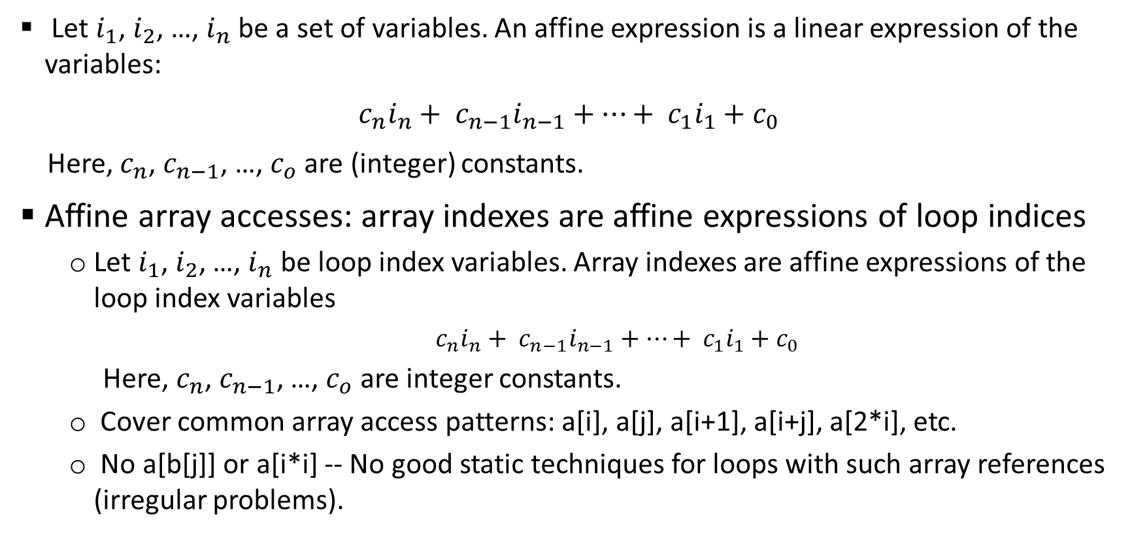
Affine expression and affine array accesses
  Let $i_{1}$, $i_{2}$, …, $i_{n}$ be a set of variables. An affine expression is a linear expression of the variables:
  $c_{n}i_{n}+ c_{n−1}i_{n−1}+…+ c_{1}i_{1}+c_{0}$
  Here, $c_{n}$, $c_{n−1}$, …, $c_{o}$ are (integer) constants.
Affine array accesses: array indexes are affine expressions of loop indices
  Let $i_{1}$, $i_{2}$, …, $i_{n}$ be loop index variables. Array indexes are affine expressions of the loop index variables
    $c_{n}i_{n}+ c_{n−1}i_{n−1}+…+ c_{1}i_{1}+c_{0}$
  Here, $c_{n}$, $c_{n−1}$, …, $c_{o}$ are integer constants.
  Cover common array access patterns: a[i], a[j], a[i+1], a[i+j], a[2*i], etc.
  No a[b[j]] or a[i*i] -- No good static techniques for loops with such array references (irregular problems).

Slide 15
Affine loops
All loop bounds have to be affine expressions of the loop index variables of the containing loops.
All array references are affine array accesses.
No pointers, no aliases of the arrays.
for (i=0; i<n; i++)
for (j=0; j<n; j++)
a[i+j*10] = 0;
for (i=0; i<n; i++)
for (j=0; j<n; j++)
a[i][j+1] = 0;
for (i=0; i<n; i++)
for (j=0; j<n; j++)
a[i*j] = 0;
for (i=0; i<n; i++)
for (j=0; j<n; j++)
a[b[i][j]] = 0;

Slide 16
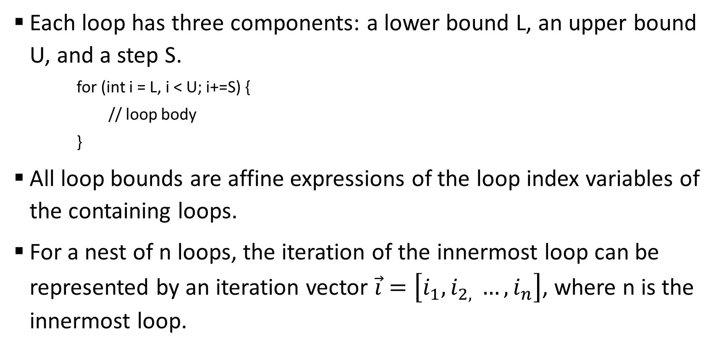
Affine loops
Each loop has three components: a lower bound L, an upper bound U, and a step S.
    for (int i = L, i < U; i+=S) {
    // loop body
    }
All loop bounds are affine expressions of the loop index variables of the containing loops.
For a nest of n loops, the iteration of the innermost loop can be represented by an iteration vector $\vec{i}=\left[i_{1}, i_{2, }…, i_{n}\right]$, where n is the innermost loop.

Slide 17

Iteration Number and Vector
for an n-level loop: $\vec{i}=\left[i_{1}, i_{2, }…, i_{n}\right]$
    for (int $i_{1}$= $L_{1}$; $i_{1}<$ $U_{1}$; $i_{1}+$= $S_{1}$) {
    for (int $i_{2}$= $L_{2}$; $i_{2}<$ $U_{2}$; $i_{2}+$= $S_{2}$) {
    ……
    for (int $i_{n}$= $L_{n}$; $i_{n}<$ $U_{n}$; $i_{n}+$= $S_{n}$) {
    // innermost loop body
    }
    }
    }

Slide 18
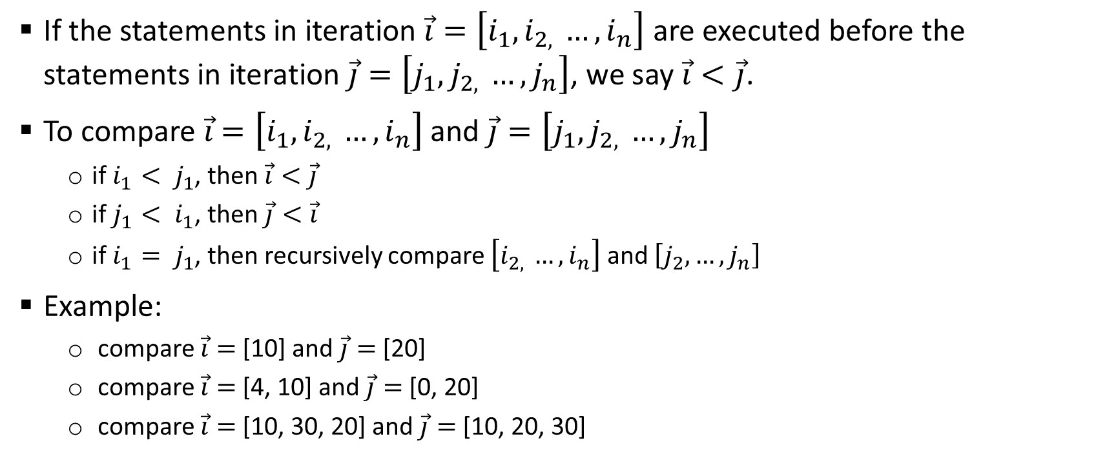
Iteration Number and Vector
If the statements in iteration $\vec{i}=\left[i_{1}, i_{2, }…, i_{n}\right]$ are executed before the statements in iteration $\vec{j}=\left[j_{1}, j_{2, }…, j_{n}\right]$, we say $\vec{i}<\vec{j}$.
To compare $\vec{i}$ $=\left[i_{1}, i_{2, }…, i_{n}\right]$ and $\vec{j}=\left[j_{1}, j_{2, }…, j_{n}\right]$
  if $i_{1}< j_{1}$, then $\vec{i}<\vec{j}$
  if $j_{1}< i_{1}$, then $\vec{j}<\vec{i}$
  if $i_{1}= j_{1}$, then recursively compare $\left[i_{2, }…, i_{n}\right]$ and $\left[j_{2}, …, j_{n}\right]$
Example:
  compare $\vec{i}=$[10] and $\vec{j}=$[20]
  compare $\vec{i}=$[4, 10] and $\vec{j}=$[0, 20]
  compare $\vec{i}=$[10, 30, 20] and $\vec{j}=$[10, 20, 30]

Slide 19
Dependence in the loop and loop parallelism
for (i=0; i<n; i++)
c[i] = a[i] + b[i];
For some loops like the one above, executing loop iterations in any order yields the same results (semantically equivalent).
  Different iterations access different data (no dependence across iterations)
This type of loops is said to be parallelizable. One can execute the loop on n processors by giving each processor an ID = 0, 1, …, n-1. Each processor executes the same code c[ID] = a[ID] + b[ID].

Slide 20
Dependence in a loop
for (i=1; i<n; i++)
a[i] = a[i-1] + b[i];
For some loops like the one above, executing loop iterations in different order will yield different results.
  Iteration [1]: a[1] = a[0] + b[1]
  Iteration [2]: a[2] = a[1] + b[2]
  Iteration [3]: a[3] = a[2] + b[3]
There is a true dependence across loop iterations. The iterations must be executed in the original order.

Slide 21
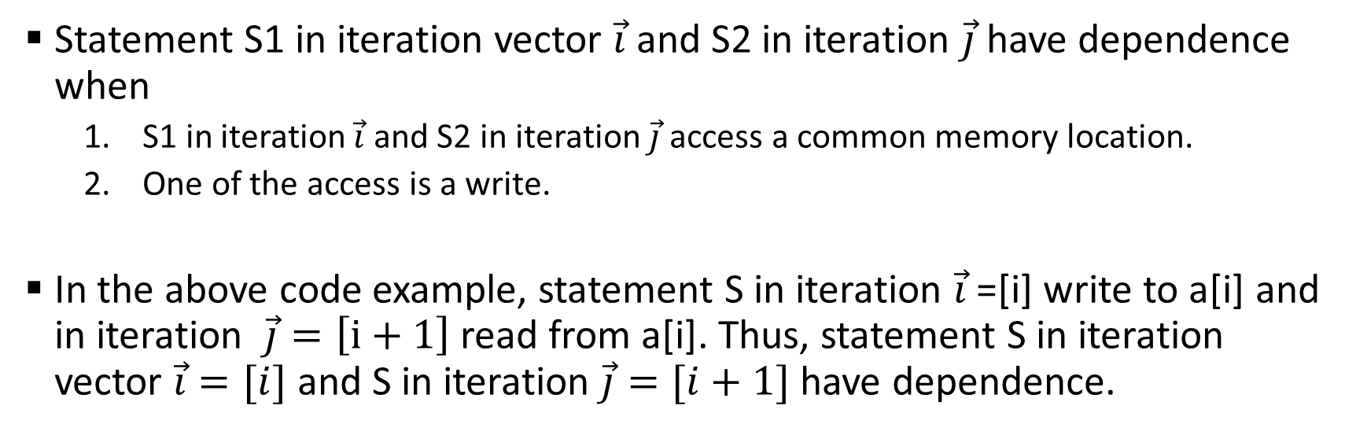
Dependence in a loop
for (i=1; i<n; i++)
S: a[i] = a[i-1] + b[i];
Statement S1 in iteration vector $\vec{i}$ and S2 in iteration $\vec{j}$have dependence when
  S1 in iteration $\vec{i}$ and S2 in iteration $\vec{j}$ access a common memory location.
  One of the access is a write.
In the above code example, statement S in iteration $\vec{i}$=[i] write to a[i] and in iteration $\vec{j}=\left[i+1\right]$ read from a[i]. Thus, statement S in iteration vector $\vec{i}=[i]$ and S in iteration $\vec{j}=[i+1]$have dependence.

Slide 22
Loop carried dependence
A loop-carried dependence is a dependence that is present only when the dependence is between statements in different iterations of a loop.
  Otherwise, we call it loop-independent dependence.
Loop-carried dependence must be preserved when we restructure the loop (change the order in the iteration space).
Loop-carried dependence is also what prevents loops from being parallelized.

Slide 23
Data dependence analysis
Data dependence analysis (by the compiler or human) is to compute the set of statement instances that are dependent.
  This is an important step for the compiler (or human) to restructure or parallelize the loops.
The dependence is often represented as dependence distance vectors or dependence direction vectors.

Slide 24
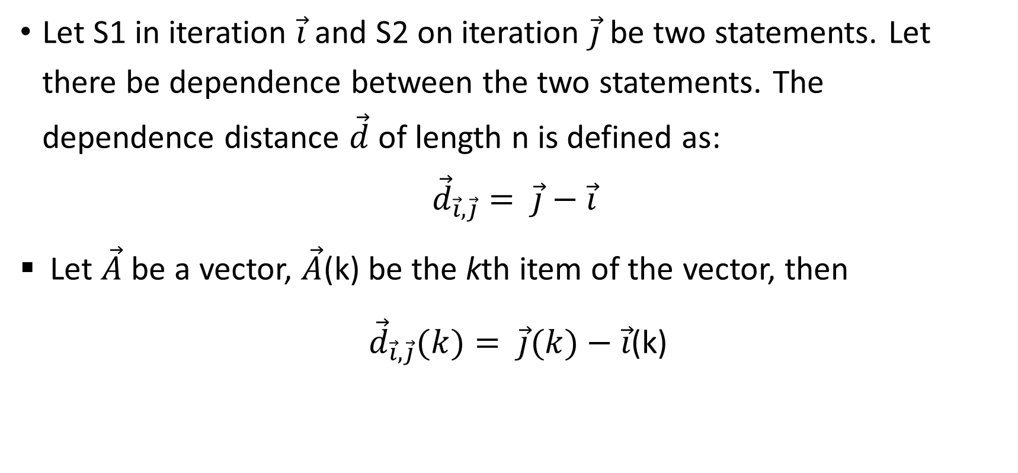
Distance vector and direction vector
Let S1 in iteration $\vec{i}$ and S2 on iteration $\vec{j}$ be two statements. Let there be dependence between the two statements. The
dependence distance $\vec{d}$ of length n is defined as:
$${\vec{d}}_{\vec{i}, \vec{j}}= \vec{j}−\vec{i}$$
Let $\vec{A}$ be a vector, $\vec{A}$(k) be the kth item of the vector, then
${\vec{d}}_{\vec{i}, \vec{j}}(k)= \vec{j}(k)−\vec{i}$(k)

Slide 25

Distance vector and direction vector
Let ${\vec{D}}_{\vec{i}, \vec{j}}$ be the direction vector
${\vec{D}}_{\vec{i}, \vec{j}}(k)=$ $\left\{\begin{aligned}\text{"<}",{\vec{d}}_{\vec{i}, \vec{j}}\left(k\right)>0 \\ \text{"=}",{\vec{d}}_{\vec{i}, \vec{j}}\left(k\right)=0 \\ \text{"}>",{\vec{d}}_{\vec{i}, \vec{j}}\left(k\right)<0\end{aligned}\right.$

Slide 26
Distance vector and direction vector example
for (int i = 0; i<n; i++)
for (int j=0; j<n; j++)
for (int k=0; k<n; k++) {
S1: a[i+1][j][k-2] = a[i][j][k] + 1;
S2: a[i+1][j-1][k+2] = c[i][j][k] + d[i][j][k];
}
Get each pair of array references for potential dependence
Five array references in the loop. Arrays c and d are used only once – no dependence.
Array a is used three times. We need to analyze the dependence between three pairs in the program: a[i+1][j][k-2] and a[i][j][k], a[i+1][j][k-2] and a[i+1][j-1][k+2], and a[i+1][j-1][k+2] and a[i][j][k]. Each pair results in a distance vector (or direction vector).

Slide 27
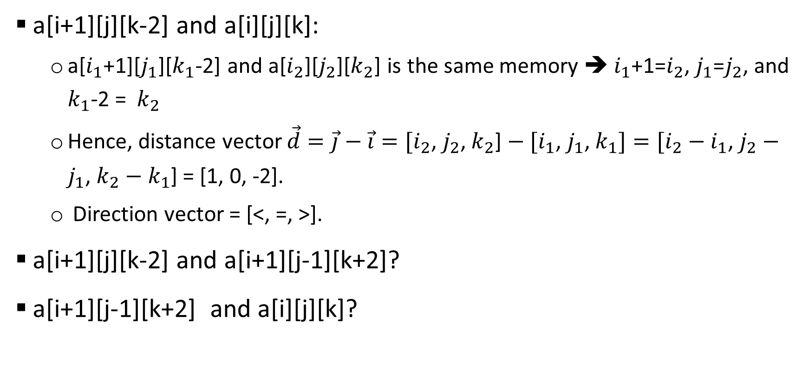
Distance vector and direction vector example
a[i+1][j][k-2] and a[i][j][k]:
  a[$i_{1}$+1][$j_{1}$][$k_{1}$-2] and a[$i_{2}$][$j_{2}$][$k_{2}$] is the same memory ➔ $i_{1}$+1=$i_{2}$, $j_{1}$=$j_{2}$, and $k_{1}$-2 = $k_{2}$
  Hence, distance vector $\vec{d}=\vec{j}−\vec{i}=[i_{2}$, $j_{2}$, $k_{2}$] $− [i_{1}$, $j_{1}$, $k_{1}]=[i_{2}−i_{1}$, $j_{2}−j_{1}$, $k_{2}−k_{1}$] = [1, 0, -2].
  Direction vector = [<, =, >].
a[i+1][j][k-2] and a[i+1][j-1][k+2]?
a[i+1][j-1][k+2] and a[i][j][k]?

Slide 28
Reordering transformation
A reordering transformation preserves a dependence if it preserves and relative execution order of the source and sink of the dependence.
Any reordering transformation that preserves every dependence in a program preserves the semantics of the program
Loop optimization: Finding the reordering transformation that preserves all dependence in the program while achieving better locality!
  Find all dependence distance/direction vector in the loops, make sure that the transformations preserves all of them.

Slide 29
Scalar replacement of array elements
for (i=0; i<N; i++)
for(j=0; j<N; j++)
for (k=0; k<N; k++)
c(i, j) = c(i, j) + a(i, k)* b(k, j);
Scalar replacement allows registers to be allocated to the scalar, which reduces memory references.
  Registers are almost never allocated to array elements.
for (i=0; i<N; i++)
for(j=0; j<N; j++) {
ct = c(i, j)
for (k=0; k<N; k++)
ct = ct + a(i, k)* b(k, j);
c(i, j) = ct;
}

Slide 30
Loop normalization
for (i=a; i<b; i+= c) {
// loop body
}
Make the loop index variable starts from 1 (or 0) with a step of 1.
It does not do too much by itself. But it simplifies the iteration space and makes it easier to manipulate, which enables other optimizations.
for (ii=1; ii<(b-a)/c; ii++) {
i = a + (ii-1) *c;
// loop body
}

Slide 31
Loop transformations
Change the shape and direction of loop iterations
  Change the access pattern
    Increase data reuse (locality)
    Reduce overheads
  Valid transformations need to maintain all loop carried dependence.
  Unimodular transformations
    Loop interchange, loop permutation, loop reversal, loop skewing, and many others
  Loop fusion and distribution
  Loop tiling
  Loop unrolling

Slide 32
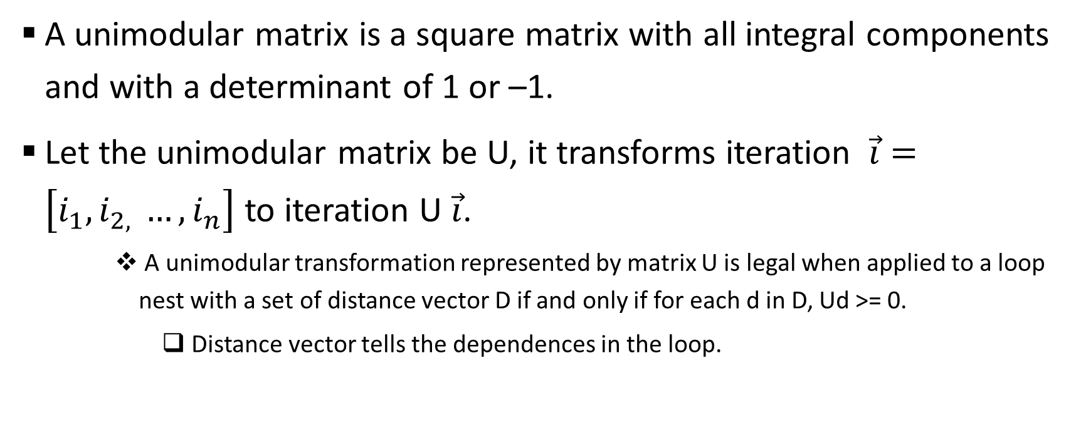
Unimodular transformations
A unimodular matrix is a square matrix with all integral components and with a determinant of 1 or –1.
Let the unimodular matrix be U, it transforms iteration $\vec{i}=\left[i_{1}, i_{2, }…, i_{n}\right]$ to iteration U $\vec{i}$.
    A unimodular transformation represented by matrix U is legal when applied to a loop nest with a set of distance vector D if and only if for each d in D, Ud >= 0.
      Distance vector tells the dependences in the loop.

Slide 33
Unimodular transformations: loop interchange
for (i=0; i<n; i++)
for (j=0; j < n; j++)
a(i, j) = a(i-1, j) + 1;
for (j=0; j<n; j++)
for (i=0; i < n; i++)
a(i,j) = a(i-1, j) + 1;
Distance vector = [1, 0]
Ud >= 0, the transformation for this loop nest is legal.

Slide 34
Unimodular transformations: loop permutation
for (i=0; i<n; i++)
for (j=0; j < n; j++)
for (k=0; k < n; k++)
for (l=0; l<n; l++)
// loop body
for (k=0; k<n; k++)
for (l=0; l < n; l++)
for (i=0; i < n; i++)
for (j=0; j<n; j++)
// loop body

Slide 35
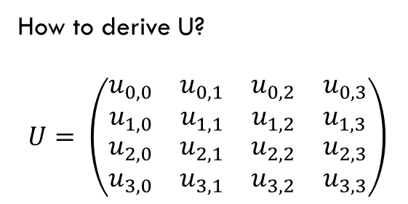
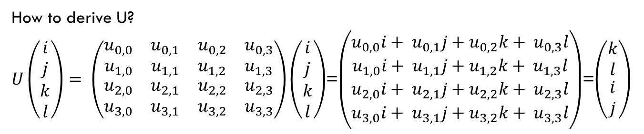
Unimodular transformations: loop permutation
for (i=0; i<n; i++)
for (j=0; j < n; j++)
for (k=0; k < n; k++)
for (l=0; l<n; l++)
// loop body
for (k=0; k<n; k++)
for (l=0; l < n; l++)
for (i=0; i < n; i++)
for (j=0; j<n; j++)
// loop body
How to derive U?
$$U= \left(\begin{matrix}\begin{matrix}u_{0,0} & u_{0,1} \\ u_{1,0} & u_{1,1}\end{matrix} & \begin{matrix}u_{0,2} & u_{0,3} \\ u_{1,2} & u_{1,3}\end{matrix} \\ \begin{matrix}u_{2,0} & u_{2,1} \\ u_{3,0} & u_{3,1}\end{matrix} & \begin{matrix}u_{2,2} & u_{2,3} \\ u_{3,2} & u_{3,3}\end{matrix}\end{matrix}\right)$$
How to derive U?
$U\left(\begin{matrix}\begin{matrix}i \\ j\end{matrix} \\ \begin{matrix}k \\ l\end{matrix}\end{matrix}\right)= \left(\begin{matrix}\begin{matrix}u_{0,0} & u_{0,1} \\ u_{1,0} & u_{1,1}\end{matrix} & \begin{matrix}u_{0,2} & u_{0,3} \\ u_{1,2} & u_{1,3}\end{matrix} \\ \begin{matrix}u_{2,0} & u_{2,1} \\ u_{3,0} & u_{3,1}\end{matrix} & \begin{matrix}u_{2,2} & u_{2,3} \\ u_{3,2} & u_{3,3}\end{matrix}\end{matrix}\right)\left(\begin{matrix}\begin{matrix}i \\ j\end{matrix} \\ \begin{matrix}k \\ l\end{matrix}\end{matrix}\right)$=$\left(\begin{matrix}\begin{matrix}u_{0,0}i+ u_{0,1}j+u_{0,2}k+ u_{0,3}l \\ u_{1,0}i+ u_{1,1}j+u_{1,2}k+ u_{1,3}l\end{matrix} \\ \begin{matrix}u_{2,0}i+ u_{2,1}j+u_{2,2}k+ u_{2,3}l \\ u_{3,0}i+ u_{3,1}j+u_{3,2}k+ u_{3,3}l\end{matrix}\end{matrix}\right)$=$\left(\begin{matrix}\begin{matrix}k \\ l\end{matrix} \\ \begin{matrix}i \\ j\end{matrix}\end{matrix}\right)$
Hence, $u_{0,0}i+ u_{0,1}j+u_{0,2}k+ u_{0,3}l=k ⇒u_{0,2}$ = 1, $u_{0,0}$ = 0, $u_{0,1}$ = 0, $u_{0,3}$ = 0

Slide 36
for (int i = 0; i<n; i++)
for (int j=0; j<n; j++)
for (int k=0; k<n; k++) {
S1: a[i+1][j][k-2] = a[i][j][k] + 1;
S2: a[i+1][j-1][k+2] = c[i][j][k] + d[i][j][k];
}
Is this legal?
Distance vectors for the loop
[1, 0, -2], [1, -1, 2], and [0, 1, -4].
for (int k = 0; k<n; k++)
for (int i=0; i<n; i++)
for (int j=0; j<n; j++) {
S1: a[i+1][j][k-2] = a[i][j][k] + 1;
S2: a[i+1][j-1][k+2] = c[i][j][k] + d[i][j][k];
}

Slide 37
Unimodular transformations: loop reversal
for (i=0; i<n; i++)
for (j=0; j < n; j++)
a(i,j) = a(i-1, j) + 1.0;
for (i=0; i<n; j++)
for (j=9; j >=0; i--)
a(i,j) = a(i-1, j) + 1.0;

Slide 38
Unimodular transformations: loop skewing
for (i=0; i<n; i++)
for (j=0; j < n; j++)
a(i) = a(i+ j) + 1.0;
for (i=0; i<n; i++)
for (j=i+1; j <i+n; j++)
a(i) = a(j) + 1.0;

Slide 39
Loop fusion
Takes two adjacent loops that have the same iteration space and combines the body.
  Legal when there are no flow, anti- and output dependences in the fused loop.
  Why
    Increase the loop body, reduce loop overheads
    Increase the chance of instruction scheduling
    May improve locality
for (i=0; i<n; i++)
a(i) = 1.0;
for (j=0; j<n; j++)
b(j) = 1.0
for (i=0; i<n; i++) {
a(i) = 1.0;
b(i) = 1.0;
}

Slide 40
Loop distribution
Takes one loop and partitions it into two loops.
  Why
    Reduce memory trace
    Improve locality
    Increase the chance of instruction scheduling
for (i=0; i<n; i++) {
a(i) = 1.0;
b(i) = a(i);
}
for (i=0; i<n; i++)
a(i) = 1.0;
for (i=0; i<n; i++)
b(i) = a(i)

Slide 41
Loop tiling
Replaceing a single loop into two loops.
  for(I=0; I<n; I++) … → for(I=0; I<n; I+=t) for (ii=I, ii < min(I+t,n); ii++) …
    T is call tile size;
N-deep nest can be changed into n+1-deep to 2n-deep nest.
for (i=0; i<n; i++)
for (j=0; j<n; j++)
for (k=0; j<n; k++)
For (i=0; i<n; i+=t)
for (ii=I; ii<min(i+t, n); ii++)
for (j=0; j<n; j+=t)
for (jj=j; jj < min(j+t, n); jj++)
for (k=0; j<n; k+=t)
for (kk = k; kk<min(k+t, n); kk++)

Slide 42
Loop tiling
When using with loop interchange, loop tiling create inner loops with smaller memory trace – great for locality.
Loop tiling is one of the most important techniques to optimize for locality
  Reduce the size of the working set and change the memory reference pattern.
For (i=0; i<n; i+=t)
for (ii=I; ii<min(i+t, n); ii++)
for (j=0; j<n; j+=t)
for (jj=j; jj < min(j+t, n); jj++)
for (k=0; j<n; k+=t)
for (kk = k; kk<min(k+t, n); kk++)
For (i=0; i<n; i+=t)
for (j=0; j<n; j+=t)
for (k=0; k<n; k+=t)
for (ii=I; ii<min(i+t, n); ii++)
for (jj=j; jj < min(j+t, n); jj++)
for (kk = k; kk<min(k+t, n); kk++)

Slide 43
Loop unrolling
Reduce control overheads.
Increase chance for instruction scheduling.
Large body may require more resources (register).
This can be very effective!!!!
for (i=0; i<100; i++) a(i) = 1.0;
for (i=0; i<100; i+=4) {
a(i) = 1.0;
a(i+1) = 1.0;
a(i+2) = 1.0;
a(i+3) = 1.0;
}

Slide 44
Loop optimization in action
Optimizing matrix multiply:
    for (i=1; i<=N; i++)
    for (j=1; j<=N; j++)
    for(k=1; k<=N; k++)
    c(i, j) = c(i, j) + A(i, k)*B(k, j)
  First look: memory references -- c(i, j), A(i, 1..N), B(1..N, j)
    Spatial locality: memory reference stride = 1 is the best
    Temporal locality: hard to reuse cache data since the memory trace is too large.

Slide 45
Loop optimization in action
Initial improvement: increase spatial locality in the inner loop, references to both A and B have a stride 1.
  Transpose A before go into this operation (assuming column-major storage).
  Demonstrate my_mm.c method 1
Transpose A /* for all i, j, A’(i, j) = A(j, i) */
For (i=1; i<=N; i++)
for (j=1; j<=N; j++)
for(k=1; k<=N; k++)
c(I, j) = c(I, j) + A’(k, I)*B(k, j)

Slide 46
Loop optimization in action
C(i, j) are repeatedly referenced in the inner loop: scalar replacement (method 2)
Transpose A
for (i=1; i<=N; i++)
for (j=1; j<=N; j++)
for(k=1; k<=N; k++)
c(i, j) = c(i, j) + A(k, i)*B(k, j)
Transpose A
for (i=1; i<=N; i++)
for (j=1; j<=N; j++) {
t = c(i, j);
for(k=1; k<=N; k++)
t = t + A(k, i)*B(k, j);
c(i, j) = t;
}

Slide 47
Loop optimization in action
Inner loops memory footprint is too large:
  A(1..N, i), B(1..N, i)
  Loop tiling + loop interchange
    Memory footprint in the inner loop A(1..t, i), B(1..t, i)
    Using blocking, one can tune the performance for the memory hierarchy:
      Innermost loop fits in register; second innermost loop fits in L2 cache, …
Method 4
      for (j=1; j<=N; j+=t)
      for(k=1; k<=N; k+=t)
      for(I=1; i<=N; i+=t)
      for (ii=I; ii<=min(I+t-1, N); ii++)
      for (jj = j; jj<=min(j+t-1,N);jj++) {
      t = c(ii, jj);
      for(kk=k; kk <=min(k+t-1, N); kk++)
      t = t + A(kk, ii)*B(kk, jj)
      c(ii, jj) = t
      }

Slide 48
Loop optimization in action
Loop unrolling (method 5)
for (j=1; j<=N; j+=t)
for(k=1; k<=N; k+=t)
for(I=1; i<=N; i+=t)
for (ii=I; ii<=min(I+t-1, N); ii++)
for (jj = j; jj<=min(j+t-1,N);jj++) {
t = c(ii, jj);
t = t + A(kk, ii) * B(kk, jj);
t = t + A(kk+1, ii) * B(kk+1, jj);
……
t = t + A(kk+15, ii) * B(kk + 15, jj);
c(ii, jj) = t
}
This assumes the loop can be nicely unrolled, you need to take care of the boundary condition.

Slide 49
Loop optimization in action
Instruction scheduling (method 6)
  ‘+’ would have to wait on the results of ‘*’ in a typical processor.
  ‘*’ is often deeply pipelined: feed the pipeline with many ‘*’ operation.
  Effective for older machine, no longer effective on the current linprog.
for (j=1; j<=N; j+=t)
for(k=1; k<=N; k+=t)
for(I=1; i<=N; i+=t)
for (ii=I; ii<=min(I+t-1, N); ii++)
for (jj = j; jj<=min(j+t-1,N);jj++) {
t0 = A(kk, ii) * B(kk, jj);
t1 = A(kk+1, ii) * B(kk+1, jj);
……
t15 = A(kk+15, ii) * B(kk + 15, jj);
c(ii, jj) = c(ii, jj) + t0 + t1 + … + t15;
}

Slide 50
Loop optimization in action
Further locality improve: block order storage of A, B, and C. (method 7)
for (j=1; j<=N; j+=t)
for(k=1; k<=N; k+=t)
for(I=1; i<=N; i+=t)
for (ii=I; ii<=min(I+t-1, N); ii++)
for (jj = j; jj<=min(j+t-1,N);jj++) {
t0 = A(kk, ii) * B(kk, jj);
t1 = A(kk+1, ii) * B(kk+1, jj);
……
t15 = A(kk+15, ii) * B(kk + 15, jj);
c(ii, jj) = c(ii, jj) + t0 + t1 + … + t15;
}

