Slide 1
Review
Describe computation graph
For a computation graph, how do we define Work(CG), span(CG), and parallelism?
Scheduling computation graph
  What is a greedy schedule?
  How good is greedy schedule?

Slide 2
Speedup and Scalability
Speedup, Scalability, strong scaling, weak scaling
Amdahl’s law
Gustafson’s law

Slide 3
Performance expectation
When using 1 processor, the sequential program runs for 100 seconds. When we use 10 processors, should the program run for 10 times faster?
    This works only for embarrassingly parallel computations – parallel computations that can be divided into completely independent computations that can be executed simultaneously. There may have no interaction between separate processes; sometime the results need to be collected.
      Embarrassingly parallel applications are the kind that can scale up to a very large number of processors. Examples: Monte Carlo analysis, numerical integration, 3D graphics rendering, and many more.
    In other types of applications, the computation components interact and have dependencies, which prevents the applications from using a large number of processors.

Slide 4
Scalability
Scalability of a program measures how many processors that the program can make effective use of.
  For a computation represented by a computation graph, parallelism is a good indicator of scalability.

Slide 5
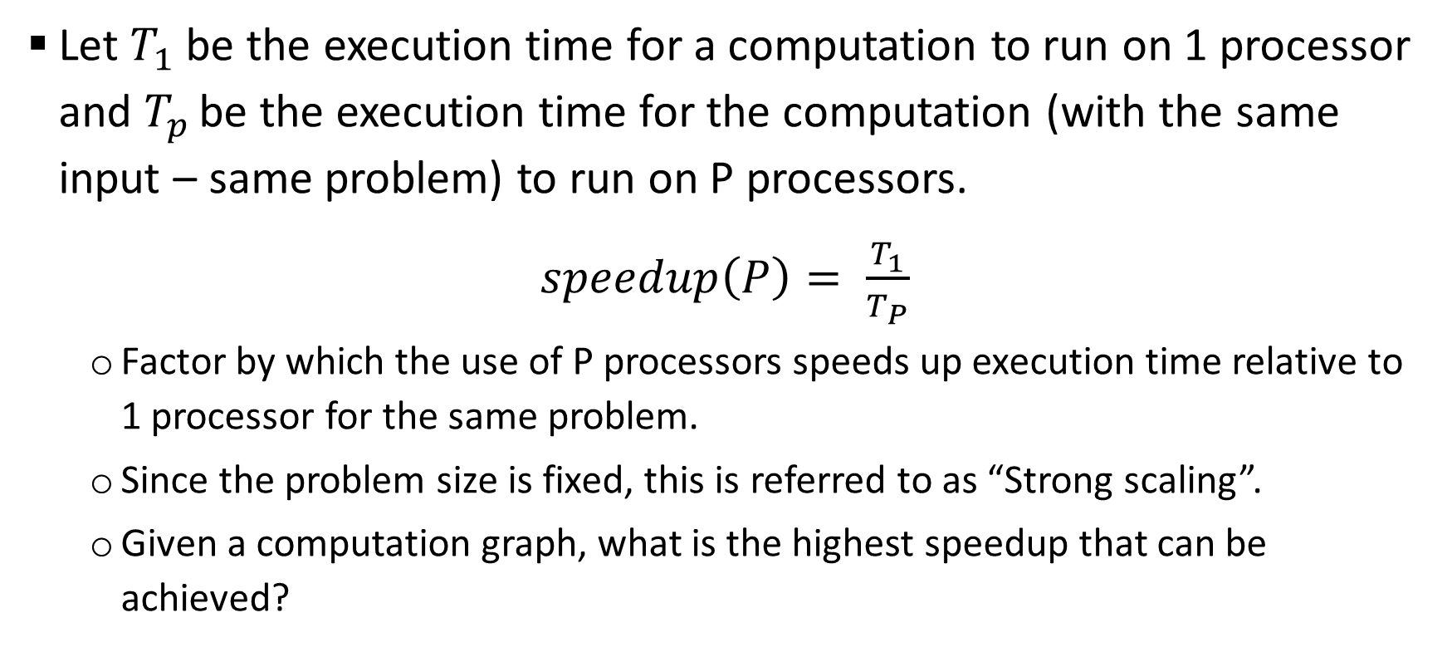
Speedup and Strong scaling
Let $T_{1}$ be the execution time for a computation to run on 1 processor and $T_{p }$be the execution time for the computation (with the same input – same problem) to run on P processors.
$speedup\left(P\right)= \frac{T_{1}}{T_{P}}$
  Factor by which the use of P processors speeds up execution time relative to 1 processor for the same problem.
  Since the problem size is fixed, this is referred to as “Strong scaling”.
  Given a computation graph, what is the highest speedup that can be achieved?

Slide 6
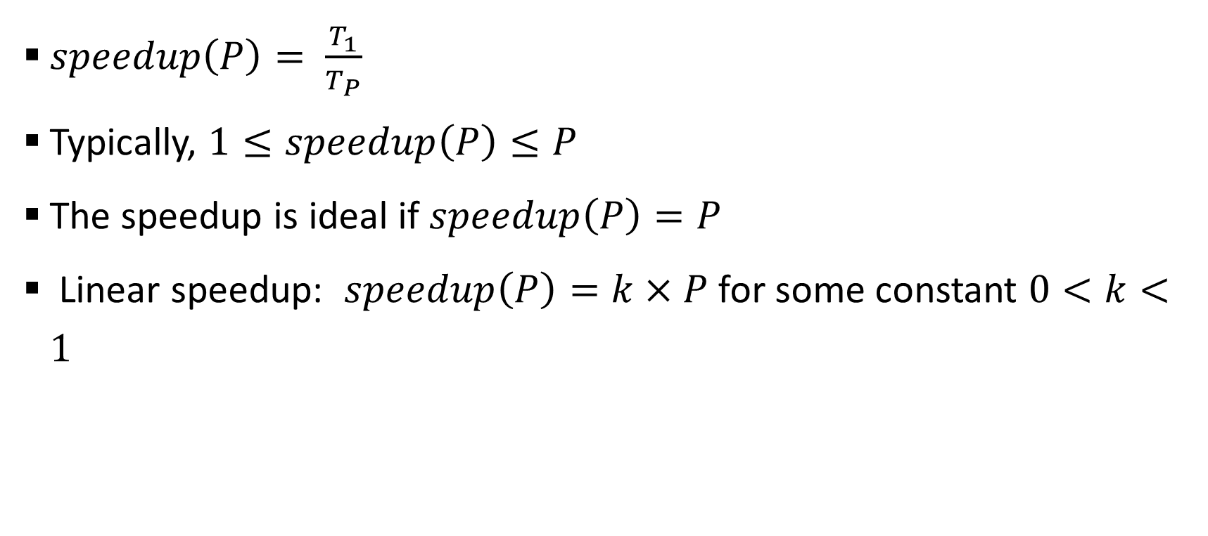
Speedup
$speedup\left(P\right)= \frac{T_{1}}{T_{P}}$
Typically, $1≤speedup\left(P\right)≤P$
The speedup is ideal if $speedup\left(P\right)=P$
Linear speedup: $speedup\left(P\right)=k×P$ for some constant $0<k<1$

Slide 7
Efficiency
The efficiency of an algorithm using P processors is
Efficiency = speedup(P) / P
  Efficiency estimates how well-utilized the processors are in running the parallel program.
  Ideal speedup means Efficiency = 1 (100% efficiency).

Slide 8
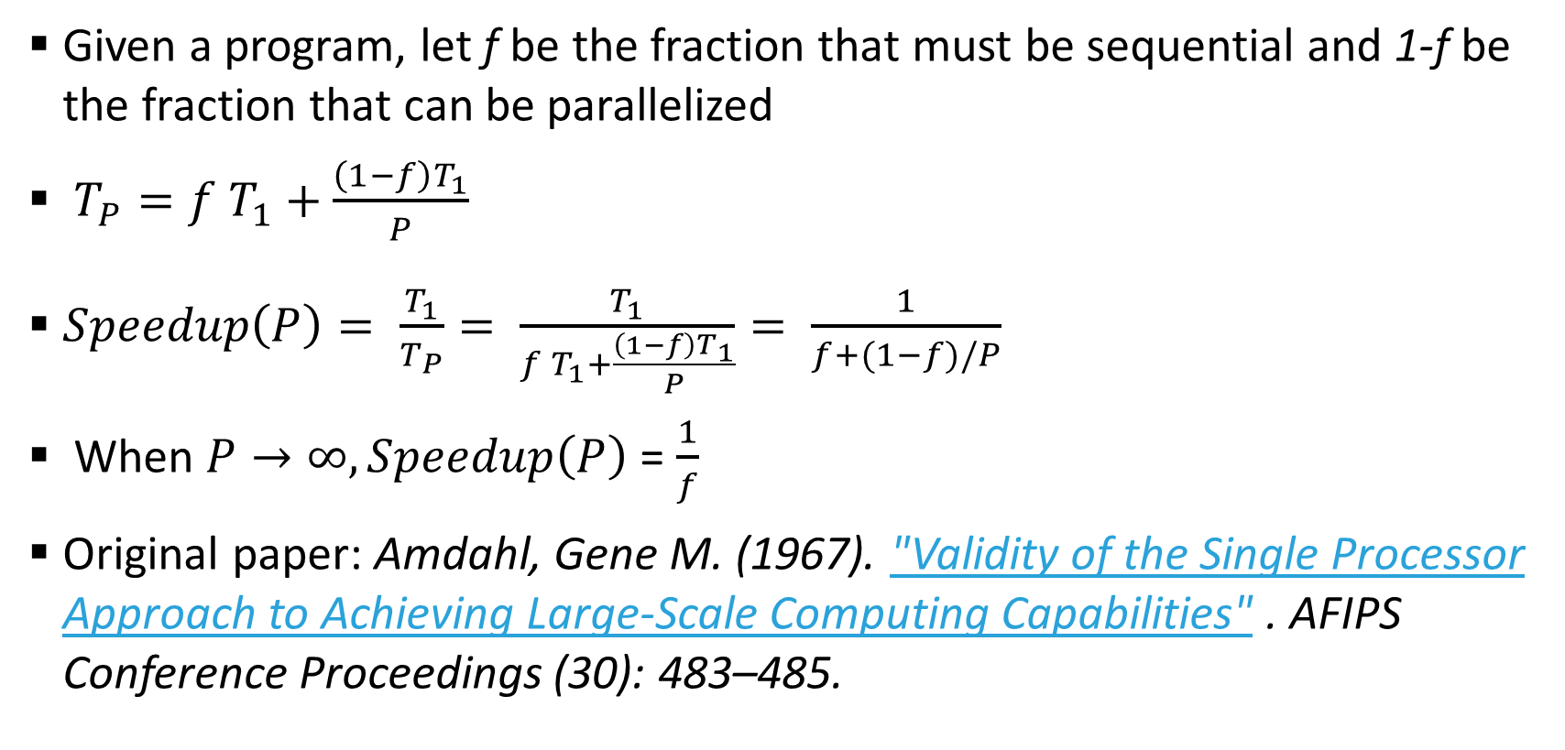
Amdahl’s Law (fixed size speedup, strong scaling)
Given a program, let f be the fraction that must be sequential and 1-f be the fraction that can be parallelized
$T_{P}=f T_{1}+\frac{\left(1−f\right)T_{1}}{P}$
$Speedup\left(P\right)= \frac{T_{1}}{T_{P}}= \frac{T_{1}}{f T_{1}+\frac{\left(1−f\right)T_{1}}{P}}= \frac{1}{f+(1−f)/P}$
When $P→∞, Speedup\left(P\right)$ = $\frac{1}{f}$
Original paper: Amdahl, Gene M. (1967). "Validity of the Single Processor Approach to Achieving Large-Scale Computing Capabilities" . AFIPS Conference Proceedings (30): 483–485.

Slide 9
Amdahl’s law
Amdahl’s law: As P increases, the percentage of work in the parallel region reduces, performance is more and more dominated by the sequential region.
time
P=1
P=2
P=4

Slide 10
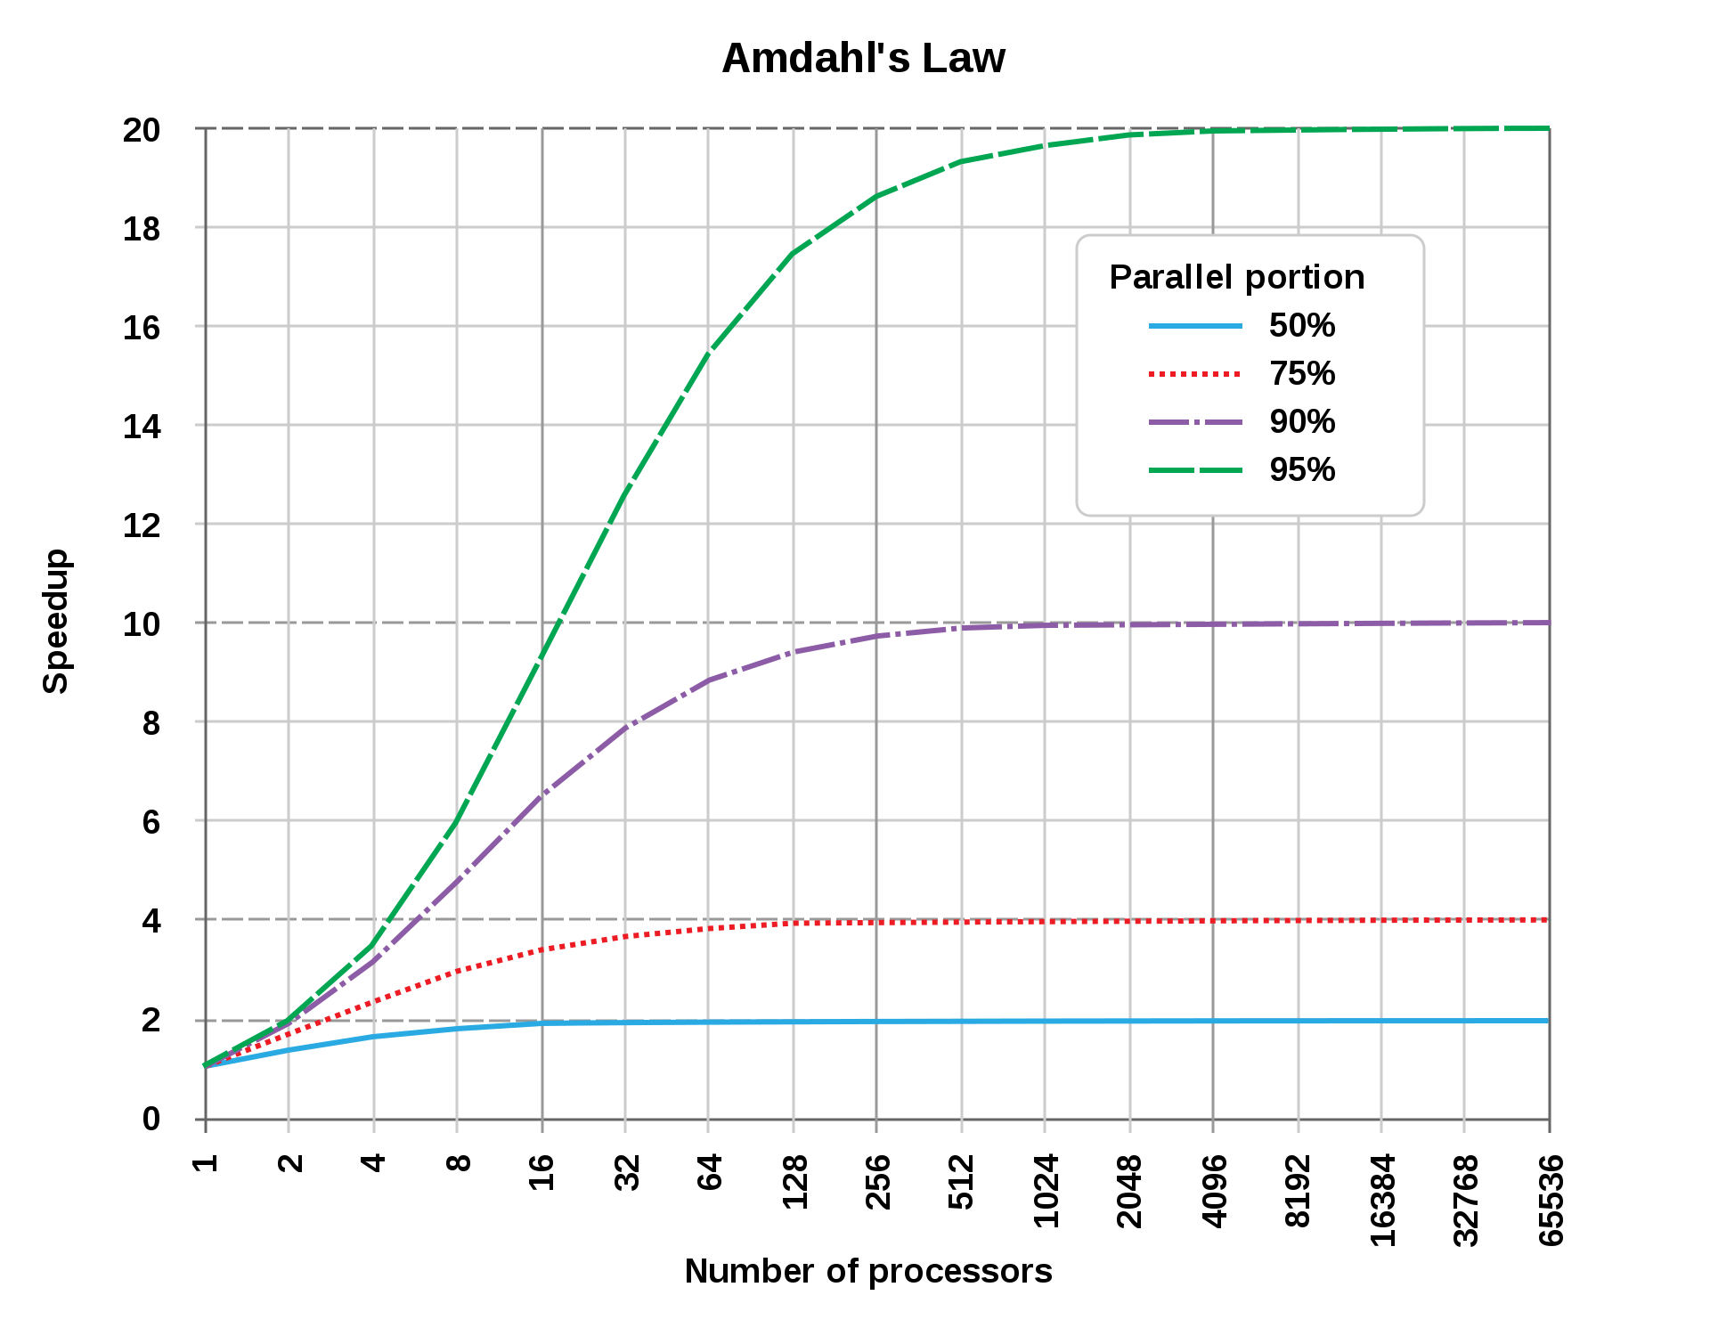
Implication of Amdahl’s Law
For strong scaling, the speedup is bounded by the percentage of sequential portion of the program, not by the number of processors!
Strong scaling will be hard to achieve for many programs.

Slide 11
Gustafson’s Law (scaled speedup, weak scaling)
Large scale parallel/distributed systems are expected to allow for solving problem faster or larger problems.
  Amdahl’s Law indicates that there is a limit on how faster it can go.
  How about bigger problems? This is what Gustafson’s Law sheds lights on!
In Amdahl’s law, as the number of processors increases, the amount of work in each node decreases (more processors sharing the parallel part).
In Gustafson’s law, as the number of processors increases, the amount of work in each node remains the same (doing more work collectively).

Slide 12
Gustafson’s law
Gustafson’s law: As P increases, the total work on each process remains the same. So the total work increases with P.
time
P=1
P=2
P=4

Slide 13
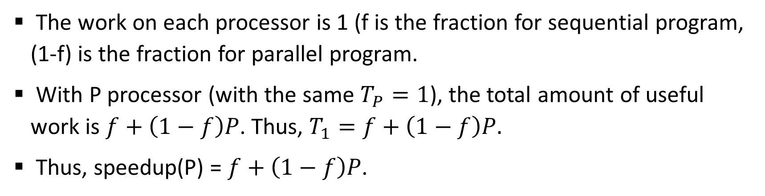
Gustafson’s Law (scaled speedup, weak scaling)
The work on each processor is 1 (f is the fraction for sequential program, (1-f) is the fraction for parallel program.
With P processor (with the same $T_{P}=1$), the total amount of useful work is $f+\left(1−f\right)P$. Thus, $T_{1}=f+\left(1−f\right)P.$
Thus, speedup(P) = $f+\left(1−f\right)P$.
No of PEs | Strong scaling speedup (Amdalh’s law, f = 10%) | Weak scaling speedup (Gustafson’s law, f = 10%)
2 | 1.82 | 1.9
4 | 3.07 | 3.7
8 | 4.71 | 7.3
16 | 6.40 | 14.5
100 | 9.90 | 90.1

Slide 14
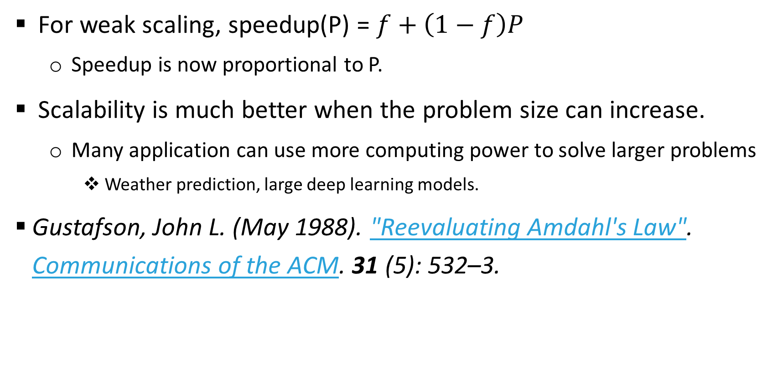
Implication of Gustafson’s law
For weak scaling, speedup(P) = $f+\left(1−f\right)P$
  Speedup is now proportional to P.
Scalability is much better when the problem size can increase.
  Many application can use more computing power to solve larger problems
    Weather prediction, large deep learning models.
Gustafson, John L. (May 1988). "Reevaluating Amdahl's Law". Communications of the ACM. 31 (5): 532–3.

Slide 15
Summary
Speedup, Scalability, strong scaling, weak scaling
Amdahl’s law
Gustafson’s law

