Slide 1
Computation Graph and Scheduling
Review:
  Flynn’s Taxonomy
  Data parallelism .vs. function parallelism
  Give some common metrics to report CPU performance. What is the difference between peak performance and sustained performance?

Slide 2
Modeling the execution of a parallel program
The execution of a parallel program can be represented as a computation graph (CG) or parallel program dependence graph that allows for reasoning about the execution.
  Nodes are sequential subtasks
  Edges represent the dependency constraints
    Both control dependency and data dependency are captured.
  A CG is a directed acyclic graph (DAG) since a node cannot depend on itself.
CG describes a set of computational tasks and the dependencies between them.

Slide 3
Computation graph example
The computation graph for lect2/sum_omp.cpp
Node A must be executed before Node B if there is a path from A to B in the graph
CG can be used as a visualization technique to help us understand the complexity of the algorithms.
CG can also be used as a data structure for the compiler or the system to schedule the execution of the sub-tasks.
A
B
C
D

Slide 4
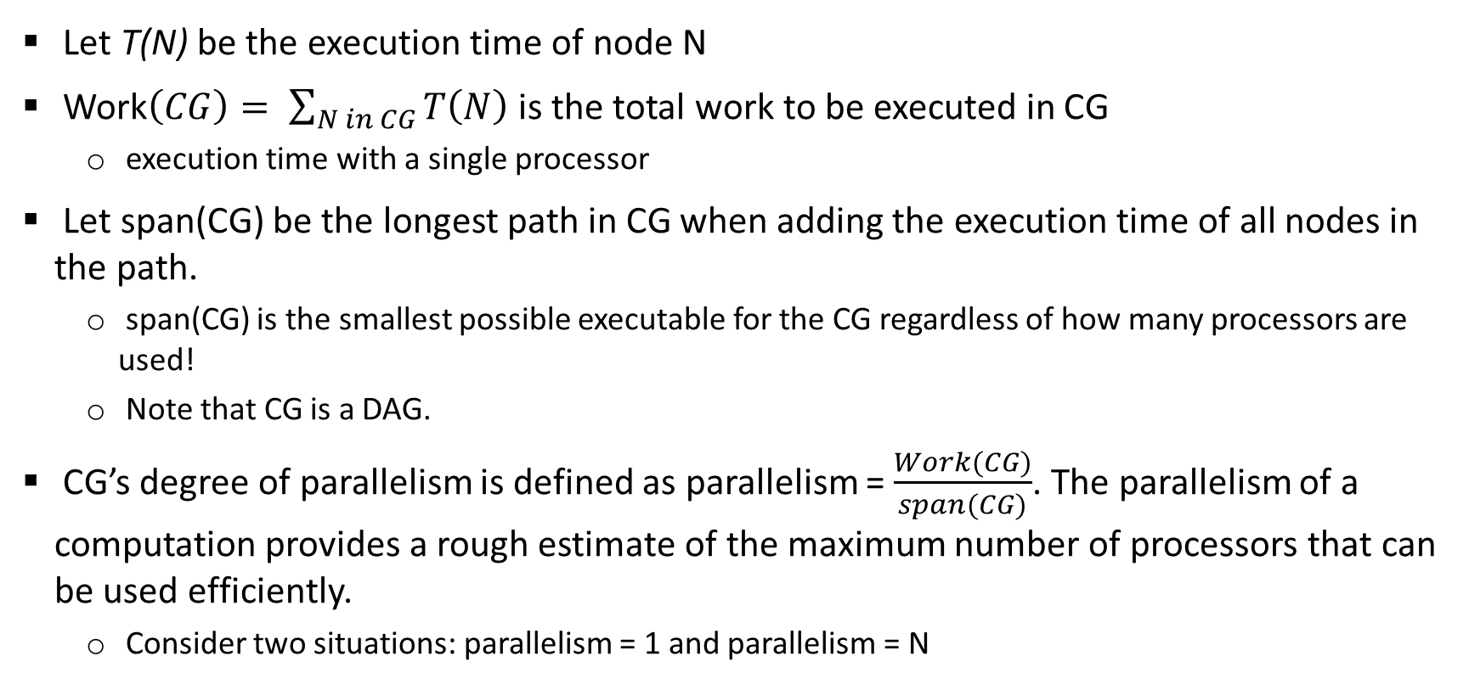
Complexity with computation graph
Let T(N) be the execution time of node N
Work$\left(CG\right)= \sum_{N in CG}{T\left(N\right)}$ is the total work to be executed in CG
  execution time with a single processor
Let span(CG) be the longest path in CG when adding the execution time of all nodes in the path.
  span(CG) is the smallest possible executable for the CG regardless of how many processors are used!
  Note that CG is a DAG.
CG’s degree of parallelism is defined as parallelism = $\frac{Work(CG)}{span(CG)}$. The parallelism of a computation provides a rough estimate of the maximum number of processors that can be used efficiently.
  Consider two situations: parallelism = 1 and parallelism = N

Slide 5
Let the time for each node be 1, compute the work, span, and parallelism for the following two computation graphs
A
A
B
C
D
E
B
C
D
F
E
F
G
G

Slide 6
What are the work, span and parallelism of the following CG?
A: 1
B: 2
C: 4
D: 1
E: 2
F: 1
G: 2
H: 1
I: 2

Slide 7
Scheduling of a computation graph
Assume each node takes 1 time steps.
A task can be allocated only when all of its predecessors have been executed.
A
B
C
Task scheduling:
Time step P0 P1
1 A -
2 B C
3 D E
4 H F
5 G -
6 I -
7 J -
D
E
F
G
H
I
J

Slide 8
Scheduling of a computation graph
A
Another schedule: better than the previous one
Task scheduling (2 processors)
Time step P0 P1
1 A -
2 B C
3 D E
4 F G
5 H I
6 J -
Scheduling makes a difference! How to get an
effective scheduling scheme?
B
C
D
E
F
G
H
I
J

Slide 9
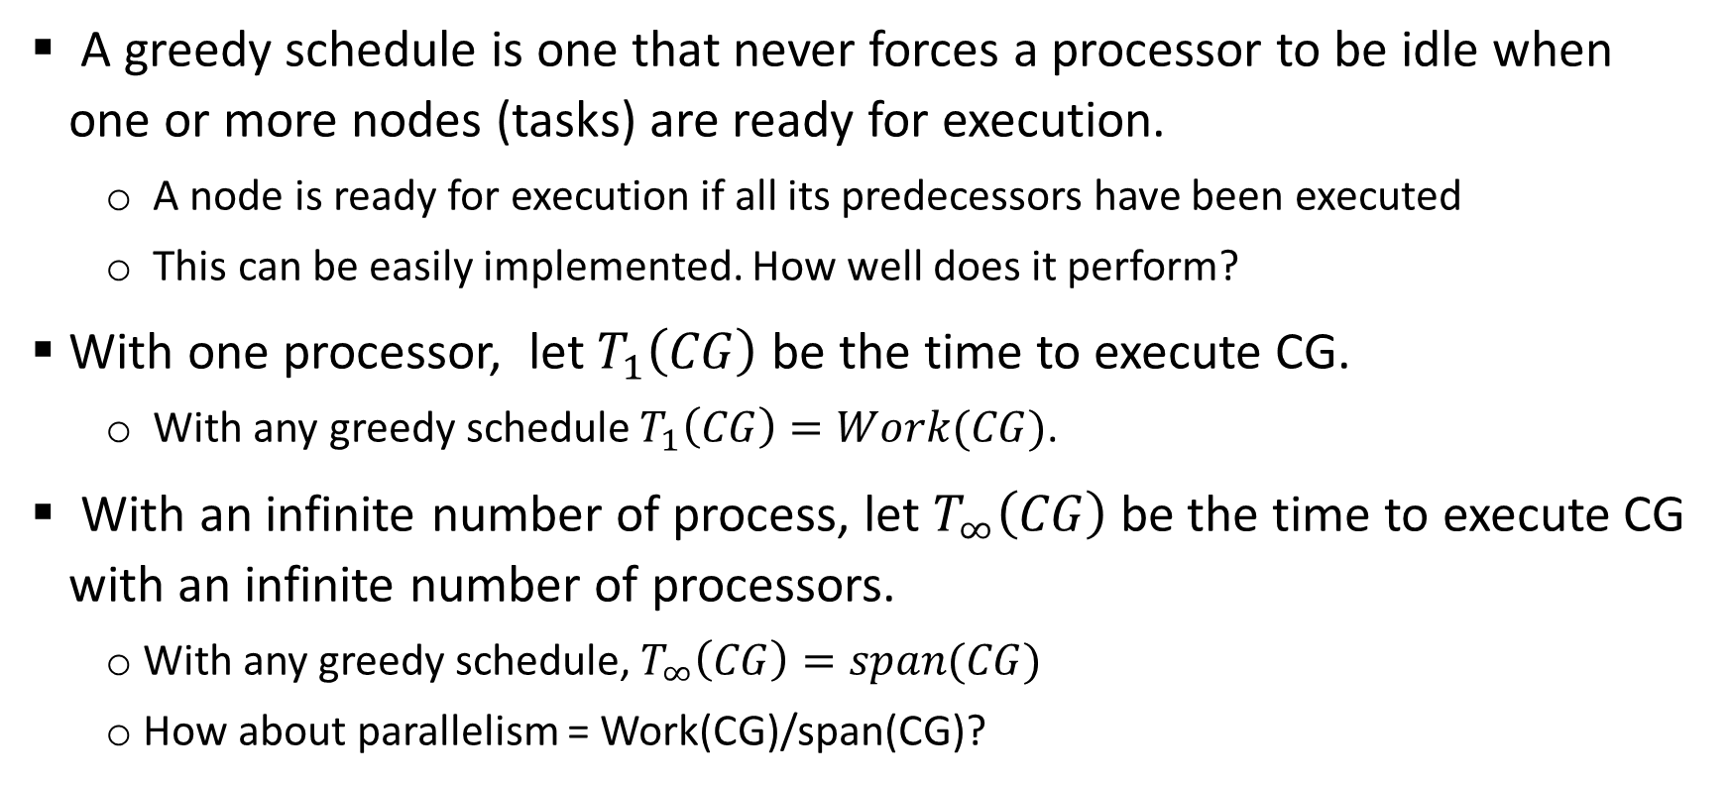
Greedy schedule
A greedy schedule is one that never forces a processor to be idle when one or more nodes (tasks) are ready for execution.
  A node is ready for execution if all its predecessors have been executed
  This can be easily implemented. How well does it perform?
With one processor, let $T_{1}\left(CG\right)$ be the time to execute CG.
  With any greedy schedule $T_{1}\left(CG\right)=Work(CG)$.
With an infinite number of process, let $T_{∞}\left(CG\right)$ be the time to execute CG with an infinite number of processors.
  With any greedy schedule, $T_{∞}\left(CG\right)=span(CG)$
  How about parallelism = Work(CG)/span(CG)?

Slide 10
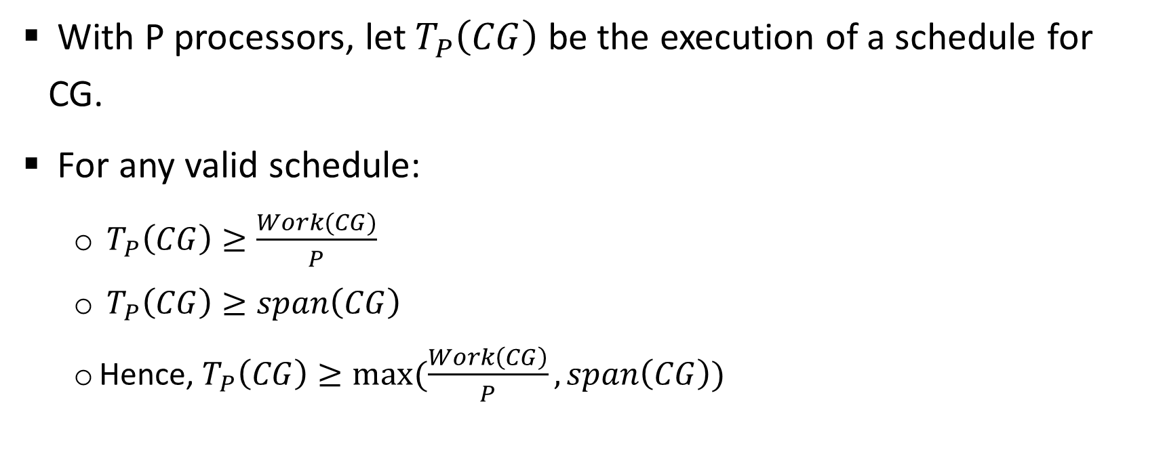
Greedy schedule
With P processors, let $T_{P}\left(CG\right)$ be the execution of a schedule for CG.
For any valid schedule:
  $T_{P}\left(CG\right)≥\frac{Work(CG)}{P}$
  $T_{P}\left(CG\right)≥span\left(CG\right)$
  Hence, $T_{P}\left(CG\right)≥max⁡(\frac{Work\left(CG\right)}{P}, span\left(CG\right))$

Slide 11
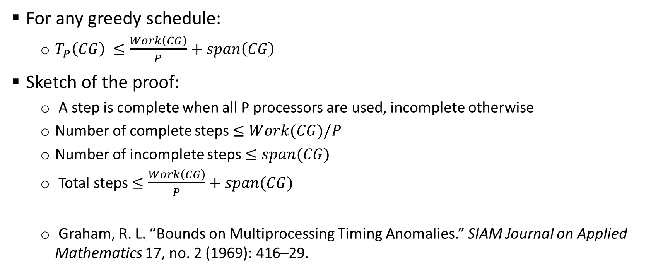
Greedy schedule
For any greedy schedule:
  $T_{P}\left(CG\right) ≤\frac{Work\left(CG\right)}{P}+span\left(CG\right)$
Sketch of the proof:
  A step is complete when all P processors are used, incomplete otherwise
  Number of complete steps $≤Work(CG)/P$
  Number of incomplete steps $≤span(CG)$
  Total steps $≤\frac{Work\left(CG\right)}{P}+span(CG)$
  Graham, R. L. “Bounds on Multiprocessing Timing Anomalies.” SIAM Journal on Applied Mathematics 17, no. 2 (1969): 416–29.

Slide 12
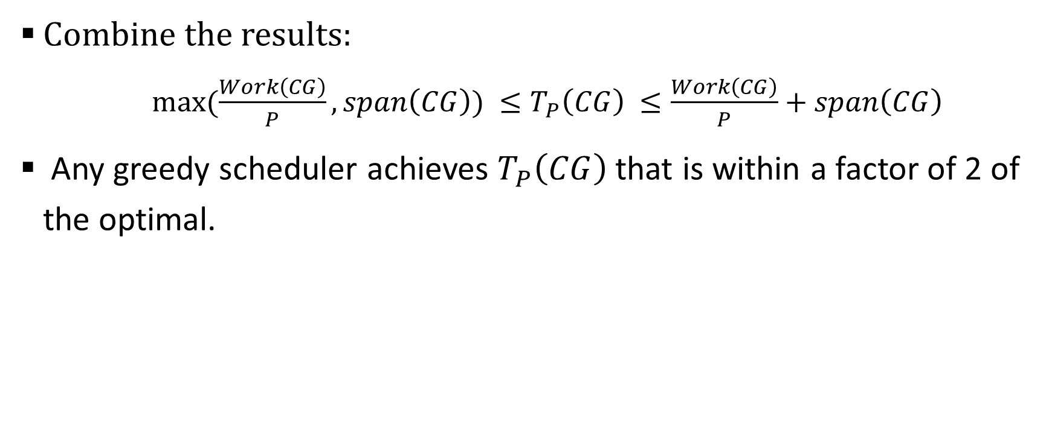
Greedy schedule
Combine the results:
  $max⁡(\frac{Work\left(CG\right)}{P}, span\left(CG\right)) ≤T_{P}\left(CG\right) ≤\frac{Work\left(CG\right)}{P}+span\left(CG\right)$
Any greedy scheduler achieves $T_{P}\left(CG\right)$ that is within a factor of 2 of the optimal.

Slide 13
Create a greedy schedule for the following CG with 2 and 3 processors
A: 1
Time step: P0 P1 P0 P1 P2
1
2
3
4
5
6
7
8
9
10
B: 2
C: 4
D: 1
E: 2
F: 1
G: 2
H: 1
I: 2

Slide 14
Summary
Flynn’s taxonomy: SISD, SIMD, MISD, MIMD
Performance metrics MIPS, GFLOPS.
Peak performance and sustained performance.
Computation graph: describe the dependencies between tasks in a parallel computation.
Parallelism = Work(G) / span(G), an approximation of the number of processors that can be used effectively in the computation.
Greedy scheduler assigns tasks to processors whenever a task is ready and a processor is available. The execution time with a greedy scheduler is at most 2 times that of the optimal scheduler.

