Slide 1
CUDA programming III - GPU implementation of Matrix Multiplication
Implementing MM on GPU
  Memory hierarchy
  Synchronization
Hardware limit and occupancy.

Slide 2
CUDA extension to declare kernel routines
__global__ indicates routine can only be called from host and only executed on device
__device__ indicates routine can only be called from device and only executed on device
__host__ indicates routine can only be called from host and only executed on host

Slide 3
Routine for device
__global__ routine must have a void return value.
Generally cannot call C library routines except CUDA built-in math routines such as sin, cos, etc.
  Check NVIDIA CUDA programming guide for details.
CUDA also has device only routines.

Slide 4
Example for 2D grid/blocks
Matrix multiply:
for (i=0; i<N; i++)
for(j=0; j<K; j++)
for (k=0; k<M; k++)
c[i][j] += a[i][k] * b[k][j]
2D mesh must be stored in the linear (1D) array (column major order)
    c[i][j] = c[i+N*j] = *(c+i+N*j);
    a[i][k] = a[i+K*j] = *(a+i+K*k);

Slide 5
First try
Using one thread to compute one c[i][j], a total of N*K threads will be needed.
  N*K blocks of threads and 1 thread each block
  See lect28/mm0.cu
  // kernel MM routine
  __global__ void mmkernel(float *a, float *b, float *c, int N, int M, int K)
  {
  int i = blockIdx.x, j = blockIdx.y;
  float sum = 0.0f;
  for (int k = 0; k< M; k++) sum += a[i+N*k] * b[k+K*j];
  c [i+N*j] = sum;
  }
dim3 dimBlock(1); dim3 dimGrid(N, N);
mmkernel<<<dimGrid, dimBlock>>> (dev_A, dev_B, dev_C, N, M, K);

Slide 6
Another try
In Mm0.cu, each block has 1 thread. Each warp (32 threads) must be in the same block ➔ each warp has one 1 thread in this program. We want to have more threads in each block!
How about using 1 block with N*K threads?
  // kernel MM routine
  __global__ void mmkernel(float *a, float *b, float *c, int N, int M, int K)
  {
  int i = threadIdx.x, j = threadIdx.y;
  float sum = 0.0f;
  for (int k = 0; k< M; k++) sum += a[i+N*k] * b[k+K*j];
  c [i+N*j] = sum;
  }
dim3 dimBlock(1); dim3 dimGrid(N, K);
mmkernel<<<dimBlock, dimGrid>>> (dev_A, dev_B, dev_C, N, M, K);

Slide 7
Another try
How about using 1 block with N*K threads
The idea is good: filling up warps by having more threads in each block
There is a limit on the number of threads per block (1024 threads per block in aurora)!
  This is not a correct program!
  CUDA won’t produce an error. It will just give wrong results!
  We need a better way to fill up warps (have more threads in each block)!

Slide 8
Second Try
Add threads to blocks to exploit the SIMT (SIMD) support
  need to have at least 32 threads per block to have one 32 thread warp.
  More is the better (GPU will have more options).

Slide 9
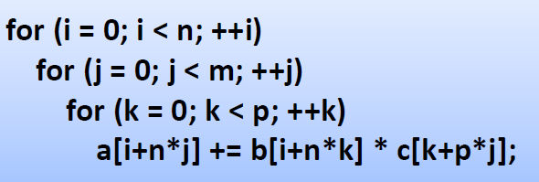
Making more threads in a block for MM
We still want one thread to compute each a[i][j].
We can use blocking and loop interchange to create more threads in each block

Slide 10

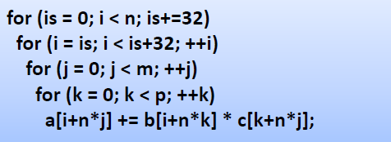
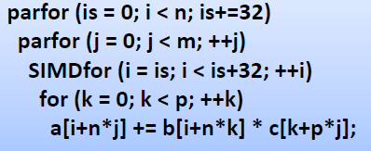
Blocking the i loop
Interchange i and j loops
32 threads in a block

Slide 11
MM with multiple threads in each block
__global__ void mmkernel(float *a, float *b, float *c, int N, int M, int K)
{
int i = blockIdx.x * blockDim.x + threadIdx.x, j = blockIdx.y;
float sum = 0.0f;
for (int k = 0; k< M; k++) sum += a[i+N*k] * b[k+K*j];
c [i+N*j] = sum;
}
dim3 dimBlock(BLOCK_SIZE);
dim3 dimGrid(N/BLOCK_SIZE, K);
mmkernel<<<dimGrid, dimBlock>>> (dev_A, dev_B, dev_C, N, M, K);
Notice the relationship between index calculation and kernel invocation.
Try mm1.cu with different BLOCK_SIZE’s. See the performance difference between mm1.cu and mm0.cu

Slide 12
CUDA memory hierarchy
Thread
Register: per-thread basis
  Private per thread
  Can spill into local memory (perf. hit)
Shared Memory: per-block basis
  Shared by threads of the same block
  Used for: Inter-thread communication
Global Memory: per-application basis
  Available for use to all threads
  Used for: Inter-thread communication
  Also used for inter-grid communication
Register
Block
Shared
Memory
Grid 0
Global
Device
Memory
. . .
Sequential
Grids
in Time
Grid 1
. . .
12

Slide 13
CUDA memory allocation
Memory Declaration Scope Lifetime
Registers Auto variables Thread Kernel
other than arrays
Local Auto arrays Thread Kernel
Shared __shared__ Block Kernel
Global __device__ Grid Application
Constant __constant__ Grid Application

Slide 14
Example
__global__ float A[1000];
__global__ void mmkernel(float *a, float *b, float *c, int N, int M, int K)
{
int i = blockIdx.x * BLOCK_SIZE + threadIdx.x;
int j = blockIdx.y;
int tx = threadIdx.x;
__shared__ float cb[BLOCK_SIZE];
int workb[BLOCK_SIZE];
……
}
Which type of variables are A, i, j, cb, workb?

Slide 15
Memory usage in mm1.cu
In mm1.cu, threads use register variables and global arrays
A block of BLOCK_SIZE threads is used to compute: BLOCK_SIZE c items: c[0][0], c[1][0], c[2][0], …. C[BLOCK_SIZE][0]
  The calculation:
    C[0][0] = A[0][0] * B[0][0] + A[0][1]*B[1][0] + A[0][2] * B[2][0] …
    C[1][0] = A[1][0] * B[0][0] + A[1][1]*B[1][0] + A[1][2] * B[2][0] …
    C[2][0] = A[2][0] * B[0][0] + A[2][1]*B[1][0] + A[2][2] * B[2][0] …
  A and C matrices have different values in different threads – no shared memory
  B matrix has the same items
    Put B in shared memory may reduce the (global) memory traffic.
    Shared memory in GPU is limited, can’t hold the whole column: need to reduce the memory footprint. How?
      for(k=0; i<M; k++) C[i][j] += A[i][k]*B[k][j]

Slide 16
MM with shared memory
for(k=0; i<M; k++) C[i][j] += A[i][k]*B[k][j]
For (ks=0; ks < M; ks+=TSIZE)
for(k=ks; k<ks+TSIZE; k++) C[i][j] += A[i][k] * B[k][j];
For(ks=0; ks<M; ks+=TSIZE)
Forall (k=ks; k<ks+TSIZE; k++) workB[k][j] = B[k][j];
for (k=ks; k<ks+TSIZE;k++) C[i][j] += A[i][k] * workB[k][j];

Slide 17
MM with shared memory
__global__ void mmkernel(float *a, float *b, float *c, int N, int M, int K)
{
int i = blockIdx.x * BLOCK_SIZE + threadIdx.x;
int j = blockIdx.y;
int tx = threadIdx.x;
__shared__ float cb[BLOCK_SIZE];
float sum = 0.0f;
for (int ks = 0; ks < M; ks+= BLOCK_SIZE) {
cb[tx] = b[ks+tx+M*j]; // copy from global to shared, all threads parallel read
for (int k = ks; k< ks+BLOCKINGSIZE; k++) sum += a[i+N*k] * cb[k-ks];
}
c [i+N*j] = sum;
}
Each thread reads different data
Each thread uses the shared array?
Any problem here?
Can the dependence be honored
in the concurrent thread execution?

Slide 18
MM with shared memory
__global__ void mmkernel(float *a, float *b, float *c, int N, int M, int K)
{
int i = blockIdx.x * BLOCK_SIZE + threadIdx.x;
int j = blockIdx.y;
int tx = threadIdx.x;
__shared__ float cb[BLOCK_SIZE];
float sum = 0.0f;
for (int ks = 0; ks < M; ks+= BLOCK_SIZE) {
cb[tx] = b[ks+tx+M*j]; // all BLOCK_SIZE threads parallel read
__syncthreads(); // barrier among all threads in a block
for (int k = ks; k< ks+BLOCKINGSIZE; k++) sum += a[i+N*k] * cb[k-ks];
__syncthreads(); // barrier among all threads in a block
}
c [i+N*j] = sum;
}
See lect28/mm2.cu

Slide 19
Some information about __syncthreads()
All threads must reach the barrier before any thread can move on.
  Threads arrives early must wait
__syncthreads() is in kernel only.
Only synchronize within each block
Barriers in different blocks are independent.

Slide 20
How hardware limits affect CUDA programming
NVIDIA define compute capability that gives resources limitations for its devices
Run devicequery.cu to see the GPU properties.
Resources limit the number of warp/threads that can be executed simultaneously on SMs.
These limits can affect how we write efficient CUDA code

Slide 21
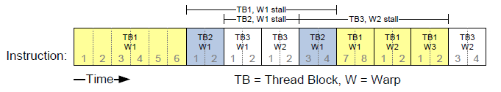
Occupancy
Warps are stalled all the time (load/store to global memory).
  If all warps are stalled, no instruction is issued.
  Needs a lot of warps to keep SM busy.
  Maximizing the number of warps in an SM is very important (also called maximize occupancy).

Slide 22
What determines occupancy?
Each SM has limited registers and shared memory
  Register and shared memory usage per thread will determine the occupancy.
  Hard limit of the number of thread blocks in each SM.

Slide 23
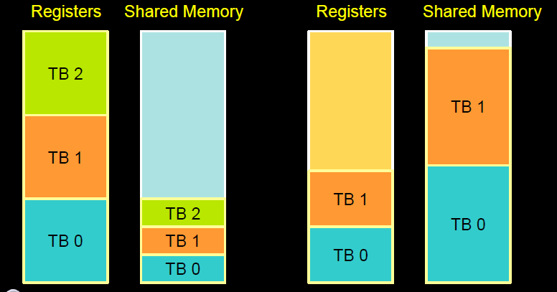
Resource limits (1)
Pool of registers and shared memory per SM
  Each thread block grabs some resources
  If one or the other is fully utilized, no more thread blocks.

Slide 24
How do you find out the register and shared memory usage
Use ‘nvcc –Xptxas –v a.cu’ to get register and shared memory usage.
You can plug the number to CUDA occupancy calculator to see the occupancy.
To change the register usage: use flag
    -maxrregcount=X
  This can significant affect the program performance as some register is now in memory.

Slide 25
Resource limits (2)
Can only have a limited number of thread blocks per SM
  If thread blocks are too small, they cannot fully utilize the SM
  Need at least 128/256 threads/block
    The number of threads per block should always be a multiple of 32.
  Higher occupancy has diminishing return for hiding latency.

