Slide 1
Graphics Processing Unit (GPU) overview

Slide 2
Graphics Processing Unit (GPU)
  GPU is the chip in computer video cards, PS3, Xbox, etc
  Designed to realize the 3D graphics pipeline
    Application → Geometry → Rasterizer→ image
GPU development:
  Fixed graphics hardware
  Programmable vertex/pixel shaders
  GPGPU
    General purpose computation (beyond graphics) using GPU in applications other than 3D graphics
    GPGPU can be treated as a co-processor for compute intensive tasks
      With sufficient large bandwidth between CPU and GPU.

Slide 3
CPU and GPU
CPU is designed for efficient general purpose computing. Large chip area is dedicated for optimizing control in general computing
  Out of order execution, multiple issues, etc to improve single thread performance.
GPU is specialized for compute intensive, highly data parallel computation
  More chip area is dedicated to processing
  Good for high arithmetic intensity programs with a high ratio between arithmetic operations and memory operations.
Heterogeneous system and computing: CPU+GPU with CPU for general purpose processing and GPU for accelerating compute-intensive, data parallel regions.

Slide 4
CPU versus GPU
CPU: The multicore trajectory seeks to maintain the execution speed of sequential programs while moving into multiple cores.
GPU: the many-thread trajectory focuses on the execution throughput of parallel applications!
Control
ALU
ALU
ALU
ALU
Cache
DRAM
DRAM
CPU
GPU

Slide 5
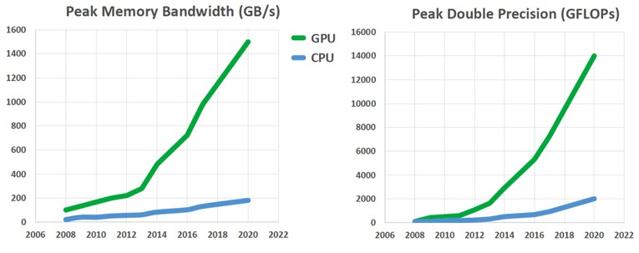
CPU versus GPU

Slide 6
Architecture of a modern GPU (van Newman Architecture)

Slide 7
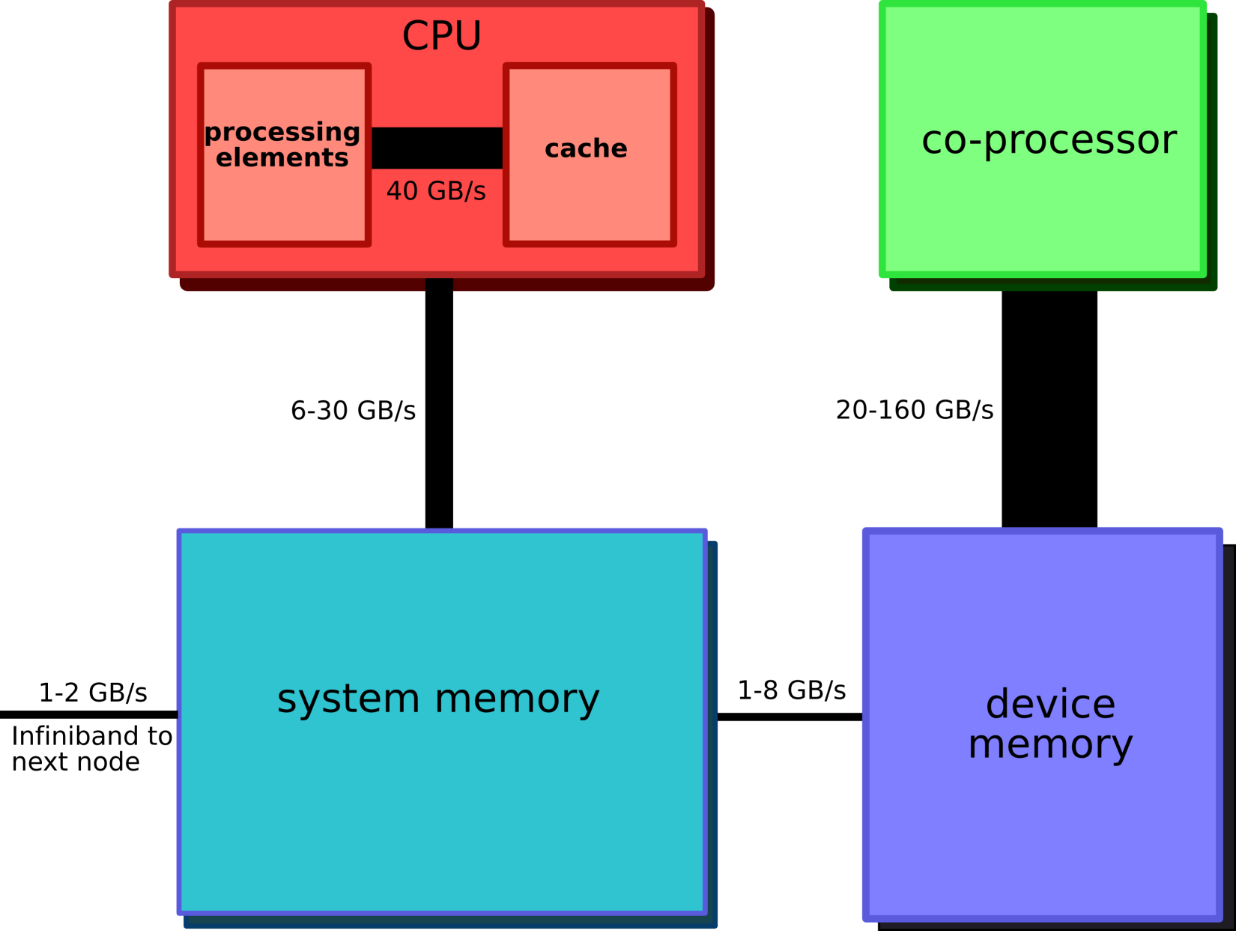
Organization of a CPU-GPU system
Ever changing moving target

Slide 8
Compute Unified Device Architecture (CUDA)
A parallel platform and programming model created by NVIDIA.
Hardware/software architecture for NVIDIA GPU to execute programs
  Main concept: hardware support for hierarchy of threads to exploit data parallelism.

Slide 9
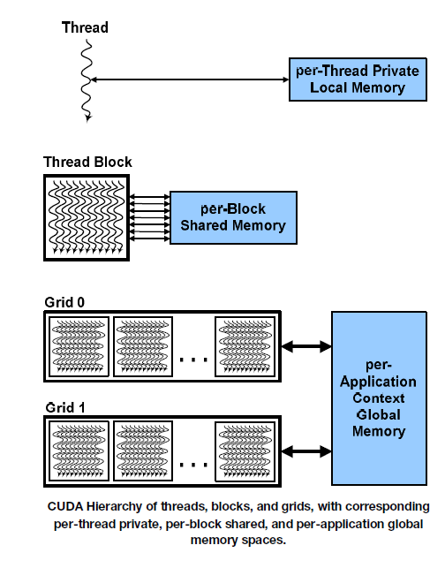
Thread Block Organization: thread, block, grid
Thread – distributed by the CUDA runtime (identified by threadIdx)
Block – A user defined group of 1 to 512 or 1024 threads (identified by blockIdx)
Grid – a group of one or more blocks. A grid is created for each CUDA kernel function called.
Thread organization is like an array of thread indices.
Goal of NVIDIA GPU: run such massively number of threads as efficient as possible.

Slide 10
Supporting thread execution
GPU supports efficient execution of a massive number of threads (each thread id often maps to one array index).
  The threads to be executed are organized into kernels
  Each kernel corresponds to one “grid” (of threads) – multiple kernels can be launched at the same time.
  Each grid has many “blocks” of threads (usually 512-1024). Example
  dim3 dimBlock(4, 4, 4);
  dim3 dimGrid(100, 100, 1);
  kernel <<<dimGrid, dimBlock>>> (….)
  There is a maximum number of threads per block (e.g. 1024 depending on GPU)
  There is a maximum value of blocks per grid (65535 often)
  You cannot go over the limits.
  Much of the GPU programming is dealing with the hardware limitations.

Slide 11
Supporting thread execution
Each GPU has multiple streaming multiprocessors (SMs)
  Threads are executed in a group of 32 (called a warp) in an SIMD manner (with one instruction – at a given time, one instruction for the whole warp is executed).
  Each SM has many processors or CUDA cores (32 in Fermi and 128 in Ampere) and a small number (1-4) instruction units.
  Each SM also has limited resources – there is a limit how many threads it can support, which affects how efficient CUDA programs are written.

Slide 12
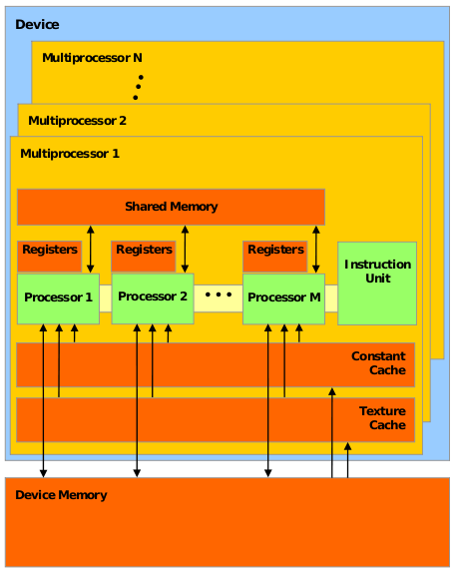
Streaming Multiprocessors
Latest generation
Block diagram
Early generation

Slide 13
SIMT and warp scheduler
CUDA exploits data parallelism
  SIMD is an effective way to exploit data parallelism with reduced control logic
CUDA uses a more flexible form (or an extension) of SIMD called SIMT (Single instruction, multi-thread) to execute threads
  32 threads are scheduled together called warp.
  All threads in a warp start at the same PC, but free to branch and execute independently.
  A warp executes one common instruction at a time.
    It performs the best when all threads share one instruction.
    If different threads in a warp run different instructions (SIMT allows this, SIMD does not), it would take multiple cycles for the warp to complete one instruction – warp divergence.

Slide 14
Warp scheduling

Slide 15
Inside the GPU
Run the massive number of threads effectively with minimum power.
NVIDIA GPU architecture evolves overtime, raw computing power keeps increasing, new features continue to be added.
  Fermi (2010)
  Kepler (2012)
  Maxwell (2014)
  Pascal (2016)
  Turing (2018)
  Ampere (2020)
There is a white paper for each of these architectures from NVIDIA. We will discuss key features in some of the generations.

Slide 16
Fermi
16 streaming multiprocessors (SMs), each SM having 32 processing units (CUDA cores), total 512 CUDA cores
Each core execute one floating point or integer instruction per clock for a thread
Each SM:
  32 Cuda cores
  64KB shared memory/L1 cache
  32K 32-bit register file per SM.
  Two warp schedulers, each with one instruction dispatch unit.
  16 load/store units
  Support double precision operations
Connecting to CPU: 1 work queue between CPU and GPU (At one time, one kernel is active)
No special support for multi-GPU systems. Communication from one GPU to another GPU:
GPU memory->CPU memory-> GPU memory

Slide 17
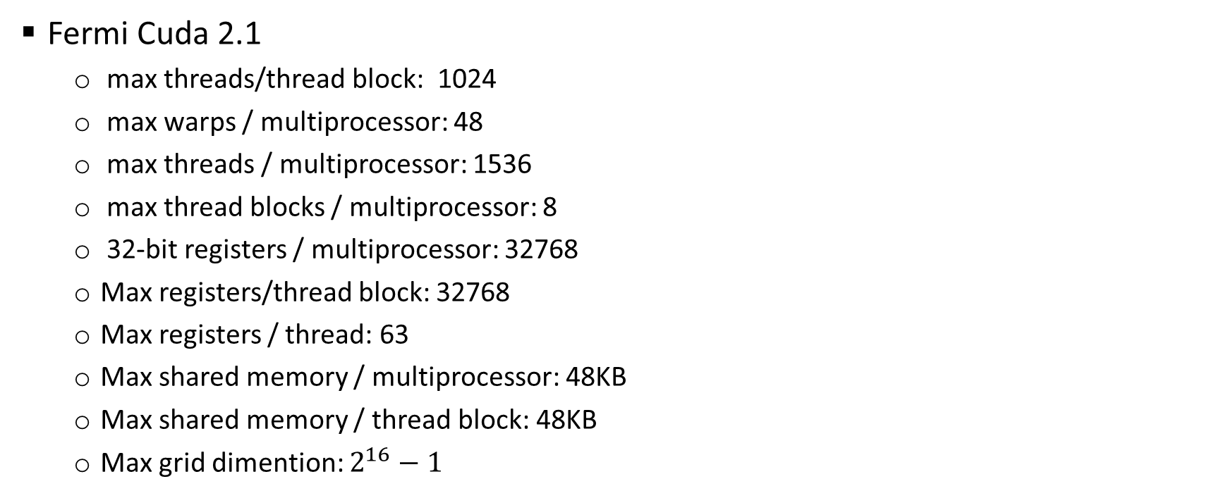
Fermi compute capability
Fermi Cuda 2.1
  max threads/thread block: 1024
  max warps / multiprocessor: 48
  max threads / multiprocessor: 1536
  max thread blocks / multiprocessor: 8
  32-bit registers / multiprocessor: 32768
  Max registers/thread block: 32768
  Max registers / thread: 63
  Max shared memory / multiprocessor: 48KB
  Max shared memory / thread block: 48KB
  Max grid dimention: $2^{16}−1$

Slide 18
Fermi warp scheduling in an SM

Slide 19
Keplar (GK120)
15 streaming multiprocessors (SMs) with 192 processing units (CUDA cores) each, total 2880 CUDA cores
Each SM:
  192 Cuda cores
  128KB shared memory/L1 cache (twice as Fermi)
  128K 32-bit register file per SM. (4 times Fermi)
  4 warp schedulers, each with two instruction dispatch units.
  32 load/store units
Hyper-Q: 32 Connecting to CPU: 32 kernels
NVIDIA GPUDirect: Support multiple GPU in one server -- moving data between GPU memory without going through CPU memory.
Dynamic parallelism: new threads can be launched from the kernel.

Slide 20
Dynamic paralelism
GPU can launch new threads

Slide 21
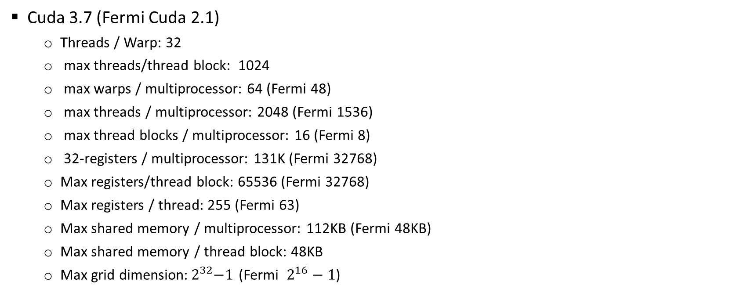
Kepler (GK120) compute capability
Cuda 3.7 (Fermi Cuda 2.1)
  Threads / Warp: 32
  max threads/thread block: 1024
  max warps / multiprocessor: 64 (Fermi 48)
  max threads / multiprocessor: 2048 (Fermi 1536)
  max thread blocks / multiprocessor: 16 (Fermi 8)
  32-registers / multiprocessor: 131K (Fermi 32768)
  Max registers/thread block: 65536 (Fermi 32768)
  Max registers / thread: 255 (Fermi 63)
  Max shared memory / multiprocessor: 112KB (Fermi 48KB)
  Max shared memory / thread block: 48KB
  Max grid dimension:${ 2}^{32}−1$ (Fermi $2^{16}−1$)

Slide 22
Maxwell
Optimizing performance per watt over Kepler

Slide 23
Pascal (GP100)
56 streaming multiprocessors (SMs) with 64 processing units (CUDE cores) each, total 3584 FP32 CUDA cores (1792 FP64 cores)
NVLink: more multi-GPU support.
HBM2: high capacity stack memory architecture, 3X memory bandwidth than earlier GPUs
Unified memory: a hardware-software solution to provide a unified virtual address space for CPU and GPU memory

Slide 24
NVLink
Further support multi-GPU system, 160GB/s speed, 5x PCIe Gen 3 speed.
PCIe 1.0 8GB/s
PCIe 2.0 16GB/s
PCIe 3.0 32GB/s
PCIe 4.0 64GB/s
PCIe 5.0 128GB/s

Slide 25
Pascal (GP100) compute capability
Cuda 6.0 (Kepler GK110 Cuda 3.7)
  Threads/Warp 32 (32)
  max warps / multiprocessor: 64 (64)
  max threads / multiprocessor: 2048 (2048)
  max thread blocks / multiprocessor: 32 (16)
  32-registers / multiprocessor: 64K (64K)
  Max registers/thread block: 64K (64K)
  Max registers / thread: 255(255)
  Max shared memory / multiprocessor: 64KB (16KB-48KB)
  Max shared memory / thread block: 48KB

Slide 26
Turing (TU102)
72 SM units with 64 CUDA cores each (4608 total), 10 tensor cores
Turing tensor cores
Memory compression
The latest one: Ampere.

