Slide 1
Basics in MPI implementation
Implementing point-to-point communication
  Eager and Rendezvous protocols
Implementing collective communication: MPI_Bcast

Slide 2
Message Protocols
Cooperative message passing requires cooperation of sender and receiver.
Focus on blocking send/receive
Process 0
MPI_Send()
Process 1
Shoud I send? What next?

Slide 3
Message Protocols
An MPI message consists of “envelope” and data.
  Envelope contains tag, communicator, length, source, and other mega data.
MPI uses two message protocols
  Eager protocol: message is sent assuming that the receiver can store
  Rendezvous protocol: Message is not sent until the receive posts the MPI_Recv.
Process 0
MPI_Send()
Process 1
Shoud I send? What next?

Slide 4
Eager protocol
Process 0
MPI_Send()
Process 1
Message is delivered to the receiver regardless
The receiver may or may not post the matching MPI_Recv yet
  If the matching MPI_Recv has not been posted, the message must be stored in the receiver’s MPI library buffer before the data is moved to the user space (after the MPI_Recv is posted).

Slide 5
Eager protocol
No synchronization delay
Requires significant buffer memory at the receiver end
  Consider running a 1M processes MPI job. If eager protocol is used, a process must be ready to receive eager messages from 1M processes.
May require receiver’s CPU involvement to drain the network buffer
If the matching MPI_Recv has not been posted, one extra copy is introduced.

Slide 6
Rendezvous protocol
Process 0
MPI_Send()
Process 1
MPI_Recv
MPI_Send returns
MPI_Recv returns
The sender sends the envelope first
The receiver sends an acknowledgement when MPI_Recv is posted.
  In the meantime, the sender is blocked and idles.
After the sender receives the ACK, it sends its data. At the receiver end, the data is directly placed in the user buffer (no system buffer needed)

Slide 7
Rendezvous protocol
Robust in comparison to the eager protocol.
No extra copy of data
May introduce synchronization delay to the application (the sender and receiver synchronize with the rendezvous protocol).

Slide 8
The use of eager and rendezvous protocols in MPI libraries
Eager protocol for small messages
  no unnecessary synchronization for small messages
  the overhead of the extra copy of a small message is ok
Rendezvous protocol for large messages
  The communication time of a large message is large (synchronization overhead is relatively small)
  Buffering large messages may not be feasible
  Extra copy of a large message is costly. Avoid the extra copy
Eager threshold
  If (message size <= eager threshold) eager protocol
  else rendezvous protocol

Slide 9
Implementation of collective communication: MPI_Bcast
Before the operation, the data is only at the root.
After the operation, the data is in all processes.
There are many algorithms that can realize this operation.
P0
A
P0
A
MPI_Bcast
P1
P1
A
P2
P2
A
P3
P3
A

Slide 10
Designing algorithms for MPI_Bcast
Design collective algorithms under an abstract model:
  Ignore physical constraints such as topology, network contention, etc.
  Obtain a theoretically efficient algorithm under the model.
Effectively map the algorithm onto a physical system.
  Contention free communication.

Slide 11
An abstract system model for algorithm design
A abstract system model: All processes are connected by a network that provides the same capacity for all pairs of processes.
interconnect

Slide 12
Performance model for estimating algorithm performance
Models for point-to-point communication cost:
  Linear model: T(m) = b * m, m is the message size
    accurate if m is very large.
  Hockney’s model: T(m) = a + b* m
    a – the startup overhead (latency term), b – bandwidth term
  LogP family models and other more complex models.
Assumptions for estimating the MPI_Bcast time:
  All processes start at the same time
  Time = the last completion time – start time

Slide 13
Naïve algorithm (flat tree algorithm)
Naïve broadcast: the root sends to each of the receivers.
  If (myrank == root) {
    for (i=0; i<nprocs; i++) if (myrank != i) MPI_Send(…data,i,…)
  } else MPI_Recv(…, data, root, …)

Slide 14
Analyzing the Naïve algorithm
Let the size of the message be m bytes, using Hockney’s model: for a point to point communication of m bytes, the time is T(m) = a + b*m. What is the overall time for the broadcast with the naïve algorithm?

Slide 15
Analyzing the Naïve algorithm
Let the size of the message be m bytes, using Hockney’s model: for a point to point communication of m bytes, the time is T(m) = a + b*m. What is the overall time for the broadcast with the naïve algorithm?
The broadcast algorithm consists of sequentially sending p-1 messages. Here, p is the number of processes in the operation.
  Bcast time = (p-1) (a + b*m)
  For small messages, the time would roughly be (p-1)a, which is equivalent to the time to perform p-1 phases of communication.
  For large messages, the time would roughly be b*(p-1)*m, which is equivalent to the time to send a (p-1)m bytes message.
Can we do better than this?

Slide 16
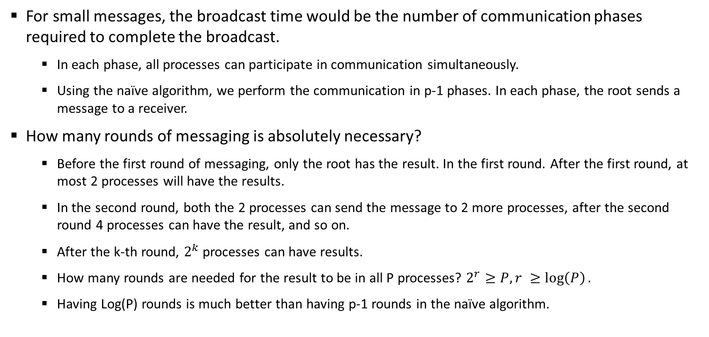
The lower bound of the number of communication phases to complete broadcast
  For small messages, the broadcast time would be the number of communication phases required to complete the broadcast.
    In each phase, all processes can participate in communication simultaneously.
    Using the naïve algorithm, we perform the communication in p-1 phases. In each phase, the root sends a message to a receiver.
  How many rounds of messaging is absolutely necessary?
    Before the first round of messaging, only the root has the result. In the first round. After the first round, at most 2 processes will have the results.
    In the second round, both the 2 processes can send the message to 2 more processes, after the second round 4 processes can have the result, and so on.
    After the k-th round, $2^{k}$ processes can have results.
    How many rounds are needed for the result to be in all P processes? $2^{r}≥P, r ≥\log\left(P\right).$
    Having Log(P) rounds is much better than having p-1 rounds in the naïve algorithm.

Slide 17
The lower bound of the total message size sent in sequence
  For large messages, the broadcast time would be dominated by the bandwidth term, which is determined by the total message size sent in sequence.
    Using the naïve algorithm, the root send p-1 message of size m in sequence. Thus, the total size is (p-1)m.
  What is the lower bound for this?
    Somewhat hard to derive. We know a message needs to be received by every process. Such a total size of m bytes is a lower bound (not clear it is a tight bound, but it is).
Put it together:
  For small messages, we want an algorithm that performs the communication in log(P) phases.
  For large messages, we want an algorithm that sends c*m total message size where c is a constant.
  Naïve performs poorly for both cases.

Slide 18
Algorithm for small message broadcast: binomial tree algorithm
We want an algorithm that doubles the number of processes having the results in every round. The binomial tree algorithm achieves this with complete the broadcast in log(P) phases.
Assuming process 0 is the root.
  Phase 1: 0→1
  Phase 2: 0→2, 1→3
  Phase 3: 0→4, 1→5, 2→6, 3→7
  and so on.
0
1
2
4
3
5
6
7

Slide 19
Algorithm for large message broadcast: scatter-allgather algorithm
Scatter-allgather algorithm chops the broadcast message into P chunks.
  In the first phase, it sends one chunk to each receiver – scatter (total size sent is m)
  in the second phase, all processes repeatedly forward data to the next process – allgather (total size sent is m in the phase)
P0
P1
P2
P3

Slide 20
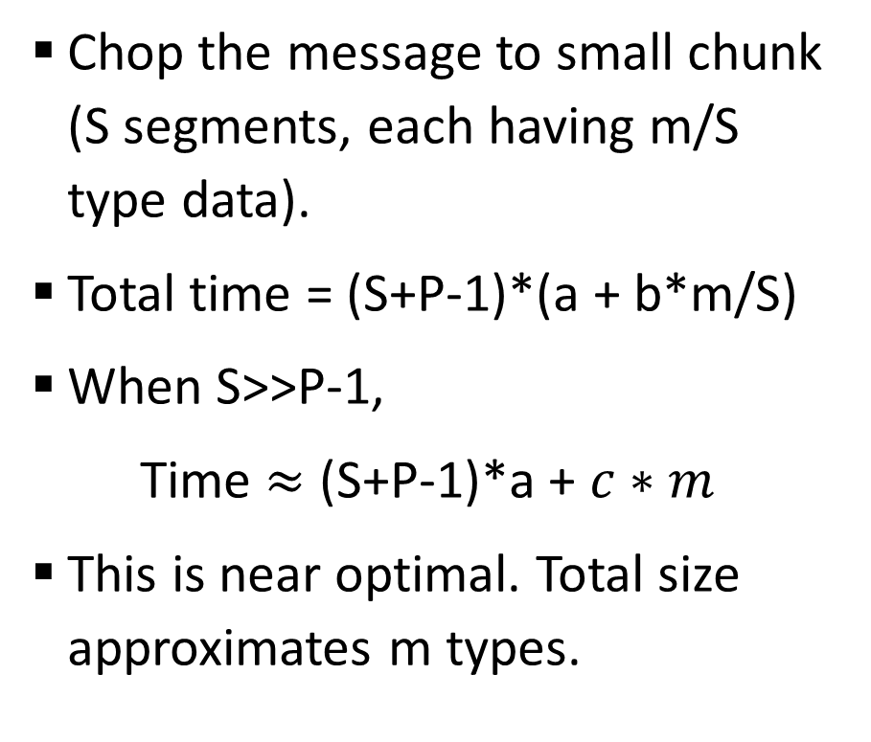
Algorithm for large message broadcast: pipelined broadcast algorithm
Chop the message to small chunk (S segments, each having m/S type data).
Total time = (S+P-1)*(a + b*m/S)
When S>>P-1,
Time $≈$ (S+P-1)*a + $c∗m$
This is near optimal. Total size approximates m types.
P0
P1
P2
P3

Slide 21
Summary
Under the abstract model
  For small messages: binomial tree
  For very large messages: scatter-allgather algorithm or pipelined algorithm
  What about medium size message?

Slide 22
Second phase: adapt the theoretical good algorithms to the specific machine architecture
Practical HPC systems have various architectural features and constraints.
  limited link bandwidth
  limited memory bandwidth (affects e.g. intra-node communication)
  Naïvely run the theoretical good algorithms may not achieve good performance.
  Algorithms for small messages can usually be applied directly.
    Small message usually do not cause memory or network issues.
  Algorithms for large messages usually need attention.
    Large message can easily cause memory or network issues.
To achieve the best performance, we will need to make the algorithms topology- or architecture-aware.

Slide 23
Consider the pipelined algorithm on an SMP cluster like linprog

Slide 24
Logical and physical communication pattern
Communication pattern in the pipelined algorithm:
  Let F:{0, 1, …, P-1} → {0, 1, …, P-1} be a one-to-one mapping function. The pattern can be F(0)→ F(1) → F(2) → ……→F(P-1)
  To achieve maximum performance, we need to find a physical mapping such that F(0)→ F(1) → F(2) → ……→F(P-1) does not have contention.

Slide 25
An example of bad mapping
0→1→2→3→4→5→6→7
  n1→n2 must carry traffic from 0→1, 2→3, 4→5, 6→7
A good mapping: 0→2→4→6→1→3→5→7
  n1→n2 only carry traffic for 6→1
0
2
1
3
n1
n2
6
5
7
4
Linprog1
Linprog2

Slide 26
Algorithm for finding the contention free mapping of linear pipelined pattern on tree
Starting from the switch connected to the root, perform depth first search (DFS). Number the switches based on the DFS order
Group machines connected to each switch, order the group based on the DFS switch number.
P. Patarasu, A. Faraj, and X. Yuan, "Pipelined Broadcast on Ethernet Switched Clusters." Journal of Parallel and Distributed Computing, 68(6):809-824, June 2008.

Slide 27
Summary
The number of cores in a compute node has been steadily increasing. Intra-node architecture features are become more important for collective communication.
Designing algorithms that can be architecture-aware and perform intra-node collective operation efficiently on such architectures is under research and development at this time.

