Slide 1
Parallel and Distributed Systems
What is a parallel computer?
  A collection of processing elements that communicate and coorperate to solve problems.
What is a distributed system?
  A collection of independent computers that appear to its users as a single coherent system.

Slide 2
Almost all Contemporary Computing Systems are Parallel and Distributed Systems.
  Mobile devices, IoT devices, many have multi-core CPUs
    IPhone 13, A15 – 6 CPU cores, 16 Neural Engine cores, 4 GPU cores
  Desktop or laptop, multi-core CPU
  A high-end gaming computer (CPU + GPU)
  Multi-core server
  Linprog cluster
  Cloud Computing platforms (Amazon AWS, Google cloud).
  Massive gaming platforms
  Internet of Things
  Fugaku supercomputer (No. 1 on November 11, 2021, 442 Peta flops peak performance)
Uniprocessor systems
Multi-processor systems

Slide 3
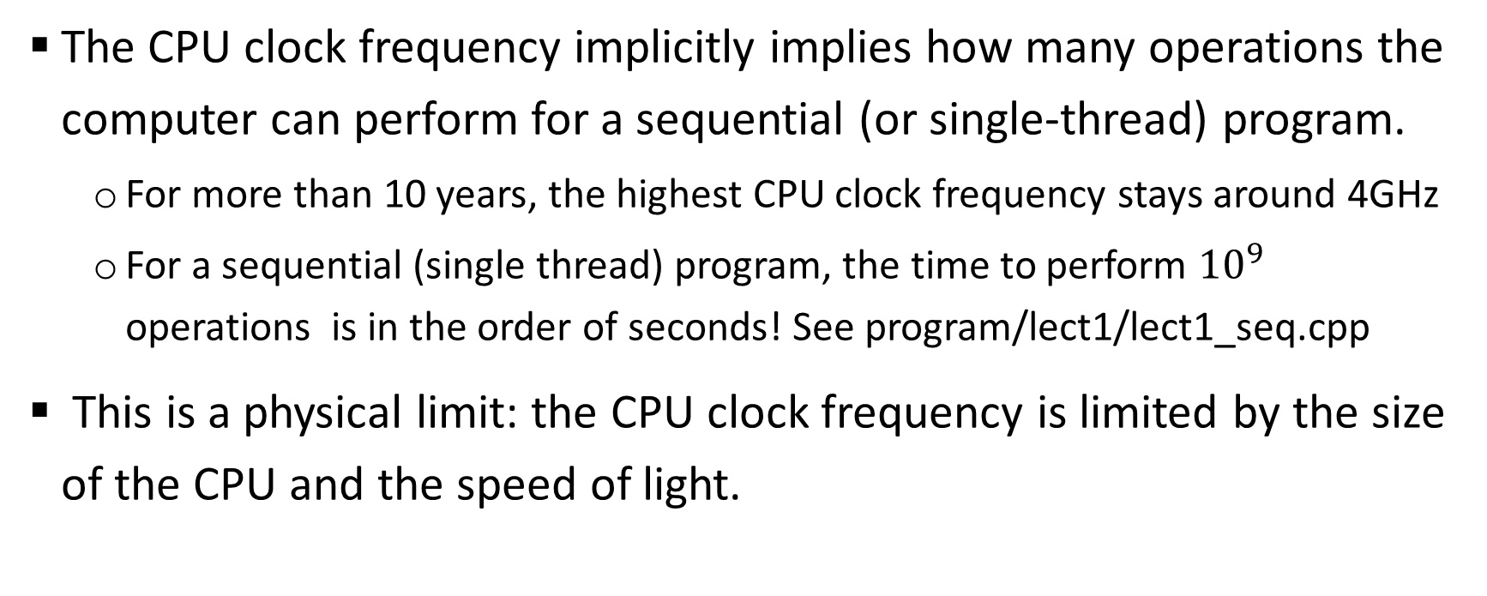
The performance limit of sequential program
The CPU clock frequency implicitly implies how many operations the computer can perform for a sequential (or single-thread) program.
  For more than 10 years, the highest CPU clock frequency stays around 4GHz
  For a sequential (single thread) program, the time to perform ${10}^{9}$ operations is in the order of seconds! See program/lect1/lect1_seq.cpp
This is a physical limit: the CPU clock frequency is limited by the size of the CPU and the speed of light.

Slide 4
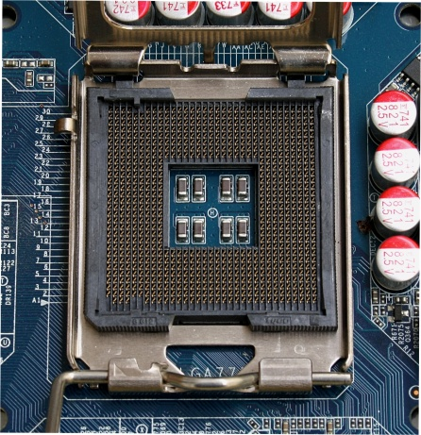
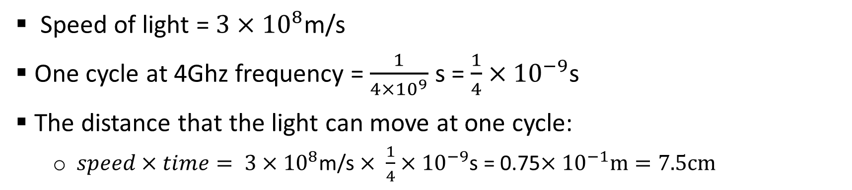
The limit of clock frequency
Speed of light = $3×{10}^{8}$m/s
One cycle at 4Ghz frequency = $\frac{1}{4×{10}^{9}}$ s = $\frac{1}{4}×{10}^{−9}$s
The distance that the light can move at one cycle:
  $speed×time= 3×{10}^{8}$m/s $× \frac{1}{4}×{10}^{−9}$s = 0.75$×{10}^{−1}m=7.5cm$
Intel chip dimension = 1.47 in x 1.47 in
= 3.73cm x 3.73cm
Not much room left for increasing the frequency!

Slide 5
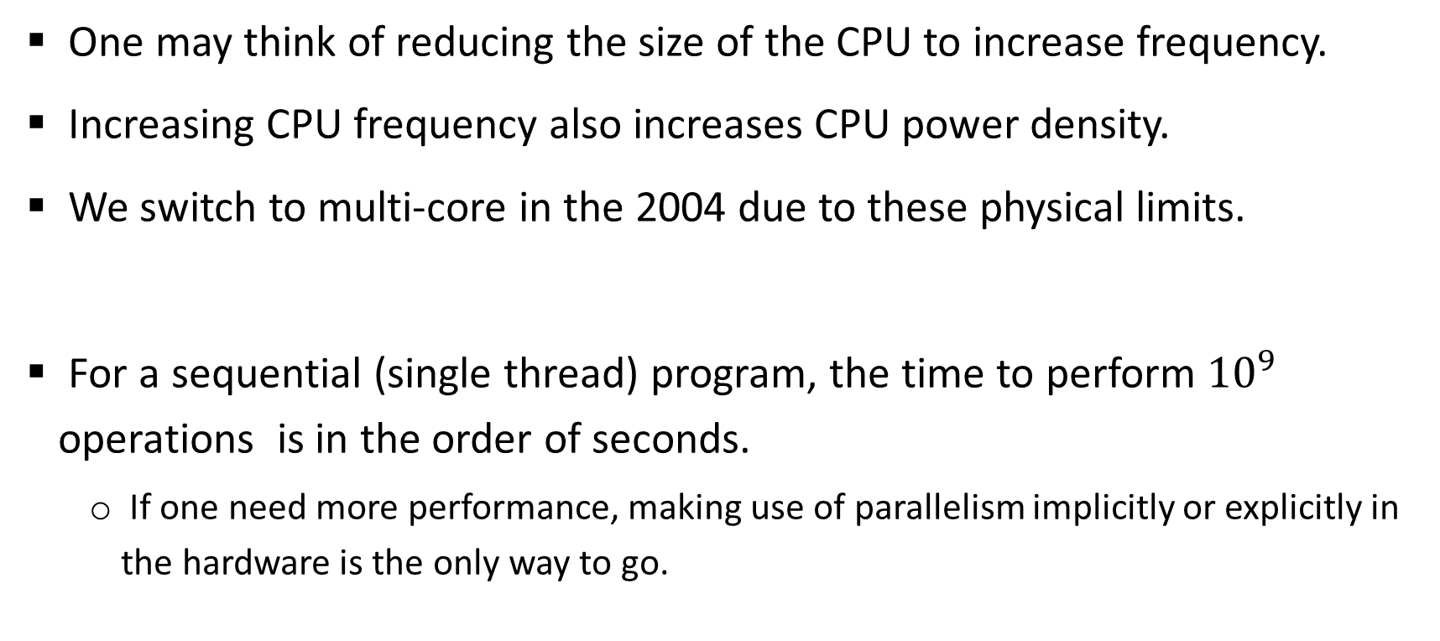
Another physical limit: power
One may think of reducing the size of the CPU to increase frequency.
Increasing CPU frequency also increases CPU power density.
We switch to multi-core in the 2004 due to these physical limits.
For a sequential (single thread) program, the time to perform ${10}^{9}$ operations is in the order of seconds.
  If one need more performance, making use of parallelism implicitly or explicitly in the hardware is the only way to go.

Slide 6
Using the Multiple Computing Elements in
Contemporary Computing Systems
In many cases, they support concurrent applications (multiple independent apps running at the same time).
They can also support individual parallel/distributed applications by pulling more computing resources for one application. This will require a different type of programming than the conventional sequential programs.
  Partition the task among multiple computing threads, coordinating and communicating among computing threads
This course will look under the hood of such systems and examine their architectures, how to write effective programs to exploit architectural features, and issues and solutions at different levels to enable parallel and distributed computing.

Slide 7
Programming Parallel and Distributed Systems
Two focuses of programming paradigms for PDS:
  Productivity
    Computing systems are fast enough for most applications. Coding is often where the bottleneck and cost are.
    Many programming systems is designed for productivity. For example, Python, Matlab, etc.
  Performance
    Computing systems are not fast enough for some applications (e.g. the training of very large deep learning models). As a result, performance is also a focus.
Programming systems in practice all claim to support both productivity and performance. As computing systems become more heterogeneous and complicated, the balance between the two is still under heavy investigation at this time.
This class focuses on performance.

Slide 8
Why parallel/distributed computing?
Some large scale applications can use any amount of computing power.
  Scientific computing applications
    Weather simulation. More computing power means more finer granularity and prediction longer into the future.
    Japan’s K machine was built to provide enough computing power to better understand the inner workings of the brain.
  Training of large machine learning models in many domains.
In small scale, we would like our programs to run faster as the technology advances – conventional sequential programs are not going to do that.

Slide 9
Why parallel/distributed computing?
Bigger: Solving larger problems in the same amount of time.
Faster: Solving the same sized problem in a shorter time.

Slide 10
More about parallel/distributed computing
Parallel/distributed computing allows more hardware resources to be utilized for a single problem. Parallel/distributed programs, however, do not always solve bigger problems or solve the same sized problems faster.
    Exploiting parallelism introduces overheads: work that is not necessary in the sequential program.
    Not all applications have enough parallelism.
    Naïve parallel programs are easy to write, but may not give you what you want.

Slide 11
What we will do in this class?
Examine architectural features of PDS
Introduce how to exploit the features and write efficient code for PDS
  Sequential code is a fundamental part of parallel code, so we will briefly discuss how to write efficient sequential code.
Study systems issues
PDS and their programming are very broad, we try to achieve a balance between breadth and depth.

