Slide 1
Interconnect Topology
First step in the interconnect design.
Topology design determines the cost of the network and significantly impact the performance:
  number of switches and links
  the switch port count (nodal degree)
  network layout
  Bound the throughput and packet latency
    Average hop counts decide the latency

Slide 2
Performance: Network offered load .vs. average package latency
Minimal latency
bounded by topology
and routing and flow
control
Average package latency
Minimal latency
bounded by topology
and routing
Minimal latency
bounded by topology
Offered load (packet generation rate)

Slide 3
Performance: Network offered load .vs. average package latency
Max throughput
bounded by topology
and routing and flow
control
Average package latency
Max throughput
bounded by topology
and routing
Max throughput
bounded by topology
Offered load (packet generation rate)

Slide 4
Topology design/performance metrics
Metrics for evaluating the performance and cost of a topology.
Assumptions:
  Perfect routing (perfectly balanced load)
  perfect flow control (no idle cycles in any link or channel)

Slide 5
Metric: nodal degree
Nodal degree: how many links connect to each node.
  Relates to cost or complexity of the implementation
  Higher degree means larger port count for each switch.
Degree = 2
Degree = 4

Slide 6
Metric: Hop count and Diameter
Path: an ordered set of links from source to destination
Hop count: number of hops in the path from source to destination
  Minimal hop count: the hop count for the shortest path from source to destination
  proxy for latency
Diameter: the largest minimal hop count among all source destination pairs in the network
Average minimum hop count: average across all source destination pairs
Routing may use longer paths, which will increase the hop count.
src
dst
3 hops from source to destination.

Slide 7
Diameter and Average minimum hop count example
Diameter = ?
Average minimum hop count =

Slide 8
Maximum channel load and bisection bandwidth
Maximum link(channel) load is defined with respect to the packet injection rate (from each node) and a traffic pattern (e.g. random uniform traffic).
A link load of 2 means that the link is loaded with twice the injection bandwidth
  If a node injects 1 flit per cycle, 2 flits will want to use the link (which can only send 1 flit in on cycle).
  If the bottleneck link can only send 1 flit each cycle (this is usually the definition of “cycle”), then the network bandwidth is ½ of the link bandwidth.

Slide 9
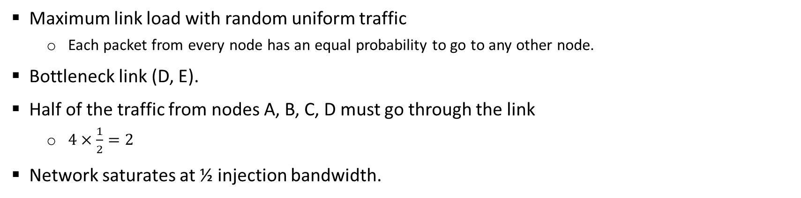
Maximum link load example
B
F
A
D
E
H
C
G
Maximum link load with random uniform traffic
  Each packet from every node has an equal probability to go to any other node.
Bottleneck link (D, E).
Half of the traffic from nodes A, B, C, D must go through the link
  $4×\frac{1}{2}=2$
Network saturates at ½ injection bandwidth.

Slide 10
Bisection bandwidth
Cut: A cut partitions all nodes into two disjoint sets.
Bisection:
  Bisection is a cut that divides all nodes into half or nearly half.
  Link (channel) bisection: counting the link in the bisection.
Bisection bandwidth: The smallest bandwidth between any half of the nodes to another half of the nodes.
  proxy for aggregate throughput
    Routing and flow control can have significant impact
    Using bisection bandwidth has an implicit assumption of ideal routing (completely load balanced) and ideal flow control.
With uniform random traffic
  ¼ of the traffic will cross the bisection in one direction.
  ½ in two directions.

Slide 11
Bisection bandwidth examples
B
F
A
D
E
H
C
G

Slide 12
Bisection bandwidth examples
Not the smallest cut, not a bisection

Slide 13
Metric: path diversity
Path diversity
  Number of shortest (or short) paths between a pair of nodes
  Multipath routing utilizes and exploits path diversity
  Fault tolerance

Slide 14
Interconnection network types
Direct
  Each switch (router) is associated (or connected) to a compute node (or terminal node)
  All switches (routers) are sources and destinations of traffic
  Examples: ring, mesh. When drawing such topology, switch and compute nodes are sometime merged in a graph.
Indirect
  Switches are distinct from compute/terminal nodes
  Compute nodes can be sources and destinations of traffic
  Switches do not generate traffic
  Example: bufferfly network

Slide 15
Direct and indirect network examples
Direct: switch and compute nodes are
together
Indirect network

Slide 16
Regular and irregular topology
Regular topologies
  Nodes are connected with some kind of patterns.
    The graph has a structure.
  Nodes are identified by coordinates.
  Routing can usually pre-determined by the coordinates of the nodes.
Irregular topologies
  Nodes are connected arbitrarily.
    The graph does not have a structure, e.g. internet
    More extensible in comparison to regular topology.
  Usually use variations of shortest path routing.
Which has better topology extensibility?

Slide 17
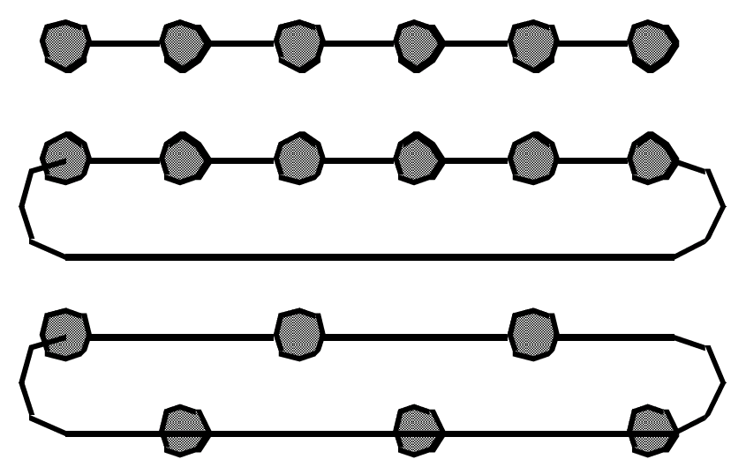
Linear array and ring
Linear array
Ring (torus)
Short wire torus
For a linear array or a ring with N nodes, what are the diameter, nodal degree, and bisection bandwidth?

Slide 18
Describing linear array and ring
Array: nodes are numbered from 0, 1, …, N-1
  Node i is connected to node i+1, 0 <= i <= N-2
Ring: nodes are numbered from 0, 1, …, N-1
  Node I is connected to node (i+1) mod N, for all 0 <= i <= N-1

Slide 19
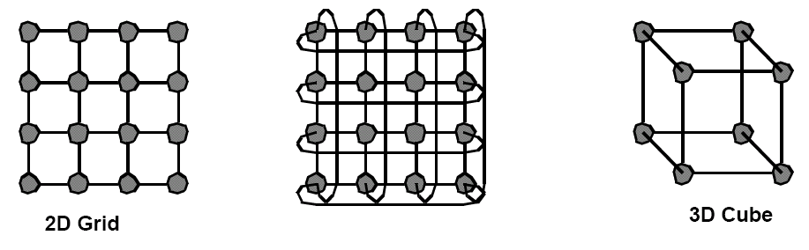
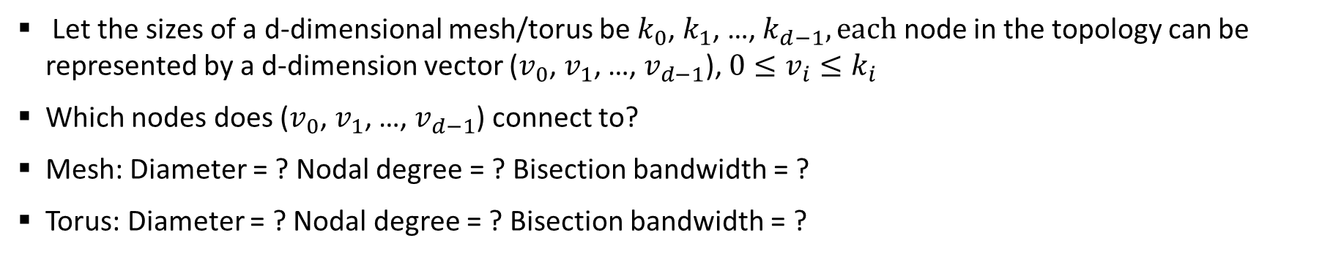
Multidimensional Meshes and Tori
2D torus
Let the sizes of a d-dimensional mesh/torus be $k_{0}$, $k_{1}$, …, $k_{d−1}, each$ node in the topology can be represented by a d-dimension vector ($v_{0}$, $v_{1}$, …, $v_{d−1}$), $0≤v_{i}≤k_{i}$
Which nodes does ($v_{0}$, $v_{1}$, …, $v_{d−1}$) connect to?
Mesh: Diameter = ? Nodal degree = ? Bisection bandwidth = ?
Torus: Diameter = ? Nodal degree = ? Bisection bandwidth = ?

Slide 20
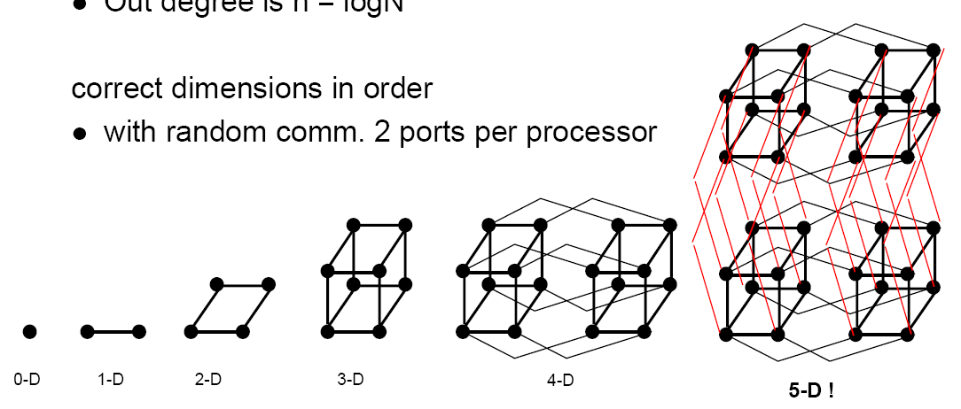
Hypercubes
010
011
110
111
000
001
100
101
Also called Binary n-cube: n dimensions, the size of each dimension is 2.
Each node is represented by a binary number.
  A link between two nodes whose binary numbers differ by 1 bit.
Diameter ? Nodal degree? Bisection bandwidth?

Slide 21
K-ary n-cube (n-dimensional, size of each dimension is k)
Generalized from hypercube (from binary (hypercube) to k-ary)
n dimensions, each dimension has k elements
Each node is identified by a n-digit k-based number.
4-ary 0-cube
4-ary 1-cube
4-ary 2-cube
4-ary 3-cube

Slide 22
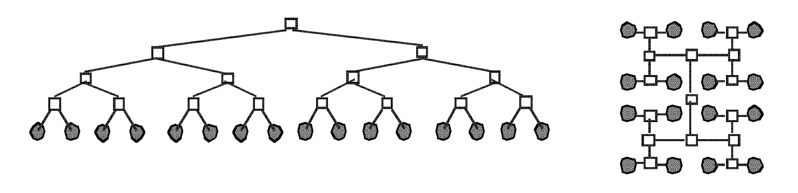
Tree
Fixed degree. Diameter? Bisection bandwidth?

Slide 23
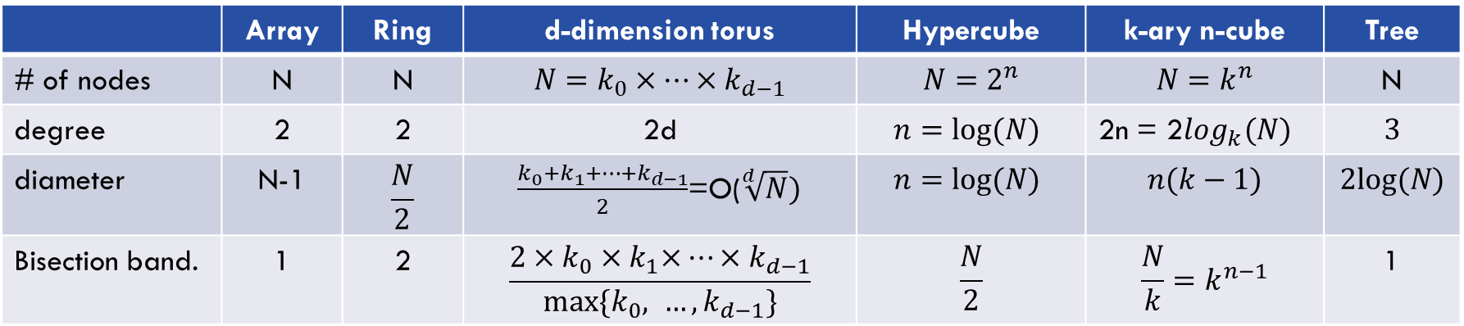
Summary
 | Array | Ring | d-dimension torus | Hypercube | k-ary n-cube | Tree
# of nodes | N | N | $$N=k_{0}×…×k_{d−1}$$ | $$N=2^{n}$$ | $$N=k^{n}$$ | N
degree | 2 | 2 | 2d | $$n=log⁡(N)$$ | 2n = 2$\log_{k}(N)$ | $$3$$
diameter | N-1 | $$\frac{N}{2}$$ | $\frac{k_{0}+k_{1}+…+k_{d−1}}{2}$=O($\sqrt[d]{N})$ | $$n=log⁡(N)$$ | $$n(k−1)$$ | $$2log⁡(N)$$
Bisection band. | 1 | 2 | $$\frac{{2×k}_{0}{×k}_{1}×…{×k}_{d−1}}{max⁡\{k_{0}, …,k_{d−1}\}}$$ | $$\frac{N}{2}$$ | $$\frac{N}{k}=k^{n−1}$$ | 1

Slide 24
Irregular topology
Irregular topology does not any special mathematic properties
  Can be expanded in any way.
  No easy way for routing: routes need to be computed like in the Internet.
    Routes can usually be determined in a regular network by using the coordinates of the source and destination.
  How to compute nodal degree, diameter, and bisection bandwidth of a irregular topology?

Slide 25
Indirect networks
Compute nodes are not directly attached to each switch, but are rather attached to the whole network.
  Using a central interconnect to connect all compute nodes
  The network emulate the cross-bar switch functionality.
  Currently dominates in data centers.

Slide 26
Fully connected network
Different organizations:
  Connected by one crossbar switch, connecting all nodes, connected with a crossbar.
All permutation communication (each node sends one message and receives one message) can be realized.

Slide 27
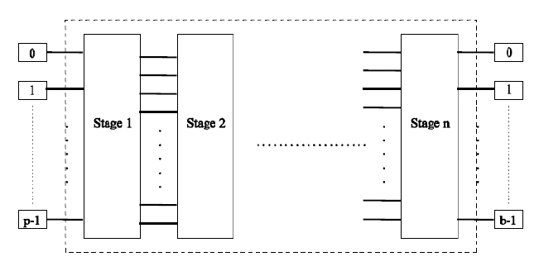
Multistage network
Try to emulate the cross-bar connection.
  Realizing permutation without blocking
  Using smaller cross-bar(2x2, 4x4) switches as the building block. Usually O(Nlg(N)) switches (lg(N) stages.

Slide 28
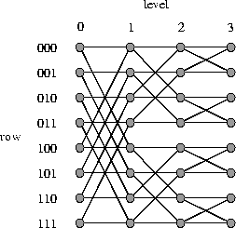
Butterfly network
Basically realize the hypercube pattern.
Nodes are numbered as binary numbers
4 stages for 8 node network:
  0-1 stage: identity + first dimension connectivity. E.g. 011-> (011, 111)
  1-2 stage: identity + second dimension connectivity connectivity. E.g. 011-> (001, 011)
  and so on.
path from 001(at level 0) to 110 (level 3)?

Slide 29
Butterfly network
path from 001(at level 0) to 110 (level 3)?
  001 -> 101 -> 111->110
Path from 000 (at level 0) to 010 (level 3)?
Butterfly network is “blocking” since cannot realize all permutations. E.g. 000->010 and 100->011.
  Notice that from a source (at level 0) to a destination (at level 3), there is a unique path.

Slide 30
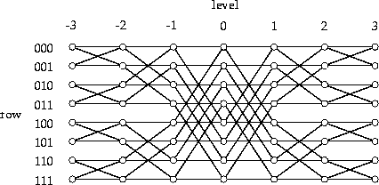
Benes network
Two copies of Butterfly networks, 2NLogN switches.
Benes network is rearrangably nonblocking – by rearranging the flows, all permutations can be realized without contention.
  This is mathematically proven in the 60s’.
  Consider 000->010 and 100->011

Slide 31
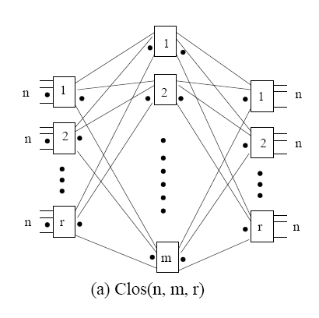
Clos network
Three stages: ingress stage, middle stage, and egress stage
  Ingress/egress stage has r n X m switches
  Middle stage has m r X r switches
  Each switch at ingress/egress stage connects to all m middle switches (one port to each switch).

Slide 32
Clos network
Theory: Clos network is strict sense non-blocking when m>=2n-1.
Strict sense non-blocking: when a new flow is added to an existing permutation, the new flow can be routed without changing existing flows.
Proof: when setting up a new flow, the source switch will at most has n-1 flows, which are routed to n-1 middle switches. Similarly, the destination switch will at most has n-1 flows. Hence, existing flows will at most use 2n-2 middle switches.

Slide 33
Fat tree
Plain tree topology has a bottleneck at the root.
Fatter links (bundling more of links together) as we go up, so bisection BW scales with N
  Not practical, root is an NxN switch

Slide 34
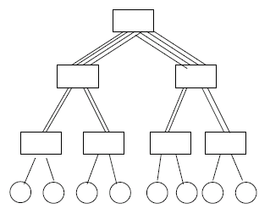
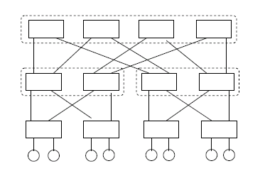
Practical Fat-tree
Use smaller switches to approximate large switches.
  Connectivity is reduced, but the topology is now implementable
  Most commodity large clusters use this topology. Also call constant bisection bandwidth network (CBB)

Slide 35
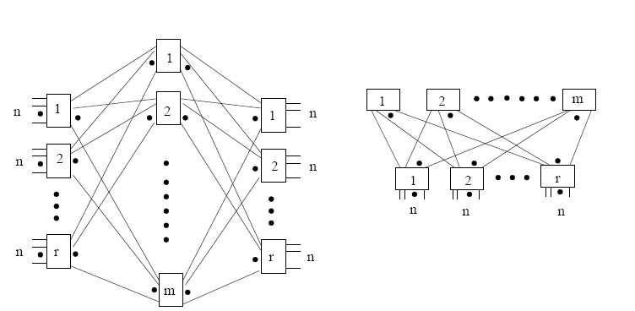
Fat-tree and Folded Clos network
A generic 2-level fat-tree (folded Clos)
A generic 3-stage Clos network

Slide 36
Recent designs
Low diameter topology with high-radix switches
  Dragonfly (diameter = 3), Slimfly (diameter = 2), Megafly, HyperX
Dragonfly topology:
  Two-level topology
  A set of a switches forming a group. A group is like a mega router.
  The switches within one group is connected by fully connected topology
  Each router is connected with p processing nodes
  Each router has h links (global links) connecting to other groups.

Slide 37
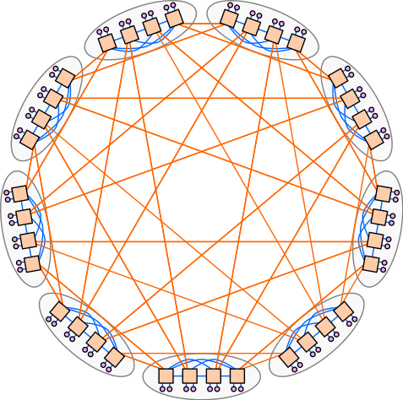
Dragonfly network
Left side shows a Dragonfly formed by 7-port switches.
  each group has 4 switches
  9 groups
What is the largest Dragonfly that can be built with 23 port switches with a group size of 12 and 6 compute nodes connecting to each switch? Each switch has 23-11-6 = 6 global links.

Slide 38
Physical constraint on topologies
Number of dimensions.
  2 or 3 dimensions
    Can be layout physically
    Short wires, easy to build
    Many hops, low bisection bandwidth
  >=4 dimensions
    Harder to build, longer wires
    Fewer hops, better bisection bandwidth
  K-ary n-cubes provide a good framework for comparison.

