Slide 1
Interconnection Networks

Slide 2
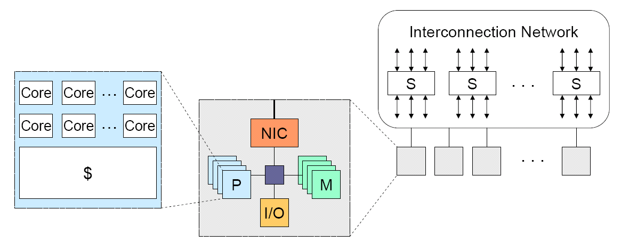
Interconnection Networks
Interconnection networks connect processors and memory elements within and across computers.
  On-chip network – connecting cores
  System/Storage area network (clusters, supercomputers, data centers)
  Local area network
  Wide area network

Slide 3
Interconnection network components
Network interface (card)
  Communication between a node and the network
Link
  Bundle of wires and fibers that carry signals
Switches (routers)
  Connects a fixed number of input channels to a fixed number of output channels.
  In the HPC community, switches also have the router functions.

Slide 4
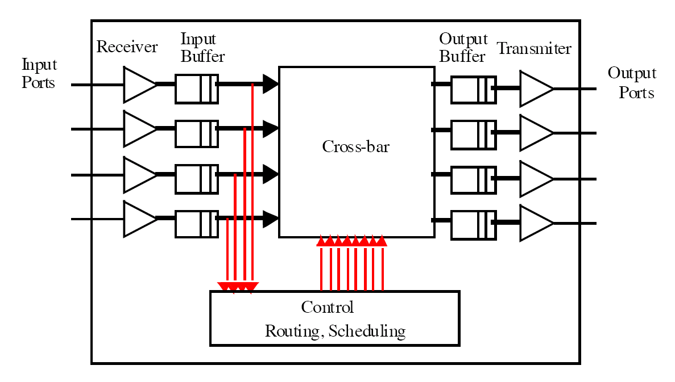
Internal of a Switch
Input data need to be moved to the output ports asap in a switch. Input and output buffers.
The CRS module takes the input information and decides the setting of the cross-bar
The cross-bar can realize a communication from any input port to any output port.

Slide 5
Crossbar can realize any permutation from input to output.
i
n
p
u
t
1
1
1
2
2
2
3
3
3
4
4
4
1
2
3
4
1
2
3
4
1
2
3
4
output
(1,2, 3, 4)->
(3, 1, 2, 4)
(1,2,3,4)->
(4,3,2,1)
A 4x4 cross-bar
Permutation: A communication pattern where each source happens once, each destination happens once. For example: (1, 2, 3, 4) -> (3, 1, 2, 4)

Slide 6
Network architecture
An interconnect consists of NICs, links, and switches(routers).
Network architecture consists of
  Topology (what): how to connect the nodes with links?
  Routing (which): which path a packet will go through?
  Switching (how): how a packet goes through a path (routers)?
  Flow control (when): when can a packet go through a router?

Slide 7
Network topology (what): how the nodes are connected with links?

Slide 8
Routing (which): which path to use?

Slide 9

Flow control (when): when can a packet go through a router?

Slide 10
Switching (how): how a packet goes through a switch
Cut-through switching
Store and forward switching

Slide 11
What makes network design challenging?
Distributed control: network resources are distributed
  Impractical to maintain a global network state view
Traffic is usually changing and unpredictable
Network resources are shared by all.
  Each link is not able to support all traffic that may use the link – a link can easy become a bottleneck when the control makes wrong choices.
Performance metrics: latency and bandwidth
  In any situation, the network must do well in these two metrics.

Slide 12
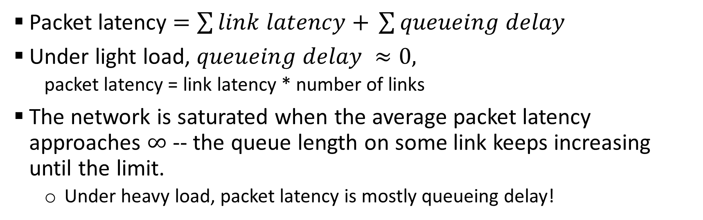
Performance metric: packet latency
Packet latency $=\sum{link latency+ }\sum{queueing delay}$
Under light load, $queueing delay ≈0,$
  packet latency = link latency * number of links
The network is saturated when the average packet latency approaches $∞$ -- the queue length on some link keeps increasing until the limit.
  Under heavy load, packet latency is mostly queueing delay!

Slide 13
Performance: Network offered load .vs. average package latency
Average package latency
Offered load (packet generation rate)
Packet latency grows very slowly at low loads, but very fast when the network is
about to saturate.

Slide 14
Performance: Network offered load .vs. average package latency
Minimal latency
bounded by topology
and routing and flow
control
Average package latency
Minimal latency
bounded by topology
and routing
Minimal latency
bounded by topology
Offered load (packet generation rate)

Slide 15
Performance: Network offered load .vs. average package latency
Max throughput
bounded by topology
and routing and flow
control
Average package latency
Max throughput
bounded by topology
and routing
Max throughput
bounded by topology
Offered load (packet generation rate)

Slide 16
Estimating the network performance
Given a traffic pattern, we often can estimate the latency under light load and throughput under heavy load.
Estimate low load latency: Given the traffic pattern, compute the average hop count.
Let the latency for each link be 100ns in the following topology, for the random uniform traffic (for each packet, the source and the dest ination are random uniformly selected from all nodes), what is the lower bound for latency?
1
2
3
4
5

Slide 17
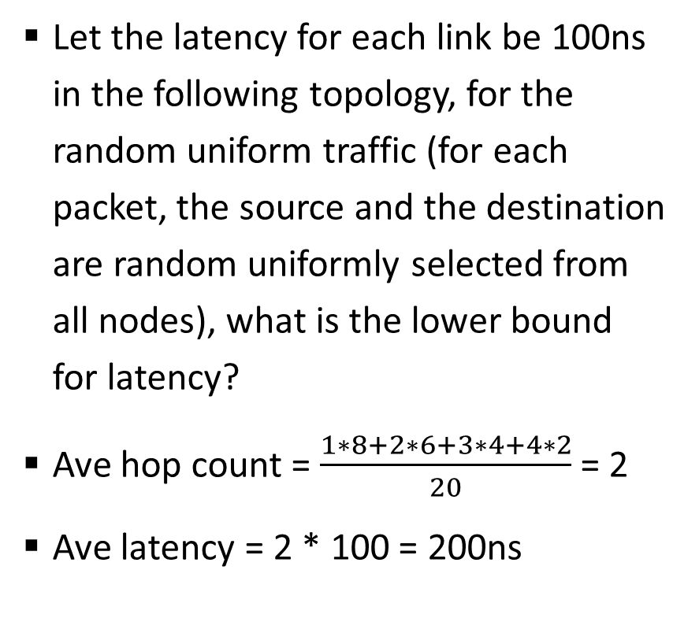
Estimating the network performance
Let the latency for each link be 100ns in the following topology, for the random uniform traffic (for each packet, the source and the destination are random uniformly selected from all nodes), what is the lower bound for latency?
Ave hop count = $\frac{1∗8+2∗6+3∗4+4∗2}{20}$ = 2
Ave latency = 2 * 100 = 200ns
Hop count for each pair of node
 | n1 | n2 | n3 | n4 | n5
n1 | - | 1 | 2 | 3 | 4
n2 | 1 | - | 1 | 2 | 3
n3 | 2 | 1 | - | 1 | 2
n4 | 3 | 2 | 1 | - | 1
n5 | 4 | 3 | 2 | 1 | -
1
2
3
4
5

Slide 18
Estimating the network performance
Let each link have a bandwidth of 1 (transferring 1 packet in 1 cycle of time), for the random uniform traffic (for each packet, the source and the dest ination are random uniformly selected from all nodes), what is the upper bound for aggregate saturated throughput?
  The network is saturated when some link cannot handle its traffic.
  To find out the saturated throughput, we need to find maximum link load
    Under uniform traffic, the link used by the most communication (source-destination pair) will have the highest load
    Which link in the topology will have a higher load then others?
1
2
3
4
5

Slide 19
Estimating the network performance
Eight links in the topology (1, 2), (2, 3), (3, 4), (4, 5), (2, 1), (3, 2), (4, 3), (5, 4)
(1, 2), (2, 3), (3, 4), (4, 5) and (2, 1), (3, 2), (4, 3), (5, 4) are symmetrical, so we only need to consider (1, 2), (2, 3), (3, 4), (4, 5) to determine the largest link load
  (1 , 2) and (4, 5), each is used by 4 communications, (2, 3) and (3, 4), each is used by 6.
  Let the maximum per node generation rate be X per cycle. Each cycle 5*X packets are generated. The change for each packet to use link (2, 3) is 6/20. So 5*x * 6/20 <= 1, X<=2/3.
  The upper bound of average per node throughput is 2/3.
1
2
3
4
5

