Slide 1

March 2022
An In-Depth Analysis of the Slingshot Interconnect.
1
1
2
Daniele De Sensi , Salvatore Di Girolamo , Kim McMahon , Duncan Roweth and Torsten Hoefler
1. ETH Zurich, Switzerland
2.HPE Cray
2
1
Notes:
Good Morning everyone, I am Saptarshi Bhowmik, Today I am going to talk about our work "A Simulation study of ...". This work was done by me and my advisor Xin Yuan and my mentors Nikhil Jain and Abhinav Bhatele.

Slide 2

March 2022
Motivation
Slingshot Topology
Dragonfly Topology
High-Radix Switches
Low-Diameter Topology
Experimental Setup
Contributions and Results
Congestion Control
Adaptive Routing
Quality of Service
Conclusion
Overview

Slide 3
March 2022
Motivation
HPC and datacenter communities are following a path towards convergence of HPC, data centers, and AI/ML workload.
Due to the wide adoption of Ethernet in Data-Centers, interconnection networks should be compatible with standard Ethernet.
Slingshot

Slide 4
March 2022
Ethernet Enhancements
Reduced the 64 Bytes minimum frame size to 32 Bytes.
Allowed IP packets to be sent without an Ethernet header.
Removed the inter-packet gap.
Implemented low-latency Forward Error Correction (FEC), Link-Level Reliability (LLR) to tolerate transient errors.

Slide 5
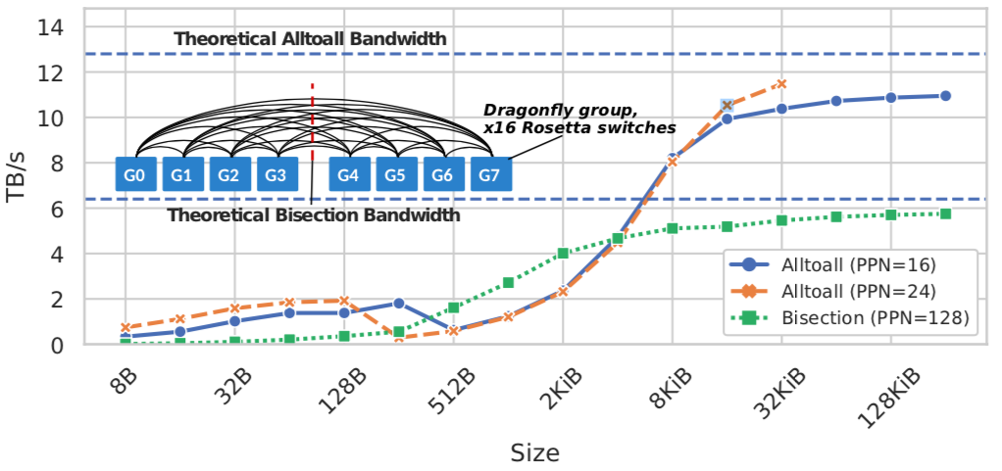
March 2022
Ethernet Enhancements
Can process both STANDARD and ENHANCED ethernet.
Bisection and MPI_Alltoall bandwidth on all the 1024 nodes of SHANDY, for different processes per node (PPN) and message sizes. The x-axis is in logarithmic scale.

Slide 6
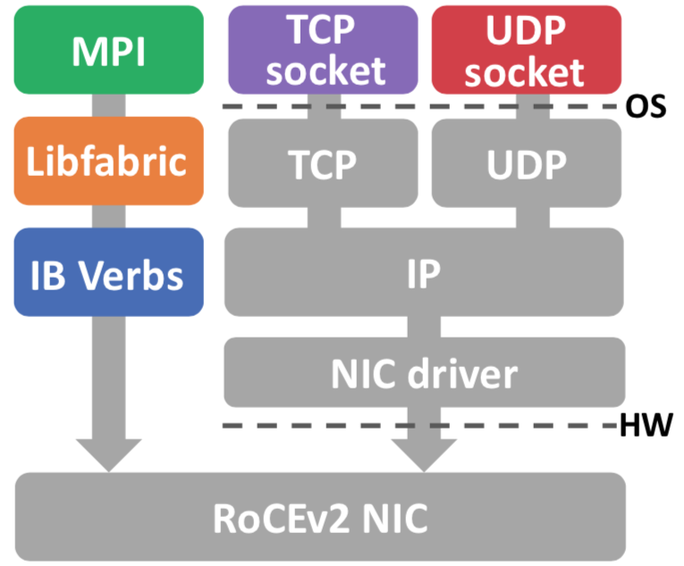
March 2022
Software Stack
Software Stack of RoCEV2

Slide 7
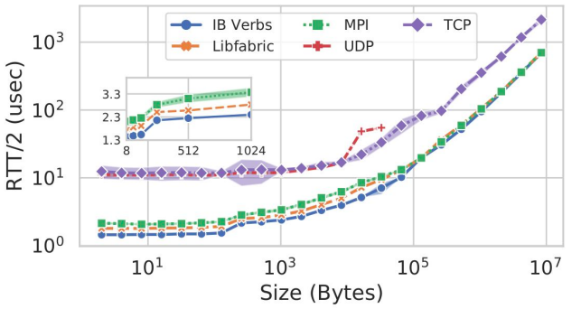
March 2022
Software Stack
Half round trip time (RTT/2) for different message sizes (x-axis) and software layers.

Slide 8
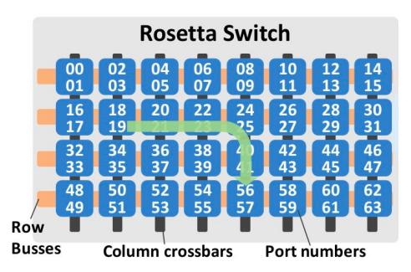
March 2022
Switch Rosetta
64 X 200 Gb/s ports
32 Tiles

Slide 9
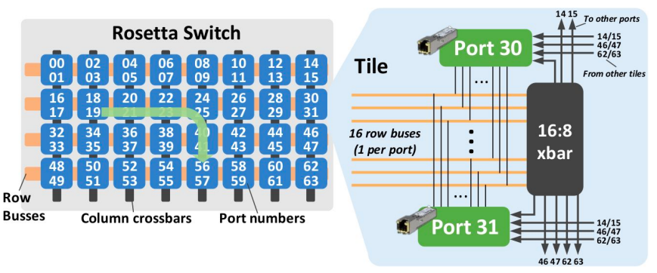
March 2022
Switch Rosetta

Slide 10
March 2022
Dragonfly Topology - Intra Group
In a 1D Dragonfly,
there is an all-to-all
connection between
the routers
R0
R1
R3
R2

Slide 11
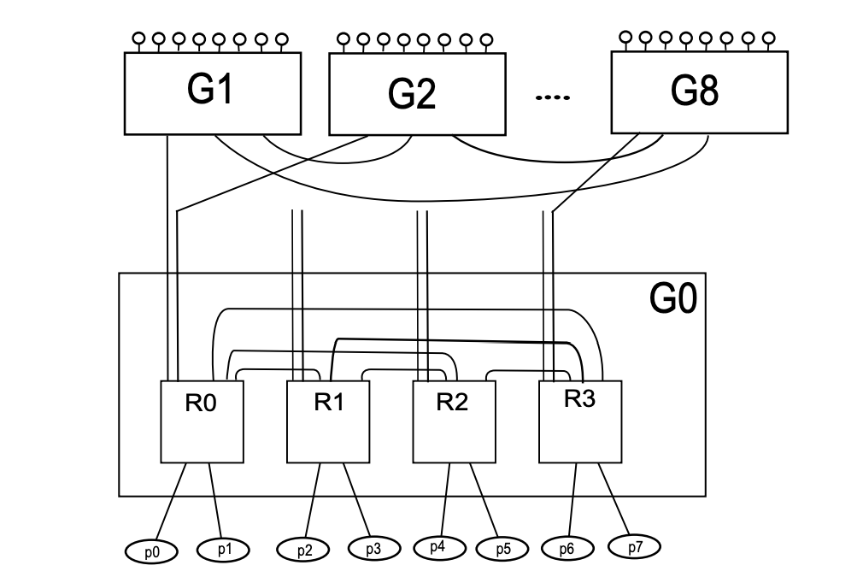
March 2022
Dragonfly Topology - Full Connectivity
p = Number of compute nodes
g = Number of groups
a = Number of routers per group
h = Number of global links per router
g = (a X h) + 1

Slide 12
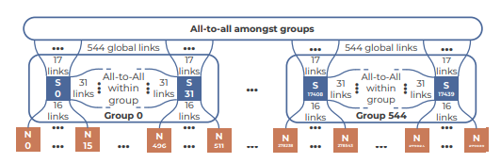
March 2022
Slingshot Topology
Dragonfly is the default topology
64 ports each switch
  16 nodes
  31 other switch intra
  17 global link inter
32 switch X 16 nodes =512 per group
17 links X 32 sw = 544 other
512 X 545 = 279K
Currently 4608 nodes

Slide 13
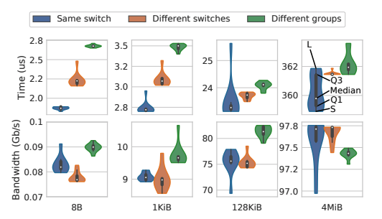
March 2022
Slingshot Topology, Latency & Bandwidth
40% node allocation impact on latency on 8B
After 16KiB < 10%
Bandwidth holds same
We sometimes observe higher bandwidth in two different groups

Slide 14
March 2022
Slingshot Routing
Minimal
Non-minimal
Adaptive

Slide 15
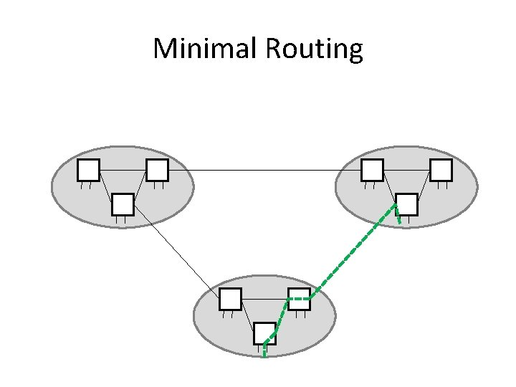
March 2022
Slingshot Routing
Minimal
Non-minimal
Adaptive

Slide 16
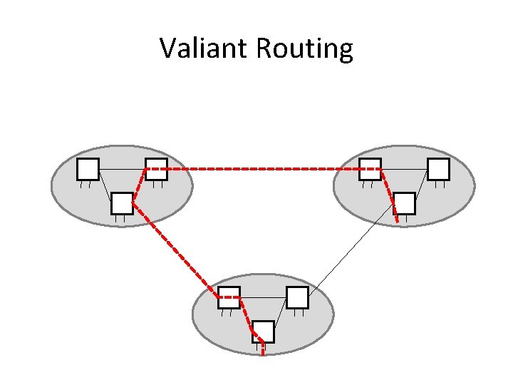
March 2022
Slingshot Routing
Minimal
Non-minimal
Adaptive

Slide 17
March 2022
Slingshot Routing
Minimal
Non-minimal
Adaptive
  Estimates 4 minimal and 4 non-minimal paths
  Path congestion and length
    Queue depth of ports
  Congestion information share
    4B
  Non-minimal path
    Hop-count and latency increase
    Bias towards minimal increase

Slide 18
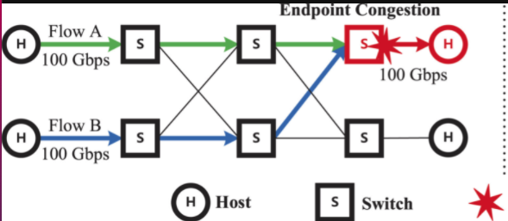
March 2022
Slingshot Congestion Control
Endpoint congestion

Slide 19
March 2022
Slingshot Congestion Control
Endpoint congestion
Existing:
Mark packet
Receive and ask sender to slow
Takes much time to adapt

Slide 20

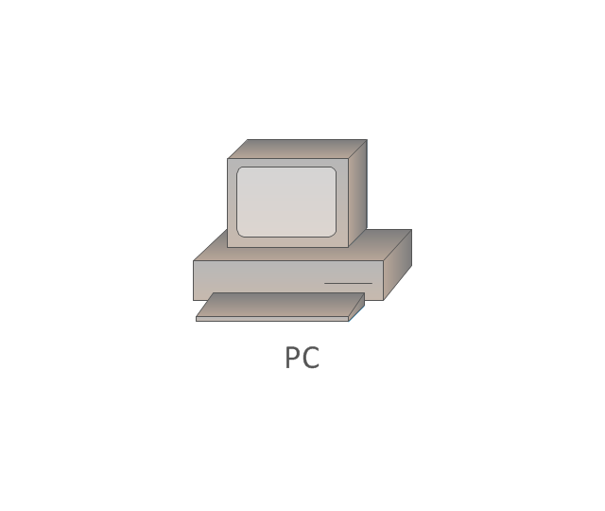
March 2022
Slingshot Congestion Control
Intermediate congestion
All paths are affected

Slide 21
March 2022
Slingshot Congestion Control
Solution:
Adaptive can bypass intermediate but not endpoint
Algorithm in hardware
Distinguish victim and contributor jobs
  By tracking all endpoint pair
  Throttle contributor stream immediately

Slide 22
March 2022
Experimental Setup
CRYSTAL:
Cray ARIES interconnect with 698 nodes.
CPUs on the nodes are Intel Xeon E5-269x.
2 groups, each containing at most 384 nodes.
MALBEC:
A SLINGSHOT system with 484 nodes.
CPUs on the nodes are either Intel Xeon Gold 61xx or Intel Xeon Platinum 81xx CPUs.
4 groups, each containing at most 128 nodes.
Each group is connected to each other group through 48 global links operating at 200Gb/s each
SHANDY:
A SLINGSHOT system with 1024 nodes.
CPUs on nodes are AMD EPYC Rome.
8 groups, each containing 128 nodes.
Each group is connected to each other group through 56 global links operating at 200Gb/s.

Slide 23
March 2022
Congestion Control
Victim node and aggressor nodes
  End point and intermediate congestion pattern
    GPCNet code
    Many-to-one (incast)
    All-to-all
    10^5 bytes avg message size
Impact of congestion
  MPI operation
  Ember microbenchmark
  MILC, HPCG, FFT
  Silo,Xapian,Img-dnn

Slide 24
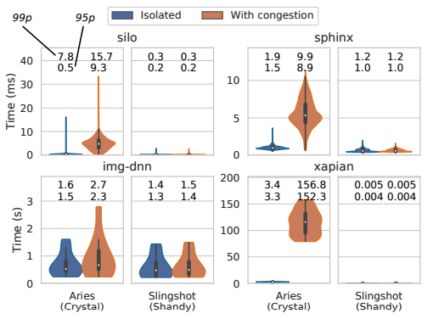
March 2022
Congestion Control
Victim aggressor split
  460/52,256.256,53/459
Allocation placement
  Linear, interleaved,random
Tailbench application
  Linear allocation
  10/90 victim/aggressor

Slide 25
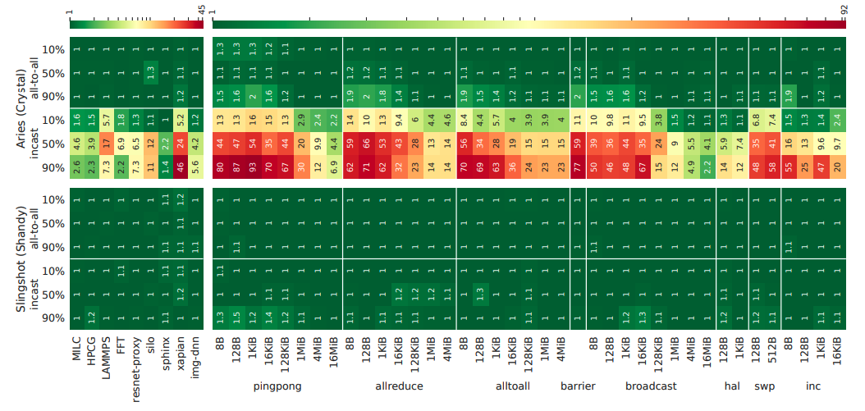
March 2022
Congestion Control

Slide 26
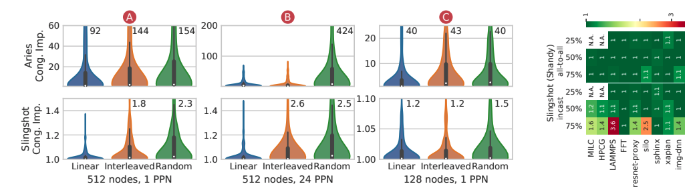
March 2022
Congestion Impact - 512 Nodes
Fig: Linear, interleaved and random allocation of nodes
A: aggressors are using 1
B: aggressors are using 24 processes per node (PPN); higher work load
Right fig: Shandy 1024 node, random allocation for worst case

Slide 27
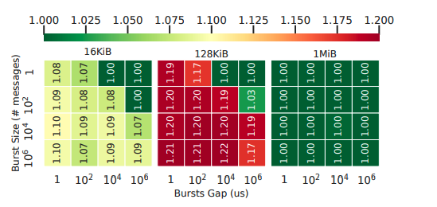
March 2022
Congestion Impact - 512 Nodes
Impact of incast congestion on a 128 byte MPI_Alltoall.
Small messages do not generate enough congestion
Large messages the congestion control algorithm and throttle the aggressor
Medium message size takes some time to be reacted by congestion control algo

Slide 28
March 2022
Quality of Service
Each traffic class occupies hardware resources in the switches
Tunable priority, ordering, minimum/maximum bandwidth, …
Jobs can be assigned to a small number traffic classes
Traffic class can be changed on a per-packet basis

Slide 29
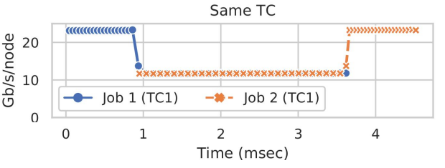
March 2022
Quality of Service Tests
25% bandwidth tapering.
2 jobs running bisection bandwidth tests.
TC1: 80% minimum bandwidth.
TC2: 10% minimum bandwidth.

Slide 30
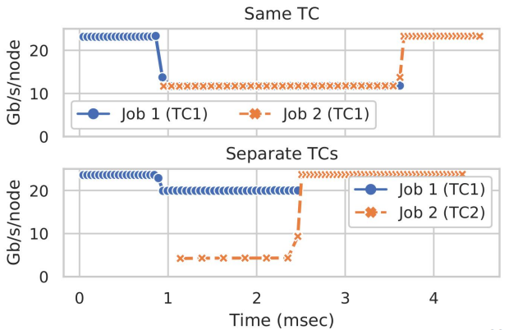
March 2022
Quality of Service Tests
25% bandwidth tapering.
2 jobs running bisection bandwidth tests.
TC1: 80% minimum bandwidth.
TC2: 10% minimum bandwidth.

Slide 31
March 2022
Conclusions
Much less affected by congestion compared to previous generation networks
Allocation policies have a much lower impact on performance on SLINGSHOT
SLINGSHOT can provide bandwidth guarantees to jobs running in separate traffic classes

Slide 32
March 2022
Thank You

