Slide 1
Security issues in Parallel and Distributed Computing - Side channel attacks and defenses
Presented by:
Kazi Mejbaul Islam

Slide 2
Outline
Introduction and Background
  Microarchitecture
  Cache hierarchy
  Side channels in microarchitecture
Threats in parallel and distributed systems
Popular Side Channel Attacks
  An example
Popular Defense Mechanisms
  From Software’s perspective
  From Hardware’s perspective

Slide 3

Introduction
Hardware can not always be trusted!
Features that enhance the architecture, may be the cause of vulnerability
ISA
Registers
Memory
Architecture
Microarchitecture
Branch Prediction
Cache
TLB
CacheMMU
Interconnection

Slide 4
Introduction
Several threats have been created using these features such as
  Stealing secret encryption key
  Tracking browser activity
  Keystroke sniffing etc.
We will discuss these issues and defenses from cache’s perspective

Slide 5
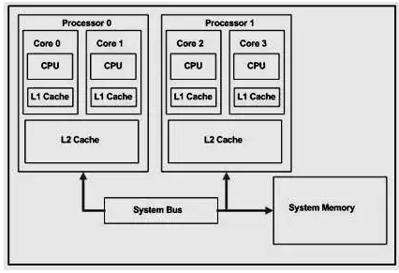
Background
Cache architecture in Multicore Systems
Figure 1. A dual-core dual-processor system

Slide 6
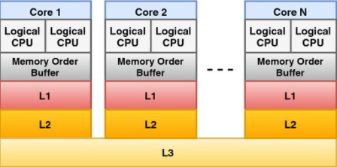
Background
Cache Hierarchy
Hit/Miss
Figure 2. Multi-level chache

Slide 7
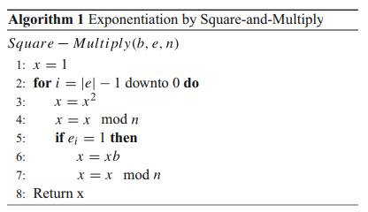
Background
Encryption (RSA)
RSA encryption contains c, m, e, and n represent ciphertext, plaintext, key, and the product of p and q (p, q are large prime numbers), respectively and calculates c using following equation:
c ≡ m^{e} mod n
How do we calculate c efficiently?

Slide 8
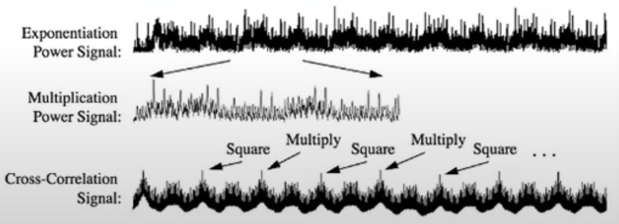
Background
Side Channels
Channels/mediums those are not meant to be information exchange
Unlike covert channel, the victim is unconscious about the attacker.
For example: Cache, TLB, power consumption
Figure 3: Power consumption pattern

Slide 9
Threats in Distributed Systems
To make computation systems massively parallel, current systems are:
  Multiprocessor
  Multicore
  Maintaining cache hierarchy
To support multiple users simultaneously, Clouds today supports lots of VMs, containers co-locate on single architecture

Slide 10
Threats in Distributed Systems
Attacks can take place at:
  Cross VM
  Cross container
  In same OS among different processes

Slide 11
Popular Side Channel Attacks
Side channel attacks can be divided into two major types:
Time Driven: In time-driven attacks, the attacker measures the total execution time of cryptographic operations to extract sensitive information
Access Driven: Attacker probes the medium to infer the execution time and pattern

Slide 12
Flush+Reload
Consists of 3 steps:
Flushes the cache
Waits for the victim to run its program
Probes the cache for specific instruction/data

Slide 13
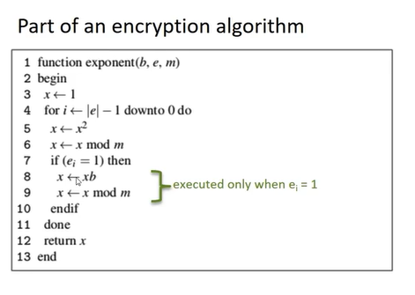
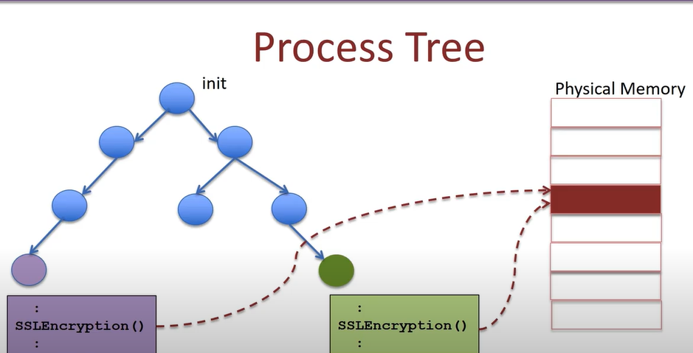
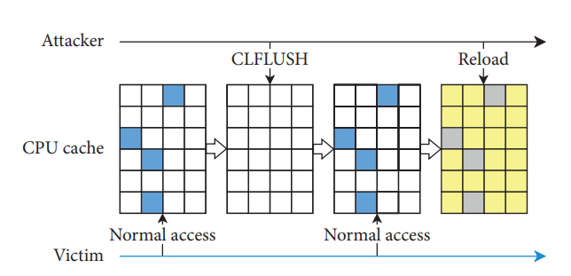
Flush+Reload
Figure 6: RSA encryption
Figure 5: Flush+Reload
Figure 7: Flush+Reload time flow

Slide 14
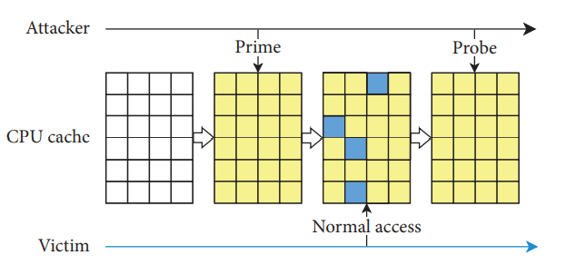
Prime+Probe
Fills all cache line with own data
Waits for victim process to get allocated and being evicted
Probes the access time taken by the victim
Figure 8: Prime+Probe

Slide 15
Example (Flush+Reload) Side-Channel Attacks on Everyday Applications by Taylor Hornby, University of Calgary
Consider a scenario where Victim is going to search for pen, pencil or marker in Wikipedia.
The Attacker knows that the Victim is going to search on Wikipedia and he has a list of words that the victim is going to search such as (pen, pencil, box, book, etc.)
Step 1: Find the common functions that can be used to distinguish the word while searching
  Search each word in the list
  Record the pattern for each word.
Suppose you have found A,B,C,D four functions.

Slide 16
Example (Flush+Reload)
The data for the attacker may look like this:
Pen: AABBCDADA…
Pencil: BCDAACCBD…
Box: CDACDAAADCB….

Slide 17
Example (Flush+Reload)
Step 2: Launch the attack
Load the program
Flush the cache
Reload A,B,C,D and record time to load
  If it is a hit, note that
  If it is a miss, omit
Flush again

Slide 18
Example (Flush+Reload)
Step 3: Match with the fist recorded data
The attacker will get a string like: AABCDAADCBA….
Using statistical algorithm or machine learning (authors have used Levenshtein distance)

Slide 19
Defense mechanism
How do you defend it?
Attack detection
Soft partitioning
Page coloring
Restricting fine grained time measurement
Disallowing KSM
Software measures
Designing new cache
Cache partition
Attack detection
Hardware measures

Slide 20
Attack Detection
Monitor hit/miss, clock cycle, branch miss etc.
Use machine learning/statistical methods to classify suspicious pattern
Able to detect flush+reload and prime+probe
Some researchers offloaded the detection system to dedicated hardware
Cons:
Requires some iterations to get data, attacker might be able to launch attack before detection
Resource expensive for some applications

Slide 21
Constant Timing
Modify the code to make the execution time abstract
  For example, in the RSA encryption, insert a condition for bit 0 and a constant time for both 1 and 0 bit.
It makes timing information abstract
Cons:
Not possible to implement in all cases
Creates performance overhead

Slide 22
Restricting Fine-Grained Time Measurements
As the attacker relies on timing information and it needs to be fine-grained, kernel can limit the time measurement
Cons:
Measuring time at high precision is used in many softwares and making these obsolete is not a practical idea.

Slide 23
Page coloring
Software mechanism to partition cache
Color the memory pages and pages of same color can be mapped into the same cache set
Cons:
Not very efficient for VM. Being inherently coarse-grained it may lead performance degradation.

Slide 24
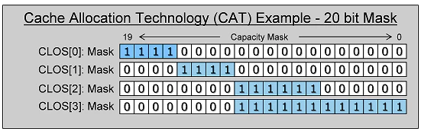
The Intel Cache Allocation Technology
CLOS refers to one Class of Service
Programs/VMs/Cores can be associated to a CLOS
Program from one CLOS can not evict cache line from other CLOS
Programs can get hit from all cache
Figure 9: Sample CAT bitmask

Slide 25
Soft-partitioning Cache
It is unnecessary to isolate all programs or VMs
A small portion of cache can be declared as dedicated to security sensitive applications
This approach can be taken from both software and hardware side

Slide 26
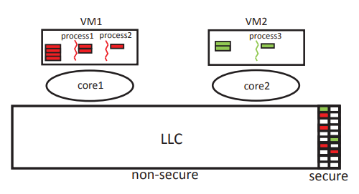
CATalyst
Partition cache using CAT
Use one small partition for security sensitive tasks
Figure 10: CATalys

Slide 27
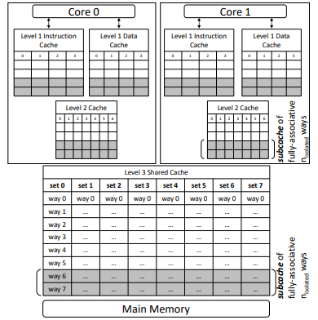
HybCache
Fix last two ways for security intensive task
This isolation is used for all L1, L2 and L3 cache
Figure 11: HybCache architecture

Slide 28
Trade-off between hardware and software approach
Defense mechanisms from software side can be implemented quickly to secure almost all systems
Hardware approaches are more efficient but it would take a long time to be used in practice
Moreover, hardware approaches would not be able to secure the existing systems

Slide 29
Conclusion
Side channel attacks are practical for distributed systems and must be taken care of.
Based on the defense mechanisms proposed by the researchers, we can conclude, a practical defense system should have:
  Good security
  Low performance overhead
  Able to secure existing system

Slide 30
Question?

