Slide 1

CUDA Unified memory
By: Jack Splaine and Luiz Hosfeld

Slide 2
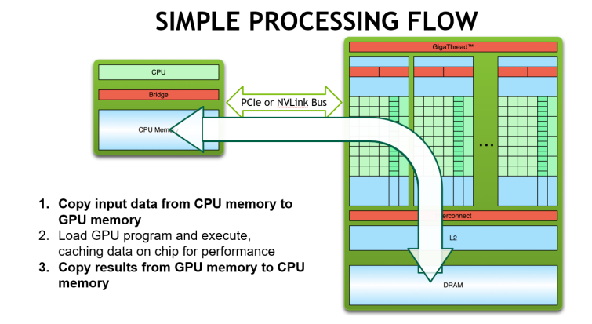
How memory normally works

Slide 3
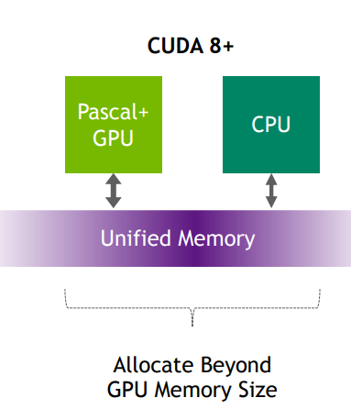
How unified memory works

Slide 4
Unified memory commands
Very simple to use
Replace typical memory commands with CUDA commands
  malloc() and new → cudaMallocManaged()
  free() and delete → cudaFree()

Slide 5
Unified memory commands
cudaMemcpy() copied data between the host and device, not used in UM, but used in CUDA
  Can use flags cudaMemcpyHostToHost, cudaMemcpyHostToDevice, cudaMemcpyDeviceToHost,and cudaMemcpyDeviceToDevice
cudaMemPrefetchAsync() prefetches memory to specified device, replaces cudaMemcpy for UM
cudaDeviceSynchronize() blocks process till all previous tasks are completed, CUDA 11.6+ this is done automatically
cudaMemAdvise() advises the system of expected memory access behaviors using a cudaMemoryAdvise advice variable

Slide 6
Memory Advice
cudaMemAdviseSetReadMostly – Informs the UM system that the data will is largely going to be read and rarely written to. Causes most pages of memory to be read only unless a write attempt is made.
  Undone by cudaMemAdviseUnsetReadMostly
cudaMemAdviseSetPreferredLocation – Informs the system where to store memory belonging to the device the advice will apply to.
  Undone by cudaMemAdvisUnsetPreferredLocation
cudaMemAdviseSetAccessedBy – Informs the system that the data is intended to only be accessed by a specified device
  Undone by cudaMemAdviseUnsetAccessedBy

Slide 7
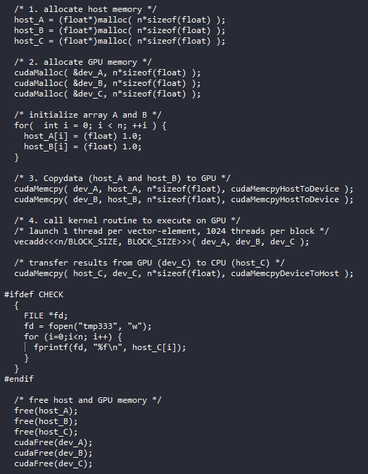
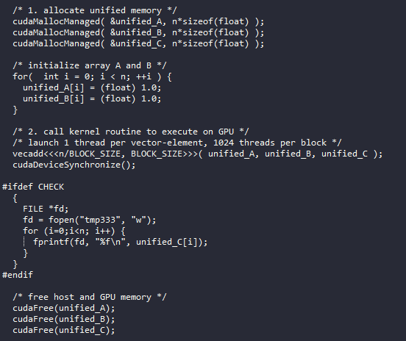
Vector Addition w/ Unified Memory

Slide 8
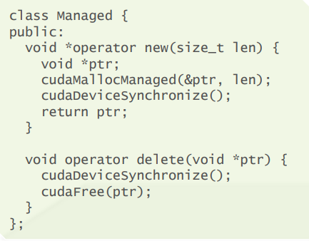
C++ Object Overloading
You can overload the new and delete keywords in C++ to use the UM commands, this way you don’t have to use the commands every time you create an object

Slide 9
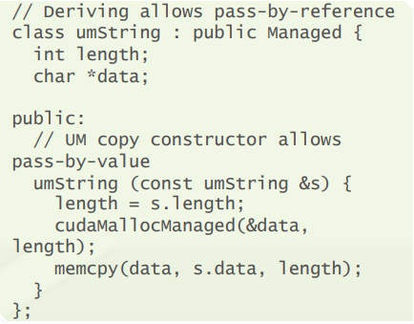
C++ Object Overloading

