Slide 1

Architecture and Performance Studies of 3D-Hyper-FleX-LION for Reconfigurable All-to-All HPC Networks
March 2022
Authors: Liu, Gengchen, et al.
University of California, Davis

Slide 2
Outline
March 2022
I. Motivation
II. 3D-HYPER-FLEX-LION NETWORK
  A. Overview of the 3D-HYPER-FLEX-LION Network.
    1) Wavelength Division Multiplexing
    2) LIONS: Arrayed Waveguide Grating Router(AWGR) for All-to-All Interconnection
    3) Flex-LIONS for optical bandwidth reconfiguration
  B. Architecture Design
    1) 3D-Hyper-FleX-LION Architectural design
    2) Fat-Tree architecture
    3) Comparison between Fat-Tree and 3D-Hyper-FleX-LION architecture
  C. Packet Routing Algorithm
  D. Scheduling of Optical Reconfiguration
II. SYSTEM MODELLING AND EVALUATION
  A. Methodology
  B. System-Scale Results
III. Conclusions
OUTLINE

Slide 3
Motivation
March 2022
The principle components of topology design depends upon radix of switches.
Since switches have limited number of ports, hierarchy of cascaded switches are used to achieve interconnectivity of tens of thousands of servers.
Cascaded switches introduces multi-hop topologies directly impact the main challenge, which is to provide low zero-load latency, particularly as the network size increases.

Slide 4
Motivation
March 2022
Another challenge in interconnect is energy efficiency.
As switch port data rates continue to increase (from 40 Gb/s to 100 Gb/s and beyond ) the energy-efficiency of the electronics substantially degrades at such high data rates.
Today’s data centers are already consuming megawatts of power.

Slide 5
Motivation
March 2022
Efficient use of network bandwidth is one of the critical aspect in HPC interconnect.
Communication patterns between compute nodes are not always uniform, we can have low link-utilization computing-intense phase and high link-utilization communication-intense phase.
It is challenging to simultaneously provide sufficient bandwidth for high-communication phases without wasting energy in low utilization phases
Unfortunately, electronic switches have fixed bandwidth which prevents adapting the link bandwidth to current communication demands
S
S
D
D

Slide 6
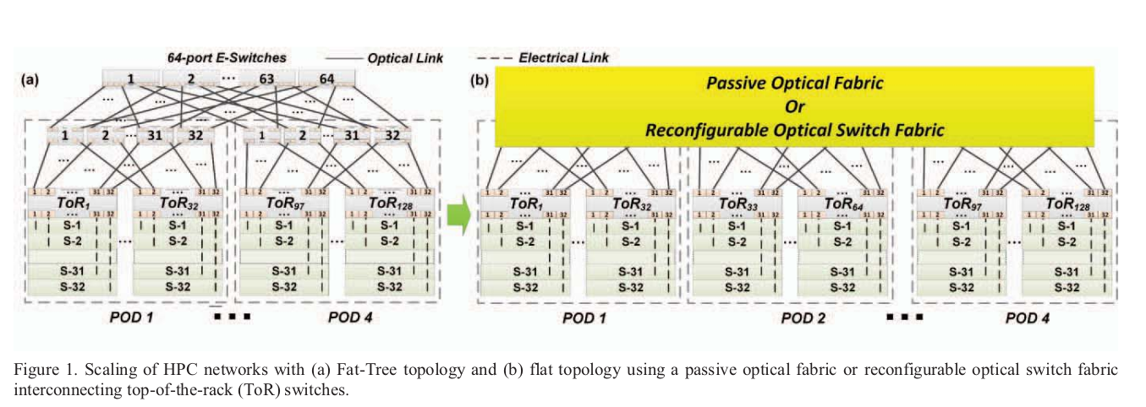
Approach
March 2022
Using routers based on Optical wavelength division multiplexing (WDM).
Optical wavelength division multiplexing (WDM) is making substantial improvement on datacom using optical transceivers (TRXs) with coarse wavelength division multiplexing (CWDM).
And as Silicon-photonic technologies are becoming commercially viable.
There are now opportunities to re-architect these networks leveraging photonic technologies.

Slide 7
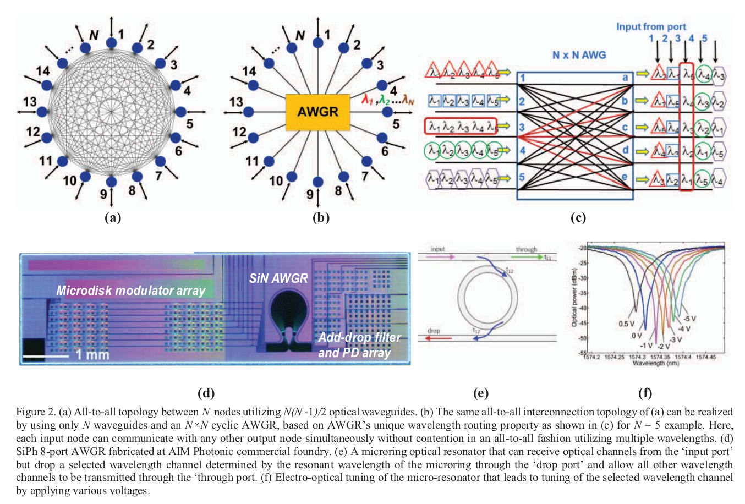
Overview of the 3D-HYPER-FLEX-LION Network
March 2022
Figure: All-to-all topology between N nodes.
Normal all-to-all topology between N nodes requires N(N -1)/2 wires.
The same all-to-all interconnection topology of can be realized by using only N waveguides with an N×N cyclic AWGR

Slide 8
Overview of the 3D-HYPER-FLEX-LION Network
March 2022
Figure: All-to-all topology between N nodes.
Good enough for Uniform Traffic Pattern.
But for non-uniform traffic pattern what type of topology should we use?

Slide 9
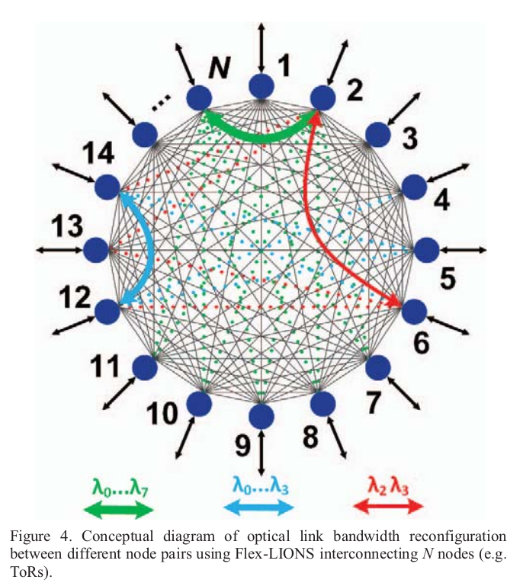
Overview of the 3D-HYPER-FLEX-LION Network
March 2022
(b)
Bandwidth reconfiguration is needed.
How to reconfigure?

Slide 10
Overview of the 3D-HYPER-FLEX-LION Network
March 2022
(b)
How to reconfigure?
Bandwidth reconfiguration is needed.
Here comes optical switching

Slide 11
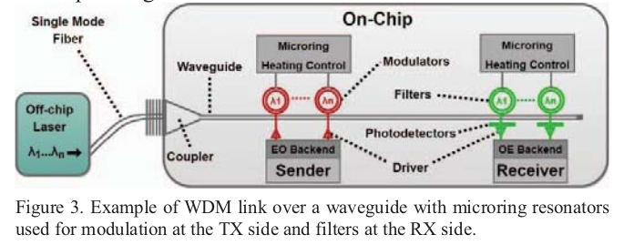
Wavelength Division Multiplexing
Overview of the 3D-HYPER-FLEX-LION Network
March 2022
WDM is gradually penetrating the datacom market with commercial TRX products for 100 Gb/s, 200 Gb/s and 400 Gb/s using CWDM with four to eight wavelengths in O band (1310 nm) modulated with nonreturn-to-zero (NRZ) or 4-level pulse amplitude modulation (PAM4) formats at a baud rate of 25 GBd .

Slide 12
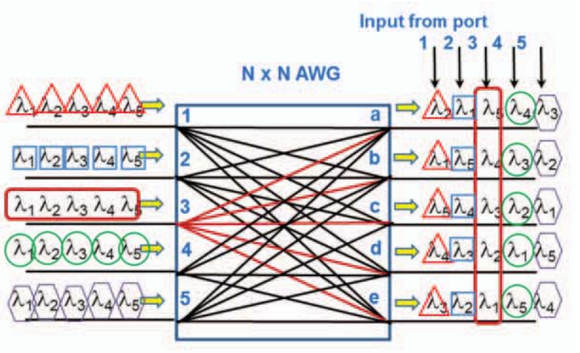
Wavelength Routing Property of an AWGR
Overview of the 3D-HYPER-FLEX-LION Network
March 2022

Slide 13
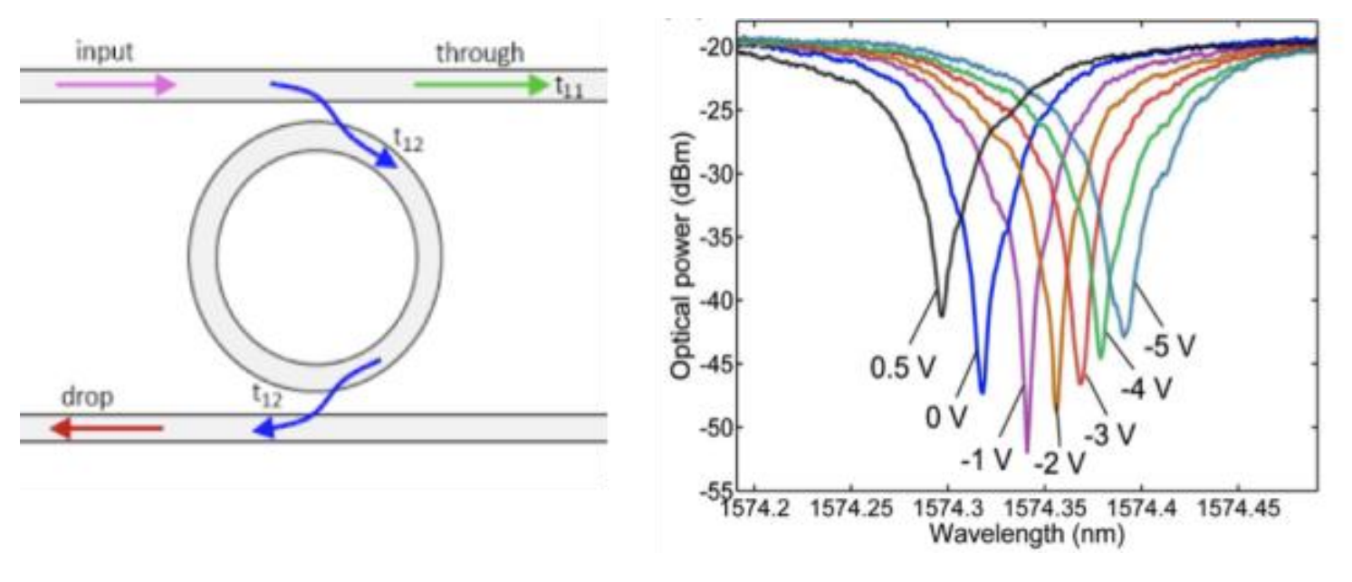
Flex-LIONS for optical bandwidth reconfiguration
Overview of the 3D-HYPER-FLEX-LION Network
March 2022
Fig: Optical Microring Resonator(MRR)
MRR can receive optical channels from the ‘input port’ but drop a selected wavelength channel determined by the resonant wavelength of the microring through the ‘drop port’ and allow all other wavelength channels to be
transmitted through the ‘through port.

Slide 14
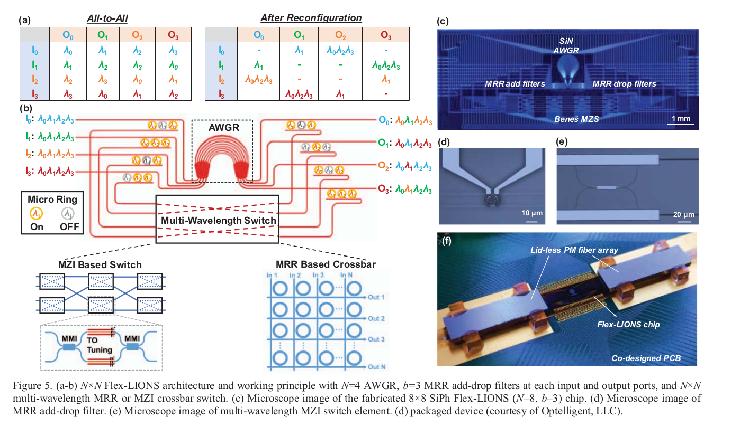
Flex-LIONS for optical bandwidth reconfiguration
Overview of the 3D-HYPER-FLEX-LION Network
March 2022

Slide 15
3D-Hyper-FleX-LION Architectural design
March 2022
Architecture Design
These optical switches are buffer less (no buffering operation at the switch input and output ports) and therefore cannot be cascaded.
Thus, they could be either used as core switches in folded-CLOS type of architectures (i.e., Fat Tree) or they could be used in directly connected architectures, e.g., Torus, Flattened Butterfly, or Dragonfly

Slide 16
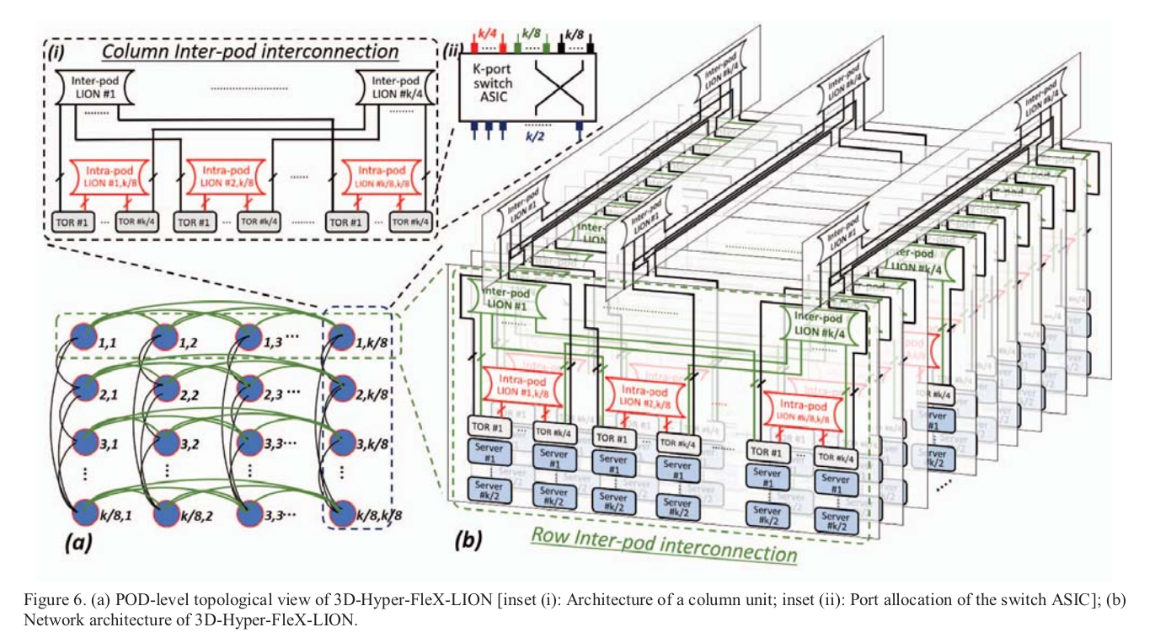
3D-Hyper-FleX-LION Architectural design
March 2022
Architecture Design

Slide 17
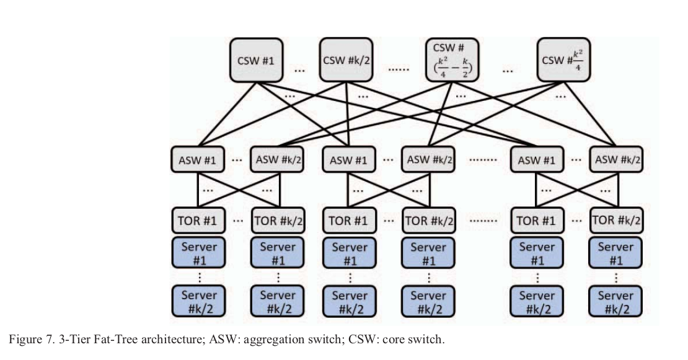
Fat Tree
March 2022
Architecture Design

Slide 18
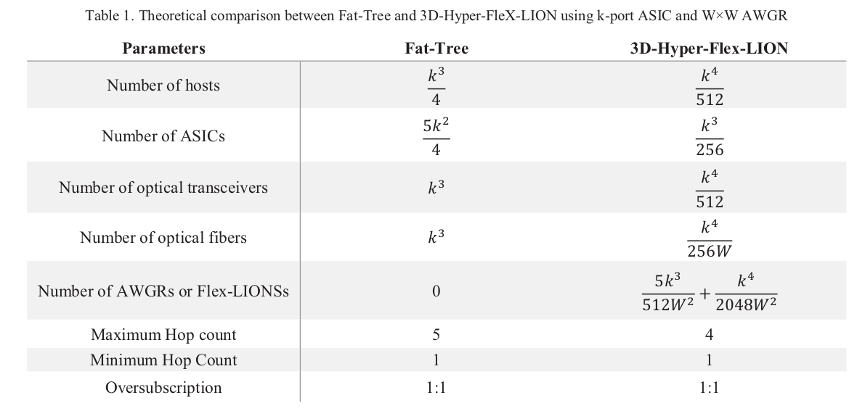
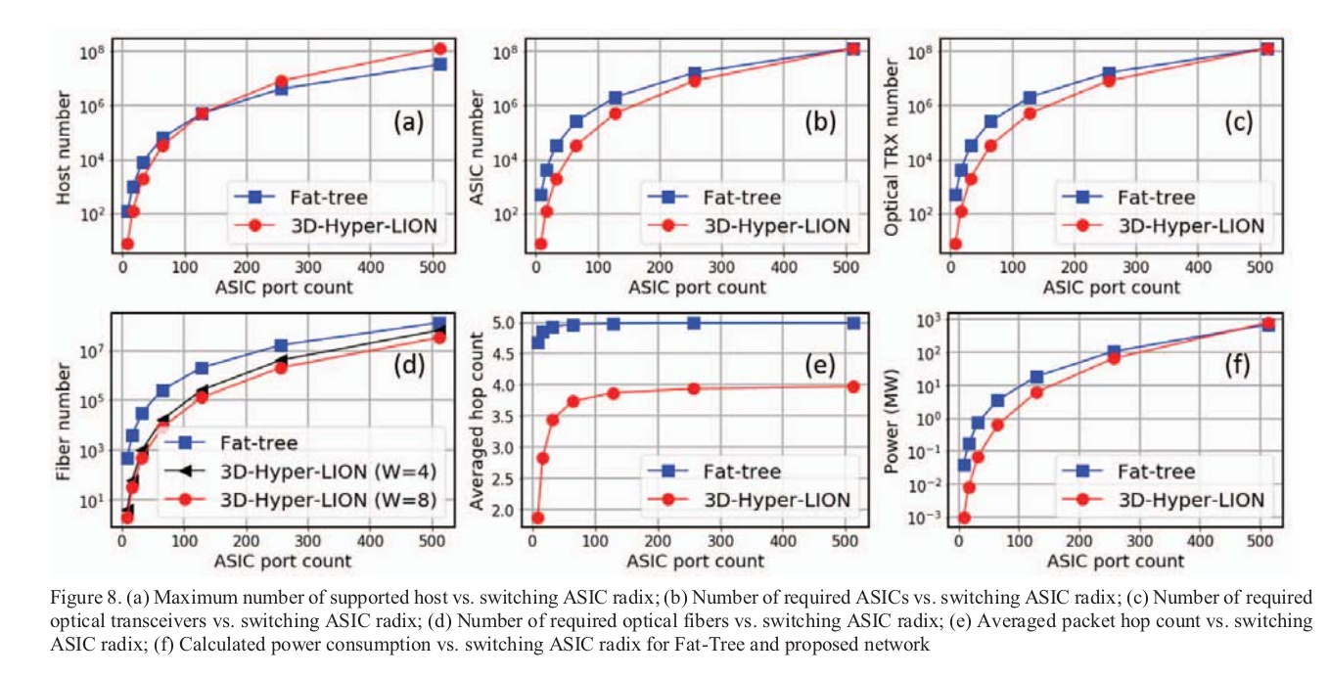
Comparison between
Fat-Tree and 3D-Hyper-FleXLION architecture
March 2022

Slide 19
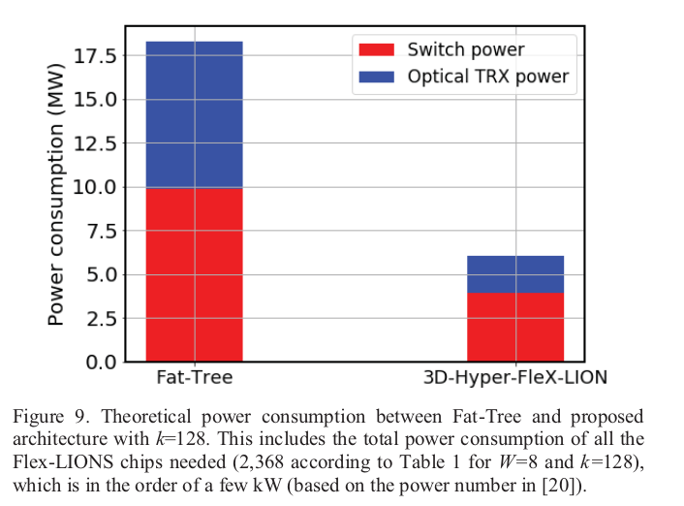
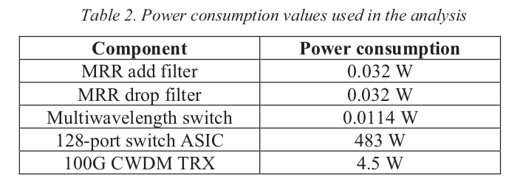
Comparison between
Fat-Tree and 3D-Hyper-FleXLION architecture
March 2022

Slide 20
Packet Routing Algorithm
March 2022
From a “hop-count” perspective, there are 3 equal-cost shortest paths between any hosts on different clusters, and 𝑘/2 − 3 equal-cost paths that cost one more hop comparing with the three shortest paths.
Deterministic shortest-path routing algorithm risks overloading the shortest path as the traffic load increases.
The outgoing traffic for a source-destination pair must be as evenly distributed along the 𝑘/2 paths as possible to maximize the bisection bandwidth of the network and avoid congestion.
Weighted-cost multipathing open shortest path first (WCMP-OSPF) algorithm is used in 3D-Hyper-FleX-LION.

Slide 21
Packet Routing Algorithm
March 2022
ToRs running WCMP performs static load balancing among the 𝑘/2 paths for the incoming flows.
We can label each host in 3D-Hyper-FleX-LION using a length-4 vectors 𝐴𝑖 = [𝐶𝑖 , 𝑃𝑖 , 𝑆𝑖 , 𝐻𝑖 ], where 𝑖 ∈ [0, 𝑘^4/512 ], 𝐶𝑖 represents the index of the cluster that the i th host belongs to. Similarly, 𝑃𝑖 represents the index of the pod that the i th host belongs to within the cluster and 𝑆𝑖 represents the index of the ToR that the i th host belongs to within the pod.
Let us consider a host 𝐴𝑚 sending a flow of packets to another host 𝐴𝑛 with 𝐶𝑚 ≠ 𝐶𝑛, 𝑃𝑚 ≠ 𝑃𝑛, 𝑆𝑚 ≠ 𝑆𝑛. The ToR that connected to host 𝐴𝑚 used a round-robin method to perform load splitting for the incoming packet flows.
The relayed ToR will use standard OSPF to forward the packets to the destination host 𝐴𝑛 without further relaying operation.
Because the round-robin operation evenly distributed the incoming traffics among the whole 3D-HyperFleX-LION network, the impact of shortest path aggregation with heavy traffic load can, therefore, be minimized.

Slide 22
Packet Routing Algorithm
March 2022
In theory, 3D-Hyper-FleX-LION can also support dynamic packet routing based on the node’s queueing condition and more relaying nodes (a packet may be relayed at each hop on its route).
The study on optimal routing algorithm for 3DHyper-FleX-LION is left for future work.

Slide 23
Scheduling of Optical Reconfiguration
March 2022
Scheduling of Optical reconfiguration is important.
Deep Reinforcement Learning can be applied.
Employ a separate DRL agent for each Flex-LIONS for learning the local policy and make the multiple agents learn collaboratively toward optimizing the network-wide performance.
First construct an auxiliary graph G(V, E), which represents a possible configuration scheme.
The network state can be represented by
  the configuration of the local switch
  inter-pod traffic matrix
  the current inter-pod connectivity.
At each decision step i, an agent makes use of deep neural networks (DNNs) to generate a configuration policy taking as input the state data. The policy suggests a probability distribution over a set of configuration actions {vi, N(vi)}, where N(vi) represents the sets of neighboring nodes of the current configuration vi.

Slide 24
Scheduling of Optical Reconfiguration
March 2022
After every agent has taken an action, the network throughput and latency are measured, with which, a team reward is generated for all the agents.
With such experiences, the agents can periodically train the DNNs by reinforcing actions that result in higher cumulative rewards.
This way, through repeated trial and error operations, the agents can eventually learn a set of successful policies that maximize the network performance.
Besides several other techniques mentioned below are currently under investigation.
Use of application-driven approaches where the expected traffic matrix can be communicated via message passing interface (MPI)
Traffic driven approach where the traffic matrix can be monitored and used to calculate the matching topology via heuristic algorithms or deep learning approaches.

Slide 25
Methodology
SYSTEM MODELLING AND EVALUATION
March 2022
Experimentally evaluated 3D-Hyper-FleX-LION and compared it to a Fat-Tree for k=32 and full bisection bandwidth.
Used gem5 with Garnet2.0 for detailed performance simulations.
To stress all corner cases of the topologies, different traffic pattern has been used
  uniform random
  tornado
  shuffle
Also included 3D-Hyper-LION architecture (without optical reconfiguration) for the sake of comparison.
Modeled the power consumption of the switches and transceivers (TRXs) based on the state-of-the-art commercially-available data center switches and TRXs from vendors like Broadcom (Tomahawk 3).

Slide 26
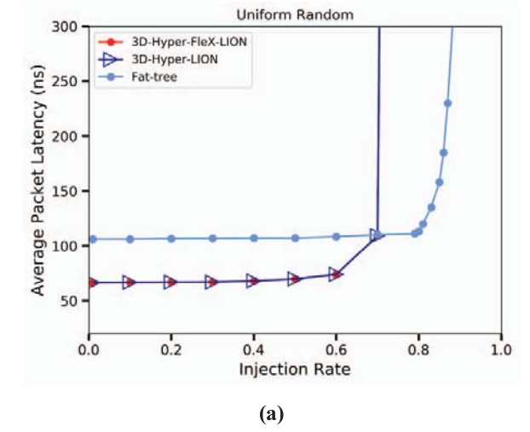
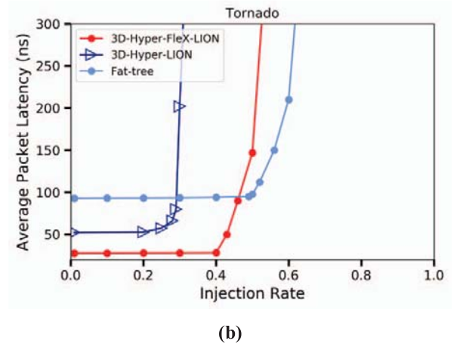
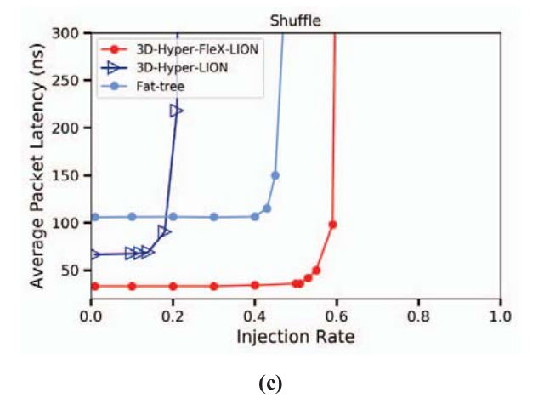

SYSTEM MODELLING AND EVALUATION
March 2022
System-Scale Results

Slide 27
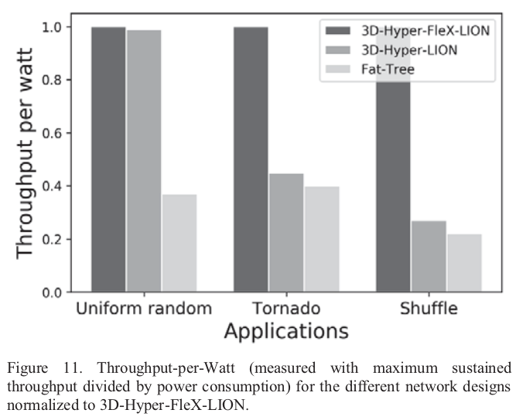
System-Scale Results
SYSTEM MODELLING AND EVALUATION
March 2022

Slide 28
Conclusion
March 2022
3D-Hyper-FleX-LION have significant advantages in terms of power, hardware resources (cost), and performance in terms of latency and throughput
When compared with a Fat-Tree network with the same number of nodes (when using a ToR with k=128 ports), 3D Hyper-FleX-LION delivers a 3× reduction in power consumption and 10× reduction in the num
Bandwidth reconfiguration increases the bandwidth of the shortest path, 3D-Hyper-Flex-LION can effectively reduce the average latency and significantly increase the system energy efficiency for workloads that have communication phases with high spatial locality.

Slide 29
Future Works
March 2022
In terms of future work, they are currently in the process of building a small-scale implementation of the proposed architecture to being able to run and profile (e.g. using DUMPI toolkit) various workload traces (e.g. FFT, HPCG) and measure performance in terms of execution time.

Slide 30

Any Questions??
March 2022

Slide 31
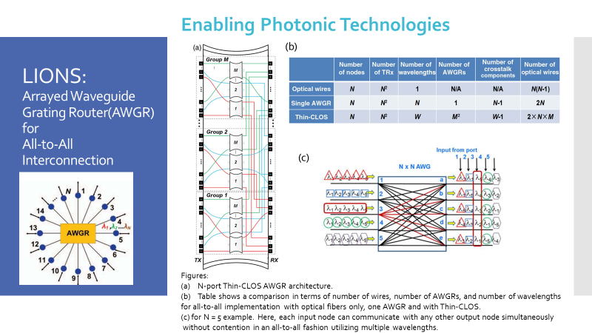

Slide 32
Some notes
March 2022
All these optical switches share a common aspect: they are bufferless (no buffering operation at the switch input and output ports) and therefore cannot be cascaded. Thus, they could be either used as core switches in folded-CLOS type of architectures (i.e., Fat Tree [1,2]) or they could be used in directly connected architectures, e.g., Torus [19], Flattened Butterfly [20,21], or Dragonfly [22]
Experimental Demonstration of a 64-Port Wavelength Routing Thin-CLOS System for Data Center Switching Architectures
As for the electronic switches, the optical switch solutions mentioned above can have scalability limitations due to different aspects mostly related to loss and coherent in-band crosstalk [23].
Thus, a W × W AWGR can intrinsically provide strictly nonblocking all-to-all communication among W compute nodes in a flat topology using W wavelengths

Slide 33
Some notes
March 2022
Three limiting factors prevent such an AWGR system from being practically deployed in a large scale (≥ 32). First, in-band (coherent) crosstalk increases significantly as the number of wavelength channels grows [27]. This can significantly impact the bit error rate (BER) of the optical links. Second, device size and fabrication constraints can also limit the port count of a single AWGR. Limitations are mainly due to the highly precise control needed for the channel spacing during fabrication as well as accurate wavelength registration required for all channels after fabrication [28]. Third, increasing the port count linearly increases the number of wavelengths, but the limited spectral range results in narrow channel spacing. Therefore, to achieve scalability, it would be desirable to use many smaller AWGRs using a smaller number of wavelengths that can be combined to provide the same interconnectivity offered by a single larger AWGR. This can be achieved by using the proposed Thin-CLOS AWGR

Slide 34
March 2022
Figure 2(a) shows a generic N-port Thin-CLOS architecture achieving the same functionality of a single N-port AWGR with N wavelengths by using smaller W-port AWGRs.
The architecture is strictly nonblocking and consists of a single layer of M groups of M AWGRs with W ports, being N= M × W.
In summary, as shown in Fig. 2(b), there are M2 AWGRs and 2 × M2 × W fiber connections in a ThinCLOS architecture (M2 × W input ports and M2 × W output ports). Although this translates to a larger number of fibers, connectors, and more complex fiber management inside the enclosure, there are several significant advantages compared with the single AWGR solution: • it greatly reduces the in-band crosstalk due to the lower port count of the AWGRs (W − 1 number of crosstalk sources instead of N − 1); • it offers lower optical losses and reduced optical loss nonuniformity and frequency deviation issues; • it allows larger channel spacing, relaxes manufacturing tolerance, and relaxes the temperature control requirement (thus reduces power consumption); and • it improves the yield and reduces the manufacturing cost of the many, identical, and smaller AWGRs
Some notes

