Slide 1
Walk through previous lecture

Slide 2
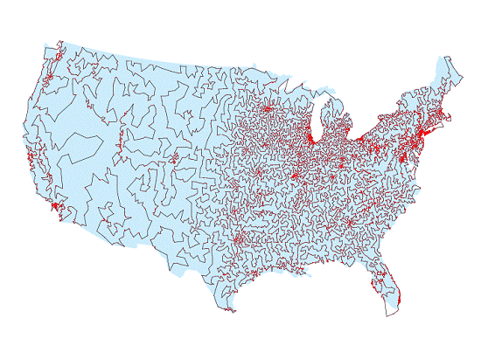
TSP
Questions:
How many tours are there?
How do you solve it?
How fast can you solve it?

Slide 3
how to run a python program
$ python hello.py

Slide 4
Functions in print
>>> print "hello" + "world" # concatenation
helloworld
>>> print len("helloworld") # length
10
>>> print "hello".upper() # upper case
HELLO
>>> print "HELLO".lower() # lower case
hello
>>> print str(3.14) # string conversion
3.14

Slide 5
Primitive Types
Name | Description | Size
int | Integer | 4 bytes
float | Floating point number | 4 bytes
long | Long integer | 4 bytes
complex | Complex numbers | 8 bytes

Slide 6
print
%d %f %s ..

Slide 7
escape sequences
\n \r \t \’ \” \\ ..

Slide 8
Arithmetic Operators
Addition (+)
Subtraction (-)
Multiplication (*)
Division (/)
Exponentiation (**)
Modulo (%)

Slide 9
conditions
>>> if condition1:
... # do this
Example:
>>> if 8 < 9:
... print "I get printed!"

Slide 10
conditions
>>> if condition1:
... # do this
... elif condition2:
... # do this
Example:
>>> if 8 < 9:
... print "I get printed!"
... elif 8 > 9:
... print "I don’t get printed!"

Slide 11
conditions
>>> if condition1:
... # do this
... elif condition2:
... # do this
... else:
... # do this
Example:
... if 8 < 9:
... print "I get printed!"
... elif 8 > 9:
... print "I don’t get printed!"
... else:
... print "I also don’t get printed!"

Slide 12
Boolean Operators
True and True is True
True and False is False
False and True is False
False and False is False
True or True is True
True or False is True
False or True is True
False or False is False
Not True is False
Not False is True

Slide 13
Boolean expressions
>>> if condition1 or condition2:
... # do this
Example:
>>> if 8 > 7 or 8 > 10:
... print "I get printed"

Slide 14
Boolean expressions
>>> if condition1 and condition2:
... # do this
Example:
>>> if 8 > 7 and 8 > 10:
... print "I don’t get printed"

Slide 15
loops
>>> for iterating_var in sequence:
... # do this again and again
Example:
>>> for index in range(10):
... print index

Slide 16
loops
>>> while condition:
... # do this again and again
Example:
>>> while index < 10:
... print index

Slide 17
Tc = (5/9)*(Tf-32);
to be continued...

