Slide 1
TA Office Hours
Tue: 10am – 11am, TBA

Slide 2
Walk through previous lecture

Slide 3
Prisoner’s Dilemma
X and Y get arrested with insufficient evidence. The police having separated both prisoners, visit each of them and offer the same deal:
If one testifies for the prosecution against the other and the other remains silent, the silent accomplice receives the full 10-year sentence and the betrayer goes free.
If both stay silent, the police can only give both prisoners 6 months for a minor charge.
If both betray each other, they receive a 2-year sentence each.

Slide 4
Prisoner’s Dilemma
X and Y get arrested with insufficient evidence. The police having separated both prisoners, visit each of them and offer the same deal:
Concept of Dominant Strategy, Equilibriums and Nash Equilibriums
 | Prisoner X Stays Silent | Prisoner X Betrays
Prisoner Y Stays Silent | Bother Serve 6 months | Prisoner Y serves ten years; Prisoner X goes free
Prisoner Y Betrays | Prisoner X serves ten years; Prisoner Y goes free | Both serve two years

Slide 5
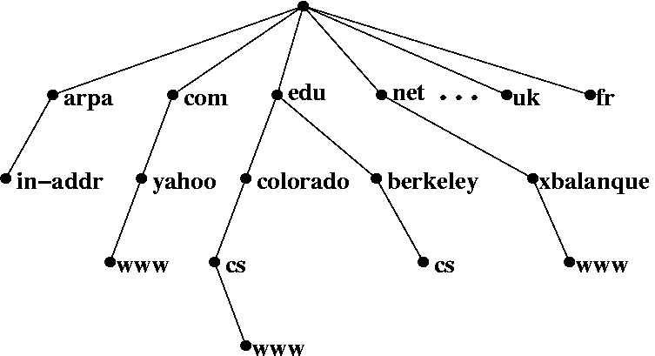
Trees in Computer Science
Domain name system: Convert names to numbers.
yahoo.com → 98.139.183.24

Slide 6
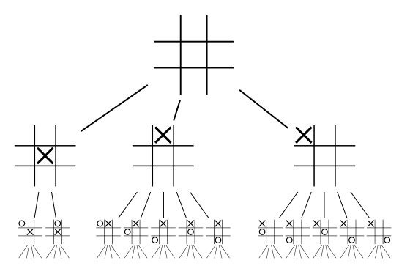
Tic-Tac-Toe tree
Moves in a game.

Slide 8
statements
>>> print “O hai, world!”

Slide 9
loops

Slide 10
loops
>>> while True:
... print "O hai!"

Slide 11
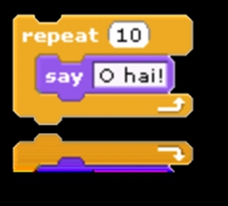
loops

Slide 12
loops
>>> for i in range(10): ... print "O hai!"

Slide 13
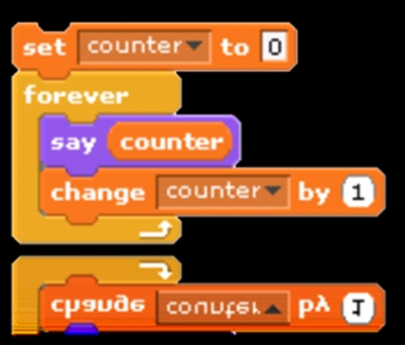
variables

Slide 14
variables
>>> counter=0 >>> while True:
... print counter ... counter=counter+1

Slide 15
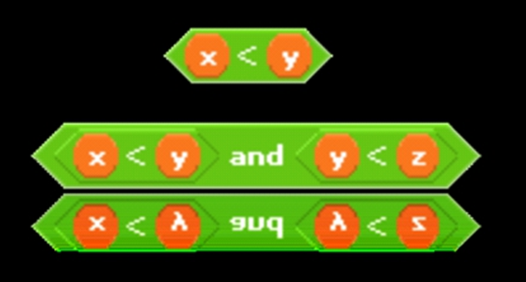
expressions

Slide 16
expressions
(x < y)
((x < y) && (y < z))

Slide 17
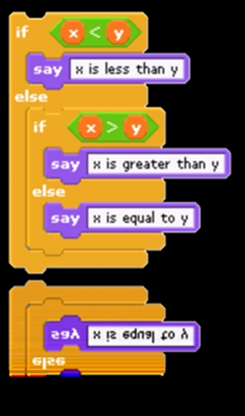
conditions

Slide 18
conditions
>>> If x < y:
... print "x is less than y"
... elif x > y:
... print "x is greater than y"
... else:
... print "x is equal to y"

Slide 19
If, Else and Elif
(hello.py)
>>> if 8 < 9:
... print "I get printed!"
... elif 8 > 9:
... print "I don't get printed."
... else:
... print "I also don't get printed!"

Slide 20
how to run a python program
$ python hello.py

Slide 21
arrays
inventory=[ ]
inventory=["orange"]

Slide 22
10000011 00000001 0000000001000000
00010001 00000000 0000000000000000 0000000000000000 00001011 00000011 0000000000000000 00000000 00000000 0000000000000000 0000000000100000 0000000000100000 0000000001000000 0000000001000000 1111111111111111 0000000001000000 0111100101101110 0000000000100000 0000000000100000 0000000000000000 0000000000000000 0000000000000000 0000000000000000 0000000000000000
00111101 11111100 0000000000000000 0101000000000000 0000101000000000 0000000000000000 0000000000000000 0000000000000000 0000000100000000 0000000100000000 0000000100000000 0000000100000000 1111111111111111
01110100 00111101 0000000000000000 0000011100110000
1001000000000000 0000101100000001 0000000000100000 0000000000100000 0000000000000000 0111000000010000 0000000000000000 0000000000000000 0000000000100000 1111111111111111 1001000010000000 0010111001100100 1011000000000100 1011000000000100 1010000000000001 1011000000000100 0000000000000000 0000000000000000 0000000000000000
0000000000000000 0000000000000000 0000000000000000 0000000000000000 0000000000000000 0000000000000000 0000000000000000 0000000000000000 1111111111111111 0000000000000000 0110100101100011 0000000000000000 0000000000000000 0000000000000000 0000000000000000 0000000000000000 0000000000000000 0000000000000000
0000000100000000 0110000101101101 0000000100000000 0000000100000000 0000000000000000 0000000000000000 0000000000000000 0000000000000000 0000000000100000

Slide 23
print
>>> print "hello" # a string
hello
>>> print 7.5 # a number
7.5
>>> print "That's funny." # a string again
That's funny.
>>> print ["E", "F", "F"] # a list of strings
[‘E’, ‘F’, ‘F’]
>>> print [2, 4, 6, 8] # a list of numbers
[2, 4, 6, 8]

Slide 24
Functions in print
>>> print "hello" + "world" # concatenation
helloworld
>>> print len("helloworld") # length
10
>>> print "hello".upper() # upper case
HELLO
>>> print "HELLO".lower() # lower case
hello
>>> print str(3.14) # string conversion
3.14

Slide 25
Primitive Types
Name | Description | Size
int | Integer | 4 bytes
float | Floating point number | 4 bytes
long | Long integer | 4 bytes
complex | Complex numbers | 8 bytes

Slide 26
print
%d %f %s ..

Slide 27
escape sequences
\n \r \t \’ \” \\ ..

Slide 28
Arithmetic Operators
Addition (+)
Subtraction (-)
Multiplication (*)
Division (/)
Exponentiation (**)
Modulo (%)

Slide 29
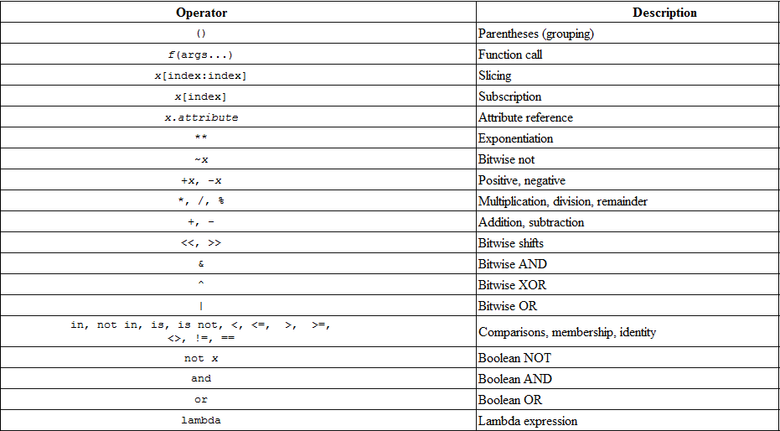
precedence
http://www.mathcs.emory.edu/~valerie/courses/fall10/155/resources/op_precedence.html

Slide 30
to be continued...

