Slide 1
vim basics
Vi IMproved

Slide 2
What is vim?
Text editor.
  Based off older editor; vi.
Very efficient.
Open source.
Available for UNIX based distros, MAC, Windows, and others.

Slide 3
Starting vim
In a terminal session, enter: vim [options] [file …]
[options] is a list of zero or more options to start your windows with.
[file …] is a list of zero or more files to edit.
vim will open windows using [options] with the [file …].
Notes:
Talk about the relation between files, buffers, and windows.

Slide 4
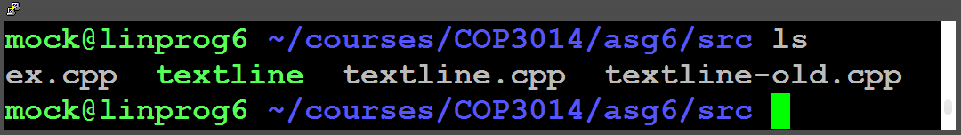
What will the following commands do?
  Note that ‘-o’ and ‘-O’ are options that open the file list vertically (think a stack of pancakes), or horizontally (think a line of dominoes).
vim textline.cpp
vim –o textline.cpp textline.h
vim –O textline.cpp textline.h
vim
Notes:
CTRL-w CTRL-w is a shortcut for switching to the next window.

Slide 5
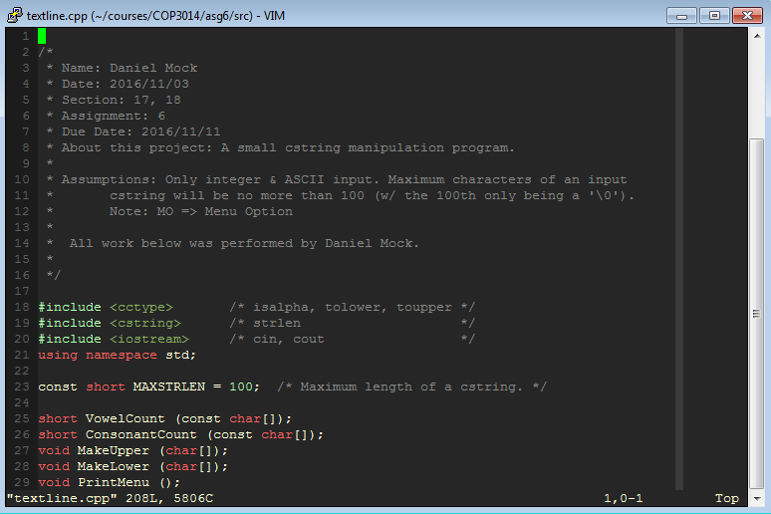
vim textline.cpp

Slide 6
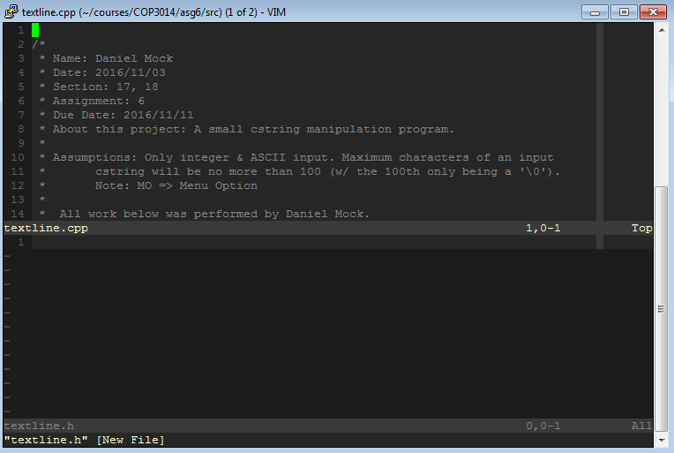
vim –o textline.cpp textline.h

Slide 7
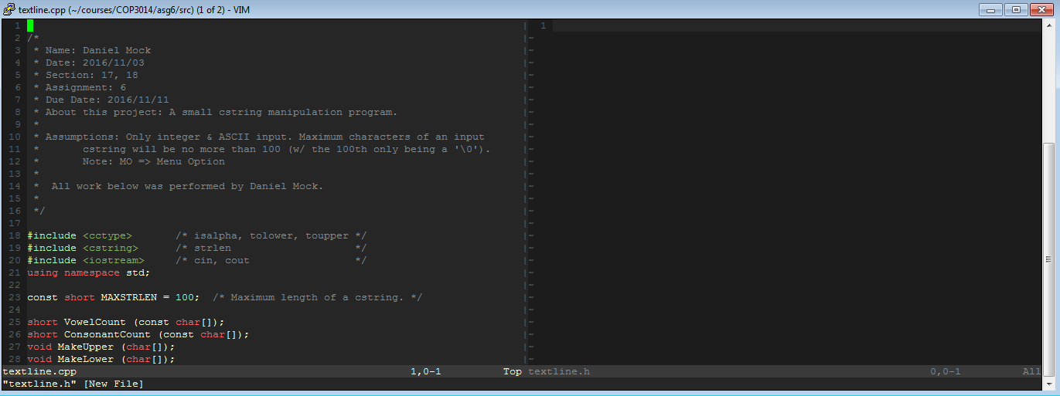
vim –O textline.cpp textline.h

Slide 8
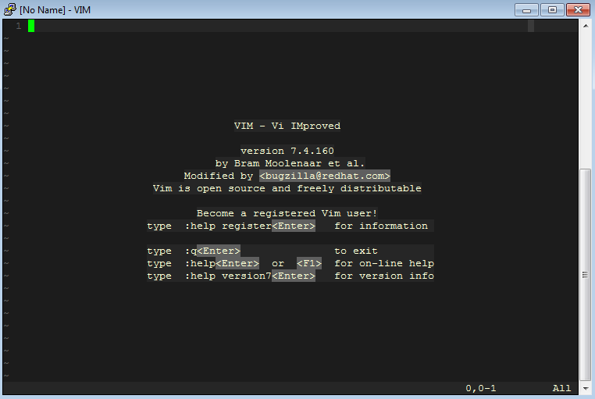
vim

Slide 9
Take note
vim is case sensitive!
CTRL-<key> means holds down CTRL and press <key>.
<sometext> means replace <sometext> with some text.
  2d<exampletext> => 2dfoo, 2dbar, 2d$$, etc.
[text] means the addition of text is optional.
  2d[<exampletext>] => 2d, 2dbanana, etc.
  2d[exampletext] => 2d, 2dexampletext

Slide 10
Navigation
While not in Insert mode, each of the following commands moves the cursor one character in a direction.
  h – Left.
  j – Down.
  k – Up.
  l – Right (an L).
To move by a word.
  b – Backward.
  w – Forward.
gg goes to the first line of file, G the last.

Slide 11
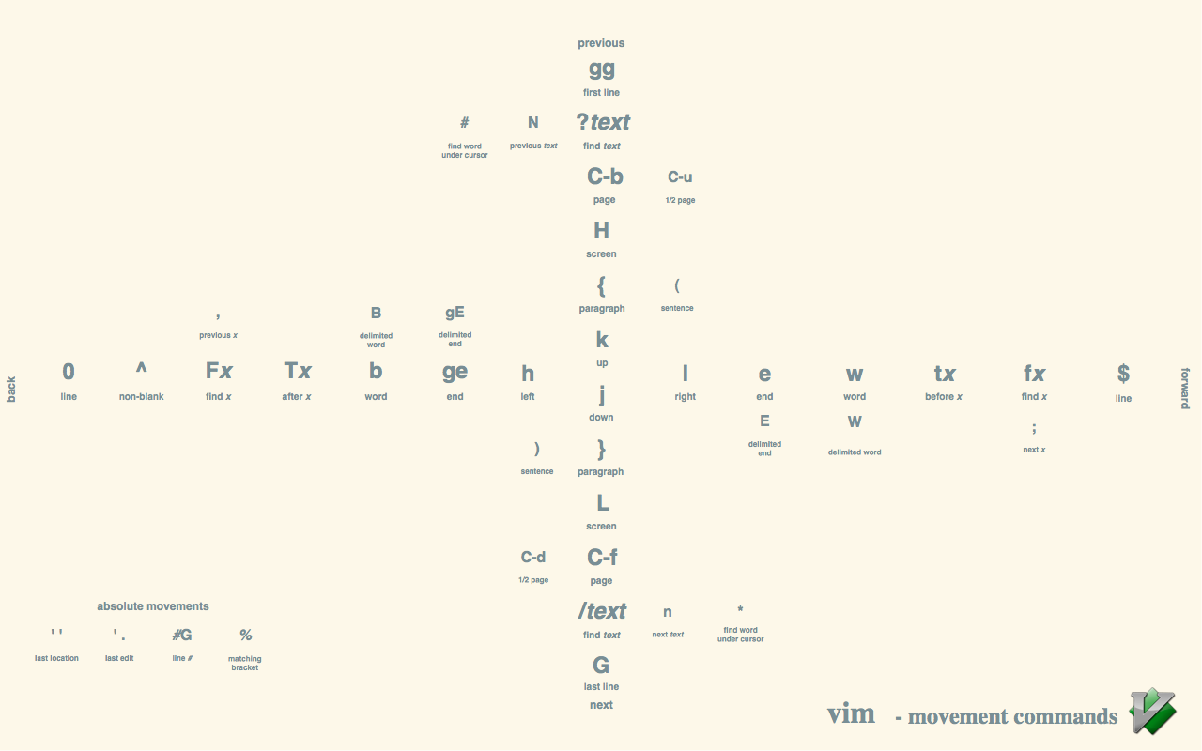
Notes:
Image source: https://coderwall.com/p/q-1lhw/vim-movement-shortcuts-wallpaper

Slide 12
How do you use vim?
vim is operated in several modes.
  normal (command)
  insert
  visual
  etc.
We will only focus on normal, insert, and visual mode.
To switch between modes, press ESC to go to normal mode, and then enter the command that starts the mode you wish to be in.

Slide 13
Normal (command) mode
Normal mode is where we enter commands.
Commands can do a variety of things.
  Enter another mode.
  Copy, paste, and delete text.
  Search for text.
  Set options.
  And much more.

Slide 14
Insert mode
Lets us insert new text into a file.
While in Normal mode, press i, a, o, I, A, or O to enter Insert mode.
The only difference in the options is where we begin inserting text.
  i – Before cursor.
  a – After cursor.
  I – Before beginning of line.
  A – After end of line.
  o – Below line on newly created line.
  O – Above line on newly created line.

Slide 15
Insert mode cont.
Once you are in insert mode, any key you press will be put into the file at the cursor’s position.
The exceptions are any CTRL-<key> and ALT-<key>.

Slide 16
Visual mode
Lets us highlight text and perform commands on the highlighted text.
There are three different highlighting methods.
  plain (as in vanilla) : v
  block : CTRL-v
  linewise : SHIFT-v

Slide 17
Operators, counts, and motions
Many commands are just a mixture of an operator and a motion.
Operator: Specifies what type of command we want to perform.
  d for delete, p for ‘paste’, …
Motion: How the operator will be used.
  w – until start of next word, excluding its first character.
  e – to end of current word, including the last character.
  $ - until end of line, including the last character.
  <ARROW KEYS> – try it out.
  Many more.
Count: How many times to repeat a command.
  [<count>]<command>; i.e. 2dw – delete 2 words

Slide 18
Common commands
Yank (copy): y<motion>
Put (paste): p
Delete: d<motion>
  Delete cursor character: x
Undo: u
Replace: r<x>, where <x> is the new character.
Search: /<sp>, where <sp> is what you are searching for.
  i.e. /potato would find the next occurrence of the text: potato
  <sp> is a regular expression.

Slide 19
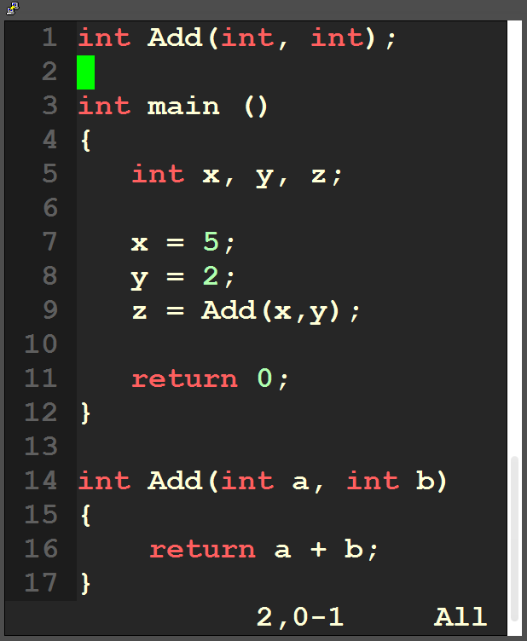
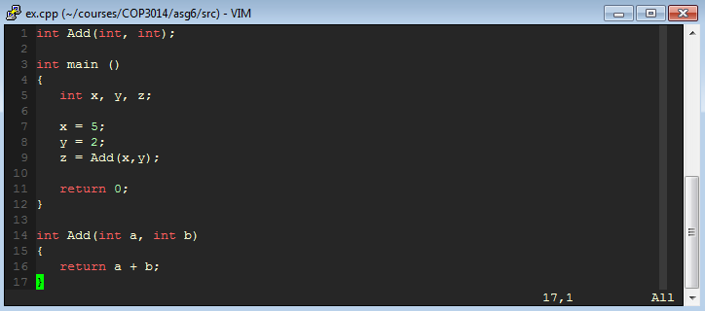
Search and replace
Suppose we have the file aside and we want to change the function to add two doubles and return a double. How could we efficiently change the code?

Slide 20
Method 1
Use search command / and search for int on current line: /int
The cursor is brought to the first character of the matched text.
Use 3x to delete 3 characters starting from the cursor position.
Repeat until all instances of int are replaced.
Drawbacks?
Commands related to search.
  n – Next match forward starting from cursor position.
  N – Next match backward starting from cursor position.
  / - Just entering / is the same as n.

Slide 21
Method 2
Same process to find each instance of int we want to change.
Use dw instead of 3x, as dw is more portable.
Still just as slow and inefficient as Method 1.
Any better ideas?
  Think about features you might have used in Microsoft Word or Visual Studio.

Slide 22
Substitute command
Works similarly to Find and Replace in Microsoft products.
Supports regular expressions.
The command is :s/<old>/<new>[/<extra>]
  <old> - The expression to search for.
  <new> - The expression to replace <old> with.

Slide 23
Substitute command cont.
Some more features you may find useful.
:s/<old>/<new>/g
  Replace all instances on the current line.
:%s/<old>/<new>/g
  Replace all instances in the entire file.
:%s/<old>/<new>/gc
  Same as previous, but prompt user to change at each instance.
Notes:
Open ex.cpp in terminal and complete the problem.

Slide 24
Set command
The set command turns options on or off.
:set [no]<option>
Put no before the option if you want to turn it off.
More than just binary options.

Slide 25
Set command cont.
Useful options to have enabled.
number – Turn line numbering on (as seen in previous pictures)
ruler – Shows cursor position in bottom right as well as % of file past.
tabstop=<num> - Number of characters a tab should take up.
backspace=indent,eol,start – Gets backspace to work in Insert mode.

Slide 26
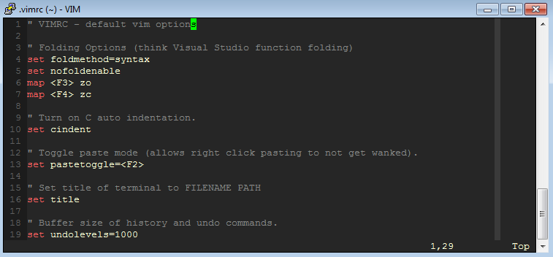
Set command cont.
These options only persist until you close the file.
To make them persistent, put them in your ~/.vimrc file.

Slide 27
Saving
:w [filename]
Saves the currently open buffer to the file associated with it.
If [filename] is supplied, saves a copy to [filename].
Think of Microsoft Save and Save As.

Slide 28
Quitting
:q
Close the current buffer.
If multiple files are open, :qa closes them all.
You can’t close a file if there are changes that have not been saved!

Slide 29
Saving and quitting
:wq [filename]
  Save (As) and quit.
:x
  Save and quit.
Note: Append a to each command to apply it to all open buffers.
  :wa, :qa, :xa, etc.

Slide 30
Forcing a save or quit
Append ! to each command to FORCE it to happen.
:w! [filename] – write to [filename] now!
:q! – Quit now, I don’t care about any unsaved changes!

Slide 31
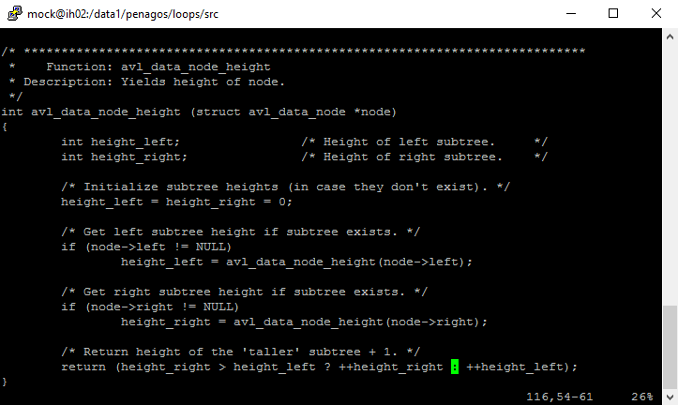
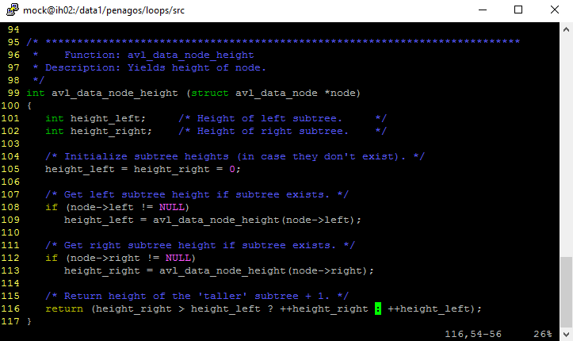
Syntax coloring
Turn on syntax coloring with :syntax on.
Then choose a color scheme with :color <scheme>.
  You can cycle thru the default schemes with TAB.

Slide 32
Basic review
Run vimtutor on a machine where vim is installed.
Check out Lynda.com’s intro to vim.
vim’s manpage.
vim’s :help command.

