Slide 1
CGS 3066: Web Programming and Design Fall 2019

Slide 2
AJAX
AJAX = Asynchronous JavaScript and XML.
A technique for creating fast and dynamic web pages.
AJAX allows web pages to be updated asynchronously by exchanging small amounts of data with the server behind the scenes.
This means, it is possible to update parts of a web page, without reloading the whole page.
Classic web pages, (which do not use AJAX) must reload the entire page if the content should change.
Examples of applications using AJAX: Google Maps, Gmail, Youtube, and Facebook tabs.

Slide 3
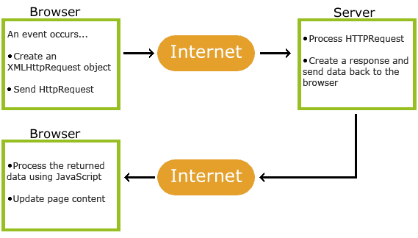
AJAX

Slide 4
XMLHttpRequest Object
The keystone of AJAX is the XMLHttpRequest object available to Javascript:
var xhttp = new XMLHttpRequest();
The XMLHttpRequest object is used to exchange data with a server.

Slide 5
Send a Request To a Server
To send a request to a server, we use the open() and send() methods of the XMLHttpRequest object
Open(method,url,anync) parameters
method: GET or POST
url: the server side file/script location
async: true for Asynchronous data transfer, false for synchronous
xmlhttp.open("GET","ajax_info.txt",true);
xmlhttp.send() sends the HttpRequest;

Slide 6
GET request
If you want to send information with the GET method, add the information to the URL:
xmlhttp.open("GET",“server.php?fname=Henry&lname=Ford",true);
xmlhttp.send();
http://www.w3schools.com/ajax/ajax_xmlhttprequest_send.asp

Slide 7
POST Requests
A simple POST request:
xmlhttp.open("POST","demo_post.php",true);
xmlhttp.send();
http://www.w3schools.com/ajax/ajax_xmlhttprequest_send.asp

Slide 8
POST Requests
To POST data like an HTML form, add an HTTP header with setRequestHeader().
Specify the data you want to send in the send() method:
xmlhttp.open("POST",“server_filename.txt",true); xmlhttp.setRequestHeader("Content-type","application/x-www-form-urlencoded"); xmlhttp.send("fname=John&lname=Doe");
http://www.w3schools.com/ajax/ajax_xmlhttprequest_send.asp

Slide 9
Server Response
To get the response from a server, use the responseText or responseXML property of the XMLHttpRequest object.
The responseText property returns the response as a string, and you can use it accordingly:
document.getElementById(“someDiv").innerHTML=xmlhttp.responseText;
http://www.w3schools.com/ajax/ajax_xmlhttprequest_send.asp

Slide 10
The onreadystatechange Event
When a request to a server is sent, we want to perform some actions based on the response.
The onreadystatechange event is triggered every time the readyState changes.
The readyState property holds the status of the XMLHttpRequest.

Slide 11
readyState and status Attribute
readyState holds the status of the XMLHttpRequest. Changes from 0 to 4:
0: request not initialized (before open())
1: server connection established (after send())
2: request received
3: processing request
4: request finished and response is ready
status value of 200 denotes a successful request(“OK”)
Common status values in case of an unsuccessful request:
404: file not found
500: Internal Server Error
503: Service Unavailable

Slide 12
Example
var xmlhttp= new XMLHttpRequest();
xmlhttp.onreadystatechange=function()
{ if (xmlhttp.readyState==4 && xmlhttp.status==200) { alert(xmlhttp.responseText);
// perform any DOM manipulation using responseText }
}
xmlhttp.open("GET", "server.txt", true);
xmlhttp.send();

Slide 13
jQuery AJAX
$.ajax({
method: "POST",
url: "some.php",
data: { name: "John", location: "Boston" },
dataType: "json"
})
.done(function( msg ) {
alert( "Data Saved: " + msg );
})
.always(function(){
alert("complete");
});

