Slide 1


CGS 3066: Web Programming and Design
Fall 2019
Accessing MySQL through PHP

Slide 2
Accessing Database
MySQL can be accessed from PHP in three ways:
        Legacy non-OO mysql_ routines (deprecated)
        New mysqli
            Procedural version – similar to mysql_
            OO version – similar to PDO
        PDO - Portable Data Objects
        We will use PDO for our examples.
https://www.php.net/manual/en/mysqlinfo.api.choosing.php

Slide 3
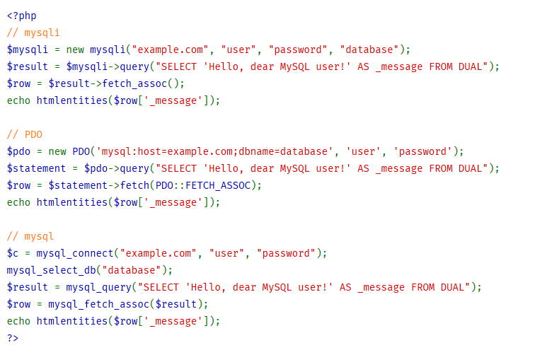
Accessing MySQL
https://www.php.net/manual/en/mysqlinfo.api.choosing.php

Slide 4
PDO: Connecting to MySQL
<?php
$servername = "localhost";
$username = "username";
$password = "password";
$database = "database_name";
try {
$conn = new PDO("mysql:host=$servername;dbname=$database", $username, $password);
// set the PDO error mode to exception
$conn->setAttribute(PDO::ATTR_ERRMODE, PDO::ERRMODE_EXCEPTION);
echo "Connected successfully";
}
catch(PDOException $e)
{
echo "Connection failed: " . $e->getMessage();
}
// Do your work
// Then close the connection
$conn = null;
?>

Slide 5
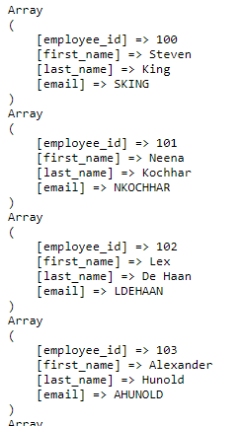
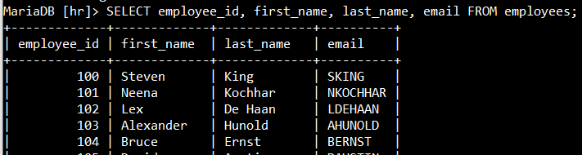
Select Data
<?php
require_once "dbconnect.php";
$query = "SELECT employee_id, first_name, last_name, email FROM employees";
$stmt = $conn->query($query);
echo "<pre>\n";
while ( $row = $stmt->fetch(PDO::FETCH_ASSOC) ) {
print_r($row);
}
echo "<pre>\n";
// Close the connection
$conn->close();
?>
pdo1.php

Slide 6
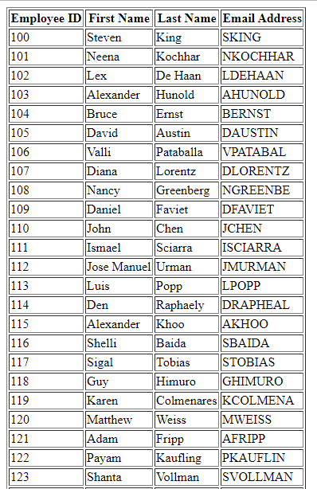
Select Data
<?php
require_once "dbconnect.php";
$query = "SELECT employee_id, first_name, last_name, email FROM employees";
$stmt = $conn->query($query);
echo "<table border='1'>";
echo "<tr>";
echo "<th>Employee ID</th>";
echo "<th>First Name</th>";
echo "<th>Last Name</th>";
echo "<th>Email Address</th>";
echo "</tr>";
while ( $row = $stmt->fetch(PDO::FETCH_ASSOC) ) {
echo "<tr>";
echo "<td>" . $row["employee_id"] . "</td>";
echo "<td>" . $row["first_name"] . "</td>";
echo "<td>" . $row["last_name"] . "</td>";
echo "<td>" . $row["email"] . "</td>";
echo "</tr>";
}
echo "</table>";
$conn->close();
?>
pdo2.php

Slide 7
Insert Data
<?php
require_once "dbconnect.php";
if(isset($_POST["submit"])){
$first_name = $_POST["first_name"];
$last_name = $_POST["last_name"];
$email = $_POST["email"];
$password = $_POST["password"];
$query = "INSERT INTO employees (first_name, last_name, email, password) VALUES ('$first_name', '$last_name', '$email', '$password')";
echo("<pre>\n".$query."\n</pre>\n");
try{
$conn->exec($query);
echo "Employee added successfully.";
$conn = null;
}
catch(PDOException $e)
{
echo $query . "<br>" . $e->getMessage();
}
}
?>
pdo3_insert.php

Slide 8
Insert Data
<!DOCTYPE html>
<html>
<head>
<title>Add new employee</title>
</head>
<body>
<div>Add a new employee</div>
<form action="" method="post">
<p>First Name:<input type="text" name="first_name" autocomplete="off"></p>
<p>Last Name:<input type="text" name="last_name" autocomplete="off"></p>
<p>Email:<input type="text" name="email" autocomplete="off"></p>
<p>Password:<input type="password" name="password" autocomplete="off"></p>
<p><input type="submit" name="submit" value="Add"/></p>
</form>
</body>
</html>
pdo3_insert.php

Slide 9
Insert and Display List in Same Page
pdo4.php
<?php
require_once "dbconnect.php";
if(isset($_POST["submit"])){
$first_name = $_POST["first_name"];
$last_name = $_POST["last_name"];
$email = $_POST["email"];
$password = $_POST["password"];
$query = "INSERT INTO employees (first_name, last_name, email, password) VALUES ('$first_name', '$last_name', '$email', '$password')";
echo("<pre>\n".$query."\n</pre>\n");
try{
$conn->exec($query);
echo "Employee added successfully.";
}
catch(PDOException $e)
{
echo $query . "<br>" . $e->getMessage();
}
}
?>

Slide 10
Insert and Display List in Same Page
pdo4.php
<!DOCTYPE html>
<html>
<head>
<title>Add new employee</title>
</head>
<body>
<div>Add a new employee</div>
<form action="" method="post">
<p>First Name:<input type="text" name="first_name" autocomplete="off"></p>
<p>Last Name:<input type="text" name="last_name" autocomplete="off"></p>
<p>Email:<input type="text" name="email" autocomplete="off"></p>
<p>Password:<input type="password" name="password" autocomplete="off"></p>
<p><input type="submit" name="submit" value="Add"/></p>
</form>
</body>
</html>

Slide 11
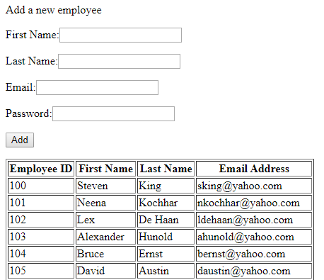
Insert and Display List in Same Page
pdo4.php
<?php
$query = "SELECT employee_id, first_name, last_name, email FROM employees";
$stmt = $conn->query($query);
echo "<table border='1'>";
echo "<tr>";
echo "<th>Employee ID</th>";
echo "<th>First Name</th>";
echo "<th>Last Name</th>";
echo "<th>Email Address</th>";
echo "</tr>";
while ( $row = $stmt->fetch(PDO::FETCH_ASSOC) ) {
echo "<tr>";
echo "<td>" . $row["employee_id"] . "</td>";
echo "<td>" . $row["first_name"] . "</td>";
echo "<td>" . $row["last_name"] . "</td>";
echo "<td>" . $row["email"] . "</td>";
echo "</tr>";
}
echo "</table>";
$conn = null;
?>

Slide 12
Delete Data
pdo5_delete.php
<?php
require_once "dbconnect.php";
if(isset($_POST["submit"])){
$employee_id = $_POST["employee_id"];
$query = "DELETE FROM employees WHERE employee_id = $employee_id";
echo("<pre>\n".$query."\n</pre>\n");
try{
$conn->exec($query);
echo "Employee deleted successfully.";
$conn = null;
}
catch(PDOException $e)
{
echo $query . "<br>" . $e->getMessage();
}
}
?>
<!DOCTYPE html>
<html>
<head>
<title>Delete an Employee</title>
</head>
<body>
<p>Delete an employee</p>
<form method="post"><p>ID to Delete:
<input type="text" name="employee_id"></p>
<p><input type="submit" name="submit" value="Delete"/></p>
</form>
</body>
</html>

Slide 13
Add/Delete in Same Page
pdo6_del_list.php
<?php
require_once "dbconnect.php";
if(isset($_POST["submit"])){
$first_name = $_POST["first_name"];
$last_name = $_POST["last_name"];
$email = $_POST["email"];
$password = $_POST["password"];
$query = "INSERT INTO employees (first_name, last_name, email, password) VALUES ('$first_name', '$last_name', '$email', '$password')";
try{
$conn->exec($query);
echo "Employee added successfully.";
}
catch(PDOException $e)
{
echo $query . "<br>" . $e->getMessage();
}
}

Slide 14
Add/Delete in Same Page
pdo6_del_list.php
if(isset($_POST["delete"])){
$employee_id = $_POST["employee_id"];
$query = "DELETE FROM employees WHERE employee_id = $employee_id";
try{
$conn->exec($query);
echo "Employee deleted successfully.";
}
catch(PDOException $e)
{
echo $query . "<br>" . $e->getMessage();
}
}
?>

Slide 15
Add/Delete in Same Page
pdo6_del_list.php
<!DOCTYPE html>
<html>
<head>
<title>Add new employee</title>
</head>
<body>
<div>Add a new employee</div>
<form action="" method="post">
<p>First Name:<input type="text" name="first_name" autocomplete="off"></p>
<p>Last Name:<input type="text" name="last_name" autocomplete="off"></p>
<p>Email:<input type="text" name="email" autocomplete="off"></p>
<p>Password:<input type="password" name="password" autocomplete="off"></p>
<p><input type="submit" name="submit" value="Add"/></p>
</form>
</body>
</html>

Slide 16
Add/Delete in Same Page
pdo6_del_list.php
<?php
$query = "SELECT employee_id, first_name, last_name, email FROM employees";
$stmt = $conn->query($query);
echo "<table border='1'>";
echo "<tr>";
echo "<th>Employee ID</th>";
echo "<th>First Name</th>";
echo "<th>Last Name</th>";
echo "<th>Email Address</th>";
echo "<th>Action</th>";
echo "</tr>";
echo "</table>";
$conn = null;
?>
while ( $row = $stmt->fetch(PDO::FETCH_ASSOC) ) {
echo "<tr>";
echo "<td>" . $row["employee_id"] . "</td>";
echo "<td>" . $row["first_name"] . "</td>";
echo "<td>" . $row["last_name"] . "</td>";
echo "<td>" . $row["email"] . "</td>";
echo "<td><form method='POST'>\n";
echo "<input type='hidden' name='employee_id' value='". $row["employee_id"] . "'>\n";
echo "<input type='submit' name='delete' value='Delete'>\n";
echo "</td></form>";
echo "</tr>";
}

Slide 17
SQL Injection
SQL injection is a code injection technique, used to attack data-driven applications, in which malicious SQL statements are inserted into an entry field for execution (e.g. to dump the database contents to the attacker). SQL injection must exploit a security vulnerability in an application's software, for example, when user input is either incorrectly filtered for string literal escape characters embedded in SQL statements or user input is not strongly typed and unexpectedly executed. SQL injection is mostly known as an attack vector for websites but can be used to attack any type of SQL database. (Wikipedia)

Slide 18
login1.php
<?php
require_once "dbconnect.php";
if(isset($_POST["submit"])){
  $email = $_POST["email"];
  $password = $_POST["password"];
  $query = "SELECT * FROM employees WHERE email = '$email' AND password = '$password'";
  try{
  $stmt = $conn->query($query);
  $row = $stmt->fetch(PDO::FETCH_ASSOC);
  print_r($row);
  if($row === false){
  echo "<p>Login incorrect.</p>";
  } else{
  echo "<p>Login success.</p>";
  }
  }
  catch(PDOException $e)
  {
  echo $query . "<br>" . $e->getMessage();
  }
}
?>
<!DOCTYPE html>
<html>
<head>
<title>Login</title>
</head>
<body>
<h4>Please Login</h4>
<form action="" method="post">
<p>Email:<input type="text" name="email" autocomplete="off"></p>
<p>Password:<input type="password" name="password" autocomplete="off"></p>
<p><input type="submit" name="submit" value="Login"/></p>
</form>
</body>
</html>

Slide 19
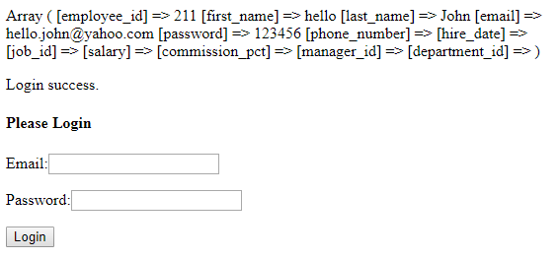
login1.php

Slide 20
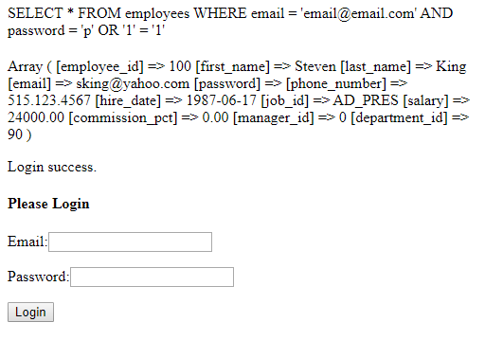
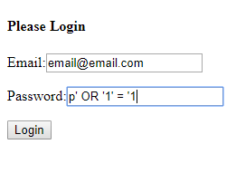
login1.php

Slide 21
Remedy – Use Prepared Statements
login2.php
……
$query = "SELECT * FROM employees WHERE email = :email AND password = :password";
…………..
try{
$stmt = $conn->prepare($query);
$stmt->bindParam(':email', $email);
$stmt->bindParam(':password', $password);
$stmt->execute();
$row = $stmt->fetch(PDO::FETCH_ASSOC);
print_r($row);
………….
When the statement is executed, the placeholders get replaced with the actual strings and everything is automatically escaped!

Slide 22
Self Study
Implement the Employee Edit page with PDO prepared statement

Slide 23
Acknowledgement
Some content is used (directly or with some modification) from the following sources:
- Charles Severance, University of Michigan School of Information

