Slide 1
CGS 3066: Web Programming and Design Fall 2019
More on SQL

Slide 2
Primary Key
A primary key is a special relational database table column (or combination of columns) designated to uniquely identify all table records.
A primary key’s main features are:
It must contain a unique value for each row of data.
It cannot contain null values.
A primary key is either an existing table column or a column that is specifically generated by the database according to a defined sequence. (techopedia.com)

Slide 3
Primary Key
Primary keys can be defined when creating a table:
CREATE TABLE table_name (
id_col INT PRIMARY KEY,
col2 CHARACTER VARYING(20),
...
)
Or can be defined using alter table query by adding constraint:
ALTER TABLE <table identifier>
ADD [ CONSTRAINT <constraint identifier> ]
PRIMARY KEY ( <column expression> {, <column expression>}... )

Slide 4
Foreign Key
A foreign key is a column or group of columns in a relational database table that provides a link between data in two tables. It acts as a cross-reference between tables because it references the primary key of another table, thereby establishing a link between them.
(techopedia.com)

Slide 5
Unique Key
A unique key is a set of one or more than one fields/columns of a table that uniquely identify a record in a database table.
Unique keys can be defined when creating a table:
CREATE TABLE table_name (
id_col INT PRIMARY KEY,
col2 CHARACTER VARYING(20),
...
identifier> ( <column expression> {, <column eUNIQUE INDEX <constraint xpression>}... )
)
Or can be defined using alter table query by adding constraint:
ALTER TABLE <table identifier>
ADD [ CONSTRAINT <constraint identifier> ]
UNIQUE INDEX( <column expression> {, <column expression>}... )
ALTER TABLE fruits ADD CONSTRAINT uq_1 UNIQUE INDEX (`name`, color )

Slide 6
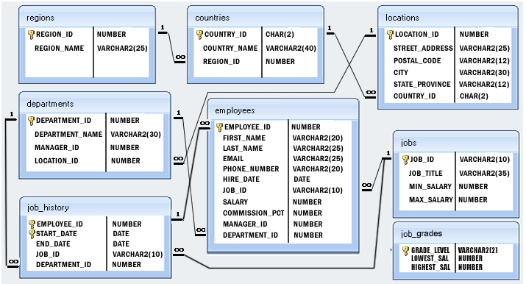
HR Database

Slide 7
Perform SQL Operations on Employee Database
https://www.w3resource.com/mysql-exercises/basic-simple-exercises/index.php
Display all employees
Display salaries of all employees
Display the unique job_ids for the employees
Display IDs and names (first_name, last_name) using alias full_name
Select names (first_name, last_name), salary, PF of all the employees (PF is calculated as 15% of salary)

