Slide 1
CGS 3066: Web Programming and Design Fall 2019
Intro to MySQL and Relational Databases

Slide 2
Relational Database
Relational databases model data by storing rows and columns in tables. The power of the relational database lies in its ability to efficiently retrieve data from those tables - in particular, where the query involves multiple tables and the relationships between those tables.

Slide 3
Structured Query Language
Structured Query Language is the language we use to issue commands to the database
- Create/Insert data
- Read/Select some data
- Update data
- Delete data
SQL allows us for CRUD operations to our data in a database.

Slide 4
Terminology
Database - contains one or more tables
Relation (or table) - contains tuples and attributes
Tuple/Row/Record - a set of fields which generally represent an “object” like a person or a music track
Attribute/Column/Field - one of possibly many elements of data corresponding to the object represented by the row

Slide 5
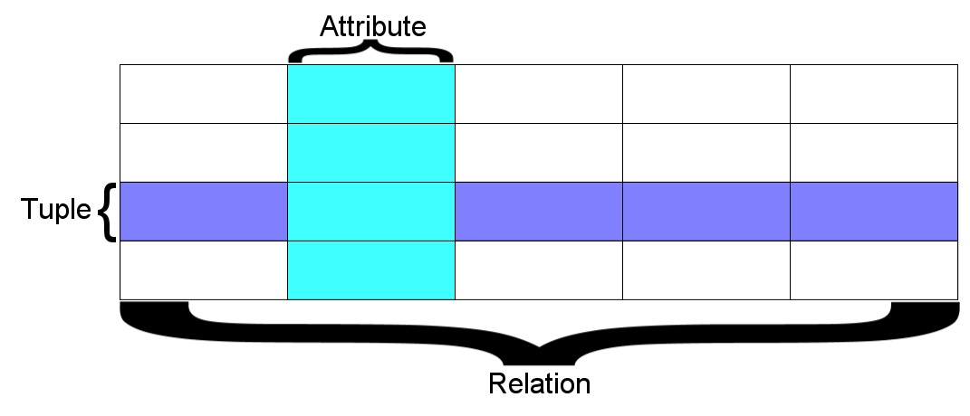
Terminology
A relation is defined as a set of tuples that have the same attributes. A tuple usually represents an object and information about that object. Objects are typically physical objects or concepts. A relation is usually described as a table, which is organized into rows and columns. All the data referenced by an attribute are in the same domain and conform to the same constraints. (wikipedia)

Slide 6
Common Database Systems
Three major Database Management Systems in wide use
- Oracle - Large, commercial, enterprise-scale, very tweakable
- MySQL - Simpler but very fast and scalable - commercial open source
- MS SQL Server - Very nice - from Microsoft (also Access)
Many other smaller projects, free and open source
- HSQL, SQLite, PostgreSQL ...

Slide 7
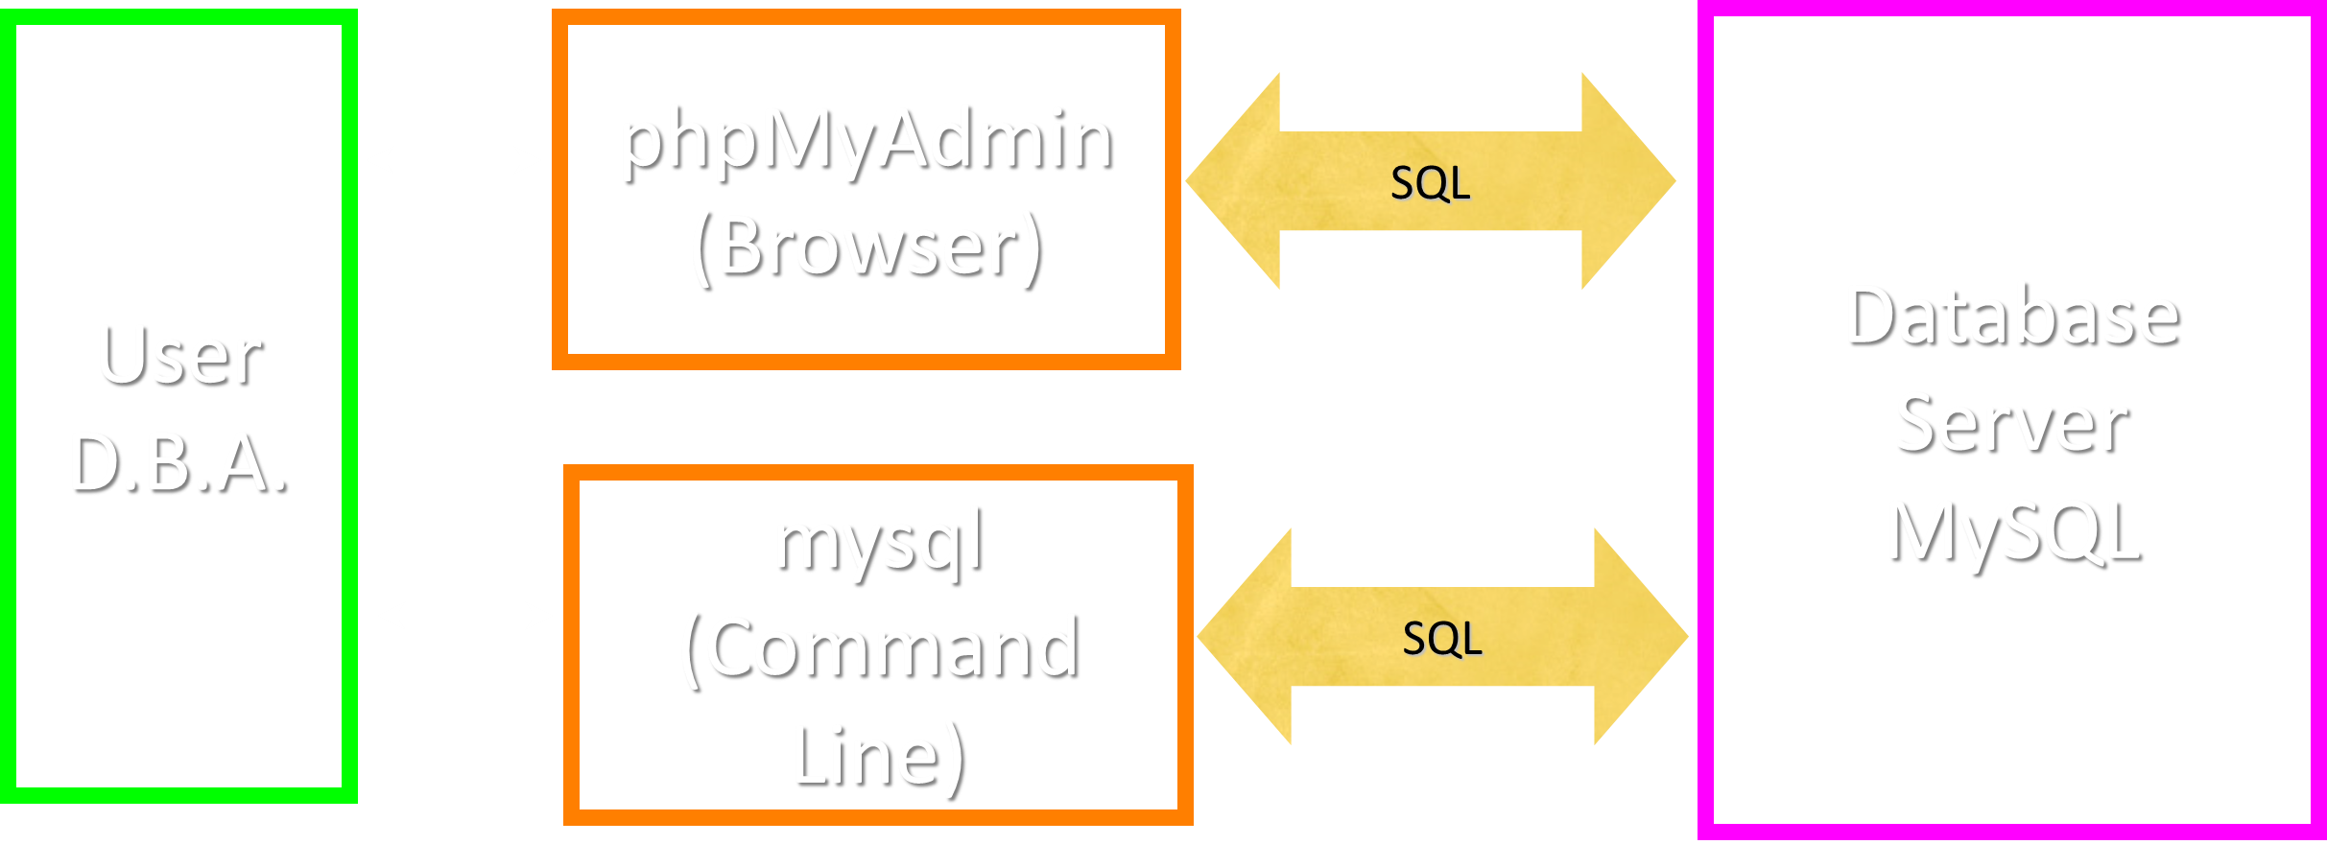
Using SQL

Slide 8
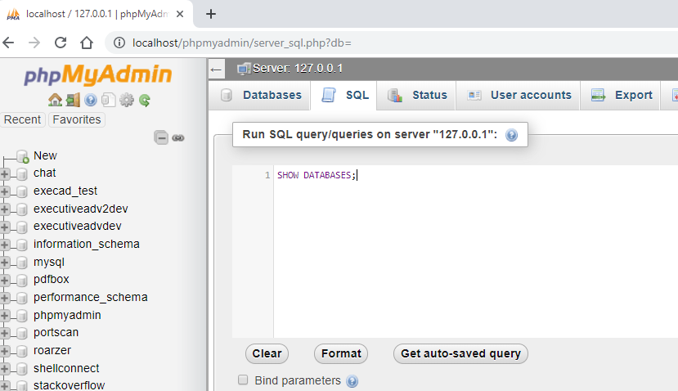
Play with phpMyAdmin

Slide 9
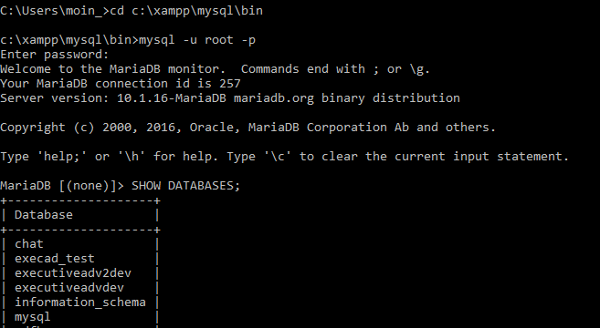
Play with mysql Command
Open Command Prompt window ( Terminal in Linux/Mac)
Open mysql command line using “mysql” command:
$mysql –u USER –p

Slide 10
Common SQL Commands/Operations
● SELECT — Retrieves data from one or more tables
● INSERT — Inserts data into a table
● UPDATE — Updates data in a table
● DELETE — Deletes data from a table
● CREATE — Creates a database, table or index
● ALTER — Modifies the structure of a table
● DROP — Wipes out a database or table

Slide 11
Create a Database
Create a database:
>CREATE DATABASE cgs3066;
>USE cgs3066;
Drop a database:
>DROP DATABASE cgs3066;
View list of tables:
>SHOW TABLES;

Slide 12
Create a Table
Create a database:
>CREATE TABLE fruits (
id INT UNSIGNED AUTO_INCREMENT,
name VARCHAR(30),
color VARCHAR(30),
PRIMARY KEY (id)
);
View table details:
>DESCRIBE fruits;

Slide 13
Add Data to Table
Insert data:
INSERT INTO table VALUES (value1 , value2 , ...)
This inserts values into each of the fields of the table, in the order that the fields were created.
To insert against selective fields (other fields will get NULL or Default value):
INSERT INTO table (field1 , field2 , ...) VALUES (value1, value2 , ...);

Slide 14
Add Data to Table
INSERT INTO fruits (name, color) VALUES (‘banana’, ‘yellow’);
INSERT INTO fruits (name, color) VALUES (‘tangerine’, ‘orange’);
INSERT INTO fruits (name, color) VALUES (‘plum’, ‘purple’);
INSERT INTO fruits (name, color) VALUES (‘lime’, ‘green’);
INSERT INTO fruits (name, color) VALUES (‘apple’, ‘red’);
INSERT INTO fruits (name, color) VALUES (‘mango’, ‘green’);

Slide 15
Reading Data From a Table
Select chosen fields only:
SELECT field1, field2, …….. FROM table WHERE condition;
Select all fields:
SELECT * FROM table;

Slide 16
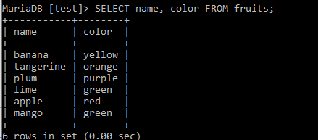
Reading Data From a Table
SELECT name, color FROM fruits;

Slide 17
Filtering Data
SELECT name, color FROM fruits WHERE name = 'plum';

Slide 18
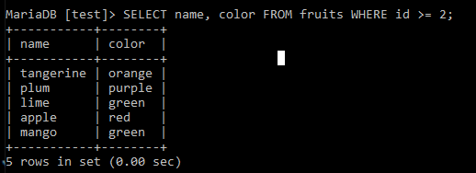
Filtering Data
SELECT name, color FROM fruits WHERE id >= 2;

Slide 19
Filtering Data
SELECT name, color FROM fruits WHERE id >= 2 AND color = ‘green’;

Slide 20
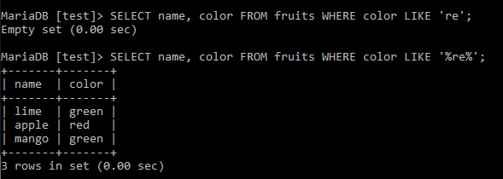
Filtering Data with LIKE
SELECT name, color FROM fruits WHERE color LIKE 're';
SELECT name, color FROM fruits WHERE color LIKE '%re%';

Slide 21
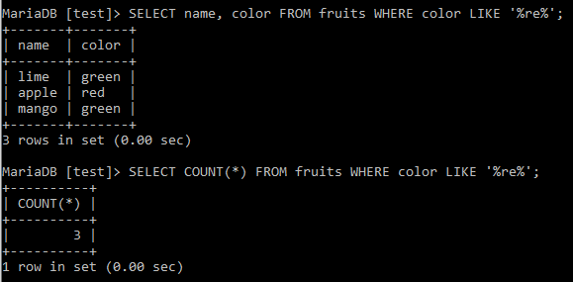
Counting the Records
SELECT COUNT(*) FROM fruits WHERE color LIKE '%re%';

Slide 22
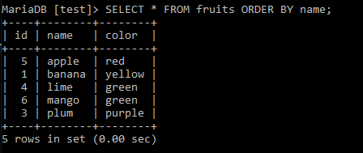
Sorting the Data
SELECT name, color FROM fruits ORDER BY name;
SELECT name, color FROM fruits ORDER BY color DESC;

Slide 23
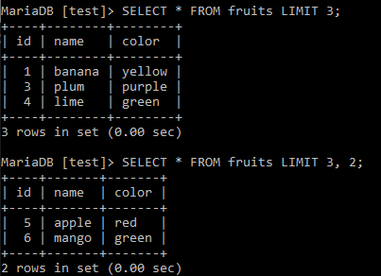
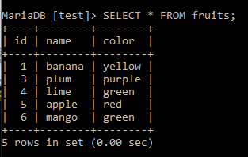
LIMIT and OFFSET
SELECT * FROM fruits LIMIT 3;
SELECT * FROM fruits LIMIT 3 OFFSET 2;
SELECT * FROM fruits LIMIT 3, 2;

Slide 24
Updating Data
You change existing data in a table with the UPDATE statement.
As with the SELECT statement, you can (and usually will) add a WHERE clause to specify exactly which rows you want to update.
If you leave out the WHERE clause, the entire table gets updated.
UPDATE table SET field1 = value1, field2 = value2, ... WHERE condition;

Slide 25
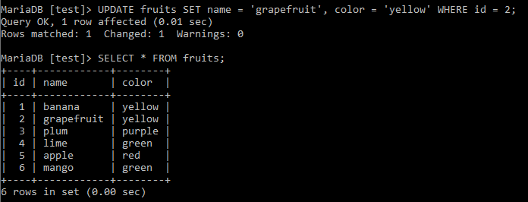
Updating Data
UPDATE fruits SET name = 'grapefruit', color = 'yellow' WHERE id = 2;

Slide 26
Deleting Data From a Table
Delete selected records (matched with condition):
DELETE FROM table WHERE condition;
Delete all records from table:
DELETE FROM table;

Slide 27
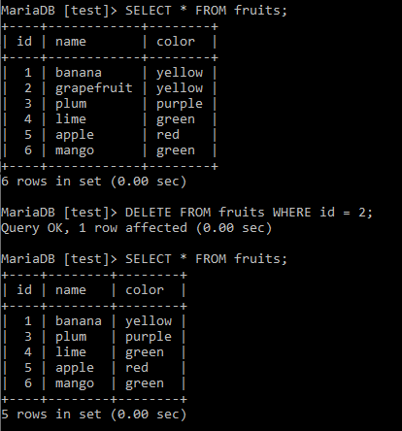
Deleting data from a table
DELETE FROM fruits WHERE id = 2;

Slide 28
Drop a table/database
Delete a table and all records in it:
DROP TABLE table;
Delete a database and all tables/procedures/triggers in it:
DROP DATABASE database;
!!DROP operations are not reversible!!

Slide 29
SQL Summary
INSERT INTO fruits (name, color) VALUES ('banana', 'yellow’);
SELECT name, color FROM fruits;
SELECT name, color FROM fruits WHERE name = 'plum’;
SELECT name, color FROM fruits WHERE id >= 2 AND color = 'green’;
SELECT name, color FROM fruits WHERE color LIKE '%re%’;
SELECT * FROM fruits ORDER BY name;
SELECT * FROM fruits LIMIT 3;
SELECT * FROM fruits LIMIT 3 OFFSET 2;
SELECT * FROM fruits LIMIT 3, 2;
UPDATE fruits SET name = 'grapefruit', color = 'yellow' WHERE id = 2;
DELETE FROM fruits WHERE id = 2;

Slide 30
Table Schema

Slide 31
Data Types
Text fields (small and large)
Binary fields (small and large)
Numeric fields
AUTO_INCREMENT fields

Slide 32
String Fields
Understand character sets and are indexable for searching
CHAR allocates the entire space (faster for small strings where length is known)
VARCHAR allocates a variable amount of space depending on the data length (less space)

Slide 33
Text Fields
Have a character set - paragraphs or HTML pages
- TINYTEXT up to 255 characters
- TEXT up to 65K
- MEDIUMTEXT up to 16M
- LONGTEXT up to 4G
Generally not used with indexing or sorting - and only then limited to a prefix

Slide 34
Binary Types (rarely used)
Character = 8 - 32 bits of information depending on character set
Byte = 8 bits of information
- BYTE(n) up to 255 bytes
- VARBINARY(n) up to 65K bytes
Small Images - data
Not indexed or sorted

Slide 35
Binary Large Object (BLOB)
Large raw data, files, images, word documents, PDFs, movies, etc.
No translation, indexing, or character set
- TINYBLOB(n) - up to 255
- BLOB(n) - up to 65K
- MEDIUMBLOB(n) - up to 16M
- LONGBLOB(n) - up to 4G

Slide 36
Integer Numbers
Integer numbers are very efficient, take little storage, and are easy to process because CPUs can often compare them with a single instruction.
- TINYINT (-128, 128)
- SMALLINT (-32768, +32768)
- INT or INTEGER (2 Billion)
- BIGINT - (10**18 ish)
https://dev.mysql.com/doc/refman/5.7/en/numeric-type-overview.html

Slide 37
Floating Point Numbers
Floating point numbers can represent a wide range of values, but accuracy is limited.
- FLOAT (32-bit) 10**38 with seven digits of accuracy
- DOUBLE (64-bit) 10**308 with 14 digits of accuracy
https://dev.mysql.com/doc/refman/5.7/en/numeric-type-overview.html

Slide 38
Date Types
TIMESTAMP - 'YYYY-MM-DD HH:MM:SS' (1970, 2037)
DATETIME - 'YYYY-MM-DD HH:MM:SS'
DATE - 'YYYY-MM-DD'
TIME - 'HH:MM:SS'
Built-in MySQL function NOW()

Slide 39
AUTO_INCREMENT
Often as we make multiple tables and need to JOIN them together, we need an integer primary key for each row so we can efficiently add a reference to a row in some other table as a foreign key.

Slide 40
Acknowledgement
Some content is used (directly or with some modification) from the following sources:
- Charles Severance, University of Michigan School of Information

